Slide 1
CS1201: Programming Language 2
Classes and objects

Slide 2
Two Programming Paradigms
Structural (Procedural) Object-Oriented
PROGRAM PROGRAM
FUNCTION
OBJECT
Operations
Data
FUNCTION
OBJECT
OBJECT
Operations
Data
FUNCTION
Operations
Data
Function calls
Messages passing
Notes:
A list of tasks to perform.
Viewed as a collection of interacting objects. Each object can be viewed as an independent machine with a distinct role or responsibility. Operations are closely associated with the objects, carry their own operators around with them .

Slide 3
Object-Oriented Programming Language Features
1. Data abstraction
2. Inheritance of properties
3. Dynamic binding of operations to objects
4. Information hiding
Notes:
abstraction: a concept or idea not associated with any specific instance. virtual in C++, after declaration, it’s the responsibility of the programmer to implement a class to instantiate the object of the declaration

Slide 4
Review: C++ Data Types
simple
structured
integral enum
floating
array struct union class
char short int long bool
address
float double long double
pointer reference

Slide 5
C++ Program Structure
Typical C++ Programs consist of:
A function main
One or more classes

Slide 6
Classes & Objects
The class is the cornerstone of C++
It gives the C++ its identity from C
It makes possible encapsulation, data hiding and inheritance
Class:
Consists of both data and methods
Defines properties and behavior of a set of entities
Object:
An instance of a class
A variable identified by a unique name
Notes:
Aim of class: a) provide the programmer with a tool for creating new types that can be used as conveniently as the built-in types (like float) b) user-defined type
why? Separate the incidental details of the implementation from the properties essential to the correct use of it
2. Derived class, templates: organizing related classes that allow the programmer to take advantage of their relationships.

Slide 7
CLASSES
The Class is the foundation of C++ support for the OOP (Object-Oriented Programming ).
It is the core of many of its more advanced features.
In C++, the mechanism that allow you to combine data and operations on the data into a single unit is called a class.
A class is a collection of fixed number of components. The components of a class are called the members of the class.

Slide 8
Object
You can look around you now and see many examples of real-world objects: your cat, your desk, your television set, your bicycle.
These real-world objects share two characteristics: they all have state and they all have behavior
For example, dogs have state (name, color, breed, hungry) and dogs have behavior (barking, fetching).

Slide 9
Object
Software objects are modeled after real-world objects in that they, too, have state and behavior.
A software object maintains its state in variables and implements its behavior with methods.
An object combines data and operations on the data into a single unit.

Slide 10
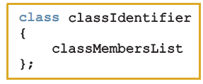
Classes
Class definition:
Defines a data type; no memory is allocated
Don’t forget the semicolon after the closing brace
Each containing data members and member functions.
Syntax:

Slide 11
Define a Class Type
class class_name
{
permission_label:
member;
permission_label:
member;
...
};
class Rectangle
{
private:
float width;
float length;
public:
void setWidth(float w);
void setLength(float l);
float calcArea();
};
Header
Data Members
Body
Member Functions

Slide 12
CLASSES
class car //name
{
String color ;
String model;
Double price ;
Void print (){
Cout <<“ the car information “<< color <<model<< price<< endl;
}
};
class MembersList consists of variable (attribute) and/or functions (method) declarations .

Slide 13
Members Declaration
Each class containing data members and member functions
Data :
If a member of a class is a variable
It is declared like any other variable
You cannot initialize a variable when you declare it
functions:
If a member of a class is a function
Only Function prototype is listed.
Or, the body of a member function is defined inside a class declaration, it is declared inline.

Slide 14
Classes
Members of a class are classified into one of three categories:
Private (default) : not accessible outside the class.
Protected: not accessible outside the class.
Public: accessible outside the class.
Note:
The keyword of category name is followed by colon (:) .
In the definition of a class, you cannot initialize a variable when you declare it.
In C++, a class is a definition. No memory is allocated for the class itself; memory is allocated for the class objects (class instances) when you declare them.

Slide 15
Accessing Class Members
Operators to access class members
Dot member selection operator (.)
Object
Reference to object
Example:
Rectangle r;
r.setWidth(3);

Slide 16
Example
#include <iostream>
using namespace std;
class Cat {
private:
int age;
int weight;
public:
Char gender;
void setAge (int yrs) { age = yrs; }
void setWeight (int kgs) { weight = kgs; }
int getAge() { return age; }
int getWeight() { return weight; }
};
Void main( )‏
{
Cat MyCat;
MyCat.setAge(3);
MyCat.setWeight(2);
MyCat.gender=“m”
cout << "My cat\‘ s age is " << MyCat.getAge();
cout << " and weighs " << MyCat.getWeight() << " kg\n“ ;
cout << “and its gender “ << MyCat.gender;
}

Slide 17
Accessibility Example1
…
Service obj;
obj.memberOne = 10;
obj.memberTwo = 20;
obj.doOne();
obj.doTwo();
…
class Service {
private:
int memberTwo;
void doTwo() {……}
public:
int memberOne;
void doOne() {…….}};
Main Program
Service Class
Notes:
This is a simple example of public and private modifiers. See how the client can access the public data member and method.

Slide 18
Accessibility Example2
#include <iostream>
#include <string>
using namespace std;
class Course {
// Data Member
public:
string studentName;
string courseCode ;
};
void main() {
Course course1, course2;
// assign values to course1
course1.courseCode= "CSC1201";
course1.studentName= "Muna AlKebir";
//assign values to course2
course2.courseCode= "csc1301";
course2.studentName= "Salwa AlAmri";
cout<< course1.studentName << " has the course "<<course1.courseCode<< endl;
cout<<course2.studentName << " has the course "<<course2.courseCode<< endl;
}

Slide 19
Accessibility Example 3
#include <iostream>
#include <string>
using namespace std;
class Course {
private:
string studentName;
string courseCode ;};
void main() {
Course course1, course2;
//assign values to course1
course1.courseCode= “CSC1201“;
course1.studentName= “Muna AlKebir“;
//assign values to course2
course2.courseCode= “CSC1301“;
course2.studentName= “Salwa AlAmri“;
cout<<course1.studentName << " has the course “<<course1.courseCode<<endl;
cout<<course2.studentName << " has the course “<< course2.courseCode<<endl;
}

Slide 20
Implementing class Functions
There are two ways:
Member functions defined outside class:
Using Binary scope resolution operator (::)
ReturnType ClassName::MemberFunctionName( ){..}
Member functions defined inside class
When the body of a member function is defined inside a class declaration, it is declared inline.

Slide 21
Implementing class Functions Example
class Rectangle
{
private:
float width, length;
public:
void setWidth (float w);
void setLength(float l){length=l;}
float calcArea() {returnwidth*length; }
};
class name
member function name
void Rectangle :: setWidth (float w)
{
width = w;
}
inline
scope operator
Notes:
1.Different structures can have member functions with the same name.
2. If defined outside, the structure name when defining a member function must be specified. (::)
3.In a member function, member names can be used without explicit reference to an object (non member fuctions). In this case, the name refers to the member of the object for which the function was invoked. Always know for which object it was invoked.
4. Inline function: the compiler is requested to insert the complete body of the function in every place that the function is called, rather than generation code to call the function in the one place it is defined

Slide 22
Example
// This program demonstrates a simple class.
#include <iostream>
// Rectangle class declaration.
class Rectangle
{
private:
float width;
float length;
public:
void setWidth(float);
void setLength(float);
float calcArea(void);
float getWidth(void);
float getLength(void);
};
Mutator function(setter): member function that modifies the value(s) of member variable(s)
Accessor function(getter): member function that only accesses the value(s) of member variable(s)

Slide 23
Program continues..
// setter copies the argument w or l to private member width
void Rectangle::setWidth(float w)
{
width = w;
}
// setter copies the argument l to private member length.
void Rectangle::setLength(float l)
{
length = l;
}
Setters are:
Public
With 1 parameter
With no return value

Slide 24
Program continues..
// getWidth returns the value in the private member width.
float Rectangle::getWidth(void)
{
return width;
}
// getLength returns the value in the private member length.
float Rectangle::getLength(void)
{
return length;
}
// calcArea multiplies the private members width and length.
float Rectangle::calcArea(void)
{
return width * length;
}
Getters are:
Public
With no parameters
With return value

Slide 25
Program continues..
void main(void)
{
Rectangle box;
float wide, long;
cout << "This program will calculate the area of a\n";
cout << "rectangle. What is the width? ";
cin >> wide; // cin>>box.width; (illegal)
cout << "What is the length? ";
cin >> long;
box.setWidth(wide);
box.setLength(long);
cout << "Here is the rectangle's data:\n";
cout << "width: " << box.getWidth() << endl;
cout << "length: " << box.getLength() << endl;
cout << "area: " << box.calcArea() << endl;
}

Slide 26
Program Output
This program will calculate the area of a
rectangle. What is the width? 10 [Enter]
What is the length? 5 [Enter]
Here is the rectangle's data:
width: 10
length: 5
area: 50

Slide 27
Constructors Vs. Destructor
Constructor
Destructor
Constructors guarantee that the member variables are initialized when an object is declared.
Constructors automatically execute when a class object enters its scope.
The name of a constructor is the same as the name of the class.
A class can have more than one constructor.
A constructor without parameters is called the default constructor.
Destructor automatically execute when a class object goes out of scope.
The name of a destructor is the tilde (~), followed by the class name (no spaces in between).
A class can have only one destructor.
The destructor has no parameters.
Constructors and Destructor are functions without any type. As a result, they cannot be called like other functions.
Note : A function can return a value of type class.

Slide 28
Constructors
Constructor:
Special Member Functions
Public function member
called when a new object is created (instantiated).
Initialize data members.
Same name as class
No return type
Several constructors
Function overloading

Slide 29
Example
#include <iostream>
class Rectangle
{
private:
float width;
float length;
public:
Rectangle();
Rectangle(float , float);
void setWidth(float);
void setLength(float);
float calcArea(void);
float getWidth(void);
float getLength(void);
};
Constructor with no argument
Constructor with two arguments

Slide 30
Example cont.
Rectangle::Rectangle() {
setLength(0); // or length=0;
setWidth(0); //or width=0;
}
Rectangle::Rectangle(float l, float w) {
setLength(l); // or length=L;
setWidth(w); //or width=W;
}

Slide 31
Invoking the Default Constructor
To invoke the default constructor:
Example:
Rectangle r;

Slide 32
Invoking a Constructor with Parameters
Syntax:
Number and type of arguments should match the formal parameters (in the order given) of one of the constructors
Example:
Rectangle r(3,8);

Slide 33
Default Constructors and Default Parameters
Default constructor: a constructor with no parameters or with all default parameters
Example:
Rectangle(float=1, float=1);
Rectangle();
If a class has no constructor(s), C++ provides the default constructor
However, object declared is still uninitialized
If a class includes constructor(s) with parameter(s), but not the default constructor
C++ does not provide the default constructor

Slide 34
Example
// This program demonstrates a class with a constructor
#include <iostream>
#include <string>
using namespace std;
class InvItem
{
private:
string desc;
int units;
public:
InvItem(void) { desc = ""; }
void setInfo(string d, int un) { desc=d;
units = un;}
string getDesc(void) { return desc; }
int getUnits(void) { return units; }
};
void main(void)
{
InvItem stock;
stock.setInfo("Wrench", 20);
cout<< "Item Description: " << stock.getDesc() << endl;
cout << "Units on hand: " << stock.getUnits() << endl;
}

Slide 35
Destructors
Destructors are functions without any type
The name of a destructor is the character '~' followed by class name
For example:
~Rectangle();
A class can have only one destructor
The destructor has no parameters
Destructor automatically executes when the class object goes out of scope

Slide 36
Example
// This program demonstrates a class with a constructor
#include <iostream>
#include <string>
using namespace std;
class InvItem
{
private:
string desc;
int units;
public:
InvItem(void) { desc = ""; units=0;}
InvItem(string d, int u) { desc = d; units=u; }
~InvItem(void) { cout << "The destructor is now running.\n"; }
void setDes(string d) { desc=d;}
void setUnits(int u) { units=u;}
string getDes(void) const { return desc; }
int getUnits(void) const { return units; }
};
void main(void)
{
string d;
int u;
cout<< "Enter Item Description: ";
getline(cin, d);
cout<< "Enter Item units : ";
cin>>u;
InvItem item1(d,u);
InvItem item2;
cout<<"Item#1:Item Description: "<< item1.getDes() << "\t"<<"Units on hand: " << item1.getUnits() << endl;
cout<<"Item#2:Item Description: "<< item2.getDes() << "\t"<<"Units on hand: " << item2.getUnits() << endl;
}

Slide 37
Copy constructor
Initializes a new object from another, existing one
Signature:
Class::Class(const Class&);

Slide 38
Copy constructor cont.
There are three general cases where the copy constructor is called instead of the assignment operator:
When instantiating one object and initializing it with values from another object (slide#41).
When passing an object by value( not preferred ).
When an object is returned from a function by value(slide#47).

Slide 39
Example
#include <iostream>
class Rectangle
{
private:
float width;
float length;
public:
Rectangle();
Rectangle(float , float);
Rectangle(const Rectangle & );
void setWidth(float);
void setLength(float);
float calcArea(void);
float getWidth(void);
float getLength(void);
};
Constructor with no argument
Constructor with two arguments
Copy Constructor

Slide 40
Copy constructor for class Rectangle
Rectangle::Rectangle(const Rectangle & r)
{
width = r.width;
length = r.length;
}

Slide 41
Copy constructor: defining a new object
Copy Constructor is called here .
It is equivalent to
Rectangle r3 (r2);
Rectangle r1(8,6);
// init 2 local objects from r1
Rectangle r2(r1);
Rectangle r3=r2;
// init a dynamic object from r1
Rectangle * pr = new Rectangle(r1);

Slide 42
Q?
Which of the following two statements call copy constructor and which one calls assignment operator?
MyClass t1, t2;
MyClass t3 = t1; // ----> (1)
t2 = t1; // -----> (2)
calls copy constrictor
calls assignment operator ( later)

Slide 43
When should we write our own copy constructor in C++?
If a class doesn’t contain pointers, then there is no need to write copy constructor.
The compiler creates a default copy constructor and assignment operators for every class.
The compiler created copy constructor and assignment operator may not be sufficient when we have pointers or any run time allocation of resource

Slide 44
Passing Objects to Functions
A class object can be passed as an argument to a function
Passed by value: function makes a local copy of object. Original object in calling environment is unaffected by actions in function
Passed by reference: function can use ‘set’ functions to modify the object.

Slide 45
Notes on Passing Objects
Using a value parameter for an object can slow down a program and waste space
Using a reference parameter speeds up program, but allows the function to modify data in the structure
To save space and time, while protecting structure data that should not be changed, use a const reference parameter
void showData(const Rectangle &r) // header
{ cout<<" Length:"<<r.getLength()<<"width:"<<r.getWidth(); }
Notes:
See pr7-09.cpp

Slide 46
Returning an Object from a Function
A function can return an object
Rectangle initRectangle(); // prototype
Rectangle r1 = initRectangle(); // call
Function must define a object
for internal use
to use with return statement

Slide 47
Returning an Object Example
Rectangle initRectangle()
{
Rectangle r; // local variable
float l, w;
cout << "Enter the length and the Width : ";
cin >> l>> w;
r.setLength(l);
r.setWidth(w);
return r;
}
void showData(const Rectangle &r)
{ cout<<" Length:"<<r.getLength()<<"width:"<<r.getWidth(); }
void main()
{
Rectangle r1= initRectangle();
showData(r1);
cout<< " The area= " << r1.calcArea()<<endl;
}
Returning an object
Passing an object by reference
Notes:
See pr7-10.cpp

Slide 48
Example
#include <iostream>
using namespace std;
class Circle {
private:
float radius;
public: //prototype only !
// constructors
Circle(){radius=0;}
Circle(float r){ setRadius(r); }
// destructor
~Circle(){cout<<" ending object...\n"; }
void setRadius(float r){
if ( r >=0.0)‏
radius=r;
else
radius=0.0;
}
float getRadius(){return radius; }
float area(){return 3.14*radius*radius;}
float perimeter(){return 2 * 3.14 * radius;}
};

Slide 49
Example
int main()‏{
float x;
cout<<" Enter the radius of the circle: ";
cin>>x;
Circle C1(x);
cout<<"\n the area of the circle is: "<<C1.area()<<endl;
cout<<" and the perimeter is:"<<C1.perimeter()<<endl;
return 0;
}

Slide 50
Output:

Slide 51
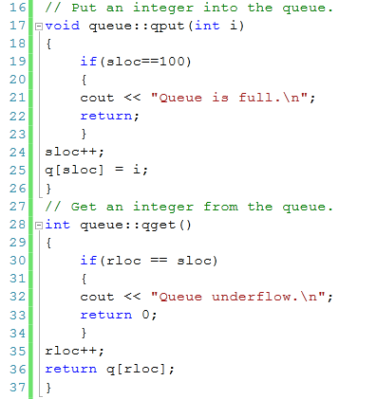
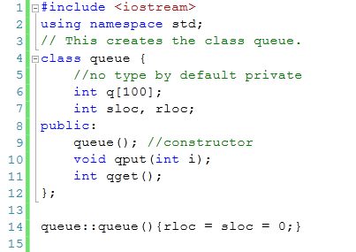
Example

Slide 52
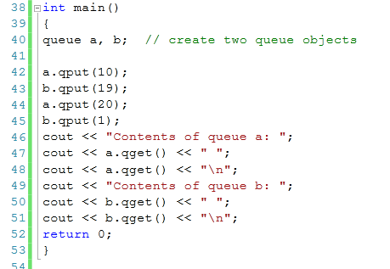

Slide 53
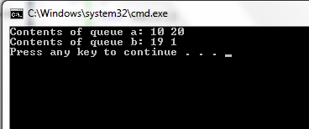
Output:

Slide 54
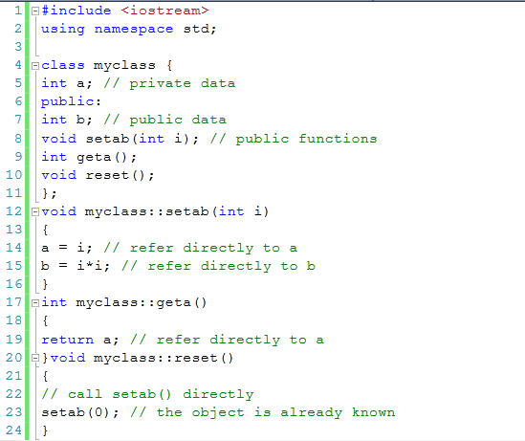
Example

Slide 55
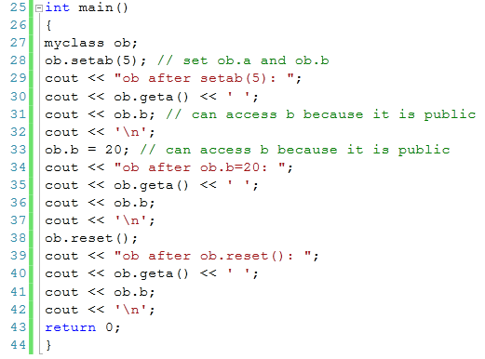
Example

Slide 56
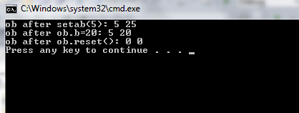
Example

Slide 57
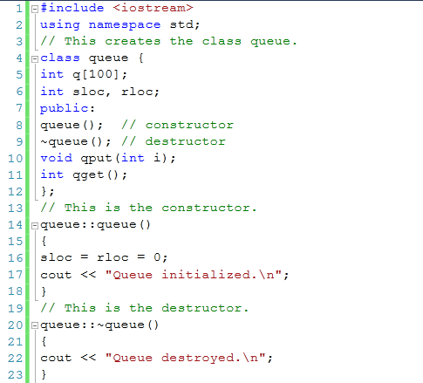
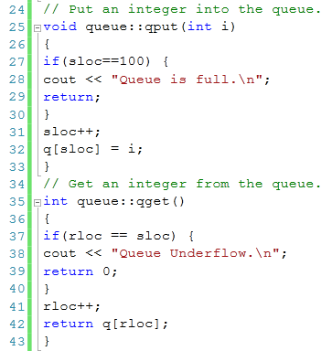
Example

Slide 58
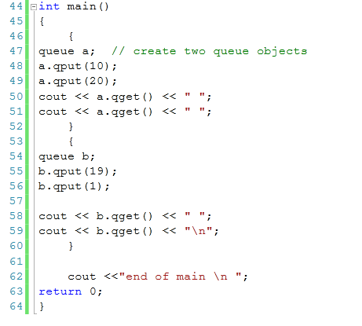

Slide 59
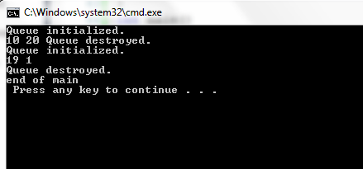
Output:

