Slide 1
Polymorphism
Programming II

Slide 2
Polymorphism
Poly = Many
Morphism = Forms

Slide 3
Overview
Substitution Principle
A more in depth discussion
Method Binding:
Static Binding
Dynamic Binding (Polymorphism)
Syntax on virtual method

Slide 4
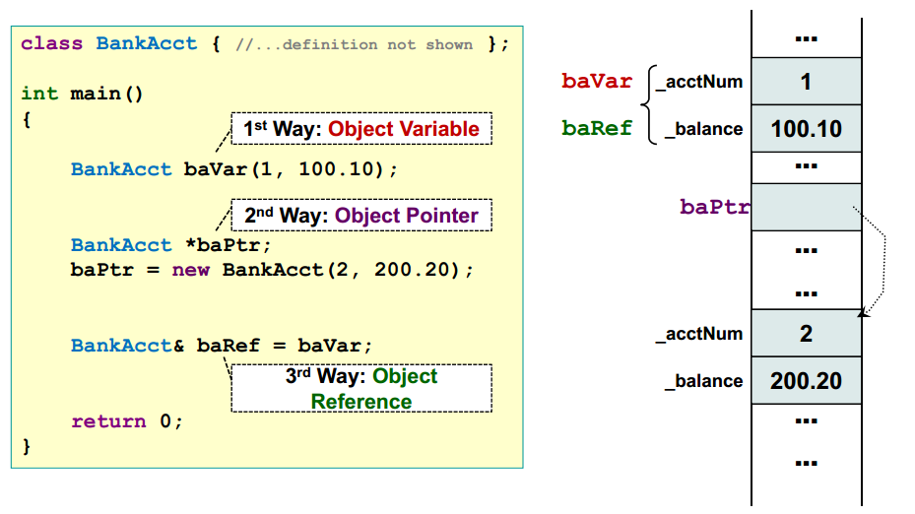
Interacting with Objects in C++
There are 3 ways to refer to an object in C++:

Slide 5
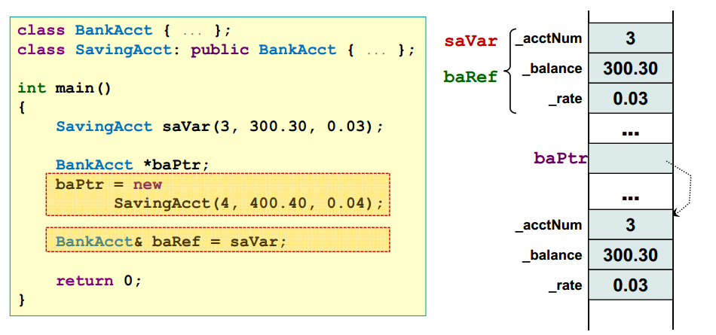
Subclass Substitution Principle
C++ allows superclass pointers to point to sublass objects.
Object pointer and reference of class type A:
Can refer to objects of type A
Can also refer to objects of subclass of A
4
400.40
0.04

Slide 6
Subclass Substitution Principle Pointers to subClasses
Let we have –
class B_Class{ … };
class D_Class: public B_Class{ … };
Then we can write –
B_Class *p1; // pointer to object of type B_Class
D_Class d_obj; // object of type D_Class
Both statement are valid:
p1 = &d_obj;
B_Class *p2 = new D_Class;
Using a base class pointer (pointing to a derived class object) we can access only those members of the derived object that were inherited from the base.

Slide 7
Polymorphism: Basic Idea
Since we know:
A superclass pointer/reference can refer to an object of subclass
A method implementation can be overridden in the subclass, resulting in multiple versions
Question:
If we invoke a method using pointer/reference, which version of the method should be invoked?
C++ provides two possibilities:
Static Binding
Dynamic Binding:
Also known as polymorphism

Slide 8
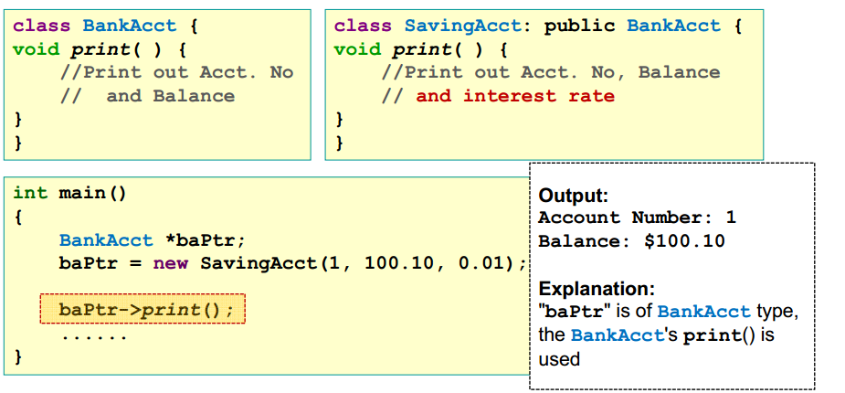
Static Binding
Use the class type of the pointer/reference to determine which version of method to call:
This information is known during compilation time

Slide 9
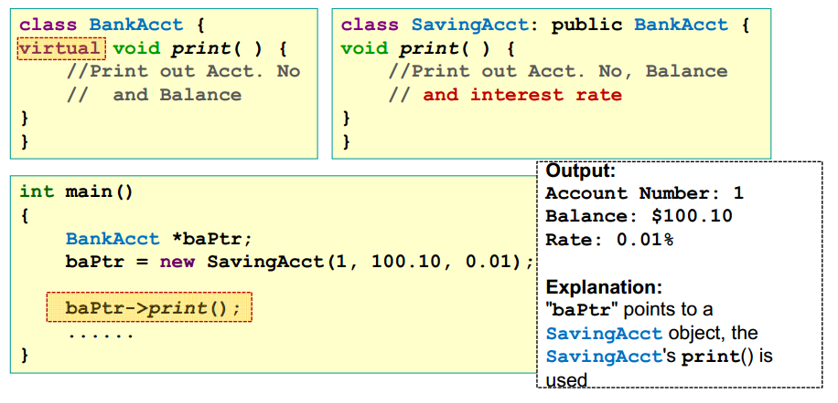
Dynamic Binding (Polymorphism)
Use the actual class type of the object to determine which version of method to call:
This information is known only during run time

Slide 10
Dynamic Binding: Syntax
To enable dynamic binding of a method in C++, add the "virtual" keyword before the method declaration
Once a method is declared as virtual:
it will remain so in all descendant classes
no need to restate the "virtual" keyword

Slide 11
Static VS Dynamic Binding: illustration
Static Binding:
The class type R of pointer or reference is used to determine the method to call
Dynamic Binding:
The class type S of object is used to determine the method to call

Slide 12
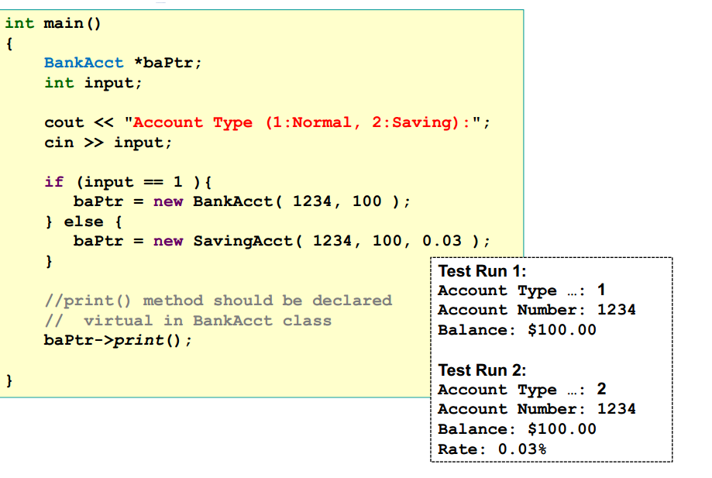
Polymorphism: Example

Slide 13
Polymorphism: Advantage
Make code reuse easier:
If a code is written to use a virtual method of a class A, the code can work with all future subclass of A with no modification
Furthermore, new/extended behavior of subclass of A can be incorporated by overriding the virtual method implementation
For example:
Code that uses the virtual method print() in BankAcct can work with all subclasses of BankAcct even when the print() is overridden

Slide 14
Common Mistake
A common error is to assume the actual type of the object is used to determine validity of method in vocation
The data type of the pointer/reference is used to determine validity of method invocation
The baPtr pointer has the type of BankAcct
BankAcct does not have payInterest() method → error!

Slide 15
Common Mistake
While it is permissible for a superclass pointer to point to a subclass object, the reverse is not true.
BankAcct b;
SavingAcct *ps = &b; // compiler error

Slide 16
Polymorphism: Summary
When we see the statement:
refR.methodM(); OR
ptrR->methodM();
At compile time:
If the class of refR/ptrR does not have a method methodM() →Compilation Error
If methodM() is not a virtual method → static binding methodM() in class of refR/ptrR is called
At run time:
If methodM() is a virtual method →dynamic binding methodM() in class of the actual object is called

Slide 17
Pure virtual methods
class Name {
public:
virtual returntype name(parameters) = 0;
...
};
Pure virtual method:
One that is declared but not implemented.
A class with one or more pure virtual functions is an Abstract Class.
Objects of abstract class can’t be created
must be implemented by subclasses (else they will be abstract)

Slide 18
Abstract Classes
Some classes exist logically but not physically.
Example : Shape
Shape s; // Legal but silly..!! : “Shapeless shape”
Shape makes sense only as a base of some classes derived from it. Serves as a “category”
Hence instantiation of such a class must be prevented
class Shape //Abstract
{ public : //Pure virtual Function virtual void draw() = 0;
};
Shape s; // error : variable of an abstract class

Slide 19
Example
Shape
+ draw(): void ← virtual
Circle
Triangle
+ draw(): void
+ draw(): void

Slide 20
Abstract Classes
A pure virtual function not defined in the derived class remains a pure virtual function.
Hence derived class also becomes abstract
class Circle : public Shape { //No draw() - Abstract public : void print(){ cout << “I am a circle” << endl; }
class Rectangle : public Shape { public : void draw(){ // Override Shape::draw() cout << “Drawing Rectangle” << endl; }
Rectangle r; // Valid
Circle c; // error : variable of an abstract class

Slide 21
Example 1
#include <iostream>
using namespace std;
class figure{
protected:
double x,y;
public:
void set_dim(double I, double J )
{ x = I;y = J;}
virtual void show_area(){
cout <<"No area computation efined"<<endl;
cout<<"for this class"<<endl;}
};
class triangle: public figure{
public:
void show_area()
{cout<<"show in triangle \tarea="<< x* 0.5 * y<<endl;}
};
class circle: public figure{
public:
void show_area()
{cout<< "show in circle \t area="<<x *x<<endl;}
};
void main(){
figure *p;
triangle t;
circle c;
p= &t;
p->set_dim(10.0,5.0);
p-> show_area();
p= &c;
p-> set_dim(10.0, 0);
p-> show_area();
}

Slide 22
Example 2
Class figure{
protected:
double x,y;
public:
void set_dim(double I, double j=0)
{x=I; Y= j; }
Virtual void show_area()=0 ;// pure function
};
Class triangle: public figure{
Public:
Void show_area(){cout<< x* 0.5 * y;}};
Class circle: public figure{
Public:
// no definiton of show_area() will case error
};
Int main(){
Figure *p;
Triangle t;
Circle c; // illegal – can’t create
P= &t;
P-> set_dim(10.0,5.0);
P-> show_area();
p= &c;
P-> set_dim(10.0);
P-> show_area();
Return0;}

Slide 23
Virtual Destructors
Constructors cannot be virtual, but destructors can be virtual.
It ensures that the derived class destructor is called when a base class pointer is used while deleting a dynamically created derived class object.

Slide 24
Virtual Destructors (contd.)
Using non-virtual destructor
#include <iostream>
using namespace std;
class base {
public:
~base() { cout << "destructing base"<<endl; }};
class derived : public base {
public:
~derived() {cout << "destructing derived"<<endl; }};
void main() {
base *p = new derived;
delete p;
}

Slide 25
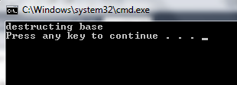
Using non-virtual destructor

Slide 26
Virtual Destructors (contd.)
Using virtual destructor
#include <iostream>
using namespace std;
class base {
public:
virtual ~base() { cout << "destructing base"<<endl; }};
class derived : public base {
public:
~derived() {cout << "destructing derived"<<endl; }};
void main() {
base *p = new derived;
delete p;
}

Slide 27
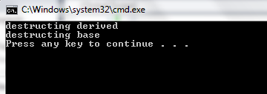
Virtual Destructors (contd.)
Using virtual destructor

Slide 28
References
http://www.comp.nus.edu.sg/~cs2103/AY1314S2/files/Implementing%20polymorphism.pdf

