Slide 1
Array of objects

Slide 2
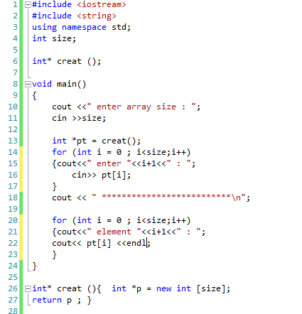
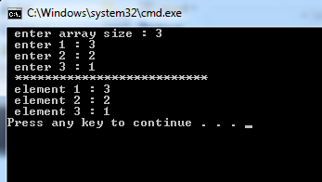
Define function create() to create array dynamically with size as global variables

Slide 3
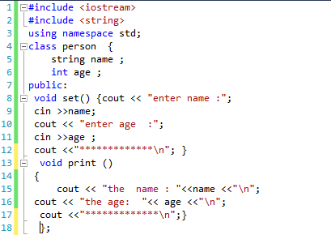
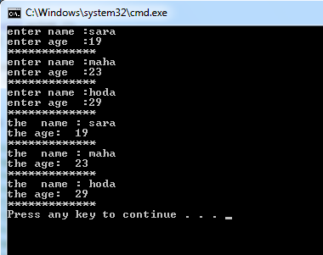
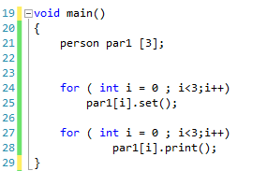
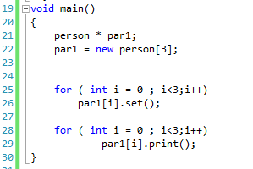
Write the definition of an array called par1 of 3 objects of class person .

Slide 4
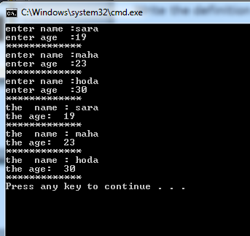
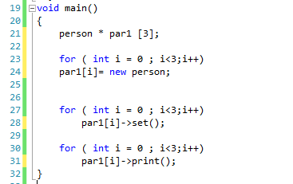
Write the definition of an array of 3 pointers called par1 to objects of class person.

Slide 5
Imagine a publishing company that markets both book and audio cassette versions of its works.
Create a class publication that stores the title and the price of a publication.
From this class derive two classes:
book, which adds a page count
tape, which adds a playing time in minutes
Each of these three classes should have
getdata() function to get its data from the user at the keyboard (no arguments passes ask the user inside the function ) .
putdata() function to display its data.

Slide 6
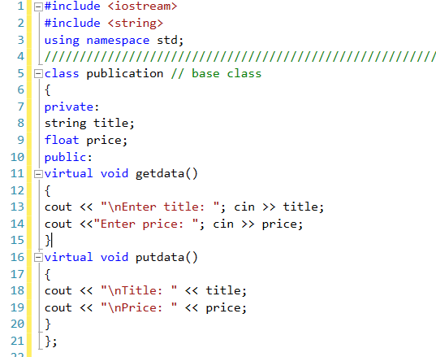

Slide 7
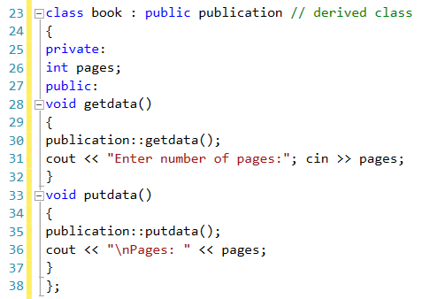

Slide 8
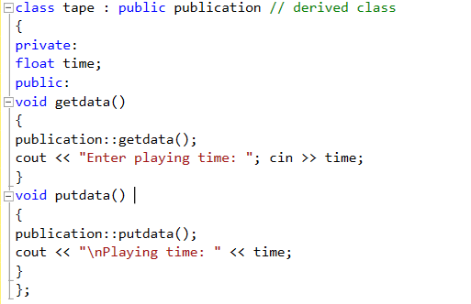

Slide 9
Write a main() program that creates an array of pointers to publication.
In a loop, ask the user for data about a particular book or tape, and use new to create an object of type book or tape to hold the data.
When the user has finished entering the data for all books and tapes, display the resulting data for all the books and tapes entered, using a
for loop and a single statement such as
pubarr[j]->putdata();
to display the data from each object in the array.

Slide 10
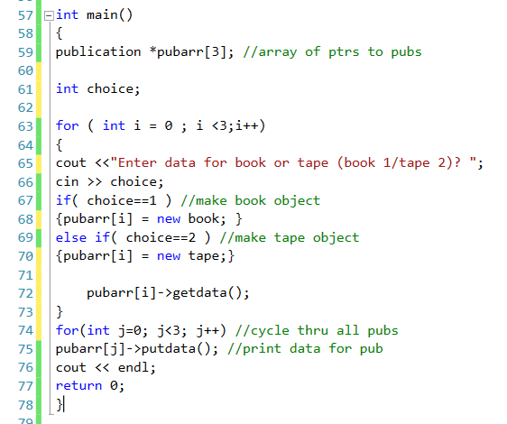

Slide 11
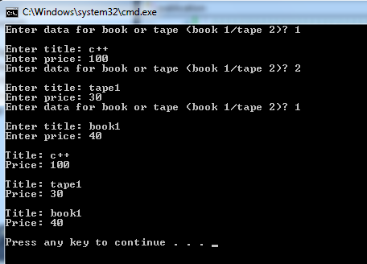

Slide 13
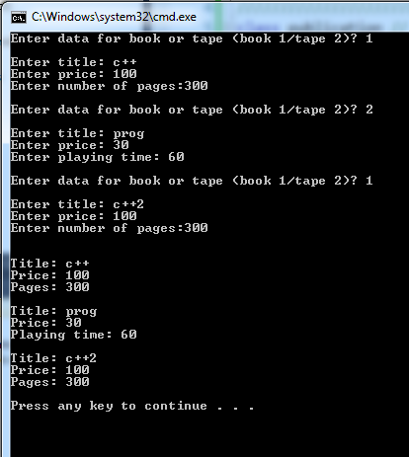

Slide 14
Extra Examples
Self read

Slide 15
Trace the program.
#include <iostream>
using namespace std ;
////////////////////////////////////////
class Pet
{
public:
Pet () {} // Constructors, Destructor
~Pet() {}
void speak(){cout << "Growl" << endl;}
};
/////////////////////////////////////////
class Rat: public Pet
{
public:
// Constructors, Destructor
Rat() {}
~Rat() {}
void speak(){cout << "Rat noise" << endl;}
};

Slide 16
Trace the program.
class Cat: public Pet
{
public:
Cat() {}
~Cat() {}
void speak(){cout << "Meow" << endl;}
};
//////////////////////////////////////////////////////////
void chorus(Pet pt, Pet *petPtr, Pet &petRef)
{
pt.speak();
petPtr->speak();
petRef.speak();
}

Slide 17
Trace the program.
void main()
{ Pet *ptr; //Pointer to base class
ptr = new Pet;
cout << "Pet Created" << endl;
cout << "Pets singing" << endl;
chorus(*ptr,ptr,*ptr);
cout << endl << endl;
delete ptr;
///////////////////////////////////////
ptr = new Rat;
cout << "Rat Created" << endl;
cout << "Rats singing" << endl;
chorus(*ptr,ptr,*ptr);
cout << endl << endl;
delete ptr;
//////////////////////////////////////////
ptr = new Cat;
cout << "Cat Created" << endl;
cout << "Cats singing" << endl;
chorus(*ptr,ptr,*ptr);
cout << endl << endl;
delete ptr;
}

Slide 18
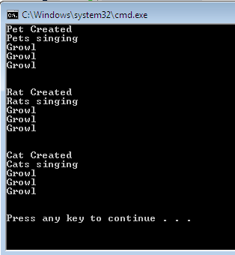

Slide 19
Convert Speak() function to virtual function then trace the program again.
class Pet
{
public:
Pet () {} // Constructors, Destructor
~Pet() {}
virtual void speak(){cout << "Growl" << endl;}
};

Slide 20
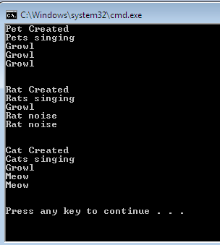

Slide 21
Change class pet to be an abstract pet.
class Pet
{
public:
Pet () {} // Constructors, Destructor
~Pet() {}
virtual void speak()=0;
};

Slide 22
void main()
{ Pet *ptr; //Pointer to base class
/* ptr = new Pet;
cout << "Pet Created" << endl;
cout << "Pets singing" << endl;
chorus(ptr,*ptr);
cout << endl << endl;
delete ptr; */
///////////////////////////////////////
ptr = new Rat;
cout << "Rat Created" << endl;
cout << "Rats singing" << endl;
chorus(ptr,*ptr);
cout << endl << endl;
delete ptr;
//////////////////////////////////////////
ptr = new Cat;
cout << "Cat Created" << endl;
cout << "Cats singing" << endl;
chorus(ptr,*ptr);
cout << endl << endl;
delete ptr;
}

Slide 23
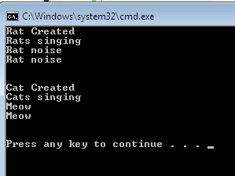

Slide 24
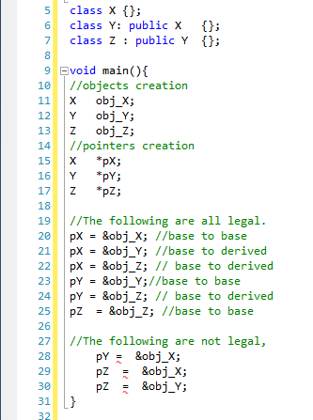
Polymorphism allows one to declare a pointer to an object and allow it to not only point to the object the pointer was declared to point to but also point to any object that was inherited from that class. For example

