Slide 1
Chapter 8
SQL: Data Definition
Pearson Education © 2009

Slide 2
Chapter 8 - Objectives
Data types supported by SQL standard and Identifiers.
Purpose of integrity enhancement feature of SQL.
How to define integrity constraints using SQL.
How to use the integrity enhancement feature in the CREATE and ALTER TABLE statements.
Purpose of views.
How to create and delete views using SQL.
Under what conditions views are updatable.

Slide 3
Identifiers
May contain A-Z, a-z, 0-9, _
No longer than 128 characters
Start with letter
Cannot contain spaces

Slide 4
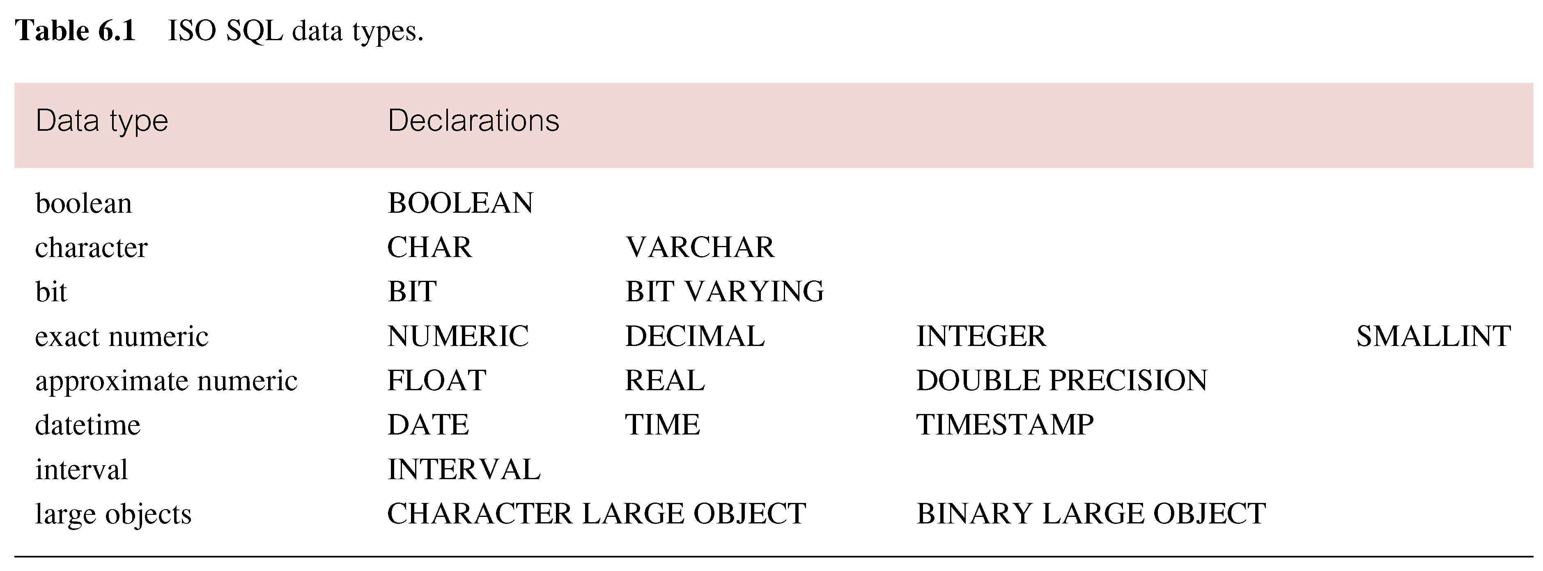
ISO SQL Data Types
Pearson Education © 2009

Slide 5
Integrity Enhancement Feature
Consider five types of integrity constraints defined in CREATE & ALTER:
Required data
Domain constraints
Entity integrity
Referential integrity
General constraints.

Slide 6
Integrity Enhancement Feature 1- Required Data
1- Required Data
Null is distinct from blank or zero.
Syntax:
columnName dataType [NOT NULL | NULL]
Example:
position VARCHAR(10) NOT NULL

Slide 7
Integrity Enhancement Feature 2-Domain Constraints
2- Domain Constraints
(a) CHECK
Syntax:
CHECK (search condition)
Example:
sex CHAR NOT NULL
CHECK (sex IN (‘M’, ‘F’))
salary DECIMAL NOT NULL
CHECK (salary > 10000)
bno INT
CHECK (bno IN(SELECT branchno FROM branch))

Slide 8
Integrity Enhancement Feature 2-Domain Constraints cont.
(b) CREATE DOMAIN
Syntax:
CREATE DOMAIN DomainName [AS] dataType
[DEFAULT defaultOption]
[CHECK (searchCondition)]
Example1:
CREATE DOMAIN SexType AS CHAR
CHECK (VALUE IN (‘M’, ‘F’));
sex SexType NOT NULL

Slide 9
Integrity Enhancement Feature 2-Domain Constraints cont.
Example2:
searchCondition can involve a table lookup:
CREATE DOMAIN BranchNo AS CHAR(4)
CHECK(VALUE IN(SELECT branchNo
FROM Branch));

Slide 10
Integrity Enhancement Feature 2-Domain Constraints cont.
Domains can be removed using DROP DOMAIN:
Syntax:
DROP DOMAIN DomainName [RESTRICT | CASCADE];
RESTRICT, domain must not be used in any existing table, view .
CASCADE, any column based on the domain is automatically changed to use the underlying data type, column constraint and default clause.

Slide 11
Integrity Enhancement Feature 3-Entity Integrity
Primary key of a table must contain a unique, non-null value for each row.
ISO standard supports PRIMARY KEY clause in CREATE and ALTER TABLE statements:
Syntax:
PRIMARY KEY(staffNo)
Example:
PRIMARY KEY(clientNo, propertyNo)
Can only have one PRIMARY KEY clause per table.
Can still ensure uniqueness for alternate keys using UNIQUE:
UNIQUE(telNo)
pno VARCHAR(5) NOT NULL UNIQUE;

Slide 12
Integrity Enhancement Feature 4 - Referential Integrity
FK is column or set of columns that links each row in child table containing foreign FK to row of parent table containing matching PK.
Referential integrity means that, if FK contains a value, that value must refer to existing row in parent table.
ISO standard supports definition of FKs with FOREIGN KEY clause in CREATE and ALTER TABLE:
- Syntax:
FOREIGN KEY (FK column (,…))
REFERENCES table_name [(CK column (,…))]
- Example:
FOREIGN KEY(bNo) REFERENCES Branch (branchNo)

Slide 13
Integrity Enhancement Feature 4 - Referential Integrity
Any INSERT/UPDATE attempting to create FK value in child table without matching CK value in parent is rejected.
Action taken attempting to update/delete a CK value in parent table with matching rows in child is dependent on referential action specified using ON UPDATE and ON DELETE subclauses:
Syntax:
FOREIGN KEY (FK column (,…) )
REFERENCES tablename [ ( CK column(,…)) ]
[ON UPDATE[CASCADE|SET NULL|SET DEFAULT|NO ACTION]]
[ON DELETE[CASCADE|SET NULL|SET DEFAULT|NO ACTION]]

Slide 14
Integrity Enhancement Feature 4 - Referential Integrity
Four options are supported when the user attempt to delete or update a CK, & there are matching FKs:
CASCADE: automatically delete/update the CK row & all matching (FKs) rows in child table.
SET NULL: delete/update the CK row & set the FK values to NULL. Valid only if NOT NULL clause is not specified for the FK.
SET DEFAULT: delete/update the CK row & set the FK values to default. Valid only if DEFAULT clause is specified for the FK.
NO ACTION: rejects the delete/update operation.

Slide 15
Integrity Enhancement Feature 4 - Referential Integrity
Examples:
FOREIGN KEY (staffNo) REFERENCES Staff ON DELETE SET NULL
FOREIGN KEY (ownerNo) REFERENCES Owner ON UPDATE CASCADE

Slide 16
Integrity Enhancement Feature 5 - General Constraints
Could use CHECK/UNIQUE in CREATE and ALTER TABLE.
In order to modify or delete an existing constraint, it is necessary that the constraint have a name.
Proceed the constraint by the CONSTRIANT clause then specify a name for the constraint.
Example:
Dept CHAR(4)NOT NULL CONSTRAINT DepNoInList
CHECK( Dept IN (SELECT Dept
FROM DEPARTMENT))

Slide 17
Data Definition
SQL DDL allows database objects such as schemas, domains, tables, views, and indexes to be created and destroyed.
Main SQL DDL statements are:
CREATE SCHEMA DROP SCHEMA
CREATE DOMAIN DROP DOMAIN
CREATE/ALTER TABLE DROP TABLE
CREATE VIEW DROP VIEW
Many DBMSs also provide:
CREATE INDEX DROP INDEX

Slide 18
Data Definition
Relations and other database objects exist in an environment.
Each environment contains one or more catalogs, and each catalog consists of set of schemas.
Schema is named collection of related database objects.
Objects in a schema can be tables, views, domains, assertions, collations, translations, and character sets. All have same owner.

Slide 19
CREATE SCHEMA
- Syntax:
CREATE SCHEMA[Name|AUTHORIZATION CreatorId ]
DROP SCHEMA Name [RESTRICT | CASCADE ]
With RESTRICT (default), schema must be empty or operation fails.
With CASCADE, operation cascades to drop all objects associated with schema in order defined above. If any of these operations fail, DROP SCHEMA fails.

Slide 20
CREATE TABLE
- Syntax:
CREATE TABLE TableName
{(colName dataType [NOT NULL] [UNIQUE]
[DEFAULT defaultOption]
[CHECK searchCondition] [,...]}
[PRIMARY KEY (listOfColumns),]
{[UNIQUE (listOfColumns),] […,]}
{[FOREIGN KEY (listOfFKColumns)
REFERENCES ParentTableName [(listOfCKColumns)],
[ON UPDATE referentialAction]
[ON DELETE referentialAction ]] [,…]}
{[CHECK (searchCondition)] [,…] })

Slide 21
CREATE TABLE
Creates a table with one or more columns of the specified dataType.
With NOT NULL, system rejects any attempt to insert a null in the column.
Can specify a DEFAULT value for the column.
Primary keys should always be specified as NOT NULL.
FOREIGN KEY clause specifies FK along with the referential action.

Slide 22
Example 7.1 - CREATE TABLE
- Example:
CREATE DOMAIN OwnerNumber AS VARCHAR(5)
CHECK (VALUE IN (SELECT ownerNo FROM PrivateOwner));
CREATE DOMAIN StaffNumber AS VARCHAR(5)
CHECK (VALUE IN (SELECT staffNo FROM Staff));
CREATE DOMAIN PNumber AS VARCHAR(5);
CREATE DOMAIN PRooms AS SMALLINT
CHECK(VALUE BETWEEN 1 AND 15);
CREATE DOMAIN PRent AS DECIMAL(6,2)
CHECK(VALUE BETWEEN 0 AND 9999.99);

Slide 23
Example 7.1 - CREATE TABLE
CREATE TABLE PropertyForRent (
propertyNo PNumber NOT NULL, ….
rooms PRooms NOT NULL DEFAULT 4,
rent PRent NOT NULL, DEFAULT 600,
ownerNo OwnerNumber NOT NULL,
staffNo StaffNumber
Constraint StaffNotHandlingTooMuch ….
branchNo BranchNumber NOT NULL,
PRIMARY KEY (propertyNo),
FOREIGN KEY (staffNo) REFERENCES Staff
ON DELETE SET NULL ON UPDATE CASCADE ….);

Slide 24
ALTER TABLE
Add a new table constraint.
Drop a table constraint.
Add a new column to a table.
Drop a column from a table.
Set a default for a column.
Drop a default for a column.

Slide 25
ALTER TABLE
- Syntax
ALTER TABLE tablename
[ADD [COLUMN] ColumnName dataType [NOT NULL] [UNIQUE]
[DEFAULT defaultOption] [CHECK (search condition)] ]
[DROP[COLUMN] ColumnName [RESTRICT | CASCADE]]
[ADD [CONSTRAINT [Constraint Name]] TableConstraint Definition]
[DROP CONSTRAINT ConstraintName [RESTRICT | CASCADE]]
[ALTER ColumnName SET DEFAULT DefaultOption]
[ALTER ColumnName DROP DEFAULT]

Slide 26
ALTER TABLE 1- Add a new table constraint 2- Drop a table constraint.
- Example 7.2(b):
Remove constraint from PropertyForRent that staff are not allowed to handle more than 100 properties at a time.
ALTER TABLE PropertyForRent
DROP CONSTRAINT StaffNotHandlingTooMuch;
Change the staff table by making the salary must be >10000
ALTER TABLE Staff
ADD CONSTRAINT StaffSalary
CHECK( Salary >10000);

Slide 27
ALTER TABLE 3- Add a new column to a table 4- Drop a column from a table
Add new column to Client table.
ALTER TABLE Client
ADD prefNoRooms PRooms;
Remove the city attribute from the client table.
ALTER TABLE Client
Drop City;

Slide 28
ALTER TABLE 5-Drop a default for a column 6-Set a default for a column
- Example 7.2(a):
Change Staff table by removing default of ‘Assistant’ for position column and setting default for sex column to female (‘F’).
ALTER TABLE Staff
ALTER position DROP DEFAULT;
ALTER TABLE Staff
ALTER sex SET DEFAULT ‘F’;

Slide 29
DROP TABLE
- Syntax:
DROP TABLE TableName [RESTRICT | CASCADE]
- Example:
DROP TABLE PropertyForRent;
Removes named table and all rows within it.
With RESTRICT, if any other objects depend for their existence on continued existence of this table, SQL does not allow request.
With CASCADE, SQL drops all dependent objects (and objects dependent on these objects).

Slide 30
Views
- View:
Dynamic result of one or more relational operations operating on base relations to produce another relation.
Virtual relation that does not necessarily actually exist in the database but is produced upon request, at time of request.
Contents of a view are defined as a query on one or more base relations.

Slide 31
Views
With view resolution, any operations on view are automatically translated into operations on relations from which it is derived.
With view materialization, the view is stored as a temporary table, which is maintained as the underlying base tables are updated.

Slide 32
SQL - CREATE VIEW
- Syntax:
CREATE VIEW ViewName [ (newColumnName [,...]) ]
AS subselect
[WITH [CASCADED | LOCAL] CHECK OPTION]
Can assign a name to each column in view.
If list of column names is specified, it must have same number of items as number of columns produced by subselect.
If omitted, each column takes name of corresponding column in subselect.

Slide 33
SQL - CREATE VIEW
List must be specified if there is any ambiguity in a column name.
The subselect is known as the defining query.

Slide 34
Example 7.3 - Create Horizontal View
Create view so that manager at branch B003 can only see details for staff who work in his or her office.
CREATE VIEW Manager3Staff
AS SELECT *
FROM Staff
WHERE branchNo = ‘B003’;

Slide 35
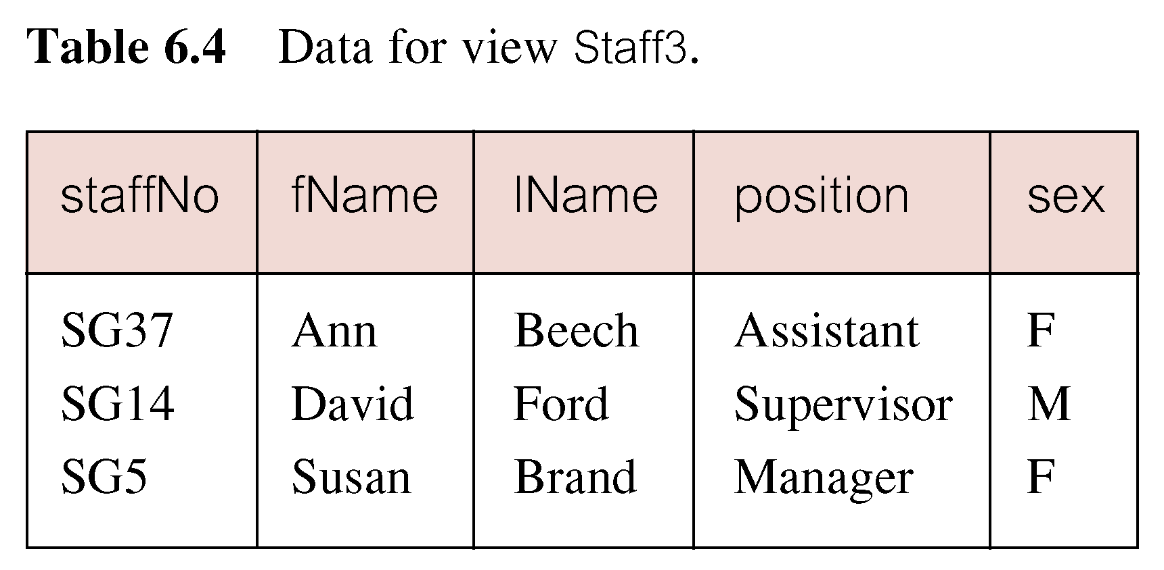
Example 7.4 - Create Vertical View
Create view of staff details at branch B003 excluding salaries.
CREATE VIEW Staff3
AS SELECT staffNo, fName, lName, position, sex
FROM Staff
WHERE branchNo = ‘B003’;

Slide 36
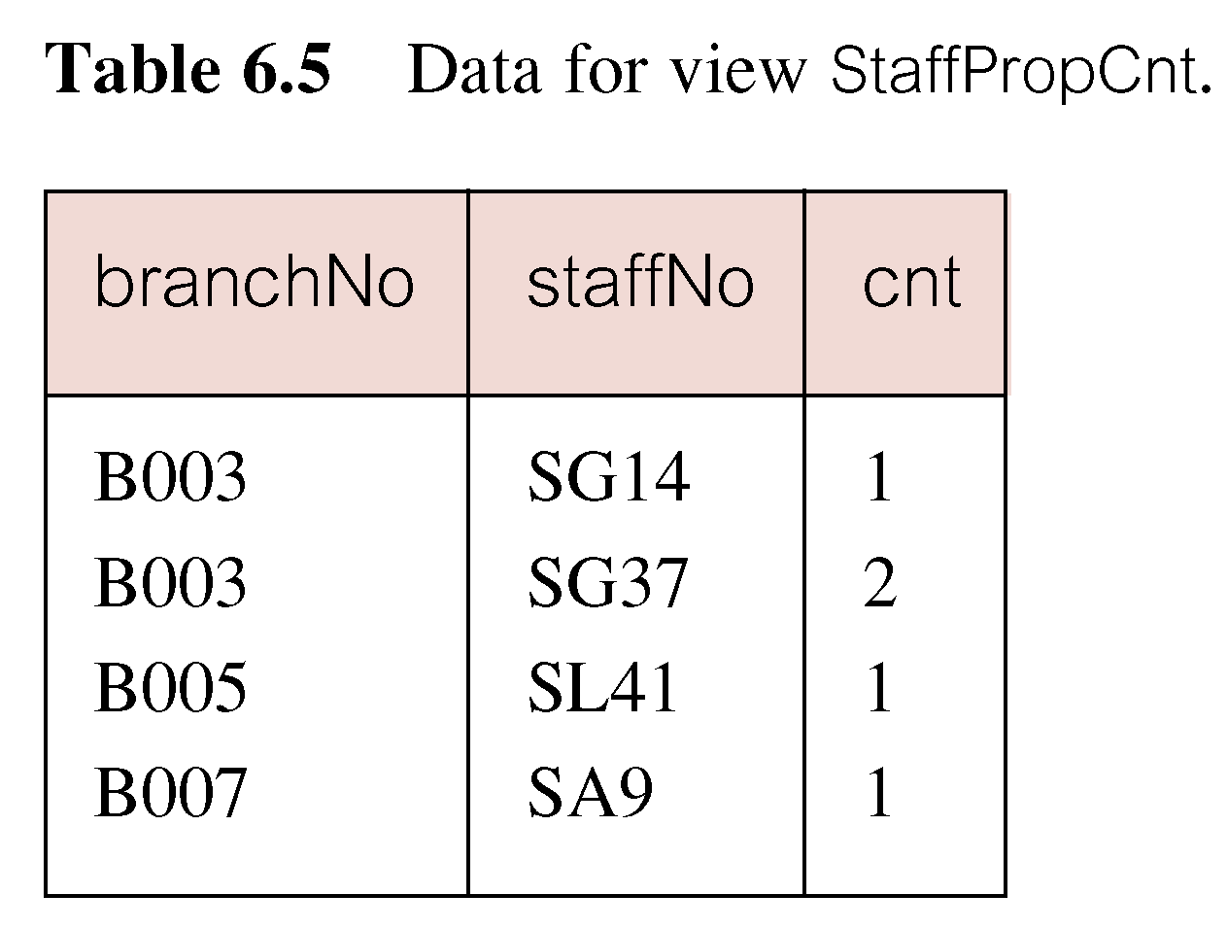
Example 7.5 - Grouped and Joined Views
Create view of staff who manage properties for rent, including branch number they work at, staff number, and number of properties they manage.
CREATE VIEW StaffPropCnt(branchNo, staffNo, cnt)
AS SELECT s.branchNo, s.staffNo, COUNT(*)
FROM Staff s, PropertyForRent p
WHERE s.staffNo = p.staffNo
GROUP BY s.branchNo, s.staffNo;

Slide 37
SQL - DROP VIEW
Causes definition of view to be deleted from database.
- Syntax:
DROP VIEW ViewName [RESTRICT | CASCADE]
- Example:
DROP VIEW Manager3Staff;
With CASCADE, all related dependent objects are deleted; i.e. any views defined on view being dropped.
With RESTRICT (default), if any other objects depend for their existence on continued existence of view being dropped, command is rejected.

Slide 38
Restrictions on Views
SQL imposes several restrictions on creation and use of views.
(a) If column in view is based on an aggregate function:
Column may appear only in SELECT and ORDER BY clauses of queries that access view.
Column may not be used in WHERE nor be an argument to an aggregate function in any query based on view.

Slide 39
Restrictions on Views
- Examples:
Following query would fail:
SELECT COUNT(cnt)
FROM StaffPropCnt;
Similarly, following query would also fail:
SELECT *
FROM StaffPropCnt
WHERE cnt > 2;

Slide 40
Restrictions on Views
(b) Grouped view may never be joined with a base table or a view.
For example, StaffPropCnt view is a grouped view, so any attempt to join this view with another table or view fails.

Slide 41
View Updatability
All updates to base table reflected in all views that encompass base table.
Similarly, may expect that if view is updated then base table(s) will reflect change.

Slide 42
View Updatability
However, consider again view StaffPropCnt.
If we tried to insert record showing that at branch B003, SG5 manages 2 properties:
INSERT INTO StaffPropCnt
VALUES (‘B003’, ‘SG5’, 2);
Have to insert 2 records into PropertyForRent showing which properties SG5 manages. However, do not know which properties they are; i.e. do not know primary keys!

Slide 43
View Updatability
If change definition of view and replace count with actual property numbers:
CREATE VIEW StaffPropList (branchNo,
staffNo, propertyNo)
AS SELECT s.branchNo, s.staffNo, p.propertyNo
FROM Staff s, PropertyForRent p
WHERE s.staffNo = p.staffNo;

Slide 44
View Updatability
Now try to insert the record:
INSERT INTO StaffPropList
VALUES (‘B003’, ‘SG5’, ‘PG19’);
Still problem, because in PropertyForRent all columns except postcode/staffNo are not allowed nulls.
However, have no way of giving remaining non-null columns values.

Slide 45
View Updatability
ISO specifies that a view is updatable if and only if:
DISTINCT is not specified.
Every element in SELECT list of defining query is a column name and no column appears more than once.
FROM clause specifies only one table, excluding any views based on a join, union, intersection or difference.
No nested SELECT referencing outer table.
No GROUP BY or HAVING clause.
Also, every row added through view must not violate integrity constraints of base table.
For view to be updatable, DBMS must be able to trace any row or column back to its row or column in the source table.

Slide 46
WITH CHECK OPTION
Rows exist in a view because they satisfy WHERE condition of defining query.
If a row changes and no longer satisfies condition, it disappears from the view.
New rows appear within view when insert/update on view cause them to satisfy WHERE condition.
Rows that enter or leave a view are called migrating rows.
WITH CHECK OPTION prohibits a row migrating out of the view.

Slide 47
Example 7.6 - WITH CHECK OPTION
CREATE VIEW Manager3Staff
AS SELECT *
FROM Staff
WHERE branchNo = ‘B003’
WITH CHECK OPTION;
Cannot update branch number of row B003 to B002 as this would cause row to migrate from view.
Also cannot insert a row into view with a branch number that does not equal B003.

