Slide 1
Introduction
CSC215
Lecture

Slide 2
Outline
Programming Languages
Object Oriented Programming
Procedural Programming
What is C?
Short history
Features, Strengths and weaknesses
Relationships to other languages
Writing C Programs
Editing
Compiling
Structure of C Programs
Comments
Variables
Functions: main, function prototypes and functions
Expressions and Statements

Slide 3
Programming Languages
Many programming languages exist, each intended for a specific purpose
Over 700 programming language entries on wikipedia
Should we learn all?
Which is the best language? None!
Choose the right tool for the job based on:
problem scope,
target hardware/software,
memory and performance considerations,
portability,
concurrency.

Slide 4
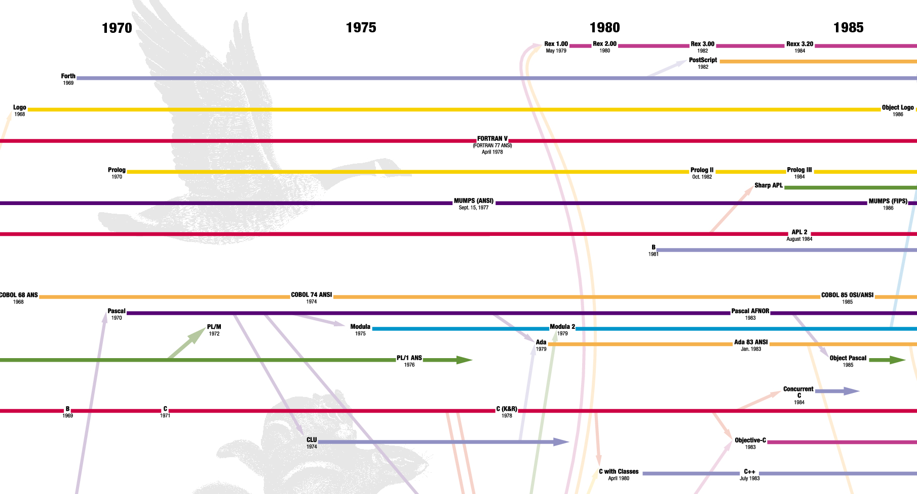
Programming Languages

Slide 5
Object Oriented Programming
Very useful to organize large software projects
The program is organized as classes
The data is broken into ‘objects’ and the sequence of commands becomes the interactions between objects:
Decide which classes you need
provide a full set of operations for each class
and make commonality explicit by using inheritance.
Covered in CSC111 and CSC113

Slide 6
Procedural Programming
The program is divided up into subroutines or procedures
Allows code to become structured
The programmer must think in terms of actions:
decide which procedures and data structures you want
Procedural languages include:
Fortran
BASIC
Pascal
C

Slide 7
What is C?
History:
1972 - Dennis Ritchie – AT&T Bell Laboratories
16-bit DEC PDP-11 computer (right)
1978 - Published; first specification of language
1989 - C89 standard (known as ANSI C or Standard C)
1990 - ANSI C adopted by ISO, known as C90
1999 - C99 standard: mostly backward-compatible, not completely implemented in many compilers
2007 - work on new C standard C1X announced
In this course: ANSI/ISO C (C89/C90)

Slide 8
What is C?
Features:
Provides low -level access to memory
Provides language constructs that map efficiently to machine instructions
Few keywords (32 in ANSI C)
Structures, unions – compound data types
Pointers - memory, arrays
External standard library – I/O, other facilities
Compiles to native code
Systems programming:
OSes, like Linux
microcontrollers: automobiles and airplanes
embedded processors: phones, portable electronics, etc.
DSP processors: digital audio and TV systems
. . . Macro preprocessor
Widely used today, Extends to newer system architectures

Slide 9
What is C?
Strengths:
Efficiency: intended for applications where assembly language had traditionally been used
Portability: hasn’t splintered into incompatible dialects; small and easily written
Power: large collection of data types and operators
Flexibility: not only for system but also for embedded system commercial data processing
Standard library
Integration with UNIX
Weaknesses
Error-prone:
Error detection left to the programmer
Difficult to understand
Large programmes
Difficult to modify
Memory management
Memory management is left to the programmer

Slide 10
Relationship to Other Languages
More recent derivatives: C++, Objective C, C#
Influenced: Java, Perl, Python (quite different)
C lacks:
Exceptions
Range-checking
Memory management and garbage collection.
Objects and object-oriented programming
Polymorphism
Shares with Java:
/* Comments */
Variable declarations
if / else statements
for / while loops
function definitions (like methods)
Main function starts program

Slide 11
C Programs
Editing:
C source code files has .c extension
Text files that can be edited using any text editor: Example product.c #include <stdio.h> main() { int a, b, c; a = 3; b = 2; c = a * b; printf(“The product is %d”, c); }
Compiling:
gcc -o product product.c
“-o” place the output in file product
“product” is the executable file
To execute the program:
product on windows or ./product on Linux and Linux-like

Slide 12
C Compilers
Several compilers
Microsoft compiler
GNU Compiler Collection (GCC)
: (see a List of C compilers)
How to install GCC on windows:
MinGW: from https://nuwen.net/mingw.html
Cygwin: from https://cygwin.com/install.html
Don’t forget to update the path!
Compilation options:
gcc -ansi product.c : check the program compatibility with ANSI C
gcc -Wall product.c : enables all the warnings that are easy to avoid
In this course we will always use: gcc -Wall -ansi -o product product.c
Cross Compilation: compiling on one platform to run on another

Slide 13
Structure of .c File
/* Begin with comments about file contents */
/* Insert #include statements and preprocessor definitions */
/* Function prototypes and variable declarations */
/* Define main() function {
Function body
}
*/
/* Define other function(s) {
Function body
}
*/

Slide 14
Structure of .c File: Comments
/∗ this is a simple comment ∗/
Can span multiple lines /∗ This comment Spans m u l t i p l e l i n e s ∗/
Completely ignored by compiler
Can appear almost anywhere| /∗ h e l l o . c − our f i r s t C program Created for CSC215 ∗/

Slide 15
Structure of .c File: #include Preprocessor
#include is a preprocessor:
Header files: constants, functions, other declarations
#include: read the contents of the header file stdio.h
stdio.h: standard I/O functions for console and files #include <stdio.h> /∗ basic I/O facilities */
stdio.h – part of the C Standard Library
other important header files: assert.h ctype.h errno.h float.h limits.h locale.h math.h signal.h setjmp.h stdarg.h stddef.h stdlib.h string.h time.h
Included files must be on include path
standard include directories assumed by default
#include "stdio.h" – searches ./ for stdio.h first

Slide 16
Structure of .c File: #Variables and Constants
Variables: named spaces in memory that hold values
Refer to these spaces using their names rather than memory addresses
Names selection adheres to some rules
Defined with a type that determines their domains and operations
Variable must be declared prior to their use
Can change their values after initialization
Constants:
Do not change their values after initialization
Can be of any basic or enumerated data type
Declared by assigning a literal to a typed name, with the use of the keyword const const int LENGTH = 10; Const char NEWLINE = '\n';
Can also use the #define preprocessor #define LENGTH 10 #define NEWLINE '\n'

Slide 17
Structure of .c File: Function Prototype
Functions also must be declared before use
Declaration called function prototype
Function prototypes: int factorial(int); int factorial(int n);
Prototypes for many common functions in header files for C Standard Library
General form: return_type function_name(arg1,arg2,...);
Arguments: local variables, values passed from caller
Return value: single value returned to caller when function exits
void – signifies no return value/arguments int rand(void);

Slide 18
Structure of .c File: Function main
main(): entry point for C program
Simplest version:
no inputs,
outputs 0 when successful,
and nonzero to signal some error int main(void);
Two-argument form of main():
access command-line arguments int main(int argc, char ∗∗argv);
More on the char **argv notation later

Slide 19
Structure of .c File: Function Definitions
Function declaration <return_type> <function_name>(<list_of_parameters>){ <declare_variables;> <program_statements;> return <expression>; }
Must match prototype (if there is one)
variable names don’t have to match
No semicolon at end
Curly braces define a block – region of code
Variables declared in a block exist only in that block
Variable declarations before any other statements

Slide 20
Console Input and Output
stdout, stdin: console output and input streams
puts(<string_expression>): prints string to stdout
putchar(<char_expression>): prints character to stdout
<char_var> = getchar(): returns character from stdin
<string_var> = gets(<buffer>): reads line from stdin into string
printf(control_string, arg1, arg2, …) to be discussed later

Slide 21
Structure of .c File: Expressions and statements
Expression:
a sequence of characters and symbols that can be evaluated to a single data item.
consists of: literals, variables, subexpressions, interconnected by one or more operators
Numeric literals like 3 or 4.5
String literals like “Hello”
Example expressions:
Binary arithmetic x+y , x-y , x*y , x/y , x%y
Statement:
A sequence of characters and symbols causes the computer to carry out some definite action
Not all statements have values
Example statement: y = x+3∗x/(y−4);
Semicolon ends statement (not newline)

Slide 22
Output Statements
/∗ The main ( ) function ∗/ int main (void)/∗ entry point ∗/ { /∗ write message to console ∗/ puts( "Hello World!" ); return 0; /∗ exit (0 => success) ∗/
}
puts(<string>): output text to console window (stdout) and end the line
String literal: written surrounded by double quotes
return 0; exits the function, returning value 0 to caller

