Slide 1
1
Managing Strategic Human Resources Today
Notes:
The main purpose of this chapter is to explain what human resource management is and why it is important to all managers. We will see that human resource management—activities like recruiting, hiring, training, appraising, and compensating employees—is both a separate management function and part of every manager’s job. The main topics we cover here are as follows: What Is Human Resource Management?, Trends Influencing Human Resource Management, The New Human Resource Managers, Strategic Human Resource Management, and The Plan of This Book.

Slide 2
Learning Objectives (1)
When you finish studying, you should be able to:
Answer the question, “What is human resource management?”
Discuss the trends affecting human resource management.
Describe important competencies human resource managers need today.
Notes:
When you finish studying, you should be able to:
Answer the question, “What is human resource management?”
Discuss the trends affecting human resource management.
Describe important competencies human resource managers need today.

Slide 3
Learning Objectives (2)
Explain and give examples of strategic human resource management.
Discuss three strategic management tools managers use.
Notes:
When you finish studying, you should be able to:
Explain and give examples of strategic human resource management.
Discuss three strategic management tools managers use.

Slide 4
What is Human Resource Management? Human resource management refers to the practices and policies you need to carry out the personnel aspects of your management job, specifically, acquiring, training, appraising, rewarding, and providing a safe, ethical, and fair environment for your company’s employees

Slide 5
Activities of Human Resource Management?
Job analyses
Planning labor needs/recruiting
Selecting
Orienting and training
Performance appraisal
Compensation
Incentives and benefits
Employee relations
Notes:
Human resource management refers to the practices and policies you need to carry out the personnel aspects of your management job, specifically, acquiring, training, appraising, rewarding, and providing a safe, ethical, and fair environment for your company’s employees.
In addition to the list shown on the slide, managers need to know about equal opportunity, ethics, and affirmative action; employee health, and safety; and, grievances and labor relations.

Slide 6
Why is HR Management Important to All Managers?
Perhaps the best way to answer that is to start by listing the sorts of personnel mistakes you don’t want to make while managing. For example, no manager wants to:
• Have your employees not performing at peak capacity
• Hire the wrong person for the job
• Experience high turnover
• Find employees not doing their best
• Have your company taken to court because of your discriminatory
actions
• Have your company cited under federal occupational safety laws
for unsafe practices
• Allow a lack of training to undermine your department’s
effectiveness
• Commit any unfair labor practices

Slide 7
Why is HR Management Important to All Managers?
Improve Profits and Performance
You May Spend Some Time as an HR Manager
HR for Entrepreneurs
Notes:
Improve profits and performance – Every employee can help improve profits and performance. Managers, especially, can make a difference by hiring, training, and creating an environment in which employees feel motivated to perform.
You may spend some time as an HR manager within the department. Many forward-thinking, profitable companies rotate managers, directors, and executives into and through different departments, especially HR. This gives the individual a chance to bring a significantly different perspective to the regular processes of a given department. And, if you think you will never become a manager, think again.
HR for Entrepreneurs — Even if you plan on starting or working in a start-up, most people graduating in the next few years will either work for a small business or create a small business of their own.

Slide 8
Line Versus Staff Authority
Authority
The right to make decisions
To direct the work of others
To give orders
Notes:
Line versus Staff Authority — Authority is the right to make decisions, to direct the work of others, and to give orders. Line managers are authorized to direct the work of subordinates and issue orders. Their subordinates are generally involved in work that directly produces or sells the company’s product or service, like sales or manufacturing. Staff managers are authorized to assist and advise line managers in accomplishing their basic goals. The subordinates of staff managers are generally involved in work that supports the products or services, in departments like purchasing or quality control. HR managers are generally staff managers.

Slide 9
Line and Staff Aspects of HRM
Line managers involved in:
Recruiting
Interviewing
Selecting
Training
Notes:
Line and Staff Aspects of HRM — Although most firms have a human resource department with its own manager, all managers tend to get involved in activities like recruiting, interviewing, selecting, and training.

Slide 10
Line versus Staff Authority
Authority is the right to make decisions, to direct the work of others, and to give orders.
Line managers are authorized to direct the work of subordinates and issue orders. Their subordinates are generally involved in work that directly produces or sells the company’s product or service, like sales or manufacturing.
Staff managers are authorized to assist and advise line managers in accomplishing their basic goals.
The subordinates of staff managers are generally involved in work that supports the products or services, in departments like purchasing or quality control. HR managers are generally staff managers.

Slide 11
Line-Staff HR Cooperation
Shared Responsibility
Notes:
Line-Staff HR Cooperation — HR and line managers share responsibility for most human resource activity.

Slide 12
Line Managers’ HR Management Responsibilities All supervisors are responsible for aspects of HR/personnel tasks such as placement, training, controlling labor costs, protecting health and safety, and development of employees.
Placement
Orientation
Training
Job performance
Cooperation
Policies and procedures
Controlling labor costs
Employee development
Morale
Health and safety
Notes:
Line Manager’s Human Resource Responsibilities — All supervisors are responsible for aspects of HR/personnel tasks such as placement, training, controlling labor costs, protecting health and safety, and development of employees.

Slide 13
Organizing the HR Department’s Responsibilities The HR department provides specialized assistance such as acting as a
Recruiters
Equal Employment Opportunity
Job analysts
Compensation managers
Training specialists
Notes:
Organizing the HR Department’s Responsibilities — The HR department provides specialized assistance such as acting as a recruiter, EEO representative, job analyst, compensation manager, training specialist, or labor relations specialist.

Slide 14
Trends Influencing HR Management What human resource managers do and how they do it is changing. Some of the reasons for these changes are obvious, such as is technology. For example, employers now use their intranets to let employees modify their own benefits plans, something they obviously couldn’t do years ago. Other trends shaping human resource management include globalization of competition, deregulation, changes in demographics and the nature of work, and economic challenges.
Notes:
What human resource managers do and how they do it is changing. Some of the reasons for these changes are obvious, such as is technology. For example, employers now use their intranets to let employees modify their own benefits plans, something they obviously couldn’t do years ago. Other trends shaping human resource management include globalization of competition, deregulation, changes in demographics and the nature of work, and economic challenges.

Slide 15
Trends Influencing HR Management
Globalization
Technological advances
The nature of work
Service jobs
Human capital
Offshoring
Notes:
Human Resource responsibilities have become broader and more strategic over time in response to a number of trends. The role of HR has evolved from primarily being responsible for hiring, firing, payroll, and benefits administration to a more strategic role in employee selection, training, and promotion, as well as playing an advisory role to the organization in areas of labor relations and legal compliance. Employers now rely on their employees’ motivation and performance to provide them with a competitive advantage.
Globalization — Globalization refers to the tendency of firms to extend their sales, ownership, and/or manufacturing to new markets abroad. Globalization of the world economy and other trends has triggered changes in how companies organize, manage, and use their HR departments.
Technological Advances — Technology is changing everything and changes in technology itself is increasing. Facebookrecruiting is one example.
The Nature of Work — Jobs are changing due to new technological demands. Dramatic increases in productivity have allowed manufacturers to produce more with fewer employees.
Service Jobs — Most newly created jobs in the U.S. are, and will continue to be, in the service sector.
Human Capital — Refers to the knowledge, education, training, skills, and expertise of a firm’s workers.
Offshoring — The search for greater efficiencies; developing countries and economics are prompting employers to export more jobs abroad.

Slide 16
Trends Influencing HR Management
Globalization — Globalization refers to the tendency of firms to extend their sales, ownership, and/or manufacturing to new markets abroad. Globalization of the world economy and other trends has triggered changes in how companies organize, manage, and use their HR departments.
Technological Advances — Technology is changing everything and changes in technology itself is increasing. Facebook-recruiting is one example.
The Nature of Work — Jobs are changing due to new technological demands. Dramatic increases in productivity have allowed manufacturers to produce more with fewer employees.
Service Jobs — Most newly created jobs in the U.S. are, and will continue to be, in the service sector.
Human Capital — Refers to the knowledge, education, training, skills, and expertise of a firm’s workers.
Offshoring — The search for greater efficiencies; developing countries and economics are prompting employers to export more jobs abroad.

Slide 17
What is Talent Management?
Employee engagement- The HR function must ensure they understand the difference between involvement and commitment. Employees cannot be “checked out” mentally yet still perform at the top of their game.
Measure HR performance and results- HR managers are expected to measure their effectiveness. They use performance measures, or metrics, including benchmarking
Add value- The human resource function goes far beyond the transactional activities in the past to include boosting performance and profitability in measurable ways.
Build high-performance work systems- Managers must focus on productivity and performance improvement. HR practices are invaluable in that effort. A high-performance work system is a set of human resource management policies and practices that together produce superior employee performance.
Notes:
They Manage Employee Engagement — The HR function must ensure they understand the difference between involvement and commitment. Employees cannot be “checked out” mentally yet still perform at the top of their game.
They Can Measure HR Performance — HR managers are expected to measure their effectiveness. They use performance measures, or metrics, including benchmarking.
They Add Value — The human resource function goes far beyond the transactional activities in the past to include boosting performance and profitability in measurable ways.
They Build High-Performance Work Systems — Managers must focus on productivity and performance improvement. HR practices are invaluable in that effort. A high-performance work system is a set of human resource management policies and practices that together produce superior employee performance.

Slide 18
Strategic HR Management We’ve seen that exercising strategic judgment is an important human resource manager proficiency. Human resource managers, therefore, need a command of strategic planning methods.
Notes:
We’ve seen that exercising strategic judgment is an important human resource manager proficiency. Human resource managers, therefore, need a command of strategic planning methods.

Slide 19
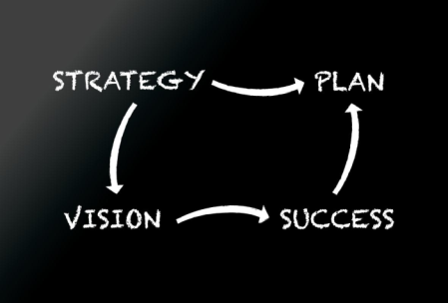
Strategic HR Management A strategic plan is designed to use a firm’s internal strengths and weaknesses to address its external weaknesses and threats. This is often referred to as a SWOT analysis.
Strengths
Weaknesses
Opportunities
Threats
(SWOT)
Notes:
Strategic Management — A strategic plan is designed to use a firm’s internal strengths and weaknesses to address its external weaknesses and threats. This is often referred to as a SWOT analysis.
HR and Competitive Advantage — HR must be involved in creating competitive advantage – factors that allow an organization to differentiate its products or services from those of its competitors to increase market share. Connecting to and being involved in developing the firm’s strategic plan will help in creating competitive advantage.

Slide 20
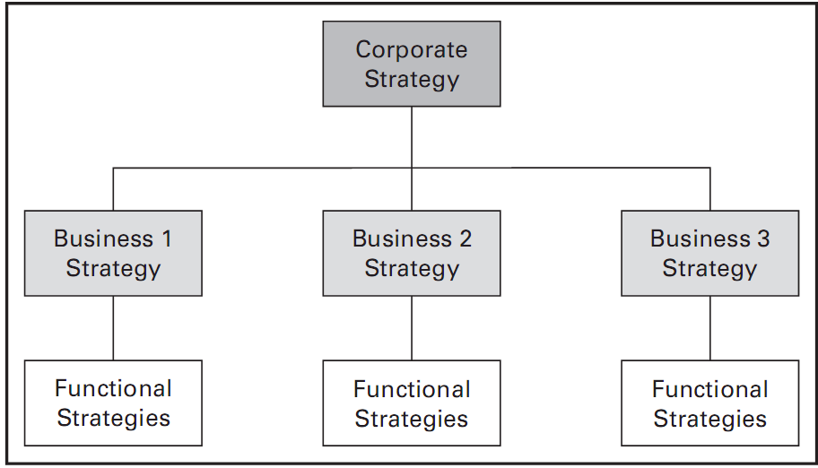
Strategic Planning Basics
Notes:
Strategic Planning Basics — Managers engage in three levels of strategic planning.
Corporate Strategy — The company-wide level is at the top. This strategy identifies the portfolio of business that comprise the company.
Competitive Strategy — At the business level, the competitive strategy identifies how to build and strengthen the business’s long-term competitive position in the market place.
Functional Strategy — The department level strategy identifies the basic course of action for each department.

Slide 21
Strategic Planning Basics Managers engage in three levels of strategic planning.
Corporate Strategy — The company-wide level is at the top. This strategy identifies the portfolio of business that comprise the company.
Competitive Strategy — At the business level, the competitive strategy identifies how to build and strengthen the business’s long-term competitive position in the market place.
Functional Strategy — The department level strategy identifies the basic course of action for each department.

Slide 22
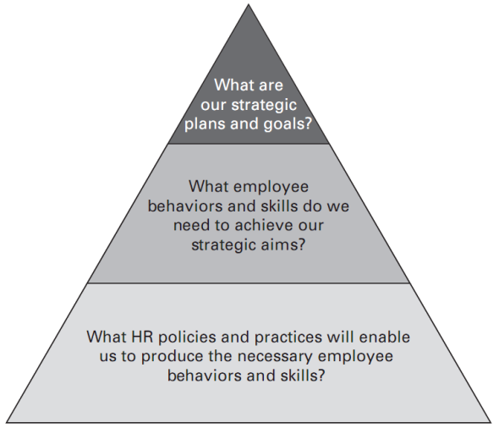
What is Strategic HR Management? Strategic HRM refers to formulating and executing HR policies and practices that produce the employee competencies and behaviors the company needs to achieve its strategic aims.
Notes:
Strategic HRM refers to formulating and executing HR policies and practices that produce the employee competencies and behaviors the company needs to achieve its strategic aims.

