Slide 1
4
Testing and Selecting Employees
Notes:
The main purpose of this chapter is to explain how to use the basic employee selection tools. The topics we cover include The Basics of Testing and Selecting Employees, Using Tests at Work, Interviewing Prospective Employees, and Using Other Selection Techniques.

Slide 2
Learning Objectives
When you finish studying this chapter, you should be able to:
Define basic testing concepts, including validity and reliability.
Discuss at least four basic types of personnel tests.
Explain the pros and cons of background investigations and pre-employment information services.
Explain the factors that can undermine an interview’s usefulness and the techniques for eliminating them.
Notes:
When we finish this chapter, you should be able to define basic testing concepts, especially the impact of reliability and validity. Since personnel testing has become so important, you should become familiar with personnel tests and be able to discuss them whether you’re an HR professional or a hiring manager. Also, investigating and validating candidate backgrounds (including experience, financial stability, and education) and knowing how to use pre-employment information services will help you make the right selections. Finally, you should be able to explain the factors that can undermine the usefulness of an interview and how to eliminate them.

Slide 3
The Basics of Testing and Selecting Employees
Why selection is important
Legal implications
Negligent hiring
Reliability
Validity
How to validate a test
Notes:
Selecting the right employees is important for four main reasons: (1) proper selection can improve employee and organizational performance; (2) your own performance depends partly on you’re the performance of your subordinates; (3) it can help reduce dysfunctional behaviors at work; and 4) it is costly to recruit and hire.
Reliability — refers to the consistency of scores obtained by the same person when retested with identical or equivalent tests.
Validity — refers to evidence that performance on a test is a valid predictor of subsequent performance on the job. It answers the question, “Does this test measure what it was intended to measure?”
How to Validate a Test
Analyze the job and write job descriptions and job specifications.
Choose the tests that measure the attributes (predictors) important for job success.
Administer the test selected to old or new employees for concurrent and predictive validation.
Relate test scores and criteria through a correlation analysis, which shows the degree of statistical relationship between (1) scores on the test and (2) job performance.
Cross-validate and revalidate by performing Steps 3 and 4 again on a new sample of employees.

Slide 4
The Basics of Testing and Selecting Employees
Selecting the right employees is important for four main reasons:
proper selection can improve employee and organizational performance;
your own performance depends partly on you’re the performance of your subordinates;
it can help reduce dysfunctional behaviors at work; and
it is costly to recruit and hire.
Reliability — refers to the consistency of scores obtained by the same person when retested with identical or equivalent tests.
Validity — refers to evidence that performance on a test is a valid predictor of subsequent performance on the job. It answers the question, “Does this test measure what it was intended to measure?”
How to Validate a Test
Analyze the job and write job descriptions and job specifications.
Choose the tests that measure the attributes (predictors) important for job success.
Administer the test selected to old or new employees for concurrent and predictive validation.
Relate test scores and criteria through a correlation analysis, which shows the degree of statistical relationship between (1) scores on the test and (2) job performance.
Cross-validate and revalidate by performing Steps 3 and 4 again on a new sample of employees.

Slide 5
Using Tests at Work Tests can be effective. Tests are also widely used by employers. For example, about 41% of companies the American Management Association surveyed tested applicants for basic skills (defined as the ability to read instructions, write reports, and perform common workplace arithmetic tasks).
Notes:
Tests can be effective. Tests are also widely used by employers. For example, about 41% of companies the American Management Association surveyed tested applicants for basic skills (defined as the ability to read instructions, write reports, and perform common workplace arithmetic tasks).

Slide 6
Types of Tests Used (1)
Cognition
Motor, physical abilities
Personality
Personality test effectiveness
Interest
Achievement
Computerized
Web-based
Notes:
Types of Tests Used at Work — Various types of tests are widely used by employers today, including those for basic skills, job skills, and psychological measurement.
Tests of Cognitive Abilities — Cognitive tests include tests of general reasoning ability (intelligence) and tests of specific mental abilities like memory and inductive reasoning.
Tests of Motor and Physical Abilities — Employers may use various tests to measure such motor abilities as finger dexterity, manual dexterity, and reaction time. They may also want to measure such physical abilities as static strength, dynamic strength, body coordination, and stamina.
Measuring Personality — Used to assess personal characteristics such as attitude, motivation, and temperament.
Personality Test Effectiveness — Historically, most experts assumed that personality tests help companies hire workers that are more effective. Industrial psychologists often study the “big five” personality dimensions: extroversion, emotional stability, agreeableness, conscientiousness, and openness to experience.
Interest Inventories — Compare one’s interests with those of people in various occupations.
Achievement Tests — Measure what a person has learned.
Computerized Testing — Increasingly replacing pencil-and-paper and manual tests.
Web-Based Testing — Studies suggest that proctored Web-based and paper-and-pencil tests of applicants produce similar results, for instance on personality and judgment tests.

Slide 7
Types of Tests Used (1)
Types of Tests Used at Work — Various types of tests are widely used by employers today, including those for basic skills, job skills, and psychological measurement.
Tests of Cognitive Abilities — Cognitive tests include tests of general reasoning ability (intelligence) and tests of specific mental abilities like memory and inductive reasoning.
Tests of Motor and Physical Abilities — Employers may use various tests to measure such motor abilities as finger dexterity, manual dexterity, and reaction time. They may also want to measure such physical abilities as static strength, dynamic strength, body coordination, and stamina.
Measuring Personality — Used to assess personal characteristics such as attitude, motivation, and temperament.
Personality Test Effectiveness — Historically, most experts assumed that personality tests help companies hire workers that are more effective. Industrial psychologists often study the “big five” personality dimensions: extroversion, emotional stability, agreeableness, conscientiousness, and openness to experience.
Interest Inventories — Compare one’s interests with those of people in various occupations.
Achievement Tests — Measure what a person has learned.
Computerized Testing — Increasingly replacing pencil-and-paper and manual tests.
Web-Based Testing — Studies suggest that proctored Web-based and paper-and-pencil tests of applicants produce similar results, for instance on personality and judgment tests.

Slide 8
Types of Tests Used (2)
Work samples and simulation
Work sampling
Management assessment centers
Situational judgment tests
Notes:
The work sampling technique tries to predict job performance by requiring job candidates to perform one or more actual samples of the job’s task.
Management Assessment Centers — provide simulations in which candidates perform realistic management tasks, under the observation of experts who appraise each candidate’s potential.
Situational Judgment Tests — These tests are designed to assess an applicant’s judgment regarding a situation encountered in the workplace.

Slide 9
Interviewing Prospective Employees An interview is a procedure designed to solicit information from a person’s oral responses to oral inquiries. A selection interview is “a selection procedure designed to predict future job performance on the basis of applicants’ oral responses to oral inquiries.”
Notes:
An interview is a procedure designed to solicit information from a person’s oral responses to oral inquiries. A selection interview is “a selection procedure designed to predict future job performance on the basis of applicants’ oral responses to oral inquiries.”

Slide 10
Types of selection interviews
Structure — Structured or directed interview; most interviews vary by the degree to which the interview has been structured or standardized.
Type of Questions — Interviews can be classified according to the nature or content of their questions, such as situational interviews, job-related interviews, behavioral interviews, and stress interviews. Puzzle questions are also popular today, and are used to see how candidates think under pressure.
How Interviews are Administered
One-on-one where two people meet alone and one person interviews the other by seeking oral responses to oral inquiries.
Sequential interviews occur when several interviewers question the candidate in a sequence before a selection is made.
Panel interviews occur when a group (panel) interviews several candidates simultaneously.
Video or phone interviews are often conducted entirely by phone or videoconferencing, saving time and travel costs.
Computerized interviews assess responses to computer-based oral, visual, or written questions/situations.
Bain & Company case interviews
By having job candidates explain how they would address the case client’s problems, the case interview used by Bain & Company combines behavioral and situational questioning to provide a realistic assessment of the candidate’s consulting skills.
Notes:
Structure — Structured or directed interview; most interviews vary by the degree to which the interview has been structured or standardized.
Type of Questions — Interviews can be classified according to the nature or content of their questions, such as situational interviews, job-related interviews, behavioral interviews, and stress interviews. Puzzle questions are also popular today, and are used to see how candidates think under pressure.
How Interviews are Administered
One-on-one where two people meet alone and one person interviews the other by seeking oral responses to oral inquiries.
Sequential interviews occur when several interviewers question the candidate in a sequence before a selection is made.
Panel interviews occur when a group (panel) interviews several candidates simultaneously.
Video or phone interviews are often conducted entirely by phone or videoconferencing, saving time and travel costs.
Computerized interviews assess responses to computer-based oral, visual, or written questions/situations.
Bain & Company case interviews
By having job candidates explain how they would address the case client’s problems, the case interview used by Bain & Company combines behavioral and situational questioning to provide a realistic assessment of the candidate’s consulting skills.

Slide 11
How to Avoid Common Interviewing Mistakes
Snap judgments
Negative emphasis
Not knowing the job
Pressure to hire
Contrast error
Non-verbal behavior
Notes:
Snap Judgments — One of the most consistent findings is that interviewers tend to jump to conclusions about candidates during the first few minutes (perhaps seconds) of the interview.
Negative Emphasis — Interviewers tend to have a consistent negative bias and are generally more influenced by unfavorable than favorable information about the candidate.
Not Knowing the Job — Interviewers who don’t know precisely what the job entails and what sort of candidate is best suited for it usually make their decisions based on incorrect or incomplete stereotypes of what a good applicant is.
Pressure to Hire — Pressure to hire can undermine an interview’s usefulness.
Candidate-Order (Contrast) Error — The order in which you see applicants affects how you rate them.
Influence of Nonverbal Behavior — Inexperienced interviewers may try to infer the interviewee’s personality from vocal and visual cues, such as energy level, voice modulation, and level of extraversion.

Slide 12
How to Avoid Common Interviewing Mistakes
Snap Judgments — One of the most consistent findings is that interviewers tend to jump to conclusions about candidates during the first few minutes (perhaps seconds) of the interview.
Negative Emphasis — Interviewers tend to have a consistent negative bias and are generally more influenced by unfavorable than favorable information about the candidate.
Not Knowing the Job — Interviewers who don’t know precisely what the job entails and what sort of candidate is best suited for it usually make their decisions based on incorrect or incomplete stereotypes of what a good applicant is.
Pressure to Hire — Pressure to hire can undermine an interview’s usefulness.
Candidate-Order (Contrast) Error — The order in which you see applicants affects how you rate them.
Influence of Nonverbal Behavior — Inexperienced interviewers may try to infer the interviewee’s personality from vocal and visual cues, such as energy level, voice modulation, and level of extraversion.

Slide 13
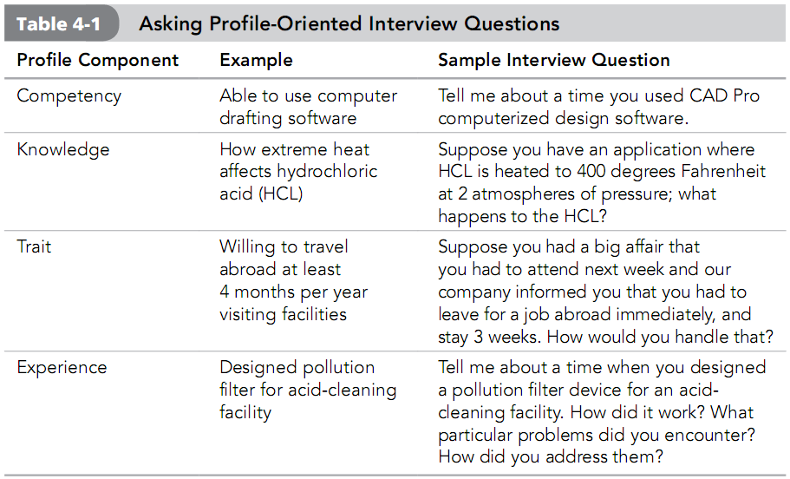
Notes:
Talent Management: Profiles and Employee Interviews are important to ensure consistency in using the same sets of competencies, traits, knowledge, and experience for recruiting, training, appraising, and compensating employees.

