Slide 1
6
Performance Management, Appraisals, and Careers
Notes:
The topics we cover include Basic Concepts in Performance Appraisal and Management, Basic Appraisal Methods, Some Practical Suggestions for More Effective Appraisals, Coaching and Career Management, Performance Management, and Talent Management Practices for Strategic Employee Appraisals.

Slide 2
Learning Objectives (1)
When you finish studying this chapter, you should be able to:
Explain the purpose of performance appraisal.
Answer the question, “Who should do the appraising?”
Discuss the pros and cons of at least eight performance appraisal methods.
Notes:
When you finish studying this chapter, you should be able to:
Explain the purpose of performance appraisal.
Answer the question, “Who should do the appraising?”
Discuss the pros and cons of at least eight performance appraisal methods.

Slide 3
Learning Objectives (2)
Explain the purpose of performance appraisal.
Answer the question, Who should do the appraising?
Discuss the pros and cons of at least eight performance appraisal methods.
Notes:
You also should be able to:
Explain the purpose of performance appraisal.
Answer the question, Who should do the appraising?
Discuss the pros and cons of at least eight performance appraisal methods.

Slide 4
Basic Concepts in Performance Appraisal and Management Comparing Performance Appraisal and Performance Management — Performance appraisal is part of a total integrated process of performance management, which consolidates goal setting, performance appraisal, and development into a single, common system, the aim of which is to ensure that the employee’s performance is supporting the company’s strategic aims.
Notes:
Comparing Performance Appraisal and Performance Management — Performance appraisal is part of a total integrated process of performance management, which consolidates goal setting, performance appraisal, and development into a single, common system, the aim of which is to ensure that the employee’s performance is supporting the company’s strategic aims.

Slide 5
Basic Concepts in Performance Appraisal and Management
Why appraise performance?
Continuous feedback
Performance management
Definition
Notes:
Why Appraise Performance? — For several reasons: 1) they play an integral role in the employer’s performance management process; 2) the appraisal lets the boss and subordinate develop a plan for correcting any deficiencies, and reinforce those things he does correctly; 3) they serve a useful career planning purpose; and 4) it plays a part in salary decisions.
The Importance of Continuous Feedback — To accomplish several (or all) of these aims, traditional annual or semi-annual appraisal reviews make sense.
Performance Management — Many employers take a continuous process approach including having self-directed (and trained) work teams give themselves ongoing appraisal information.
Performance Management Defined — Performance management is a goal-oriented and continuous way to appraise and manage employees’ performance.

Slide 6
Basic Concepts in Performance Appraisal and Management
Why Appraise Performance? — For several reasons:
they play an integral role in the employer’s performance management process;
the appraisal lets the boss and subordinate develop a plan for correcting any deficiencies, and reinforce those things he does correctly;
they serve a useful career planning purpose; and
it plays a part in salary decisions.
The Importance of Continuous Feedback — To accomplish several (or all) of these aims, traditional annual or semi-annual appraisal reviews make sense.
Performance Management — Many employers take a continuous process approach including having self-directed (and trained) work teams give themselves ongoing appraisal information.
Performance Management Defined — Performance management is a goal-oriented and continuous way to appraise and manage employees’ performance.

Slide 7
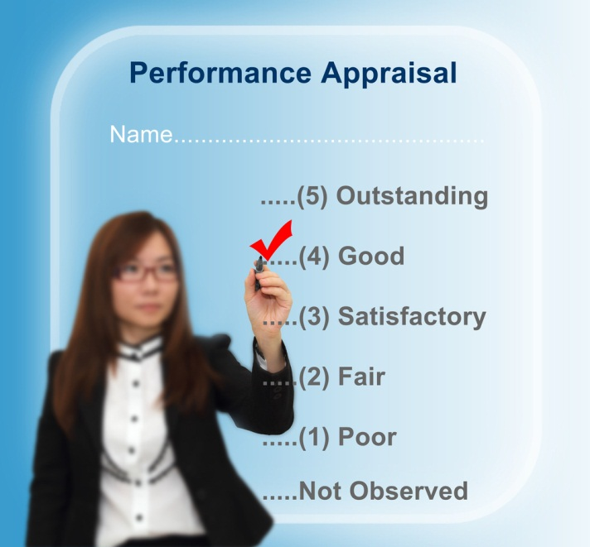
Basic Concepts in Performance Appraisal and Management
The appraisal cycle
Setting effective goals and work standards
Who should do the appraising?
Notes:
The Appraisal Cycle — The three-step process is as follows: (1) setting work standards; 2) assessing performance relative to such standards; and 3) providing feedback aimed at improving performance during the next cycle.
Setting Effective Goals and Work Standards — Some guidelines for effective goal setting are as follows: 1) assign specific goals; 2) assign measurable goals; 3) assign challenging but doable goals; and 4) encourage participation.
Who Should Do the Appraising?
The Immediate Supervisor is usually in the best position to observe and evaluate the subordinate’s performance, and is responsible for that person’s performance.
Peer Appraisals are becoming more popular with firms using self-managing teams.
Rating Committees consist of multiple raters, typically the employee’s immediate supervisor and three or four other supervisors.
Self-Ratings tend to be higher than supervisor or peer ratings.
Appraisal by Subordinates or upward feedback, is when subordinates anonymously rate their supervisor’s performance.
360-Degree Feedback is when ratings are collected from the employee, the employee’s supervisors, subordinates, peers, and internal or external customers. This method is the subject of considerable debate. One study found significant correlation between 360-degree ratings and conventional ratings. Firms should carefully assess potential costs, carefully train those giving feedback, and not rely solely on 360-degree feedback.

Slide 8
Basic Concepts in Performance Appraisal and Management
The Appraisal Cycle — The three-step process is as follows:
setting work standards;
assessing performance relative to such standards; and
providing feedback aimed at improving performance during the next cycle.
Setting Effective Goals and Work Standards — Some guidelines for effective goal setting are as follows: 1) assign specific goals;
2) assign measurable goals;
3) assign challenging but doable goals; and
4) encourage participation.
Who Should Do the Appraising?
The Immediate Supervisor is usually in the best position to observe and evaluate the subordinate’s performance, and is responsible for that person’s performance.
Peer Appraisals are becoming more popular with firms using self-managing teams.
Rating Committees consist of multiple raters, typically the employee’s immediate supervisor and three or four other supervisors.
Self-Ratings tend to be higher than supervisor or peer ratings.
Appraisal by Subordinates or upward feedback, is when subordinates anonymously rate their supervisor’s performance.
360-Degree Feedback is when ratings are collected from the employee, the employee’s supervisors, subordinates, peers, and internal or external customers. This method is the subject of considerable debate. One study found significant correlation between 360-degree ratings and conventional ratings. Firms should carefully assess potential costs, carefully train those giving feedback, and not rely solely on 360-degree feedback.

Slide 9
Basic Appraisal Methods The manager usually conducts the appraisal using one or more of the methods described in this section.
Notes:
The manager usually conducts the appraisal using one or more of the methods described in this section.

Slide 10
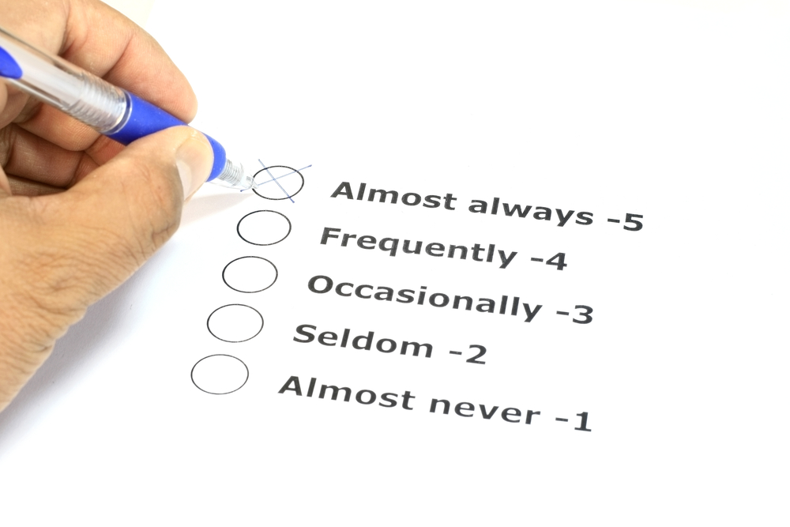
Basic Appraisal Methods
Graphic rating scale
Alternation ranking
Paired comparison
Forced distribution
Notes:
Graphic Rating Scale Method is the simplest and most popular performance appraisal technique. A scale is used to list a number of traits and a range of performance for each, then the employee is rated by identifying the score that best describes his/her performance level for each trait. Managers must decide which job performance aspects to measure. Some options include generic dimensions, actual job duties, or behaviorally recognizable competencies.
Alternation Ranking Method involves employees being ranked from best to worst on a particular trait. One way to do this is to list the highest, then the lowest, and then second highest and second lowest, and so forth until all are ranked.
Paired Comparison Method involves ranking employees by making a chart of all possible pairs of employees for each trait and indicating which is the better employee of the pair.
Forced Distribution Method — Predetermined percentages of rates are placed in various performance categories; similar to grading on a curve.

Slide 11
Basic Appraisal Methods
Graphic Rating Scale Method is the simplest and most popular performance appraisal technique. A scale is used to list a number of traits and a range of performance for each, then the employee is rated by identifying the score that best describes his/her performance level for each trait. Managers must decide which job performance aspects to measure. Some options include generic dimensions, actual job duties, or behaviorally recognizable competencies.
Alternation Ranking Method involves employees being ranked from best to worst on a particular trait. One way to do this is to list the highest, then the lowest, and then second highest and second lowest, and so forth until all are ranked.
Paired Comparison Method involves ranking employees by making a chart of all possible pairs of employees for each trait and indicating which is the better employee of the pair.
Forced Distribution Method — Predetermined percentages of rates are placed in various performance categories; similar to grading on a curve.

Slide 12
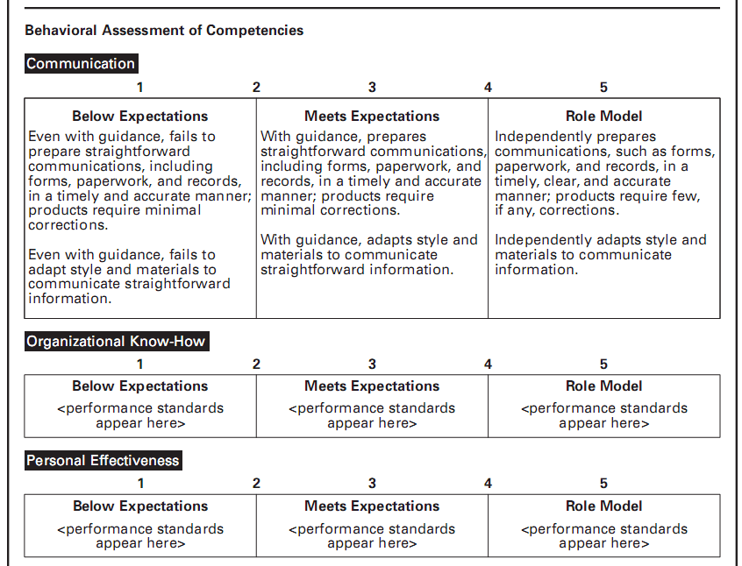
Notes:
This is a portion of a graphic rating scale with behavioral examples. Some of the key elements of this approach are the operational definitions for the categories listed. Such a set of definitions are helpful to any manager conducting an appraisal interview in that they can rate the employee yet have issues to discuss with them for possible improvement.

Slide 13
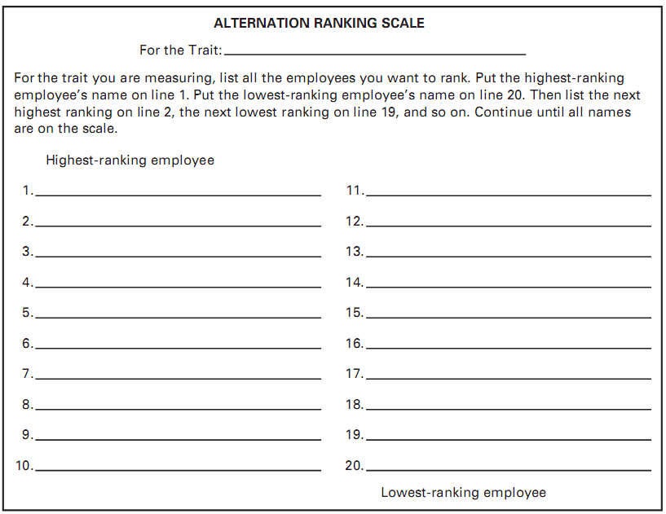
Notes:
Alternation Ranking Method involves employees being ranked from best to worst on a particular trait. One way to do this is to list the highest, then the lowest, then second highest, second lowest, and so forth until all are ranked.

Slide 14
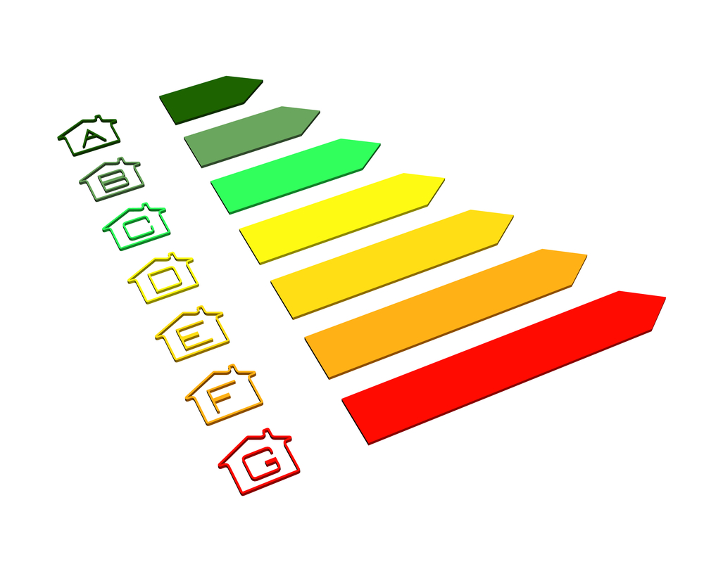
Basic Appraisal Methods
Critical incident
Behaviorally Anchored Rating Scales (BARS)
Appraisal forms in practice
Notes:
Critical Incident Method — A supervisor keeps a detailed record of uncommonly good or undesirable examples of an employee’s work-related behavior, and reviews it with the employee at predetermined times.
Behaviorally Anchored Rating Scales (BARS) combine the benefits of narratives, critical incidents, and quantified scales, by anchoring a scale with specific behavioral examples of good or poor performance. The five steps in developing a BARS are as follows: 1) generate critical incidents; 2) develop performance dimensions; 3) reallocate incidents; 4) scale the incidents; and 5) develop final instrument. The advantages of BARS include a more accurate gauge, clearer standards, feedback, independent dimensions, and consistency.
Appraisal Forms in Practice involve rating the employee’s performance for each performance factor, writing down examples and an improvement plan, aiding the employee in understanding where his/her performance was good or bad, and summarizing by focusing on problem solving.

Slide 15
Basic Appraisal Methods
Critical Incident Method — A supervisor keeps a detailed record of uncommonly good or undesirable examples of an employee’s work-related behavior, and reviews it with the employee at predetermined times.
Behaviorally Anchored Rating Scales (BARS) combine the benefits of narratives, critical incidents, and quantified scales, by anchoring a scale with specific behavioral examples of good or poor performance. The five steps in developing a BARS are as follows:
generate critical incidents;
develop performance dimensions;
reallocate incidents;
scale the incidents; and
develop final instrument.
The advantages of BARS include a more accurate gauge, clearer standards, feedback, independent dimensions, and consistency.
Appraisal Forms in Practice involve rating the employee’s performance for each performance factor, writing down examples and an improvement plan, aiding the employee in understanding where his/her performance was good or bad, and summarizing by focusing on problem solving.

Slide 16
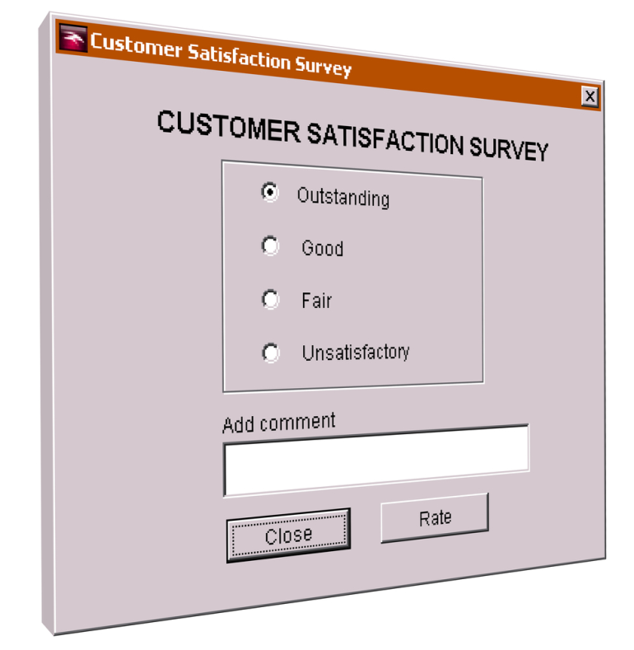
Basic Appraisal Methods
Management By Objectives (MBO)
Computerized and web-based performance appraisals
Electronic performance monitoring
Notes:
Management by Objectives (MBO) requires the manager to set specific measurable goals with each employee and then periodically discuss his/her progress toward these goals. The process consists of six steps: 1) set the organization’s goals; 2) set departmental goals; 3) discuss departmental goals; 4) mutually define expected results; 5) conduct performance reviews; and 6) provide feedback.
Computerized and Web-Based Performance Appraisal generally enables managers to keep notes on subordinates during the year, rate employees on a series of performance traits, and then generate written text to support each part of the appraisal. About one-third of employers use online performance management tools for at least some employees.
Electronic Performance Monitoring are systems used to allow managers access to their employees’ computers and telephones.

Slide 17
Basic Appraisal Methods
Management by Objectives (MBO) requires the manager to set specific measurable goals with each employee and then periodically discuss his/her progress toward these goals. The process consists of six steps:
set the organization’s goals;
set departmental goals;
discuss departmental goals;
mutually define expected results;
conduct performance reviews; and
provide feedback.
Computerized and Web-Based Performance Appraisal generally enables managers to keep notes on subordinates during the year, rate employees on a series of performance traits, and then generate written text to support each part of the appraisal. About one-third of employers use online performance management tools for at least some employees.
Electronic Performance Monitoring are systems used to allow managers access to their employees’ computers and telephones.

Slide 18
Coaching and Career Management After appraising performance, the manager typically faces several tasks. The employee may require coaching, career advice, and mentoring. The purpose of this section is to help you be more effective at coaching and mentoring employees, and at supporting career planning and talent management needs.
Notes:
After appraising performance, the manager typically faces several tasks. The employee may require coaching, career advice, and mentoring. The purpose of this section is to help you be more effective at coaching and mentoring employees, and at supporting career planning and talent management needs.

Slide 19
Coaching and Career Management
Improving your coaching skills
The basic coaching process
Preparing to coach
Planning
Active coaching
Follow-up
Notes:
Improving Your Coaching Skills — Coaching means educating, instructing, and training subordinates. Mentoring means advising, counseling, and guiding. Coaching focuses on teaching shorter-term job related skills, mentoring on helping employees navigate longer term career hazards.
The Basic Coaching Process — Preparing to coach involves understanding the problem, the employee, and his or her skills. Planning requires reaching consensus on the problem and what to change. Finally, once agreement is reached, educating, instructing, training, and ongoing encouragement are the important steps in the change process.

Slide 20
Coaching and Career Management
Improving Your Coaching Skills — Coaching means educating, instructing, and training subordinates. Mentoring means advising, counseling, and guiding. Coaching focuses on teaching shorter-term job related skills, mentoring on helping employees navigate longer term career hazards.
The Basic Coaching Process — Preparing to coach involves understanding the problem, the employee, and his or her skills. Planning requires reaching consensus on the problem and what to change. Finally, once agreement is reached, educating, instructing, training, and ongoing encouragement are the important steps in the change process.
Career management is the process of enabling employees to better understand and develop their career skill and interests and to use these skills and interests both within the company and even after they leave the firm.
Mentoring — Having a mentor — a senior person in the firm who can be a sounding board for your career questions and concerns — can enhance career satisfaction and success.
The Employee’s Role — An individual must accept responsibility for his/her own career; assess his/her own interests, skills, and values; and take the steps required to ensure a happy and fulfilling career. Finding a mentor who can be a sounding board is often helpful. Mentoring programs can be informal or formal.
The Employer’s Role — Employers can support career development efforts in many ways. There are several organizational career planning practices. The means for helping to further an employee’s career depends on the length of time the employee has been with the firm.

Slide 21
Performance Management Earlier in this chapter, we said that performance management is the continuous process of identifying, measuring, and developing the performance of individuals and teams and aligning their performance with the organization’s goals. In this section, we will look at performance management more closely.
Notes:
Earlier in this chapter, we said that performance management is the continuous process of identifying, measuring, and developing the performance of individuals and teams and aligning their performance with the organization’s goals. In this section, we will look at performance management more closely.

Slide 22
Performance Management
Performance management vs. performance appraisal
Using IT to support performance management
Improving productivity through HRIS
Notes:
Performance management vs. Performance Appraisal refers to an ongoing process of deciding upon goals, evaluating results, and providing feedback. It is always goal-directed. We can summarize performance management’s six basic elements as follows:
Direction sharing
Goal alignment
Ongoing performance monitoring
Ongoing feedback
Coaching and developmental support
Recognition and rewards
Using Information Technology to Support Performance Management allows the supervisor to assign financial and nonfinancial goals to each team’s activities and to keep all employees informed of their goals. Special performance management software then shows a real-time overview of each team’s performance.
Talent Management Practices and Strategic Employee Appraisals
Appraising and Actively Managing Employees — Several examples of strategically managing employees performance and value to the organization are provided.
Segmenting and Actively Managing Employees in Practice — Compass Group, Tesco PLC, McKinsey Consulting, and others are highlighted as examples.

Slide 23
Performance Management
Performance management vs. Performance Appraisal refers to an ongoing process of deciding upon goals, evaluating results, and providing feedback. It is always goal-directed. We can summarize performance management’s six basic elements as follows:
Direction sharing
Goal alignment
Ongoing performance monitoring
Ongoing feedback
Coaching and developmental support
Recognition and rewards
Using Information Technology to Support Performance Management allows the supervisor to assign financial and nonfinancial goals to each team’s activities and to keep all employees informed of their goals. Special performance management software then shows a real-time overview of each team’s performance.
Talent Management Practices and Strategic Employee Appraisals
Appraising and Actively Managing Employees — Several examples of strategically managing employees performance and value to the organization are provided.
Segmenting and Actively Managing Employees in Practice — Compass Group, Tesco PLC, McKinsey Consulting, and others are highlighted as examples.

