Slide 1
Development Across the Life Span
Developmental Psychology
Although there is no any limits in human development as a connected process, However the scientists have put certain conceptions of this growth and divide it into stages for the purpose of study.
Neonatal Period
Infancy
Early childhood
Middle childhood
Adolescence
adulthood

Slide 2
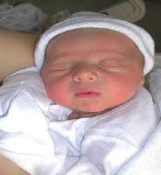
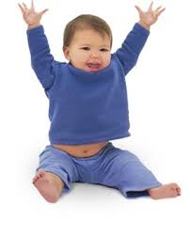
Development Across the Life Span
Developmental Psychology
Neonatal Period
Infancy

Slide 3
Neonatal period
Developmental Psychology
First two weeks of life
Marks transition from womb to independence
Reflexively grasps anything placed in hand
Weight: from 2.5 kg to 3.5 kg
Height: about 50 cm
Head size seems larger than the size of the chest
Can distinguish between usual and the new stimuli

Slide 4
Infancy
Developmental Psychology
Infancy
Age: 2 weeks until 2 years
Time of rapid physical, perceptual, cognitive, linguistic, social, and emotional growth
During sensorimotor stage – infants stare at interesting visual stimuli
Preference for human faces

Slide 5
Infancy
Developmental Psychology
Infancy
Physical & sensory development
Motor development
Language development
Cognitive development
Emotional and social development

Slide 6
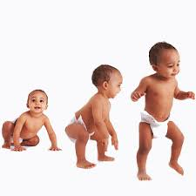
Physical and sensory development
Developmental Psychology
Infancy
Increase the height and weight
Increased bone and muscle growth
Temporary teething
Increased respiratory and digestive growth
The rapid growth in the nervous system
The rapid growth of sensory functions such as sight, hearing and touch

Slide 7
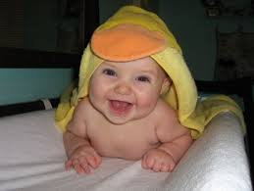
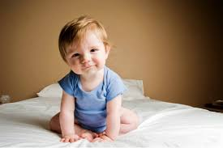
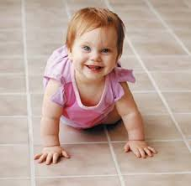
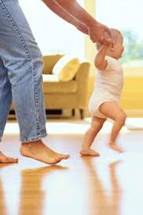
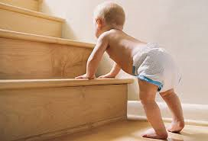
Motor development
Developmental Psychology
Infancy
Age in months | Motion
1 : 2 | Raising head
2 : 3 | Raising chest
4 : 5 | Versatility
4 : 6 | Sitting with help
7 | Sitting without help
5 : 6 | Crawling
5 : 10 | Toddler
7 : 12 | Standing with help
9 : 11 | Walking with help
12 | Standing without help
12 : 13 | Climbing stairs
11 : 15 | Walking without help
12 : 20 | Walking to the side & behind
15 : 24 | Throwing things

Slide 8
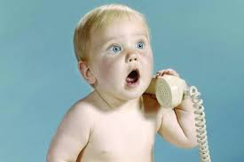
Language development
Developmental Psychology
Infancy
Age in months | stage
1 | Random voices
2 : 8 | Semi – regular voices
12 : 13 | Imitate voices
13 | Talking

Slide 9
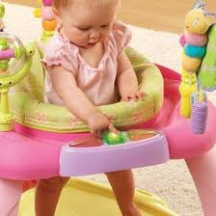
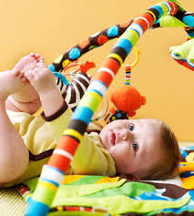
Cognitive development
Developmental Psychology
Infancy
Uses senses and motor skills
Move towards a particular goal
Discrimination stimuli
Concentration and attention are weak
Poor memory, visualization and imagination

Slide 10
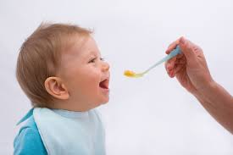
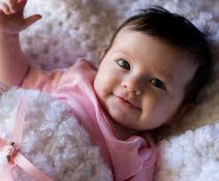
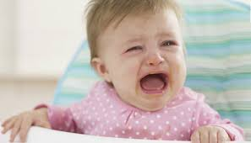
Emotional and social development
Developmental Psychology
Infancy
Strong attachments formed between infants and caregivers
Preference for human faces
Separation anxiety
Fear of strangers
Trust VS. Mistrust

