Slide 1


Dictionary Structure

Slide 2
Levels of Dictionary Structure
Megastructure
( The Framing Structure)
Front Matter
Main Body
Back Matter
Macrostructure
Microstructure

Slide 3
Front Matter
Table of contents
Preface/Forward
Instructions
Grammatical Information

Slide 4
Table of Contents
contains the main sections as enumerated in the Dictionary.

Slide 5
Preface/Forward
The purpose of the dictionary.
The intended user-group.
The data that the dictionary is based on and the limitations following from it.
Modifications of earlier editions.

Slide 6
Instructions/Introduction
How to use the dictionary.
The macrostructure: the principles of lemmatization and the selection of lemmas (selecting and including headwords in a dictionary); the organization of the headwords in the dictionary.
The microstructure and each of its components

Slide 7
Grammatical Information
Grammatical codes and patterns.

Slide 8
Back Matter
Transliteration Tables
Conversion Tables
Abbreviations
Grammar codes
Bibliography
Symbols

Slide 9
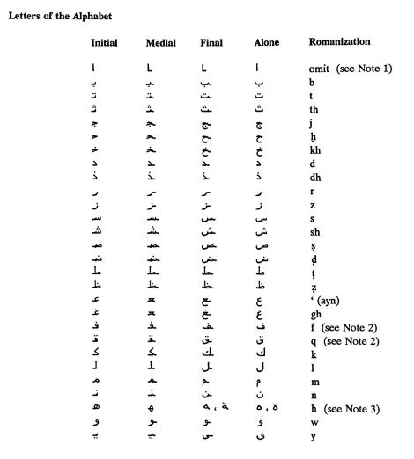
Transliteration Table

Slide 10
Maps

Slide 11
Abbreviations
Abbreviations :
- Short Forms: sth, sb, E-east, W-west
adj, adv, n, phr v, prep, pron, v
-Labels:
• Words which are used mainly or only in one region or
country: Am E, Br E, Can E, Ind E
• Words which are used in English but they are still
borrowings for they are not completely assimilated:
French, Latin, Greek

Slide 12
Labels
Words which are used in a particular situation, or
Show a particular attitude: formal, informal, humorous
Of particular context: biblical, old-fashioned, old use, taboo, medical, technical

Slide 13
Symbols
|| – separates pronunciation in Britain and in
USA: [' klα:s] || [klæs]
' – main stress
► – stress shift
[ ] – transcription of the headword
~ to substitute for a headword or initial form of a word in compounds, e.g. - sleeping: ~ bag, ~ car, ~ pill
◊ rhomb(us) is used for idioms or phraseological units

Slide 14
Grammar Code
[C] – countable
[U] – uncountable
[always+adv/prep] shows that a verb must be followed by an adverb or a preposition: She went upstairs |Robert put the letter in his briefcase.

Slide 15
Other Components
Index : an alphabetical list of expressions of a certain category, each provided with a reference either to a page number or to a dictionary article
encyclopedic subsections

Slide 16
Macrostructure of a Dictionary
The macrostructure is the list and organization of lexical items entered in a dictionary. It is the principle of the order of the entries (lemmas or headwords). E.g. Alphabetically.

Slide 17
Microstructure
The organization of the dictionary Entry
Some information provided are:

Slide 18
Pronunciation symbols
International Phonic Alphabets (IPA) vs American Heritage Dictionary (AHD):

Slide 19
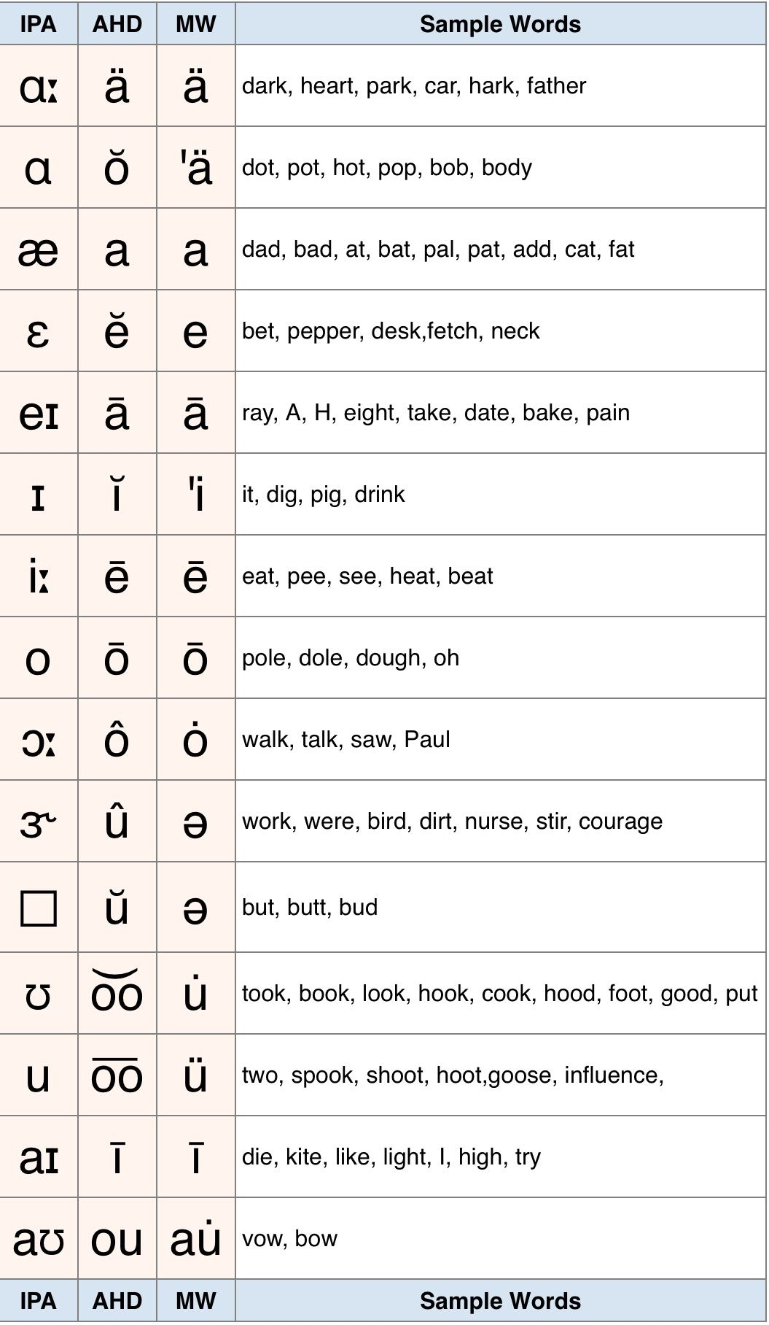

Slide 20
Part of Speech
Adjective - adj.
Adverb - adv.
Conjunction - conj.
Interjection - injer.
Noun - n.
Preposition - prep.
Pronoun - pron.
Verb - v

Slide 21
Conjugation
The variation of the form of a verb in an inflected language such as Latin, by which are identified the voice, mood, tense, number, and person.
“It was the conjugation of verbs he found most difficult"

Slide 22
Definitions
Multiple definitions are numbered
Grouped according to the part of speech they apply to
Ordered according to their use or prevalence

Slide 23
The Part of Speech Variations
lu’di∙crous∙ly adv. –lu’di∙crous∙ness n.
Note: - each variation is introduced by a dash
- the stress and syllable marks are included
- variations do not have their own entries

Slide 24
Etymology
The Word’s Origins
E.g. Sergeant - [< L servus, slave.] (The Concise American Heritage Dictionary (1997, p.638))
Multiple Entries
Poser1 - (pōz ər) n. One who poses. (1885)
Poser2 - (pōz ər) n. A baffling question. (1580)
(The Concise American Heritage Dictionary (1997,
p.550))

Slide 25
Level of Formality
formal, informal, slang, archaic, rare, regional

Slide 26
Field of Relevance
MONEY
GREETINGS
GAMES
COMPUTER
BUSINESS

Slide 28
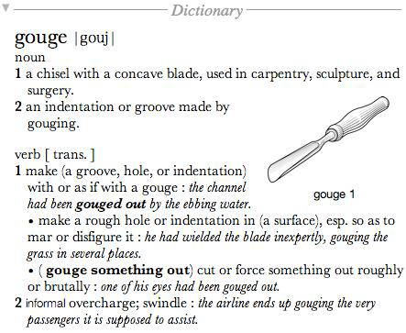
The New Oxford American
Dictionary

Slide 30
The American Heritage
Dictionary

Slide 31
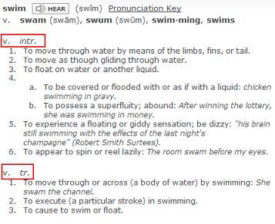
The American Heritage Dictionary

Slide 32
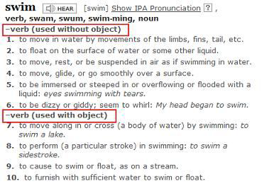
Dictionary.com

Slide 34
Cambridge advanced learner’s dictionary on CD-ROM

Slide 35
Oxford advanced learner’s compass

Slide 36
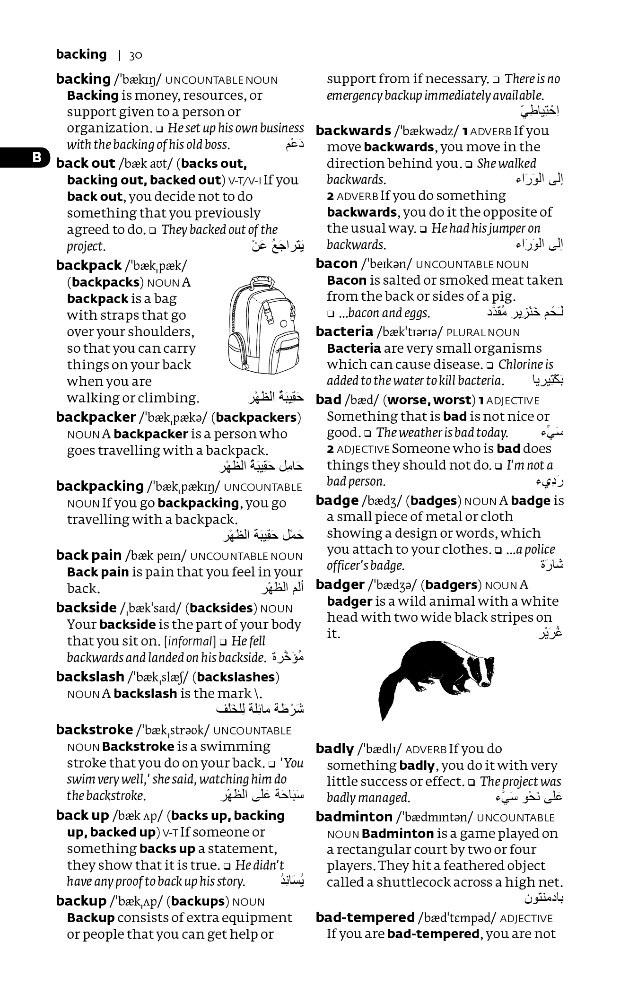
Arabic-English dictionary

Slide 37
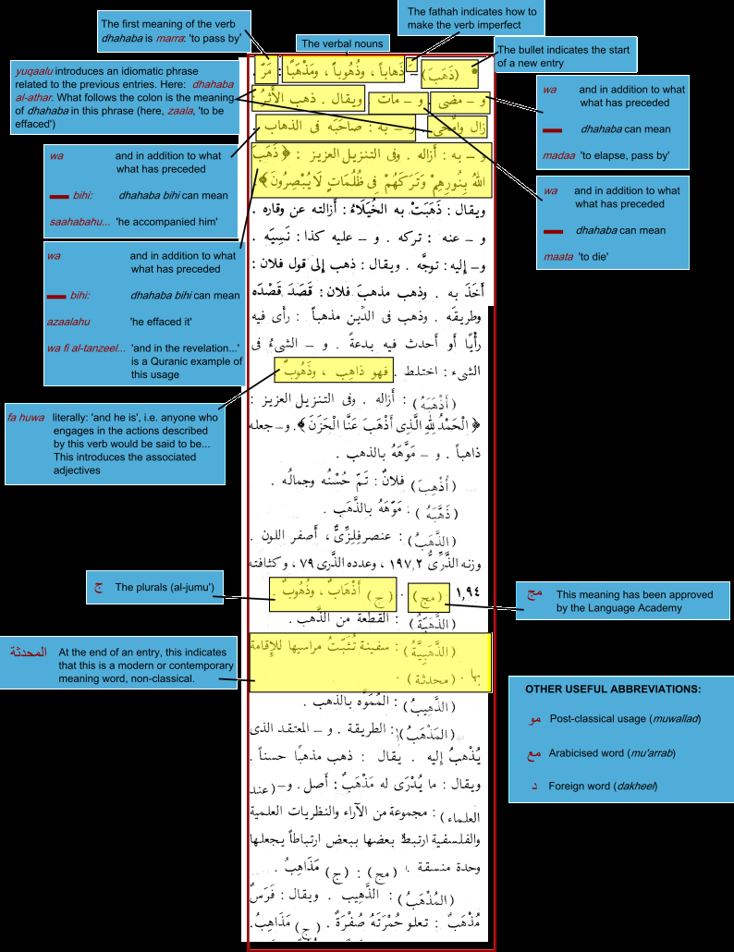
المعجم الوسيط

Slide 38
Reference structure
To one of the main sections
Out of the dictionary
Inside the article
Between articles

