Slide 1
Discrete Mathematics and Its Applications
1 The Foundations: Logic and Proofs ........................................................... 1
1 . 1 Propositional Logic . . . . . . . . . .. . . . . . . . . . . . . . . . . . . . . . . . . . . . . . . . . 1
1 .2 Propositional Equivalences . . . . . . . . . . . . . . . . . . . . . . . . . .. . . . . . . . . 2 1
1 .3 Predicates and Quantifiers . . . . . . . . . . . . . . . .. . . . . . . . . . . . . . . . . . . . 30
1 .4 Nested Quantifiers . . . . . . . . . . . . . . . . ... . . . . . . . . . . . . . . . . . . . . . . . . 50
1 .5 Rules of Inference . . . . . . . . . . . . . . . . . . . . . . . . . . . . . . . . . . . . . . . . . . 63
1 .6 Introduction to Proofs . . . . . . . . . . . . . . . . . . . . . . . . . . . . . . . . . . . . . . . 75
1 .7 Proof Methods and Strategy . . . . . . . . . . . . . . . . . . . . . . . . . . . . . . . . . . 86
End-of-Chapter Material . . . . . . . . . . . . . . . . . . . . . . . . . . . . . . . . . . . . . . . 1 04

Slide 2
Introduction to Logic
1.1 Propositional Logic
Propositions
A proposition is a declarative sentence (that is, a sentence that declares a fact) that is either true or false, but not both.

Slide 3
EXAMPLE l All the following declarative sentences are propositions.
1 . Washington, D.C., is the capital of the United States of America.
2 . Toronto is the capital of Canada.
3. 1 + 1 =2
4. 2 + 2 = 3

Slide 4
Some sentences that are not propositions are given in Example 2 .
EXAMPLE 2 Consider the following sentences.
1 . What time is it?
2 . Read this carefully.
3 . x + 1 = 2 .
4 . x + y = Z.

Slide 5
The truth value of a proposition is true, denoted by T, if it is a true proposition and false, denoted by F, if it is a false proposition.

Slide 6
The area of logic that deals with propositions is called the propositional calculus or propositional logic.
New propositions, called compound propositions, are formed from existing propositions using logical operators.

Slide 7
DEFINITION 1 Let p be a proposition. The negation of p, denoted by ¬p (also denoted by p), is the statement
"It is not the case that p."
The proposition ¬ p is read "not p." The truth value of the negation of p, - p, is the opposite of the truth value of p.

Slide 8
EXAMPLE 3 Find the negation of the proposition
"Today is Friday.“ and express this in simple English.
Solution:

Slide 9
EXAMPLE 4 Find the negation of the proposition
"At least 10 inches of rain fell today in Miami."
and express this in simple English.
Solution:

Slide 10
Remark: Strictly speaking, sentences involving variable times such as those in Examples 3 and 4 are not propositions unless a fixed time is assumed. The same holds for variable places unless a fixed place is ssumed and for pronouns unless a particular person is assumed. We will always assume fixed times, fixed places, and particular people in such sentences unless otherwise noted.

Slide 11
Table 1 displays the truth table for the negation of a proposition p.
The Truth Table for the Negation of a Proposition.
p ¬ p
T F
F T

Slide 12
The negation of a proposition can also be considered the result of the operation of the negation operator on a proposition.
The negation operator constructs a new proposition from a single existing proposition. We will now introduce the logical operators that are used to form new propositions from two or more existing propositions. These logical operators are also called connectives.

Slide 13
DEFINITION 2
Let p and q be propositions. The conjunction of p and q, denoted by p /\ q, is the proposition "p and q ." The conjunction p /\ q is true when both p and q are true and is false otherwise.

Slide 14
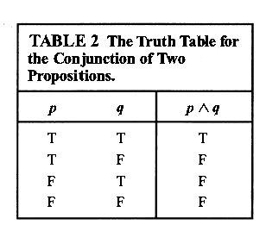

Slide 15
EXAMPLE 5 Find the conjunction of the propositions p and q where p is the proposition "Today is Friday"
and q is the proposition "It is raining today."

Slide 16
Solution: The conjunction of these propositions, p /\ q, is the proposition "Today is Friday and it is raining today." This proposition is true on rainy Fridays and is false on any day that is not a
Friday and on Fridays when it does not rain.

Slide 17
DEFINITION 3
Let p and q be propositions. The disjunction of p and q, denoted by p V q, is the proposition
"p or q ." The disjunction p V q is false when both p and q are false and is true otherwise.
A disjunction is true when at least one of the
two propositions is true.

Slide 18
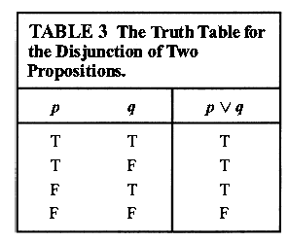

Slide 19
EXAMPLE 6
What is the disjunction of the propositions p and q where p is the proposition "Today is Friday“ and q is the proposition "It is raining today.“
Solution:

Slide 20
Conditional Statements
DEFINITION 5
Let p and q be propositions. The conditional statement $p→q$ is the proposition "if p, then q ." The conditional statement $p→q$ is false when p is true and q is false, and true otherwise.
In the conditional statement $p→q$ , p is called the hypothesis (or antecedent or premise) and q is called the conclusion (or consequence)

Slide 21
The statement $p→q$ is called a conditional statement because $p→q$ asserts that q is true
on the condition that p holds. A conditional statement is also called an implication.
statement $p→q$ is true when both p and q are true and when p is false (no matter what truth value q has).

Slide 23
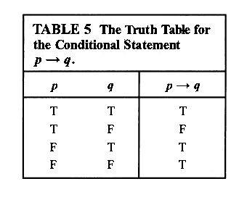

Slide 24
CONVERSE, CONTRAPOSITIVE, AND INVERSE
We can form some new conditional statements starting with a conditional statement p → q .
In particular, there are three related conditional statements that occur so often that they have special names.
1/ The proposition q → p is called the converse of p → q .
2/ The contrapositive of p → q is the proposition -q → -p.
3/ The proposition -p → -q is called the inverse of p → q.
We will see that of these three conditional statements formed from p → q , only the contrapositive always has the same truth
value as p → q .

Slide 25
When two compound propositions always have the same truth value we call them equivalent,
so that a conditional statement and its contrapositive are equivalent
The converse and the inverse of a conditional statement are also equivalent, but neither is equivalent to the original conditional statement

Slide 26
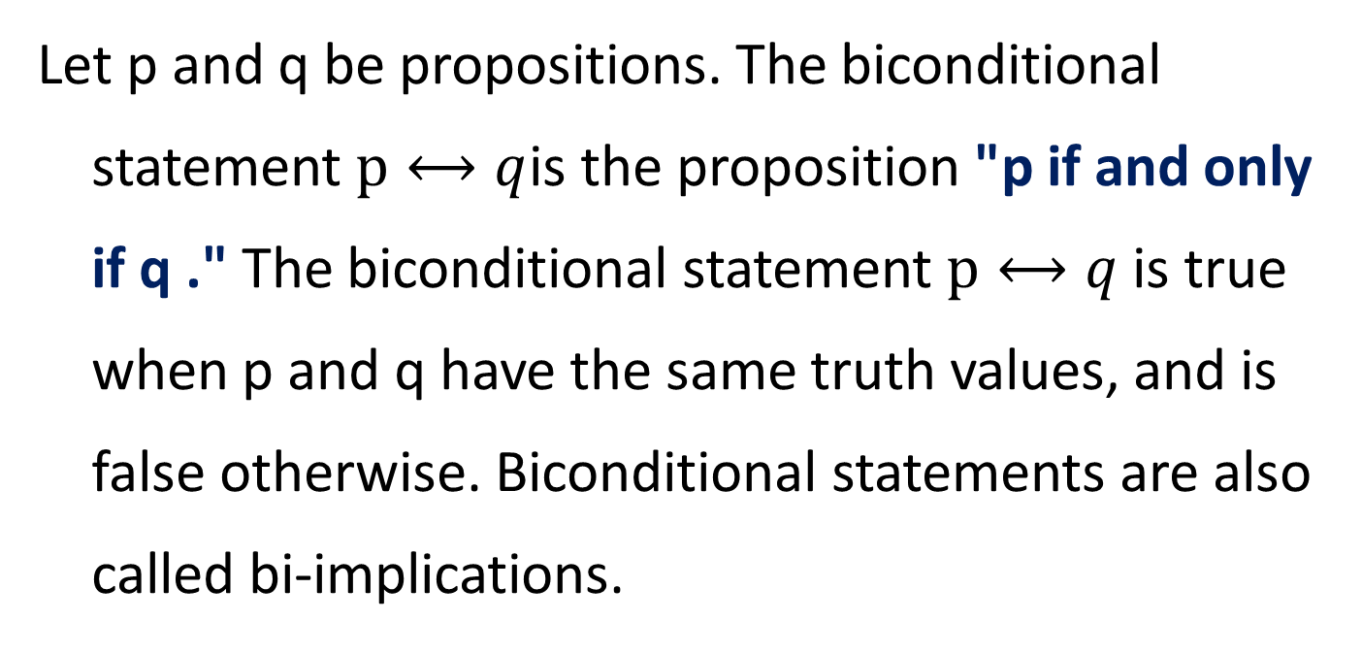
BICONDITIONALS
Let p and q be propositions. The biconditional statement $p⟷q$is the proposition "p if and only if q ." The biconditional statement $p⟷q$is true when p and q have the same truth values, and is false otherwise. Biconditional statements are also called bi-implications.

Slide 27
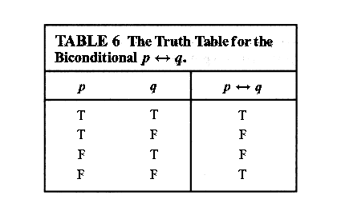

Slide 28
"p is necessary and sufficient for q "
"if p then q , and conversely"
"p iff q ."

Slide 29
Truth Tables o f Compound Propositions

Slide 30
Homework
Page 16
1 (c,e,f)
3 (a,c)
4 (a,b,c,d,g)
27 (a,d,e)
32 (e)
33 (a)

