Slide 1
ORL Course OSCE Test Example
See Comment Section for Answers

Slide 2
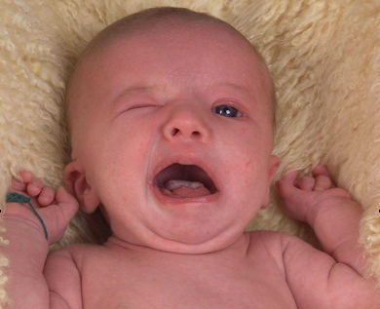
Case 1
1 day old product of forceps delivery.
A) What is the diagnosis?
B) Which side been affected?
Notes:
Answers: A) Facial (VII) nerve weakness
B) Left

Slide 3
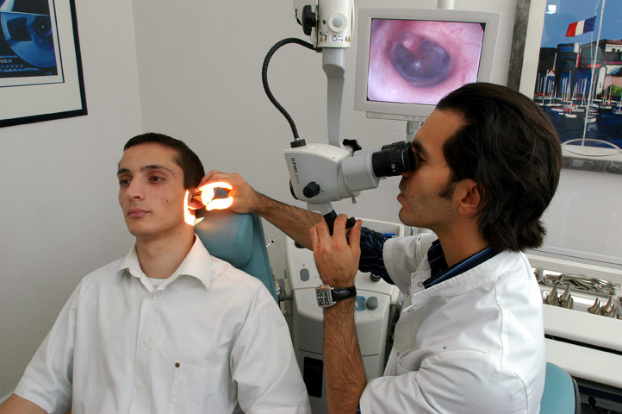
Case 2
A) What is this exam?
B) What are 3 advantages?
Notes:
Answers: A) Ear microscope
B) Magnification, Binocular vision for depth perception, both hands are free to handle instruments and suction

Slide 4
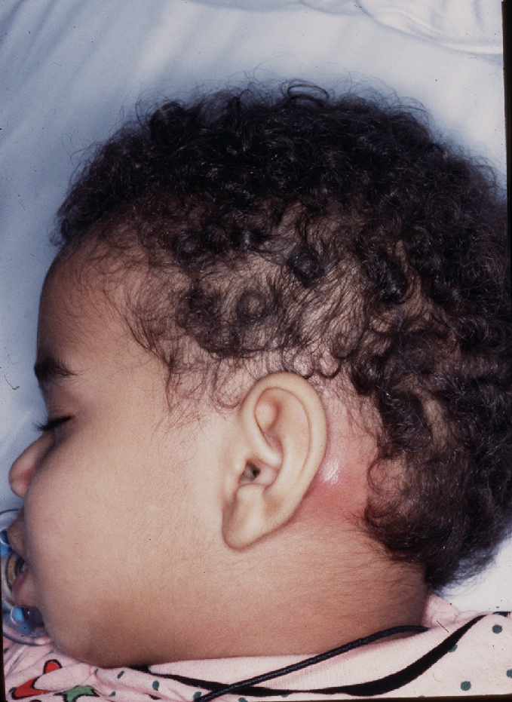
Case 3
This 2-year old child has history of upper tract infection which resulted in discharging ear and severe pain.
What is the possible diagnosis?
How do you manage such child?
Notes:
Answers: A) Left Mastoiditis
B) 1. Medical management: Admission to hospital + IV antibiotic which cross the blood brain barrier (e.g. ceftriaxone) & otic antibiotic drops+ Hydration and analgesia
2. Surgical options to be considered if medical management is failing
a. Grommet insertion b. cortical mastoidectomy

