Slide 1
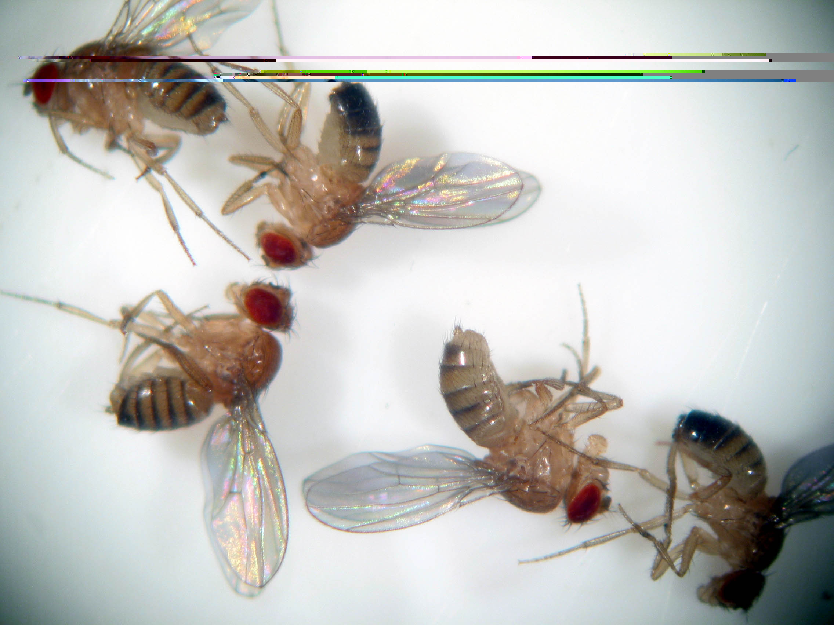
Getting to know the Fruit Fly
Drosophila melanogaster

Slide 2
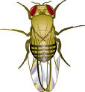
Drosophila Melanogaster, a popular genetic model organism
~ 50% of fly genes have vertebrate homologs
Small and easy to grow in lab
Short generation time
Produce high amounts of offspring

Slide 3
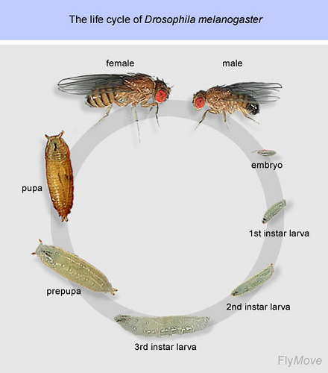
Identify the different stages of Drosophila development

Slide 4
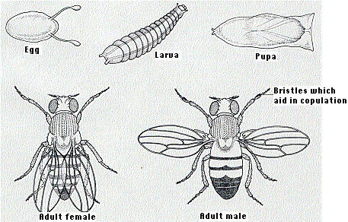
Identify the different stages of Drosophila development
The embryo: Embryos are small, oval shaped, and have two filaments at one end.
The larval stage: The larva look like worms. They use black mouth hooks to eat. Three larval stages.
The pupal stage: A pupa undergoes four days of metamorphosis. They form a hard and dark pupal case.
The adult stage: Adult flies have a head, thorax, abdomen, six legs, and two wings. They live a month or more and then die. A female does not mate for 10-12 hours after emerging from the pupa.
Notes:
4

Slide 5
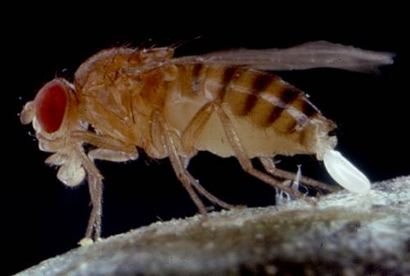
Egg Laying in D. melanogastor

Slide 6
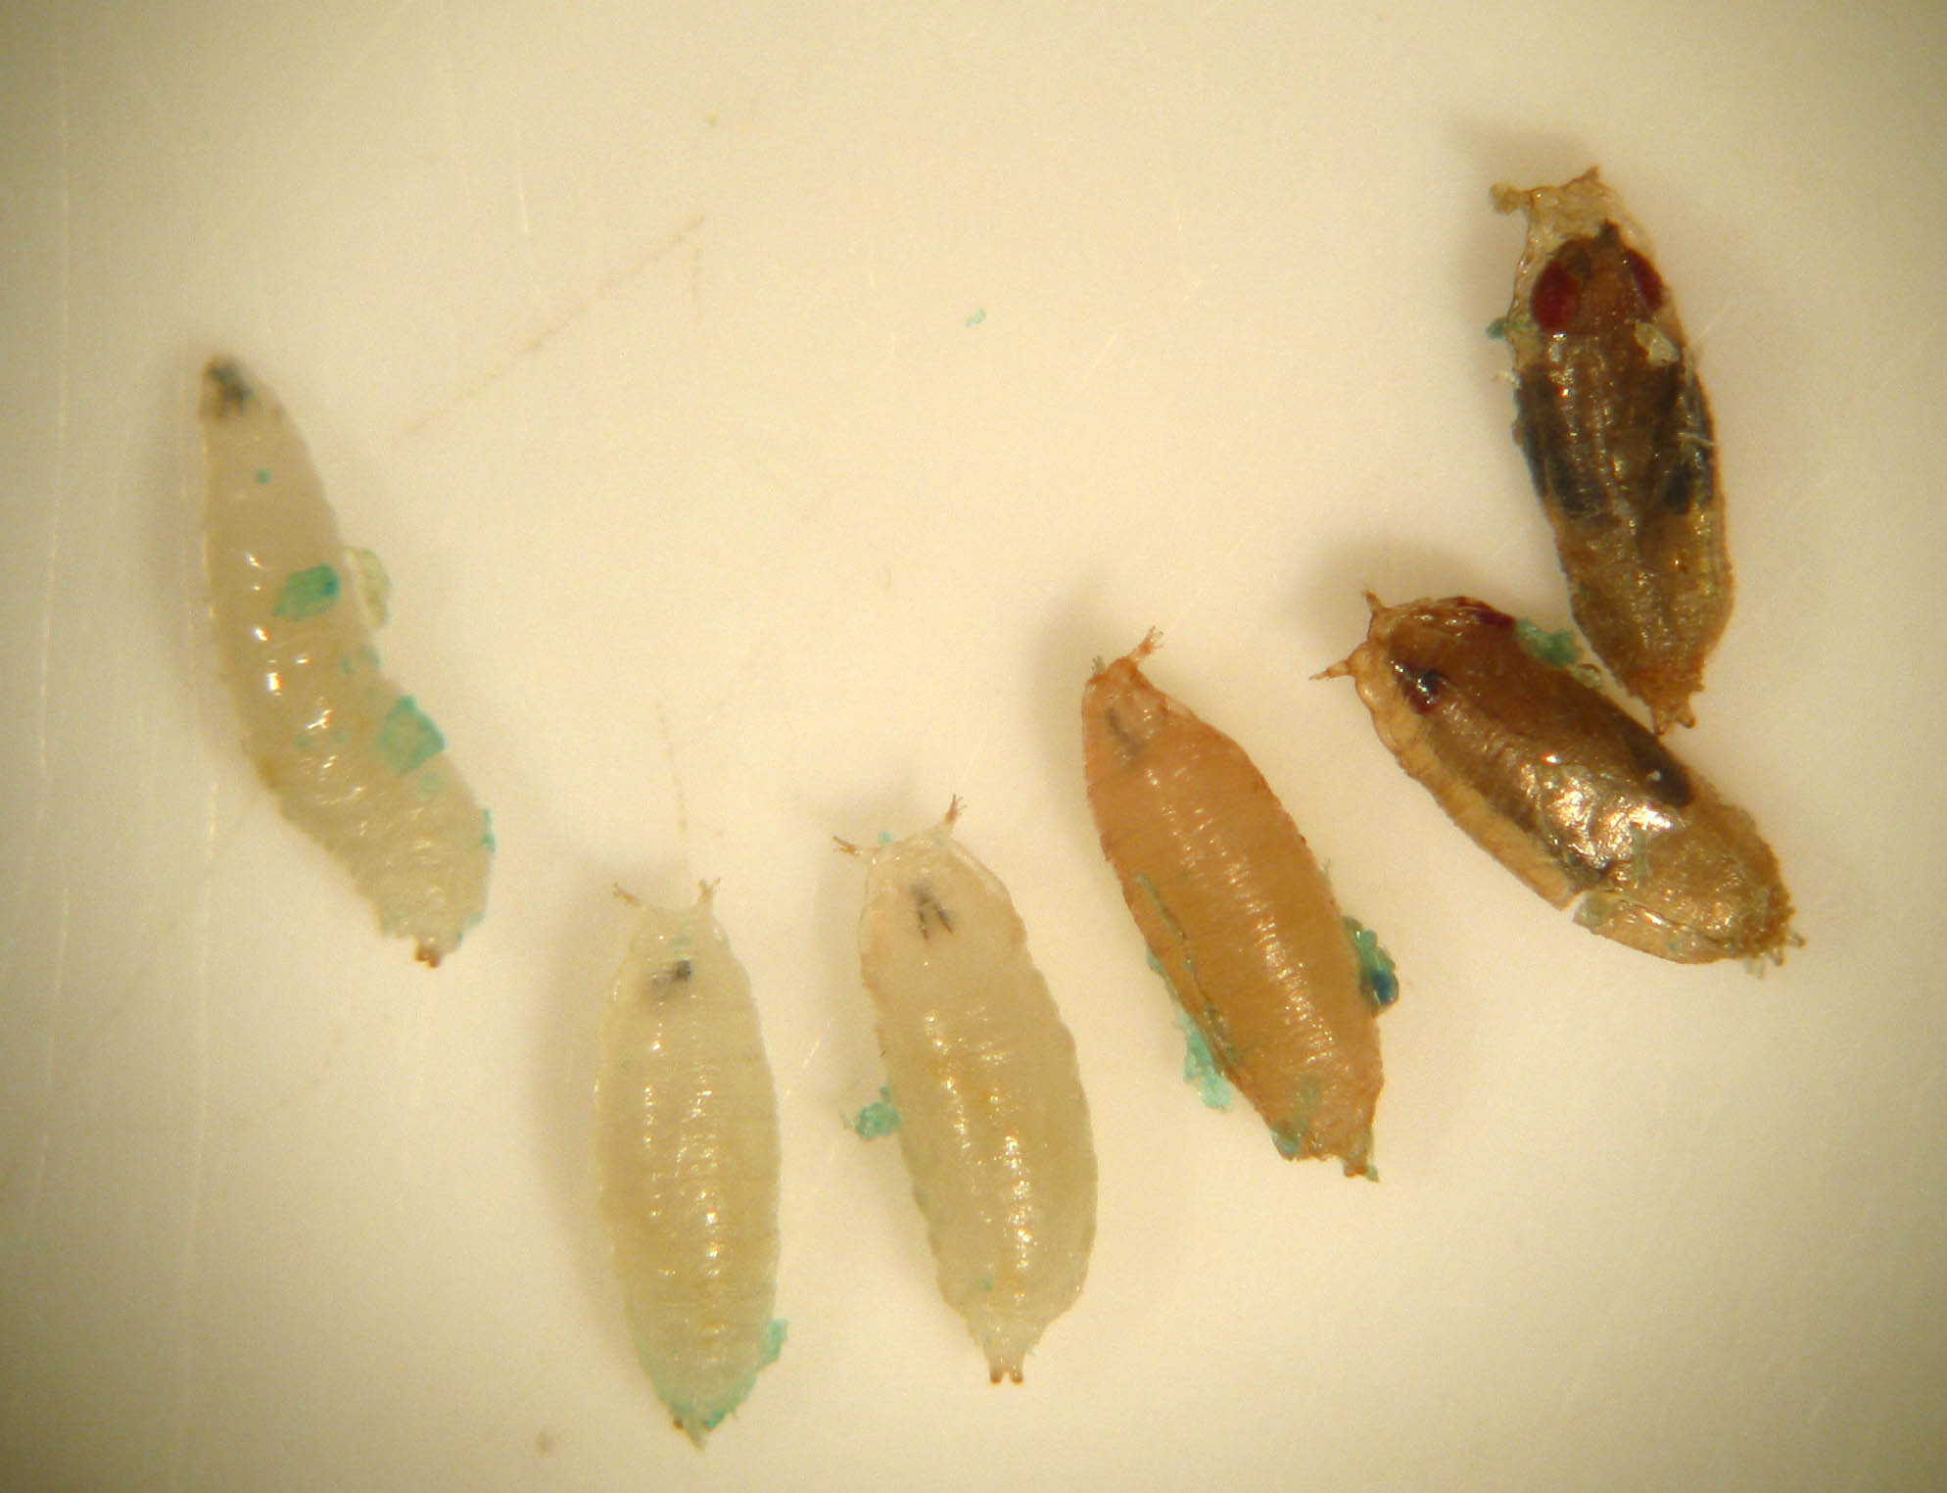
Larva to Pupa Stages
Larvae are mobile
Pupal
stages
With the onset of pupation the worm-like larva contracts and a
parchment-like pupa case hardens around the metamorphosing fly.

Slide 7
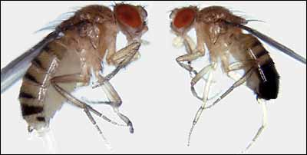
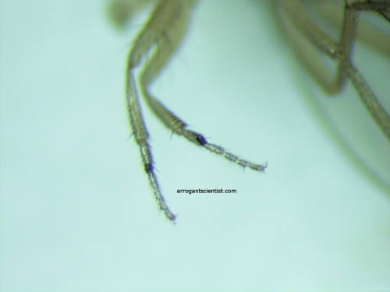
Identify males versus females
1. Size of adult The female is larger than the male.
2. Shape of abdomen The female abdomen curves to a point; the male abdomen is round
3. Markings on the abdomen Alternating dark and light bands can be seen on the entire rear portion of the female; the last few segments of the male are fused.
4. Appearance of sex comb On males there is a tiny tuft of hairs on the front legs.
5. External genitalia on abdomen Located at the tip of the abdomen, the ovipositor of the female is pointed. The claspers of the male are darkly pigmented, arranged in circular form, and located just ventral to the tip.
sex comb

Slide 8
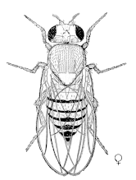
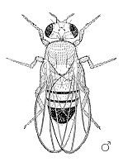
Female Male

Slide 9
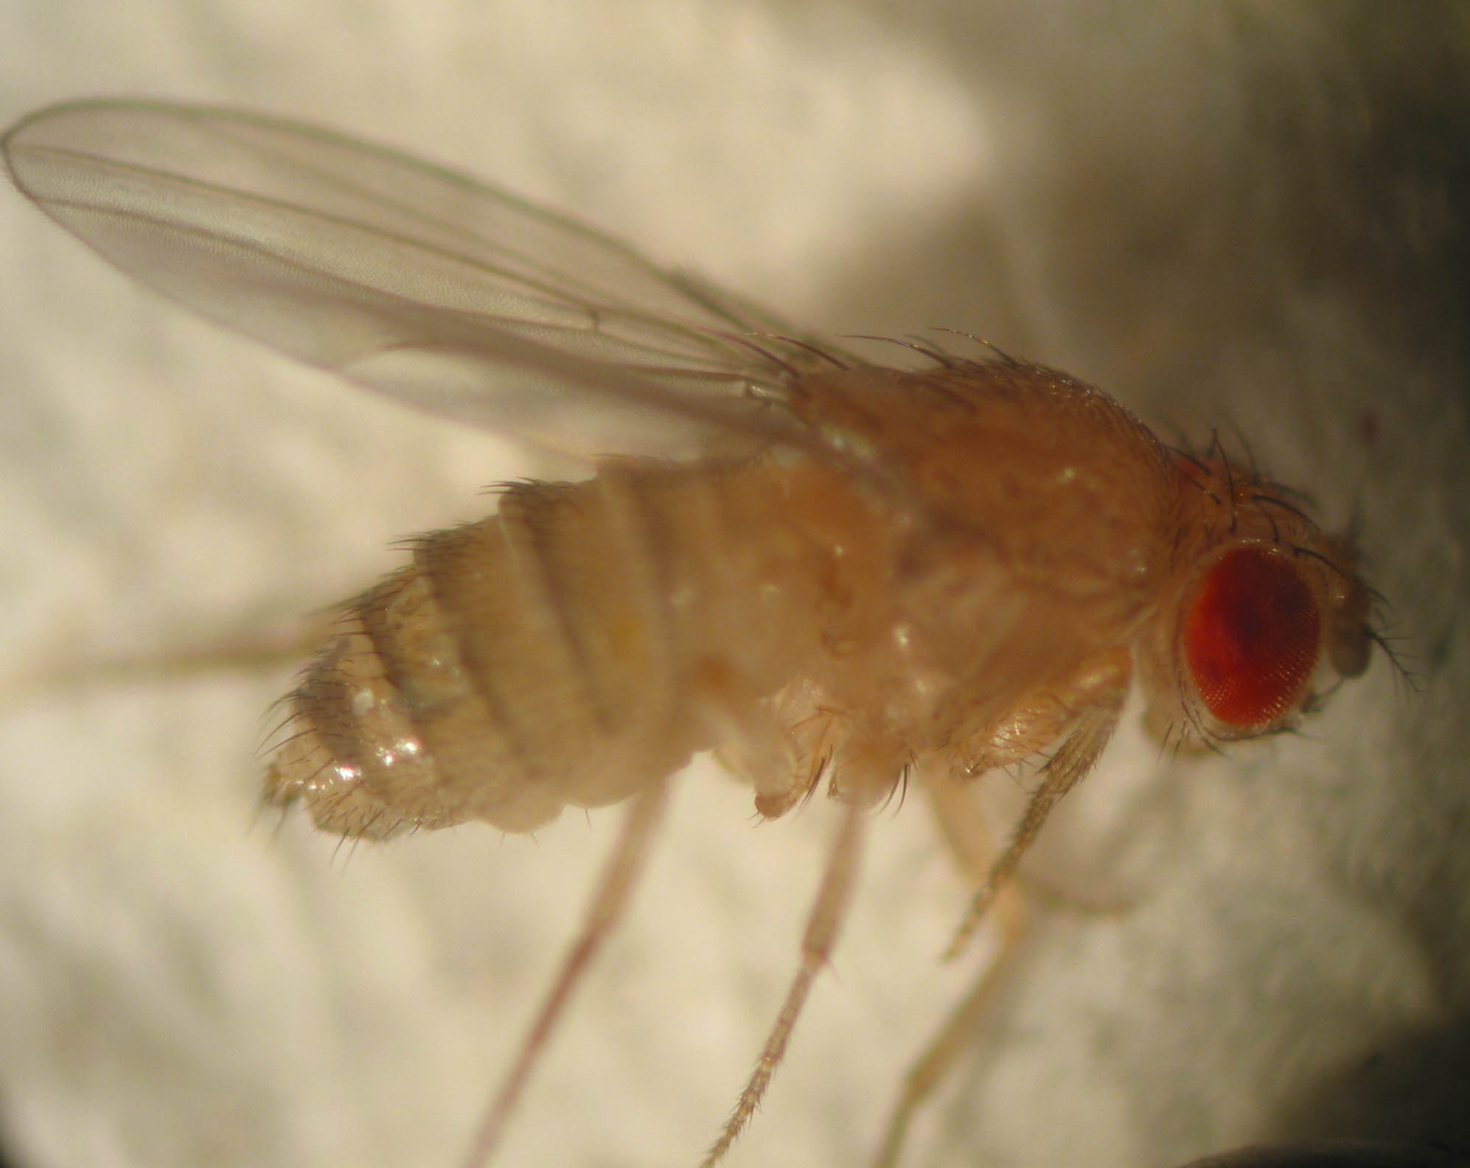
This is a *female* fruit fly
Notice the tiger-striped abdomen and the
simple tag-like tip on the abdomen.

Slide 10
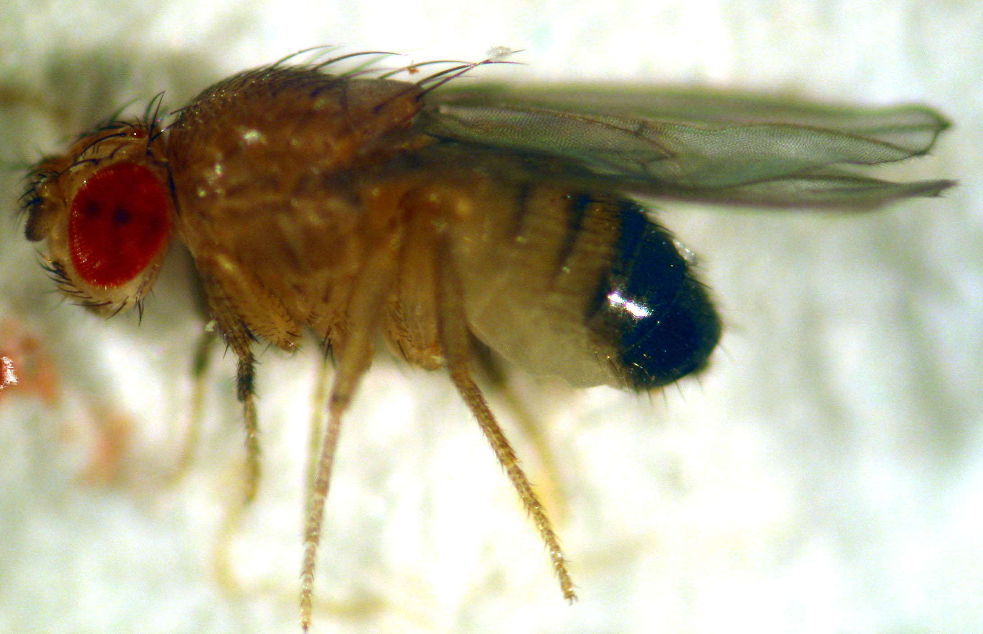
This is a mature male fruit fly
Mature males have a prominent black abdominal end.
Males also have tiny “sex combs” on their front pair of legs.

Slide 11
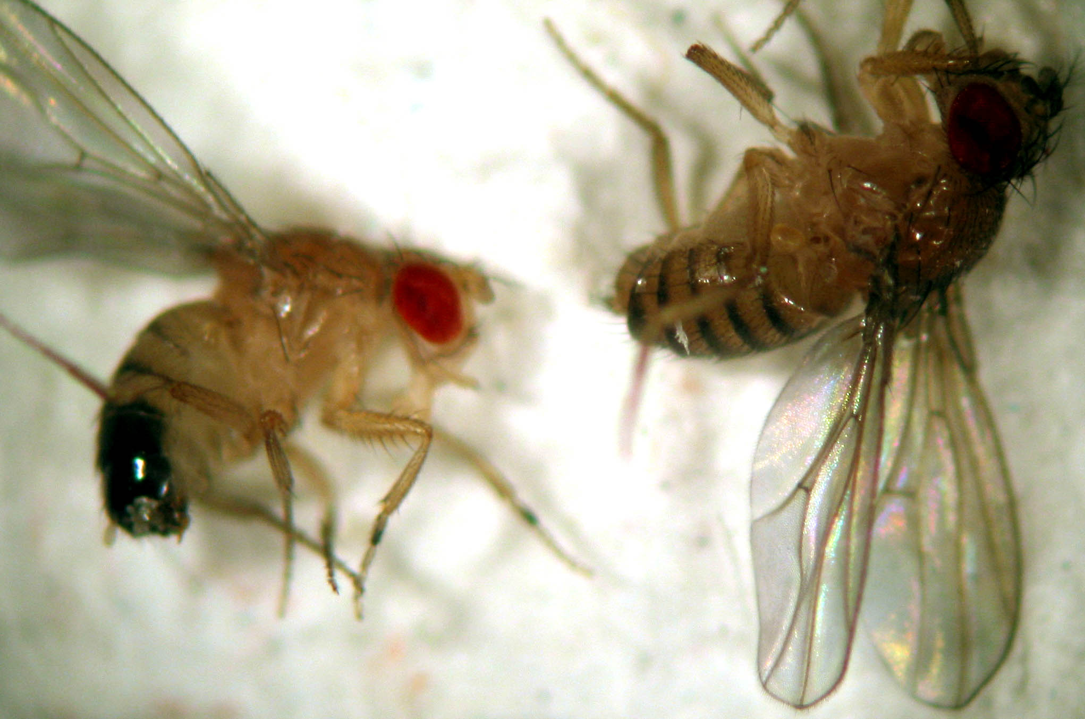
One male and one female
Find their distinguishing features.

Slide 12
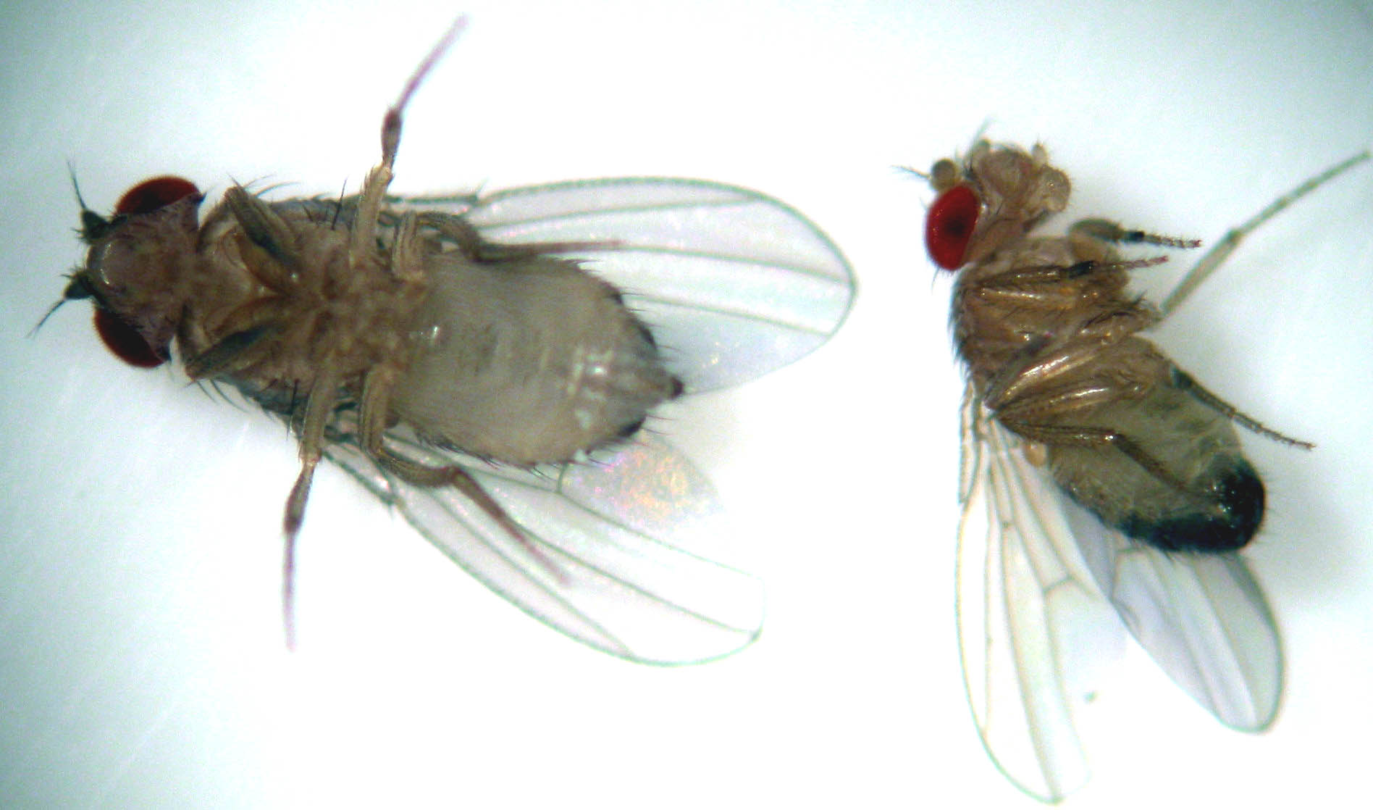
Ventral view of a male and female
Find their distinguishing features

Slide 13
Drosophila Use in Genetic Research
Drosophila specimens are well suited to investigations into Mendelian patterns of inheritance
Drosophila are small, produce large numbers of offspring, have many easily discernible mutations, have only four pairs of chromosomes, and complete their entire life cycle in approximately 12 days.
Drosophila are relatively easy to maintain, as they are hardy and have simple food requirements.
Chromosomes 1 (the X chromosome), 2, and 3 are very large, and the Y chromosome—number 4—is extremely small.
Thousands of genes reside on these four chromosomes, many of which are universal in nature, existing in most eukaryotic forms, including humans.

Slide 14
The Drosophila Genome
3 sets of autosomes
  2 and 3 - large metacentric chromosome
  4 - very small telocentric chromosome
X/Y sex Chromosomes
  X is a large telocentric chromosome

Slide 15
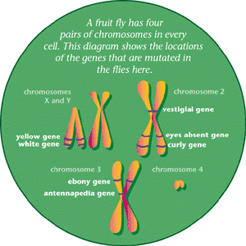
Fruit Flies Have 4 Pair of Chromosomes

Slide 16
THANK YOU

