Slide 1
Understanding the Global Context of Business
4

Slide 2
Introduction
This chapter explores the global context of business with:
  major world marketplaces and trade agreements
  factors that help determine how countries and businesses respond to international opportunities and challenges.
  decisions managers must make if they intend to compete in international markets.
  social, cultural, economic, legal, and political factors that affect international business.

Slide 3
Discuss the rise of international business and describe the major world marketplaces, trade agreements, and alliances.
Explain how differences in import-export balances, exchange rates, and foreign competition determine the ways in which countries and businesses respond to the international environment.

Slide 4
Discuss the factors involved in deciding to do business internationally and in selecting the appropriate levels of international involvement and international organizational structure.
Explain the role and importance of the cultural environment in international business.
Describe some of the ways in which economic, legal, and political differences among nations affect international business.

Slide 5
The Contemporary Global Economy
Globalization
  process by which the world economy is becoming a single interdependent system
Import
  product made or grown abroad but sold domestically
Export
  product made or grown domestically but shipped and sold abroad
Notes:
As more firms engage in international business, the world economy is fast becoming an interdependent system though a process called globalization.
We often take for granted the diversity of products we can buy as a result of international trade. Your television, your shoes, and even your morning coffee or juice are probably imports, products made or grown abroad and sold domestically in the United States. At the same time, the success of many U.S. firms depends on exports, products made or grown here, such as machinery, electronic equipment, and grains, and shipped for sale abroad.

Slide 6
The Contemporary Global Economy (cont.)
Governments and businesses are more aware of the benefits of globalization to businesses and shareholders
New technologies have made international travel, communication, and commerce faster and cheaper than ever
Sometimes a firm must expand into foreign markets simply to keep up with competitors

Slide 7
Distinctions Based on Wealth
High-income countries
Upper-middle-income countries
Lower-middle-income countries
Low-income countries
Notes:
High-income countries. Those with annual per-capita income greater than $11,115.
Upper-middle-income countries. Those with annual per-capita income of $11,115 or less but more than $3,595.
Lower-middle-income countries. Those with annual per-capita income of $3,595 or lower but more than $905.
Low-income countries (often called developing countries). Those with annual per-capita income of $905 or less.

Slide 8
Global Clusters
North America
Europe
Pacific Asia
Notes:
Geographic Clusters: The world economy revolves around three major marketplaces: North America, Europe, and Pacific Asia. In general, these clusters include relatively more of the upper-middle and high-income nations but relatively few low- and lower-middle-income countries.
As the world’s largest marketplace and most stable economy, the United States dominates the North American market. Canada also plays a major role in the international economy, and the United States and Canada are each other’s largest trading partners.
Europe is often regarded as two regions—Western and Eastern. Western Europe, dominated by Germany, the United Kingdom, and France, has long been a mature but fragmented marketplace. The transformation of this region via the European Union (discussed later in this chapter) into an integrated economic system has further increased its importance.
Pacific Asia is generally agreed to consist of Japan, China, Thailand, Malaysia, Singapore, Indonesia, South Korea, Taiwan, the Philippines, and Australia. Fueled by strong entries in the automobile, electronics, and banking industries, the economies of these countries grew rapidly in the 1970s and 1980s. After a currency crisis in the late 1990s that slowed growth in virtually every country of the region, Pacific Asia showed clear signs of revitalization until the global recession in 2009.

Slide 9
Trade Agreements and Alliances
North American Free Trade Agreement (NAFTA)
  agreement to gradually eliminate tariffs and other trade barriers among the United States, Canada, and Mexico
European Union (EU)
  agreement among major European nations to eliminate or make uniform most trade barriers affecting group members
Notes:
The North American Free Trade Agreement (NAFTA) removes most tariffs and other trade barriers among the United States, Canada, and Mexico and includes agreements on environmental issues and labor abuses.
The European Union (EU) includes most European nations, as shown in Figure 4.1. These nations have eliminated most quotas and set
uniform tariff levels on products imported and exported within their group. In 1992, virtually all internal trade barriers went down, making the EU the largest free marketplacein the world. The adoption of a common currency, the euro, by most member nations further solidified the EU’s position in the world economy.

Slide 10
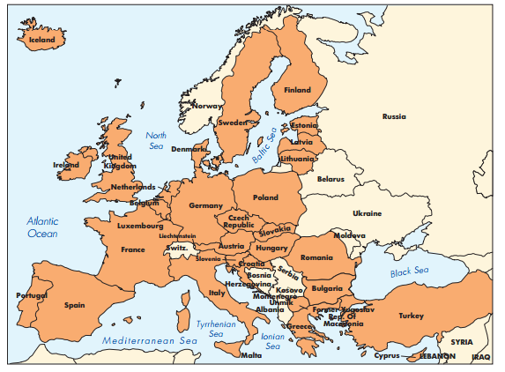
European Union

Slide 11
Trade Agreements and Alliances
Association of Southeast Asian Nations (ASEAN)
  organization for economic, political, social, and cultural cooperation among Southeast Asian nations
Notes:
The Association of Southeast Asian Nations (ASEAN) was founded in 1967 as an organization for economic, political, social, and cultural cooperation. In 1995, Vietnam became the group’s first Communist member. Figure 4.2 shows a map of the ASEAN countries. Because of its relative size, the ASEAN does not have the same global economic significance as NAFTA and the EU.

Slide 12
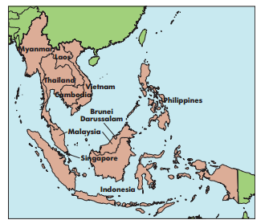
Association of Southeast Asian Nations

Slide 13
Trade Agreements and Alliances
General Agreement on Tariffs and Trade (GATT)
  international trade agreement to encourage the multilateral reduction or elimination of trade barriers
World Trade Organization (WTO)
  organization through which member nations negotiate trade agreements and resolve disputes about trade policies and practices
Notes:
The General Agreement on Tariffs and Trade (GATT) was signed in 1947. Its purpose was to reduce or eliminate trade barriers, such as tariffs and quotas. It did so by encouraging nations to protect domestic industries within agreed-on limits and to engage in multilateral negotiations. The GATT proved to be relatively successful. So, to further promote globalization, most of the world’s countries joined to create the World Trade Organization (WTO), which began on January 1, 1995. (The GATT is the actual treaty that governs the WTO.)

Slide 14
Goals of the WTO
Promote trade by encouraging members to adopt fair trade practices
Reduce trade barriers by promoting multilateral negotiations
Establish fair procedures for resolving disputes among members

Slide 15
International Trade
Balance of Trade
  economic value of all products a country exports minus the economic value of all products it imports
Notes:
A country’s balance of trade is the total economic value of all the products that it exports minus the economic value of all the products that it imports. A positive balance of trade results when a country exports (sells to other countries) more than it imports (buys from other countries). A negative balance of trade results when a country imports more than it exports. A positive balance of trade results when a country exports (sells to other countries) more than it imports (buys from other countries). A negative balance of trade results when a country imports more than it exports.

Slide 16
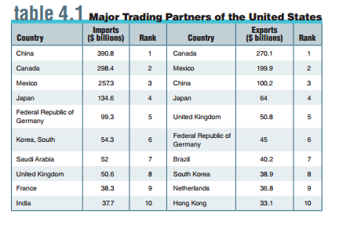
Major Trading Partners of the U.S.
Notes:
Table 4.1 lists the major trading partners of the United States. The left of the table shows the 10 largest markets for exports from the United States,
while the right of the table shows the 10 largest markets that import to the United States.

Slide 17
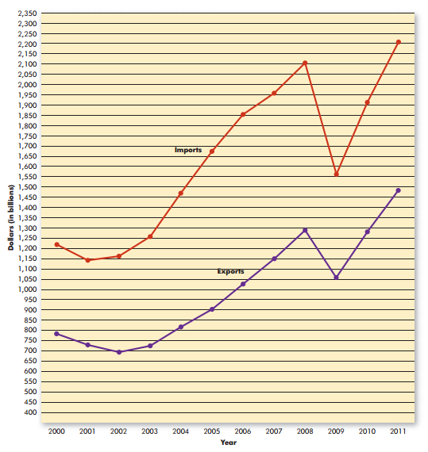
International Trade
Notes:
Figures 4.3 and 4.4 highlight two series of events: (1) recent trends in U.S. exports and imports and (2) the resulting trade deficit. As Figure 4.3 shows, both U.S. imports
and U.S. exports have, with minor variations, increased over the past eight years—a trend that’s projected to continue.

Slide 18
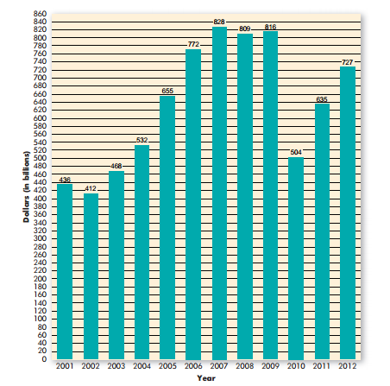
International Trade (cont.)
Trade Deficit
  situation in which a country’s imports exceed its exports, creating a negative balance of trade
Notes:
Trade deficits between 2001 and 2012 are shown in Figure 4.4. There was a deficit in each of these years because more money flowed out
to pay for foreign imports than flowed in to pay for U.S. exports.

Slide 19
International Trade (cont.)
Trade Surplus
  situation in which a country’s exports exceed its imports, creating a positive balance of trade
Balance of Payments
  flow of all money into or out of a country
Notes:
The balance of payments refers to the flow of money into or out of a country. The money that a country pays for imports and receives for exports, its balance of trade, accounts for much of its balance of payments.

Slide 20
Exchange Rates
Exchange Rate
  rate at which the currency of one nation can be exchanged for the currency of another nation
Euro
  a common currency shared among most of the members of the European Union (excluding Denmark, Sweden, and the United Kingdom
Notes:
The balance of imports and exports between two countries is affected by the rate of exchange between their currencies. An exchange rate is the rate at which the currency of one nation can be exchanged for that of another. Suppose, for example, that the exchange rate between the U.S. dollar and the British pound was $2 to £1. This means that it costs £1 to “buy” $2 or $1 to “buy” £0.5. Stated differently, £1 and $2 have the same purchasing power, or £1 = $2.
One of the most significant developments in foreign exchange has been the introduction of the euro, the common currency of the EU. The euro was officially introduced in 2002 and has replaced other currencies, such as the German Deutsche Mark and the French franc. In the years since its debut, the euro has become one of the world’s most important currencies. When it was first introduced, the euro’s value was pegged as being equivalent to the dollar: €1 = $1. But because the dollar has been relatively weak in recent years, its value has eroded relative to that of the euro. In April 2013, for example, $1 was worth only about €0.76.

Slide 21
Forms of Competitive Advantage
Absolute Advantage
  the ability to produce something more efficiently than any other country can
Comparative Advantage
  the ability to produce some products more efficiently than others
Notes:
An absolute advantage exists when a country can produce something that is cheaper or of higher quality than any other country. Saudi oil, Brazilian coffee beans, and Canadian timber come close (because these countries have such abundant supplies of these resources), but examples of true absolute advantage are rare. For example, many experts say that the vineyards of France produce the world’s finest wines. But the burgeoning wine business in California demonstrates that producers there can also make good wine—wines that rival those from France but come in more varieties and at lower prices.

Slide 22
Forms of Competitive Advantage (cont.)
National Competitive Advantage
  International competitive advantage stemming from a combination of factor conditions, demand conditions, related and supporting industries, and firm strategies, structures, and rivalries
Notes:
1 Factor conditions are the factors of production we discussed in Chapter 1 — labor, capital, entrepreneurs, physical resources, and information resources.
2 Demand conditions reflect a large domestic consumer base that promotes strong demand for innovative products.
3 Related and supporting industries include strong local or regional suppliers and/or industrial customers.
4 Strategies, structures, and rivalries refer to firms and industries that stress cost reduction, product quality, higher productivity, and innovative products.

Slide 23
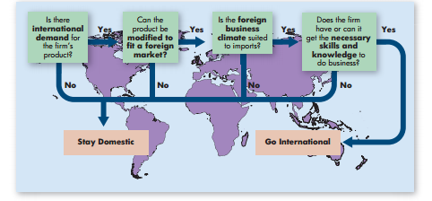

Going International
Notes:
As Figure 4.5 shows, several factors affect the decision to go international.

Slide 24
Levels of International Involvement
Exporter
  firm that distributes and sells products to one or more foreign countries
    Importer
      firm that buys products in foreign markets and then imports them for resale in its home country
Notes:
An exporter makes products in one country to distribute and sell in others. An importer buys products in foreign markets and brings them home for resale. Both conduct most of their business in their home nations. Both entail the lowest level of involvement in international operations, and both are good ways to learn the fine points of global business. Many large firms entered international business as exporters. IBM and Coke, among others, exported to Europe for several years before setting up production sites there.

Slide 25
Levels of International Involvement (cont.)
International Firm
  firm that conducts a significant portion of its business in foreign countries
Multinational Firm
  firm that designs, produces, and markets products in many nations
Independent Agent
  foreign individual or organization that agrees to represent an exporter’s interests
Notes:
As exporters and importers gain experience and grow, many move to the next level of involvement. International firms conduct a good deal of their business abroad and may even maintain overseas manufacturing facilities. An international firm may be large, but it’s still basically a domestic company with international operations. Hershey, for instance, buys ingredients for its chocolates from several foreign suppliers, but makes all of its products in the United States.
Most multinational firms, firms that design, produce, and market products in many nations, such as ExxonMobil, Nestlé, IBM, and Ford, don’t think of themselves as having domestic and international divisions. Headquarters locations are almost irrelevant, and planning and decision making are geared to international markets.
An independent agent is a foreign individual or organization that represents an exporter in foreign markets. Independent agents often
act as sales representatives: They sell the exporter’s products, collect payment, and make sure that customers are satisfied. They often represent several firms at once and usually don’t specialize in a particular product or market. Peter So operates an import-export office in Hong Kong. He and his staff of three handle imports from about 15 foreign companies into Hong Kong and about 10 Hong Kong firms that export products abroad.

Slide 26
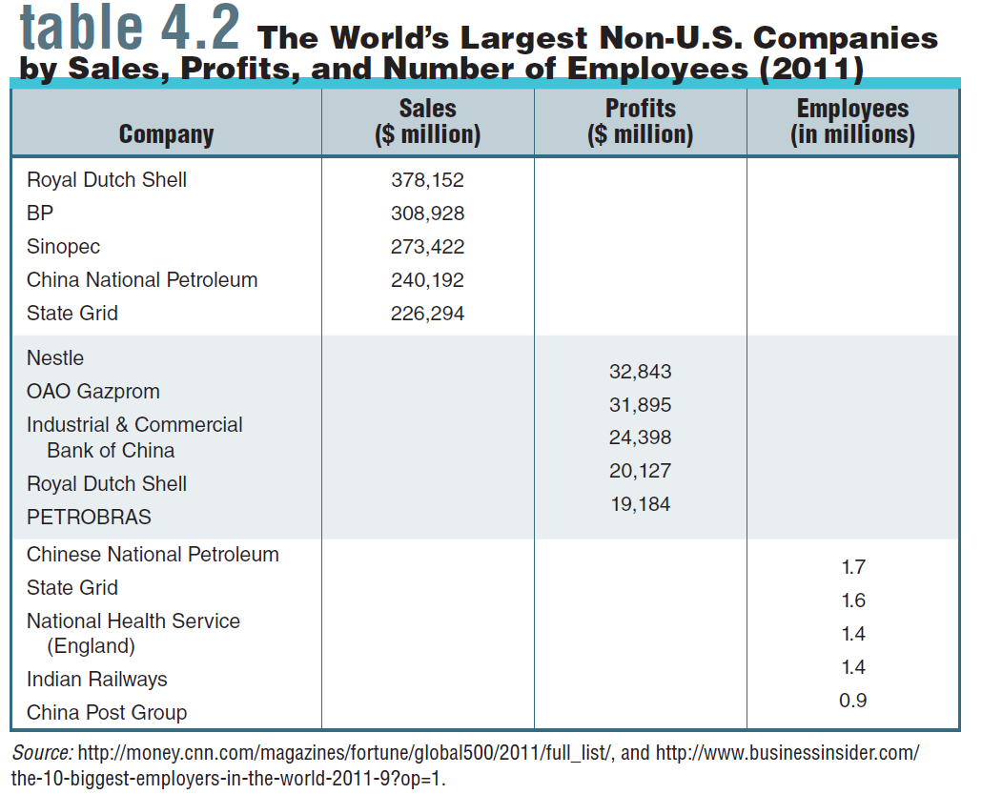
The World’s Largest Non-U.S. Companies
Notes:
The world’s largest multinationals in 2011 based on sales, profits, and employees are shown in Table 4.2.

Slide 27
International Organization Structures
Licensing Arrangement
  arrangement in which firms choose foreign individuals or organizations to manufacture or market their products in another country
Strategic Alliance
  arrangement in which a company finds a foreign partner to contribute approximately half of the resources needed to establish and operate a new business in the partner’s country - also called joint venture
Notes:
Companies seeking more involvement may opt for licensing arrangements. A licensing arrangement is a contract under which one firm allows another to use its brand name, operating procedures, or proprietary technology. Firms give foreign individuals or companies exclusive rights (called licensing agreements) to manufacture or market their products in that market. In return, the exporter receives a fee plus ongoing payments (royalties) that are calculated as a percentage of the license holder’s sales. Franchising is a popular form of licensing. For example, McDonald’s, Pizza Hut, and Hertz franchise around the world.
In a strategic alliance, a company finds a partner in the country in which it wants to do business. Each party agrees to invest resources and
capital into a new business or to cooperate in some mutually beneficial way. This new business, the alliance, is owned by the partners, who divide its profits. Such alliances are sometimes called joint ventures, but the term strategic alliance has arisen because such partnerships are playing increasingly important roles in the strategies of major companies. Ford and Russian automaker Sollers recently launched a new joint venture; Sollers will manufacture Ford products in Russia and the two partners will then work together on marketing them

Slide 28
International Organization Structures (cont.)
Branch Office
  foreign office set up by an international or multinational firm
Foreign Direct Investment (FDI)
  Arrangement in which a firm buys or establishes tangible assets in another country
Notes:
Instead of developing relationships with foreign agents or licensing companies, a firm may send its own managers to overseas branch offices, where the firm has more direct control than it does over agents or license holders.
Foreign direct investment (FDI) involves buying or establishing tangible assets in another country. Dell Computer, for example, has built assembly plants in Europe and China. Volkswagen has built a factory in Brazil, and Disney has built theme parks in France and Hong Kong. Each of these activities represents FDI by a firm in another country.

Slide 29
Barriers to International Trade
Social and Cultural Differences
Economic Differences
Legal and Political Differences

Slide 30
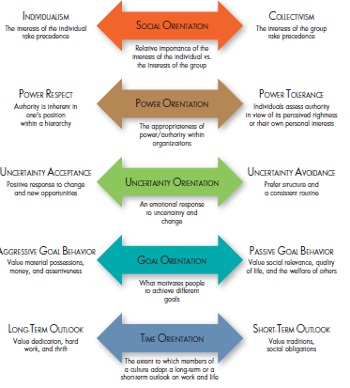
Hofstede’s Five Dimensions of National Culture
Notes:
Managers in international business also have to understand that there are differences in what motivates people in different cultures. Although it’s impossible to predict exactly how people from different cultures will react in the workplace, some insights have been developed from research on individual behaviors and attitudes across different cultures. This research, conducted by Geert Hofstede, identifies five important dimensions along which people seem to differ across cultures. These dimensions are illustrated in Figure 4.6.

Slide 31
Understanding the Cultural Environment
Social Orientation
  a person’s beliefs about the relative importance of the individual versus groups to which that person belongs
Power Orientation
  the beliefs that people in a culture hold about the appropriateness of power and authority differences in hierarchies such as business organizations
Notes:
The first dimension is social orientation. Social orientation is a person’s beliefs about the relative importance of the individual versus groups to which that person belongs. The two extremes of social orientation are individualism and collectivism. Individualism is the cultural belief that the person comes first. Research suggested that people in the United States, the United Kingdom, Australia, Canada, New Zealand, and the Netherlands tend to be relatively individualistic. Collectivism is the belief that the group comes first. Research has found that people from Mexico, Greece, Hong Kong, Taiwan, Peru, Singapore, Colombia, and Pakistan tend to be relatively collectivistic in their values.
A second important dimension is power orientation, the beliefs that people in a culture hold about the appropriateness of power and authority differences in hierarchies such as business organizations. Some cultures are characterized by power respect. This means that people tend to accept the power and authority of their superiors simply on the basis of their position in the hierarchy and to respect their right to hold that power.

Slide 32
Understanding the Cultural Environment (cont.)
Uncertainty Orientation
  the feeling individuals have regarding uncertain and ambiguous situations
Goal Orientation
  the manner in which people are motivated to work toward different kinds of goals
Time Orientation
  the extent to which members of a culture adopt a longterm versus a short-term outlook on work, life, and other elements of society
Notes:
The third basic dimension of individual differences is uncertainty orientation. Uncertainty orientation is the feeling individuals have regarding uncertain and ambiguous situations. People in cultures with uncertainty acceptance are stimulated by change and thrive on new opportunities. The research suggests that many people in the United States, Denmark, Sweden, Canada, Singapore, Hong Kong, and Australia are among those in this category. In contrast, people with uncertainty avoidance tendencies dislike and will avoid ambiguity whenever possible.
The fourth dimension of cultural values is goal orientation. In this context, goal orientation is the manner in which people are motivated to work toward different kinds of goals. One extreme on the goal orientation continuum is aggressive goal behavior. People who exhibit aggressive goal behaviors tend to place a high premium on material possessions, money, and assertiveness. On the other hand, people who adopt passive goal behavior place a higher value on social relationships, quality of life, and concern for others.
A fifth dimension is called time orientation. Time orientation is the extent to which members of a culture adopt a long-term versus a short-term outlook on work, life, and other elements of society. Some cultures, such as Japan, Hong Kong, Taiwan, and South Korea, have a longer-term orientation. One implication of this orientation is that people from these cultures are willing to accept that they may have to work hard for many years before achieving their goals. Other cultures, such as Pakistan and West Africa, are more likely to have a short-term orientation.

Slide 33
Barriers to International Trade
Quota
  restriction on the number of products of a certain type that can be imported into a country
Embargo
  government order banning exportation and/or importation of a particular product or all products from a particular country
Notes:
A quota restricts the number of products of a certain type that can be imported and, by reducing supply, raises the prices of those imports.
The ultimate quota is an embargo, a government order forbidding exportation or importation of a particular product—or even all products—from a specific country. Many nations control bacteria and disease by banning certain agricultural products. Because the United States has embargoes against Cuba (as discussed in our opening case) and Libya, U.S. firms can’t invest in these countries, and their products can’t legally be sold in U.S. markets.

Slide 34
Barriers to International Trade (cont.)
Tariff
  tax levied on imported products
Subsidy
  government payment to help a domestic business compete with foreign firms
Notes:
Tariffs are taxes on imported products. They raise the prices of imports by making consumers pay not only for the products but also for tariff fees. Tariffs take two forms: revenue and protectionist. Revenue tariffs are imposed to raise money for governments, but most tariffs, called protectionist tariffs, are meant to discourage particular imports.
A subsidy is a government payment to help a domestic business compete with foreign firms. They’re actually indirect tariffs that lower the prices of domestic goods rather than raise the prices of foreign goods. For example, many European governments subsidize farmers to help them compete against U.S. grain imports.

Slide 35
The Protectionism Debate
Protectionism
  the practice of protecting domestic business at the expense of free market competition
  Critics charge that protectionism drives up prices by reducing competition
Notes:
In the United States, protectionism, the practice of protecting domestic business at the expense of free market competition,
is controversial. Supporters argue that tariffs and quotas protect domestic firms and jobs as well as shelter new industries until they’re able to compete internationally.

Slide 36
Legal and Political Differences
Local Content Law
  law requiring that products sold in a particular country be at least partly made there
Business Practice Law
  law or regulation governing business practices in given countries
Notes:
Many countries, including the United States, have local content laws, requirements that products sold in a country be at least partly made there. Firms seeking to do business in a country must either invest there directly or take on a domestic partner.
Many businesses entering new markets encounter problems in complying with stringent regulations and bureaucratic obstacles. Such practices are affected by the business practice laws by which host countries govern business practices within their jurisdictions.

Slide 37
Legal and Political Differences (cont.)
Cartel
  association of producers whose purpose is to control supply and prices
Dumping
  practice of selling a product abroad for less than the cost of production
Notes:
Sometimes, a legal—even an accepted—practice in one country is illegal in another. In some South American countries, for example, it is sometimes legal to bribe business and government officials. The existence of cartels, associations of producers that control supply and prices, gives tremendous power to some nations, such as those belonging to the Organization of Petroleum Exporting Countries (OPEC). U.S. law forbids both bribery and cartels. Finally, many (but not all) countries forbid dumping, selling a product abroad for less than the cost of production at home. U.S. antidumping legislation sets two conditions for determining whether dumping is being practiced:
1) Products are being priced at “less than fair value.”
2) The result unfairly harms domestic industry.

Slide 38
Applying What You’ve Learned
Discuss the rise of international business and describe the major world marketplaces, trade agreements, and alliances.
Explain how differences in import-export balances, exchange rates, and foreign competition determine the ways in which countries and businesses respond to the international environment.

Slide 39
Applying What You’ve Learned (cont.)
Discuss the factors involved in deciding to do business internationally and in selecting the appropriate levels of international involvement and international organizational structure.
Explain the role and importance of the cultural environment in international business.
Describe some of the ways in which economic, legal, and political differences among nations affect international business.

