Slide 1
EIGRP
Prof. Ashraf Abdelaziz Taha
CEN 447
2014

Slide 2
Introduction
EIGRP : Enhanced Interior Gateway Routing Protocol
EIGRP gives the network administrator has several advantages :
"Distance vector routing protocols" It stores the routing information.
EIGRP is classified as a Classless routing protocols that’s mean can deal with VLSM.
IGP "interior gateway protocol" that’s mean works inside Autonomous system.
Advanced distance vector that’s selects the best path for building a cross between a distance bandwidth.
Cisco Property where Cisco has developed a protocol IGRP and produced one of the greatest routing protocols for which EIGRP
Multi protocol that’s supports many of the Protocols such as IP and IPX and apple take , however need three tables for each type .
Max count hop is its own 224 .

Slide 3
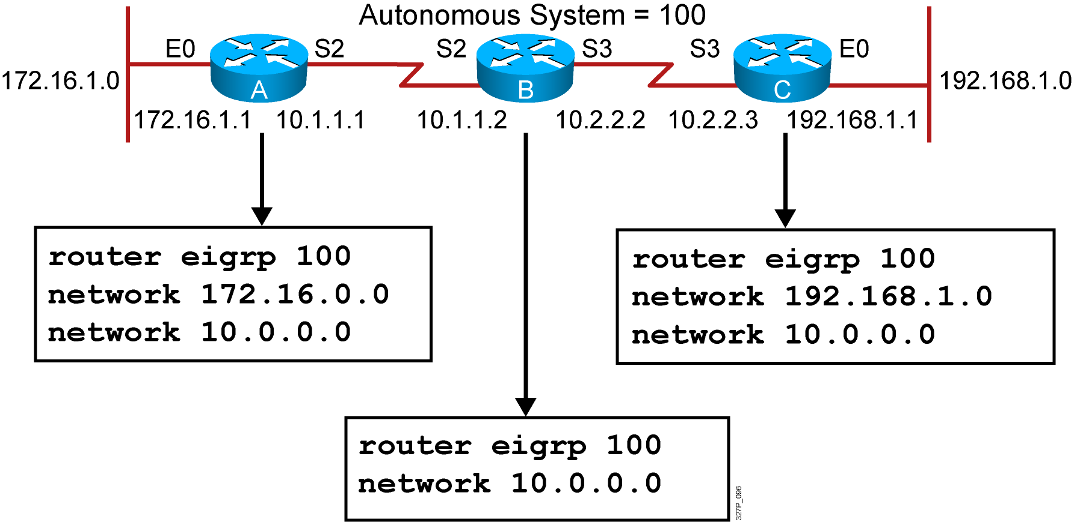
EIGRP Configuration
RouterX(config)# router eigrp autonomous-system
RouterX(config-router)# network network-number

Slide 4
EIGRP Metric
The criteria that EIGRP uses by default to calculate its metric:
Bandwidth
Delay
The optional criteria that EIGRP can be configured to use when calculating its metric:
Reliability
Load

Slide 5
EIGRP Tables
EIGRP contains three tables:
1 - Routing table
2 - Topology table
3 - Neighbor table
Best path called "successor route" and it will keep in the Routing table, and the second best path called "feasible route" and it will keep in the topology table.

