Slide 1
Epigenetics

Slide 2
Epigenetics modification:
Changing in gene expression without affecting the primary DNA sequence.
So, epigenetic modifications regulate the processes during the transition from genotype to phenotype.
Epigenetic modification including DNA methylation, histone modification and micro RNAs.

Slide 3
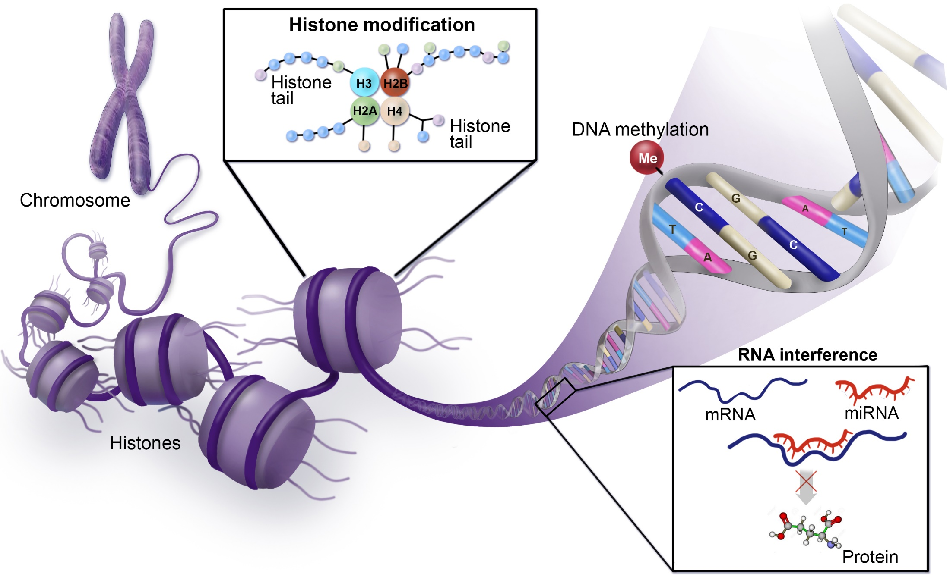

Slide 4
DNA methylation
DNA methylation is an epigenetic modification that occurs as a result of a biological mechanism that leads to the attachment of a methyl group onto the 5th carbon of cytosine (5mC).
DNA methylation processes are controlled by the DNA methyltransferase enzyme (DNMTs) family, which create 5 methylcytosine (5mC) via transferring a methyl group from a donor S- adenosyl methionine (SAM) to the 5th carbon of cytosine.
DNA according to methylation status is either Hypomethylated or hypermethylated.
A: CH₃ is added to cytosine in the presence of DNMT enzymes and SAM (donor). B: Symmetrical CpG methylation. C: Diagram shows relation between DNA methylation and gene expression.

Slide 5
Hypomethylation is a process that leads to gene activation (oncogenes) and is carried out by two mechanisms.
Passive process: loss or reduction of DNMT enzyme during cell division.
Active process: ten-eleven translocation (TET) enzyme via an enhanced oxidation mechanism leads to convert methylated cytosine to unmethylated cytosine.
Hypermethylated is a process that leads to gene inactivation (Tumor suppressor genes). which suggested an increase of DNMTs enzymes activity in cancer cells compared to normal cells.

Slide 6
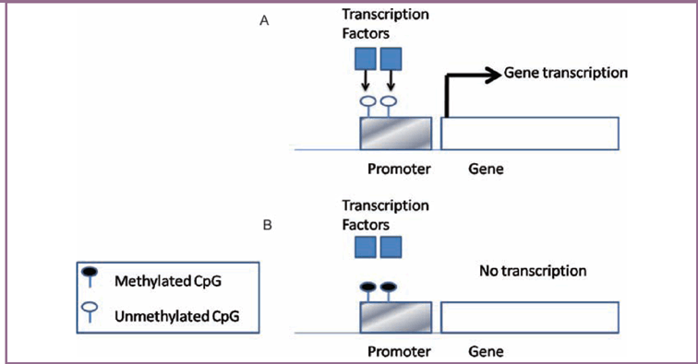
DNA methylation controlling gene expression. (A) The CpG island promoter is unmethylated and allows binding of transcription factors, which is required for transcription initiation. (B) The CpG island promoter methylation deters binding of transcription factors and causing gene inactivation.

Slide 7
Histone modification:
Histone proteins (H2A, H2B, H3 and H4) have N- and C- terminals that form histone tails, where post-translation modifications often take place causing changes of chromatin structure, including phosphorylation, methylation, and acetylation.
Histone acetylation:
Histone acetyl transferase (HAT): tend to add acetyl group on lysine residue on histone tail, which leads to chromatin becoming permissive and as a consequence a transcription process takes place.
Histone deacetylase (HDAC): tend to remove an acetyl group, causing stability of chromatin structure and expression inhibition.

Slide 8
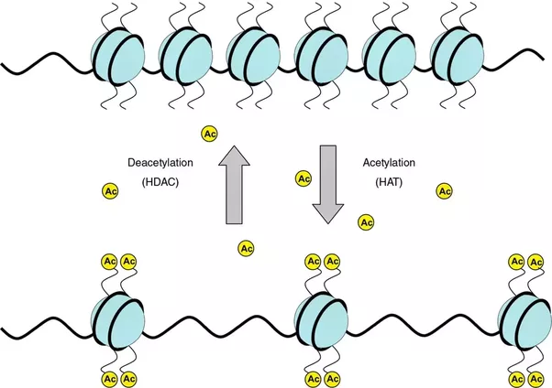
Acetyl group
remove + charge
Decrease interaction between histone and negatively charged DNA
packed chromatin converts to unpacked chromatin
Increase
Gene expression

Slide 9
Histone methylation:
Histone methylation takes place on lysine or arginine residues, and is regulated by:
Histone methyltransferases that transfer methyl groups from SAM to amino groups or guanidino group of lysine or arginine respectively.
Histone demethylases, which function antagonistically to histone methyltransferases by removing a methyl group.

Slide 10
MicroRNAs:
MicroRNAs (miRNAs), belong to a non-coding RNA family and consist of 17-25 nucleotides.
miRNAs epigenetically contribute in governing gene expression in various pathways, for instance miRNA expression may be controlled by epigenetic mechanisms, miRNAs are involved in inhibition of some epigenetic elements, or cooperation between miRNA and epigenetic elements is required to achieve a specific task.
In addition, some of 50% miRNAs, that are placed in CpG islands, have been regulated by DNA methylation and they were abnormally expressed in different tumours including miR-31 (breast cancer) and miR-124a (colon cancer).

Slide 11
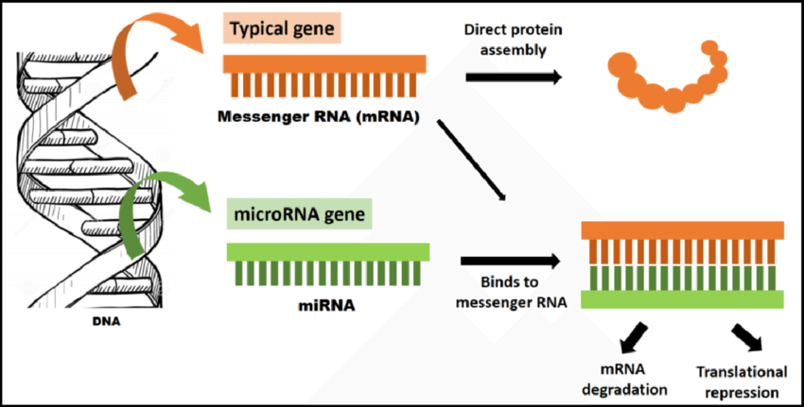
miRNAs involvtranslational repression or degradation of the target mRNA (messenger RNA). miRNAs are a class of short, non-coding, single-stranded RNA molecules, approximately 22 nucleotides in length, that negatively regulate gene expression at the post-transcriptional level. They bind sequences in the target messenger RNA through complementarity and form RNA-RNA complex.

Slide 12
Reference:
DNA Methylation in Mammals (En Li and Yi Zhang)
DNA methylation: a form of epigenetic control of gene expression ( Derek Lim and Eamonn Maher)

