Slide 1
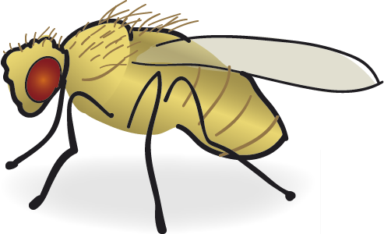
Experimental crosses in Drosophila melanogaster

Slide 2
Content :
Isolating and collecting virgins
Fly transfer
Recognition of wild type
Table for mutant types
Important Definitions in Genetics
Crosses in drosophila

Slide 3
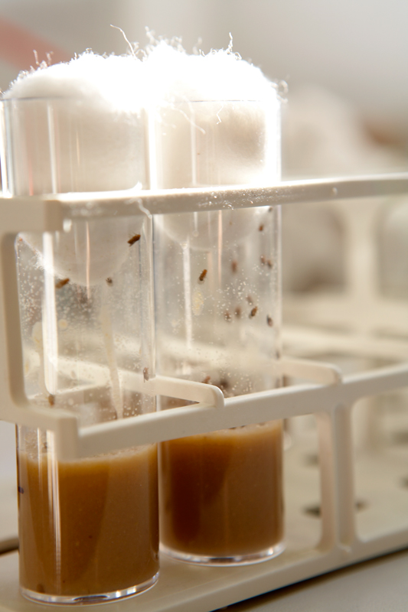
Fly transfer
You must exclude all old vials to make sure that the new media don’t contamination.
Tap gently on the wall of the stock breeding vial to force the fruit flies to come down to the bottom of the vial.
Remove the spongy plugs from both vials quickly.
Place the nozzle old vial above the nozzle of the new vial with breeding gently on the bottom of the old vial.
Finally, after you are transferring all the insects to the new vials, you must separate the new vials from stock vials and replace the spongy plugs directly (to block insects from fly or leak).

Slide 4
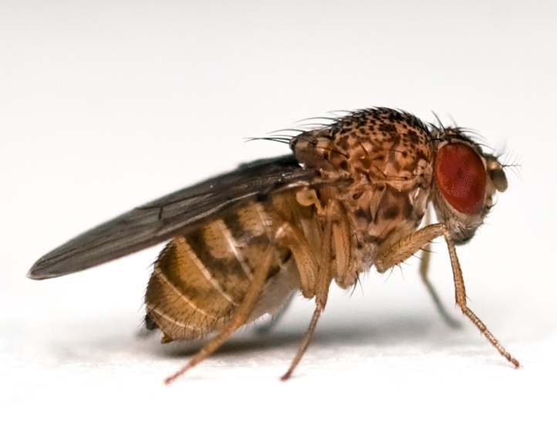
Recognition of wild type
wild type An individual having the normal phenotype; that is, the phenotype generally found in a natural population of organisms.
The typical eye color is red and the shape is round.
Body color phenotype is grey the typical.
It has Long wings with Complete edges.

Slide 5
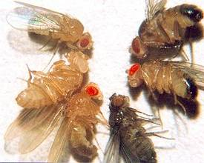
Table for mutant types
Mutation: a sudden permanent change in hereditary material involving either a physical change in chromosome relations or a biochemical change in the codons that make up genes. obtained either automatically or created using some of the factors (radiation or certain chemicals).
Mutant: An individual having a phenotype that differs from the normal phenotype or genotyping.
Secondly: Examples of some common mutants:

Slide 6
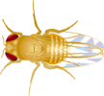
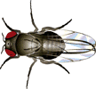
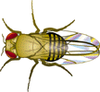
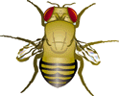
Characterize features | Symbol | Pattern of inheritance | Type of chromosome | Shape or color
yellow body | y | recessive | Chromosome –x
ebony body | e | recessive | Chromosome-3
black body | b | recessive | Chromosome-2
white eyes | w | recessive | Chromosome–x
Sepia eyes | se | recessive | Chromosome-3
bar eyes | B | incomplete dominance | Chromosome–x
wings vestigial | vg | recessive | Chromosome-2
apterous wings | ap | recessive | Chromosome-3
yellow body , white eyes | y , w
apterous ، sepia eyes | se, ap
wingless ، white eyes | vg, w

Slide 7
Important Definitions in Genetics
Mendelian law stating that for every pair of unit factors, each of them would assort independently into the newly formed gametes.
1 ـ Principle of dominance :
In a cross of parents that are pure for contrasting traits, only one form of the trait will appear in the next generation.
- Offspring that are hybrid for a trait will have only the dominant trait in the phenotype.
2- law of segregation:
the pair of alleles of each parent separate and only one allele passes from each parent on to an offspring.
- Segregation of alleles occurs during the process of gamete formation (meiosis).

Slide 8
Important Definitions in Genetics cont.
3-Law of Independent Assortment : Each allele pair segregates independently from other allele pairs during gamete formation.
4-Phenotype: The traits of an organism that are expressed. ( ex. Long – color).
5-Genotype: The genetic makeup of an organism.

Slide 9
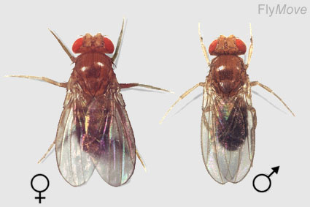
Crosses in Drosophila

Slide 10
MONOHYBRID CROSS:
a. Autosomal recessive gene:
The simplest form of a cross is a monohybrid cross, which analyses a single trait and its associated variations.
VgVg
vgvg
Wild type
Parent P1
Wingless type
vg
vg
Vg
Vg
Gametes
Generation F1
The proportion of genotypes for offspring
Vgvg
Vgvg
Vgvg
Vgvg
4:4
The proportion of phenotypes for offspring
4:4

Slide 11
b. Sex-linked cross
Wild type (Red-eye(
X*X*
XwY
white eye
Parents P1
X*
X*
Xw
Y
Gametes
X*Xw
X*Xw
X*Y
X*Y
Generation F1
The proportion of genotypes for offspring
2:2
female
male
The proportion of phenotypes for offspring
4:4

Slide 12
Dihybrid crosses: involve manipulation and analysis of two traits controlled by pairs of alleles at different loci.
vgvgSeSe
Long Wings\sepia eyes
VgVgsese
wingless
Red eye
parents P1
Vgse
Vgse
vgSe
vgSe
Gametes
The proportion of genotypes for offspring
Generation F1
VgvgSese
VgvgSese
VgvgSese
VgvgSese
4:4
The proportion of phenotypes for offspring
4:4
4 Long Wings\red eyes

Slide 13
Long Wings\red eyes
Long Wings\red eyes
VgvgSese
VgvgSese
parents P2
VgSe
vgse
VgSe
vgse
Gametes
The proportion of genotypes for offspring
Generation F2
VgvgSese
VgvgSese
vgvgsese
VgVgSeSe
1:2:1
The proportion of phenotypes for offspring
3:1
3 Long Wings\red eyes
1 wingless \ sepia eyes

Slide 14
REFRENCES:
- Mendelian Genetics: Lessons from the Fruit Fly.
file:///C:/Users/win7/Downloads/genetics.pdf
-Genetics Laboratory Drosophila crosses - gene Mapping
-Biology 2250 Principles of Genetics
-Campbell Biology, Tenth Edition - Reece, Urry, Cain et
al (1)

