Slide 1
Marketing in Today’s Economy

Slide 2
Introduction
Commoditization
A consequence of mature industries, where slowing innovation, extensive product assortment, excess supply, and frugal consumers force margins to the floor.
All organizations – both for-profit and nonprofit – require effective planning and a sound marketing strategy to achieve their goals and objectives.
Today’s economy is characterized by rapid technological change, economic/financial anxiety, and increasing consumer skepticism.

Slide 3
The Challenges and Opportunities of Marketing in Today’s Economy
Power shift to customers
Massive increase in product selection
Audience and media fragmentation
Changing value propositions
Shifting demand patterns
Privacy, security, and ethical concerns
Unclear legal jurisdiction

Slide 4
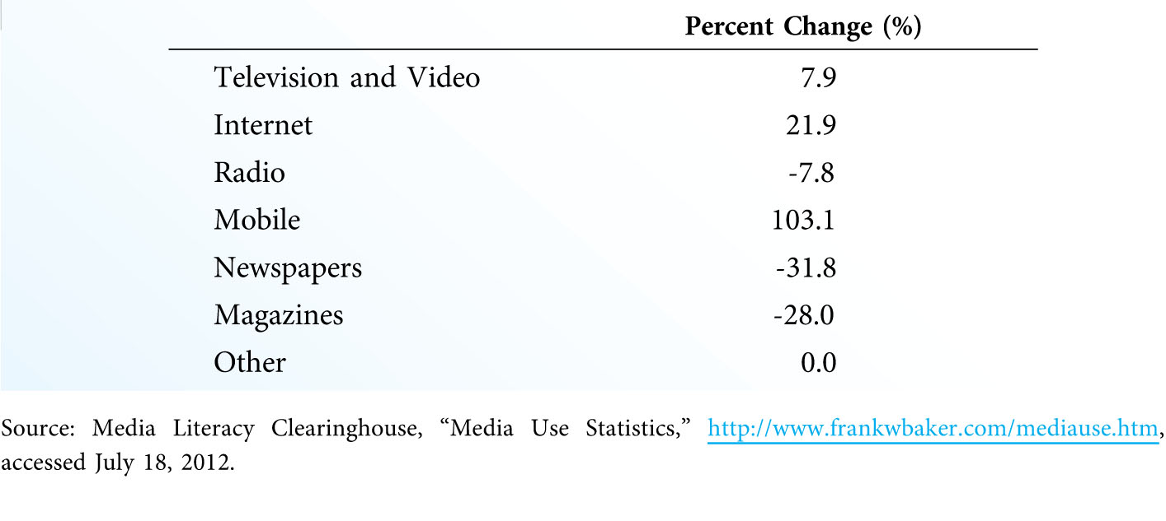
Change in Daily Media Usage by U.S. Adults, 2008-2011 (Exhibit 1.1)

Slide 5
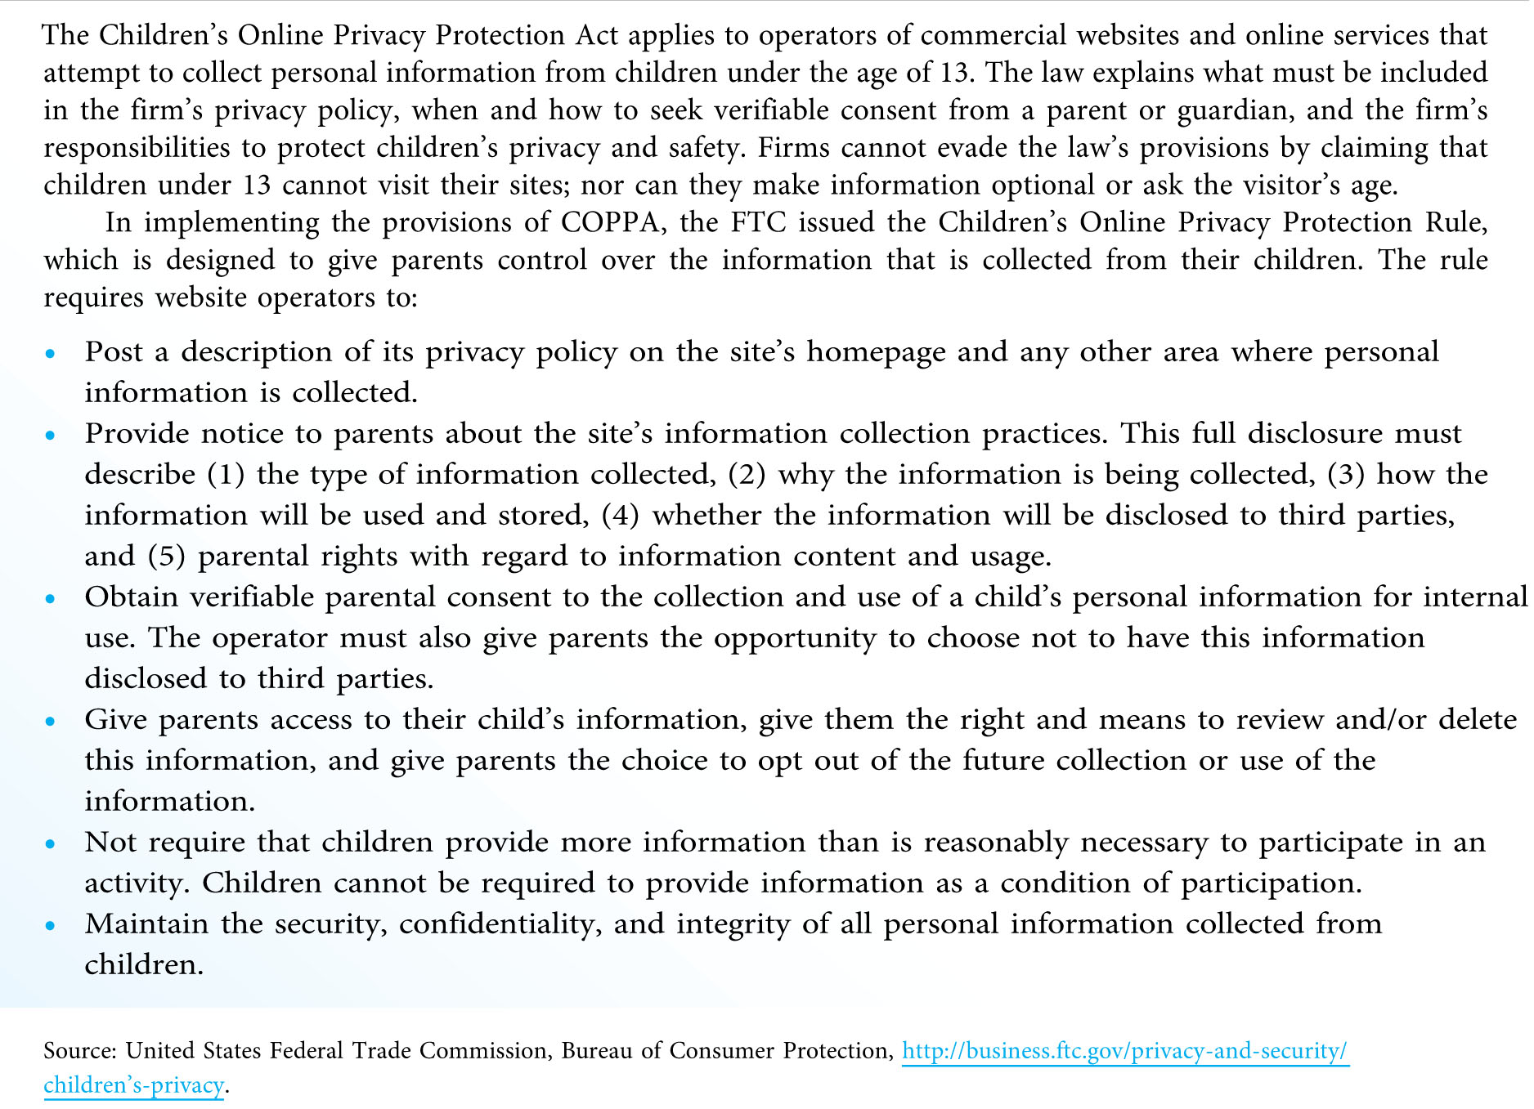
The Children’s Online Privacy Protection Act (Exhibit 1.2)

Slide 6
Increasing customer power is a continuing challenge to marketers in today’s economy. In what ways have you personally experienced this shift in power; either as a customer or as a business person? Is this power shift uniform across industries and markets? How so?

Slide 7
Basic Marketing Concepts: Marketing Defined
Marketing (2005 AMA definition)
“… an organizational function and a set of business processes for creating, communicating, and delivering value to customers and for managing customer relationships in ways that benefit the organization and its stakeholders.”
Marketing (2007 AMA definition)
“… the activity, set of institutions, and processes for creating, communicating, delivering, and exchanging offerings that have value for customers, clients, partners, and society at large.”

Slide 8
Basic Marketing Concepts: What is a Market?
Market
A collection of buyers and sellers; a group of individuals or institutions that have similar needs
Marketspace
Electronic marketplaces unbound by time or space
Metamarket
A cluster of closely related goods and services that center around a specific consumption activity
Metamediary
Provides a single access point where buyers can locate and contact many different sellers in the metamarket

Slide 9
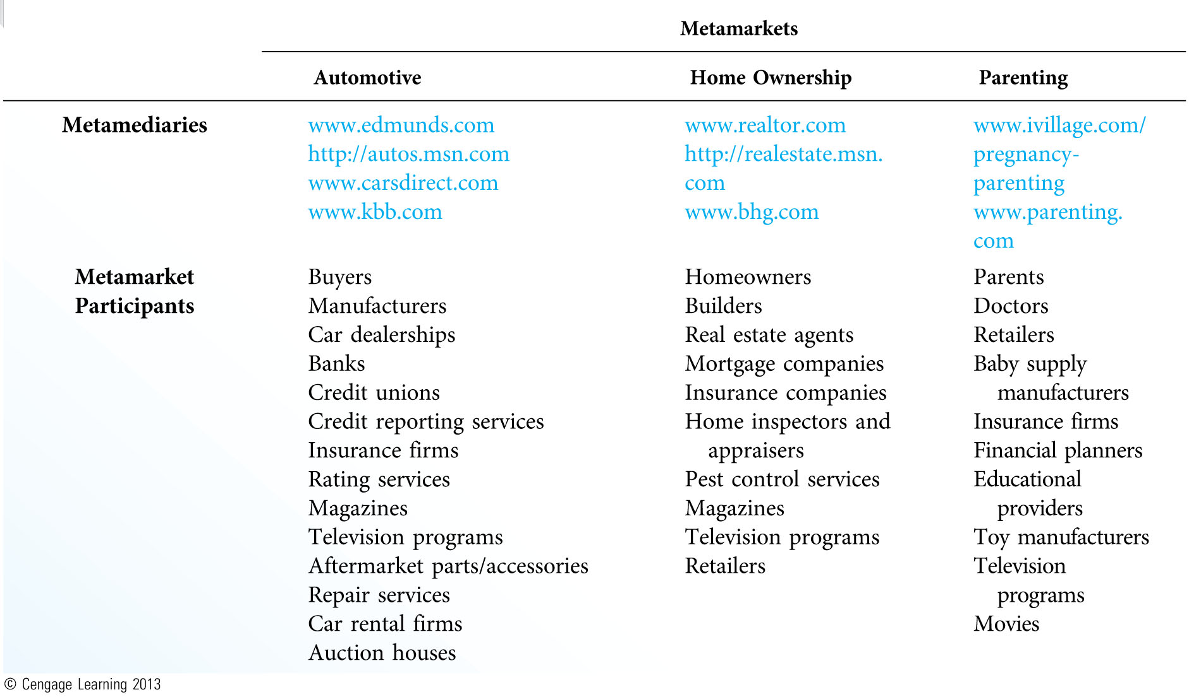
Common Metamarkets and Participants (Exhibit 1.3)

Slide 10
Basic Marketing Concepts: What Is Exchange?
Exchange
The process of obtaining something of value by offering something in return; typically obtaining products for money
Five Conditions of Exchange
There must be at least two parties to the exchange.
Each party has something of value to the other party.
Each party must be capable of communication and delivery.
Each party must be free to accept or reject the exchange.
Each party believes it is desirable to exchange with the other party.

Slide 11
Basic Marketing Concepts: What Is a Product?
Product
Something that can be acquired via exchange to satisfy a need or a want
Examples of Products
Goods
Services
Ideas
Information
Digital products
People
Places
Experiences and events
Real or financial property
Organizations

Slide 12
Basic Marketing Concepts: Utility
Utility
The ability of a product to satisfy a customer’s needs or wants
Five Types of Utility
Form utility – attributes or features that set the product apart
Time utility – products available when customers want them
Place utility – products available where customers want them
Possession utility – transfer of ownership or title; ease of acquisition
Psychological utility – positive experiential attributes that customers find satisfying

Slide 13
Major Marketing Activities and Decisions
Strategic Planning
Strategy – the organization’s game plan for success
Tactical planning – specific markets/segments and the marketing programs that will meet their needs/wants
Marketing plan – the outline of the marketing program
Research and Analysis
Internal analysis – analyzing the firm’s current strategy and performance
Competitive intelligence – analyzing competing businesses
Environmental scanning – analyzing the external environment
Situation analysis – combination of all three analyses

Slide 14
How concerned are you about privacy and security in today’s economy? Why do so many people, particularly younger people, seem to be unconcerned about privacy? Will these issues still be important in 10 years? Explain.

Slide 15
Major Marketing Activities and Decisions (continued)
Developing Competitive Advantage
Competitive advantage – something the firm does better than competing firms
SWOT analysis – strengths, weaknesses, opportunities, threats
Marketing Strategy Decisions
Market segmentation and target marketing
Marketing program decisions (the marketing mix)
Branding and positioning

Slide 16
Major Marketing Activities and Decisions (continued)
Social Responsibility and Ethics
Social responsibility – maximizing positive impact on society, while minimizing negative impact
Marketing ethics – principles/standards that define acceptable conduct in marketing activities
Implementation and Control
Process of executing the marketing plan
Marketing activities must be controlled to ensure that the strategy stays on course.
Developing and Maintaining Customer Relationships
Transactional marketing
Relationship marketing

Slide 17
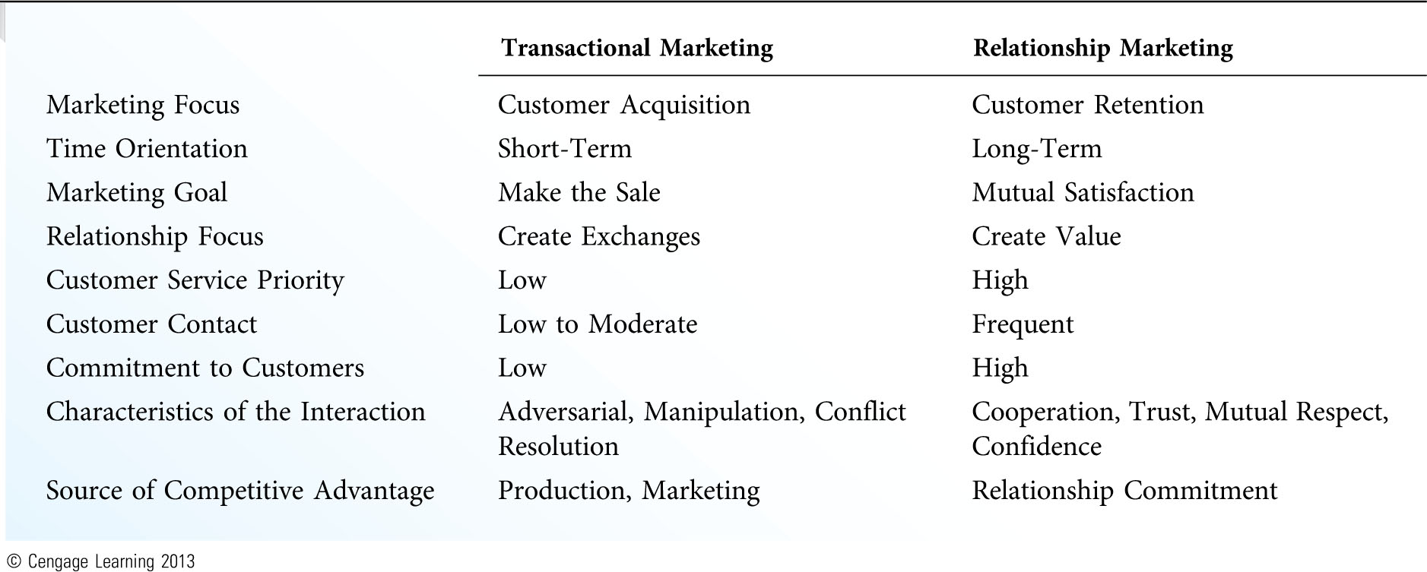
Transactional and Relationship Marketing (Exhibit 1.4)

Slide 18
The Challenges of Marketing Strategy
Unending Change
People-Driven Nature of Marketing
Lack of Rules for Choosing Marketing Activities
Increasing Customer Expectations
Declining Customer Satisfaction and Brand Loyalty
Competing in Mature Markets
Increasing commoditization
Little real differentiation among product offerings
Aggressive Cost-Cutting Measures

Slide 19
The text argues that marketing possesses very few rules for choosing the appropriate marketing activities. Can you describe any universal rules of marketing that might be applied to most products, markets, customers, and situations?

Slide 20
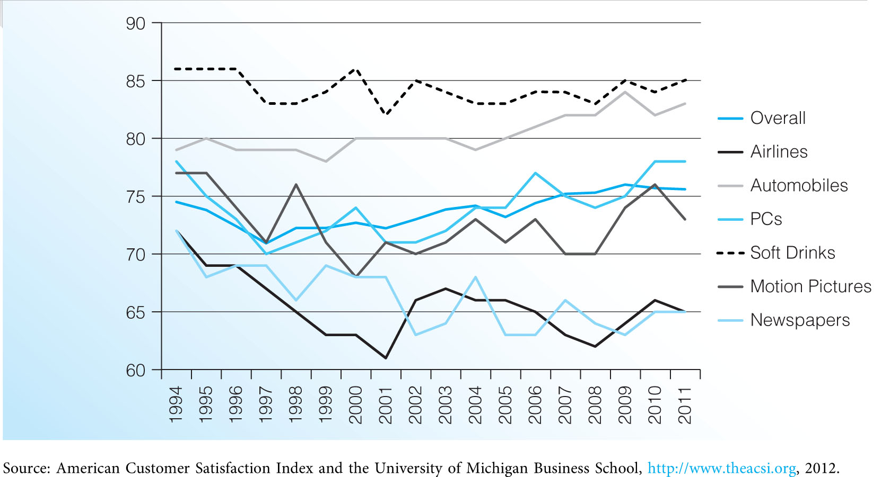
American Customer Satisfaction Index (Exhibit 1.5)

