Slide 1
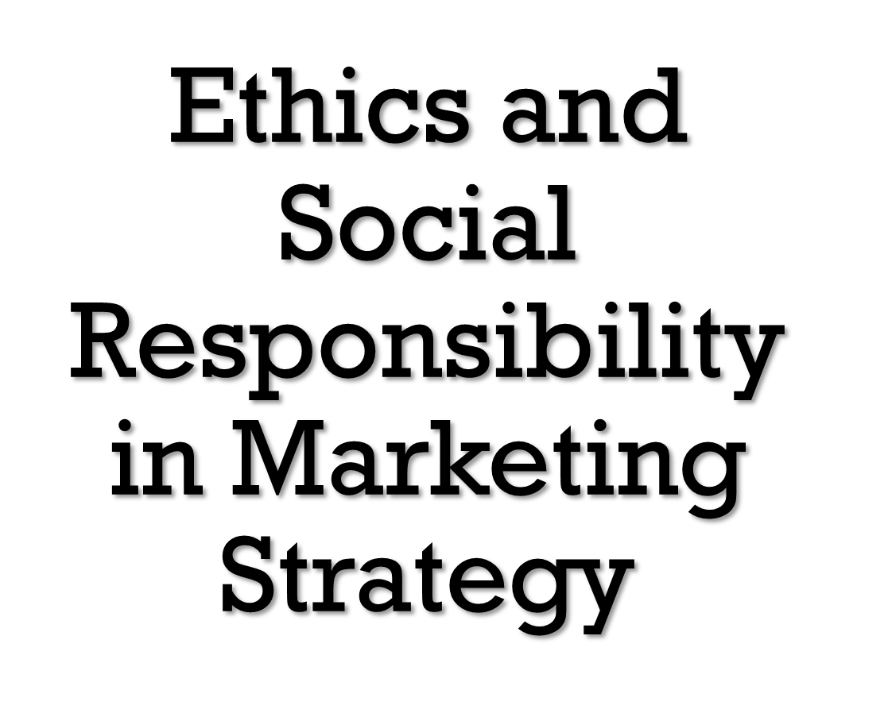

Slide 2
Ethics and Social Responsibility in Marketing Strategy
Grown in importance recently due to firms having problems in these areas
Have become necessities due to:
Stakeholder demands (especially customers)
Ethical issues can become legal issues
Improve marketing performance and profits
Are important to the development of marketing strategy

Slide 3
Why is marketing ethics a strategic consideration in organizational decisions? Who is most important in managing marketing ethics: the individual or the firm’s leadership? Explain your answer.

Slide 4
Social Responsibility and Marketing Ethics
Social Responsibility
A broad concept that relates to an organization’s obligation to maximize its positive impact on society while minimizing its negative impact
Marketing Ethics
Principles and standards that define acceptable marketing conduct as determined by the public, government regulators, private interest groups, competitors, and the firm itself

Slide 5
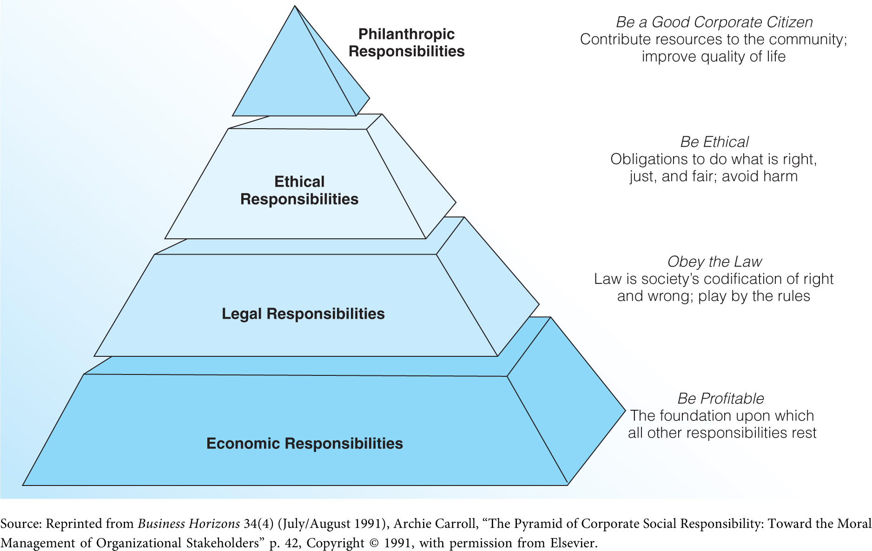
The Pyramid of Corporate Social Responsibility (Exhibit 8.1)

Slide 6
Dimensions of Social Responsibility
Economic responsibility of making a profit
Legal responsibility of obeying laws and regulations
Ethical responsibility to uphold principals and standards
Philanthropic responsibility to increase the firm’s positive impact on society

Slide 7
Sustainability
Programs designed to protect and preserve the natural environment
Eco-friendly business practices
Waste reduction
Reduction in greenhouse gas emissions
LEED building certification
Green sourcing
Green Marketing
Creating customer relationships while also enhancing the natural environment
Greenwashing – misleading consumers about the eco-friendly nature of products

Slide 8
Marketing Ethics and Strategy
The most basic ethical standards have been codified into law.
Require that organizations and individuals accept responsibility
Can lead to violations of public trust
Are intertwined with respect to a firm’s reputation

Slide 9
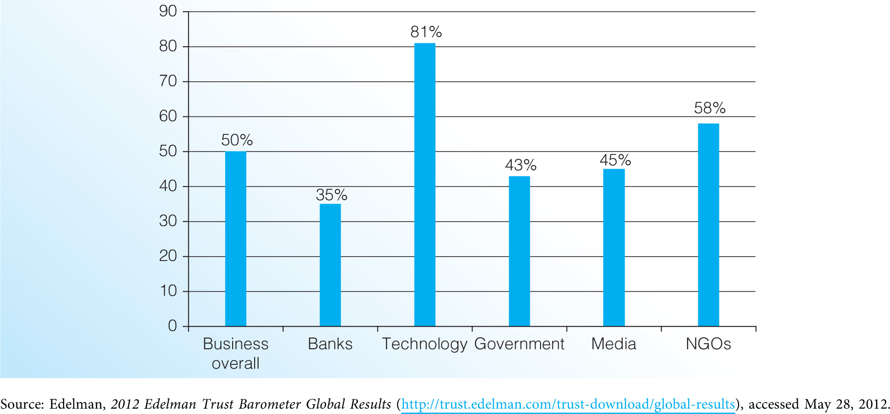
American Trust in Different Institutions (Exhibit 8.2)

Slide 10
Challenges of Being Ethical and Socially Responsible
Business decisions involve complex decisions in which correctness may not be apparent
Internet privacy, copyright, intellectual property, advertising claims
Ethical conflict may emerge from an inconsistency between personal values and the values held by members of the work group

Slide 11
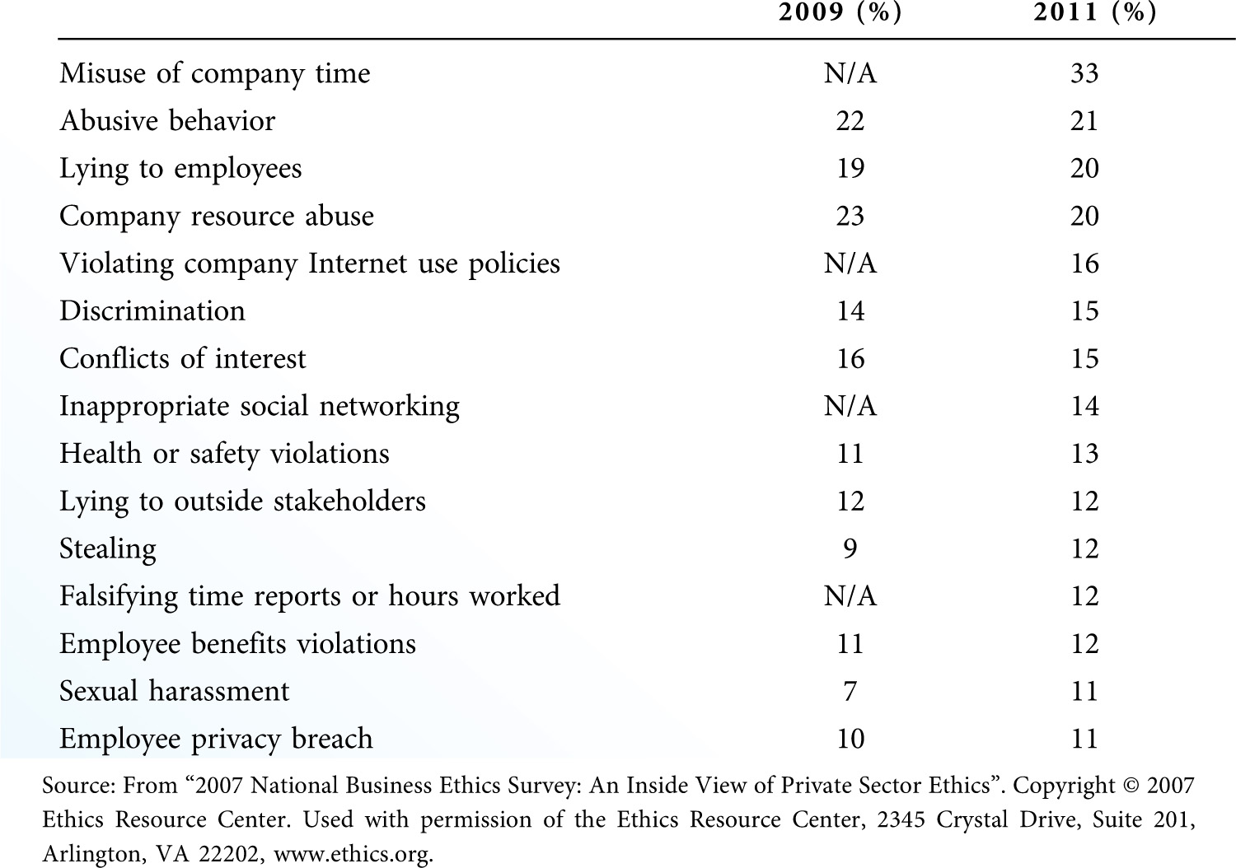
Types of Misconduct Observed in Organizations (Exhibit 8.3)

Slide 12
Ethical Issues in the Marketing Program
Product-Related Ethical Issues
Failure to disclose risks, product design, counterfeit products
Pricing-Related Ethical Issues
Price discrimination, price fixing, predatory pricing, superficial discounting
Supply Chain-Related Ethical Issues
Labor issues, raw material sources, quality control
Promotion-Related Ethical Issues
False or misleading communication, ambiguous statements, bribery, direct marketing fraud

Slide 13
Potential Ethical Issues in the Marketing Program (Exhibit 8.4)
Overall Issues
Misrepresentation, manipulation, exploitation, abuse
Product Issues
Misrepresentation, failure to disclose defects, counterfeit products
Pricing Issues
Deception, reference pricing, price discrimination
Distribution (Supply Chain) Issues
Opportunism, exclusive arrangements, slotting fees, tying contracts
Promotion Issues
Misleading advertising, bait-and-switch, high-pressure sales, gift giving

Slide 14
Why have we seen more evidence of widespread ethical marketing dilemmas within firms today? Is it necessary to gain the cooperation of marketing managers to overstate revenue and earnings in a corporation?

Slide 15
Regulating Marketing Ethics
Firms prefer to regulate themselves through:
Compliance with laws and regulations
Trade associations
Better Business Bureau
Benefits of self regulation
Less expensive
Guidelines are more practical and realistic
Reduce the need for expanded government bureaucracy

Slide 16
Codes of Conduct
Code of Conduct (Code of Ethics)
Formal statement that describes what an organization expects of its employees
Not an effective means of controlling ethical behavior unless integrated into daily decision making
Not effective unless the code has support of top management
Code must reflect management’s desire for compliance with values, rules, and policies
It is impossible for a code of conduct to take every potential ethical situation into account.

Slide 17
Codes of Conduct (continued)
Codes should have six core values
Trustworthiness
Respect
Responsibility
Fairness
Caring
Citizenship
The code will not resolve every issue encountered in daily operations.
The code can help managers deal with ethical dilemmas.

Slide 18
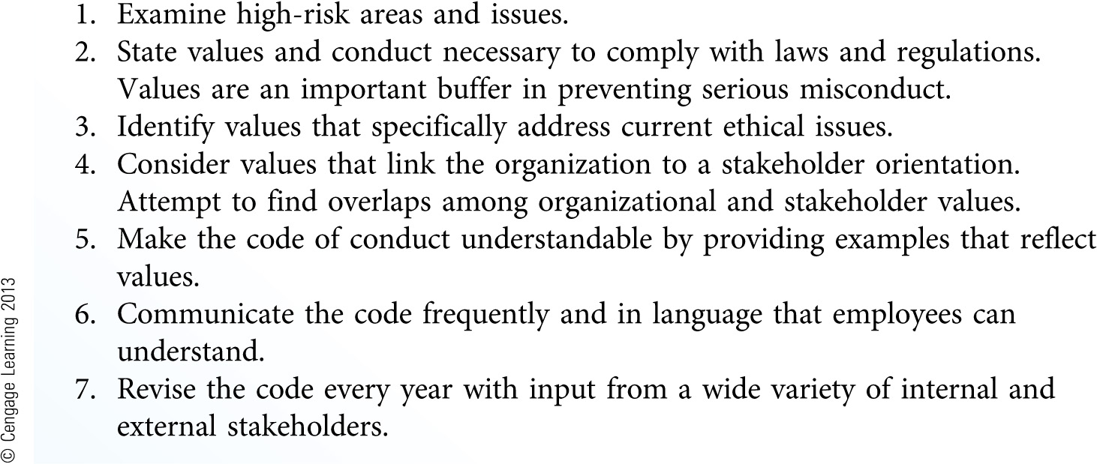
Considerations in Developing a Code of Ethical Conduct (Exhibit 8.5)

Slide 19
Ethical Leadership
Ethical cultures emerge from strong leadership.
Employees look to the leader as a model of acceptable behavior.
Great ethical leaders:
Create a common goal or vision for the company
Obtain buy-in or support from significant partners
Motivate others to be ethical
Use the resources that are available to them
Enjoy their jobs and approach them with an almost contagious tenacity, passion, and commitment

Slide 20
Connecting Ethics and Social Responsibility to Performance
Ethical Climate
Part of a corporate culture that relates to an organization’s expectations about appropriate conduct
A strong ethical climate leads employees to be:
Motivated to serve customers
Committed to the firm
Committed to high quality standards
Satisfied with their job

Slide 21
Stakeholder Orientation
The degree to which a firm understands and addresses stakeholder demands
Organization-wide generation of data about stakeholder groups and the assessment of the firm’s effects on these groups
Distribution of this information throughout the firm
The organization’s responsiveness to this intelligence
A continuum that firms are likely to adopt to varying degrees

Slide 22
Ties to Marketing Financial Performance
A climate of ethics and social responsibility has many bottom-line benefits.
Creates trust with firm’s stakeholders
Enhances the firm’s reputation
Efficient supply chains
Stronger customer loyalty and satisfaction
Higher profits and market value

Slide 23
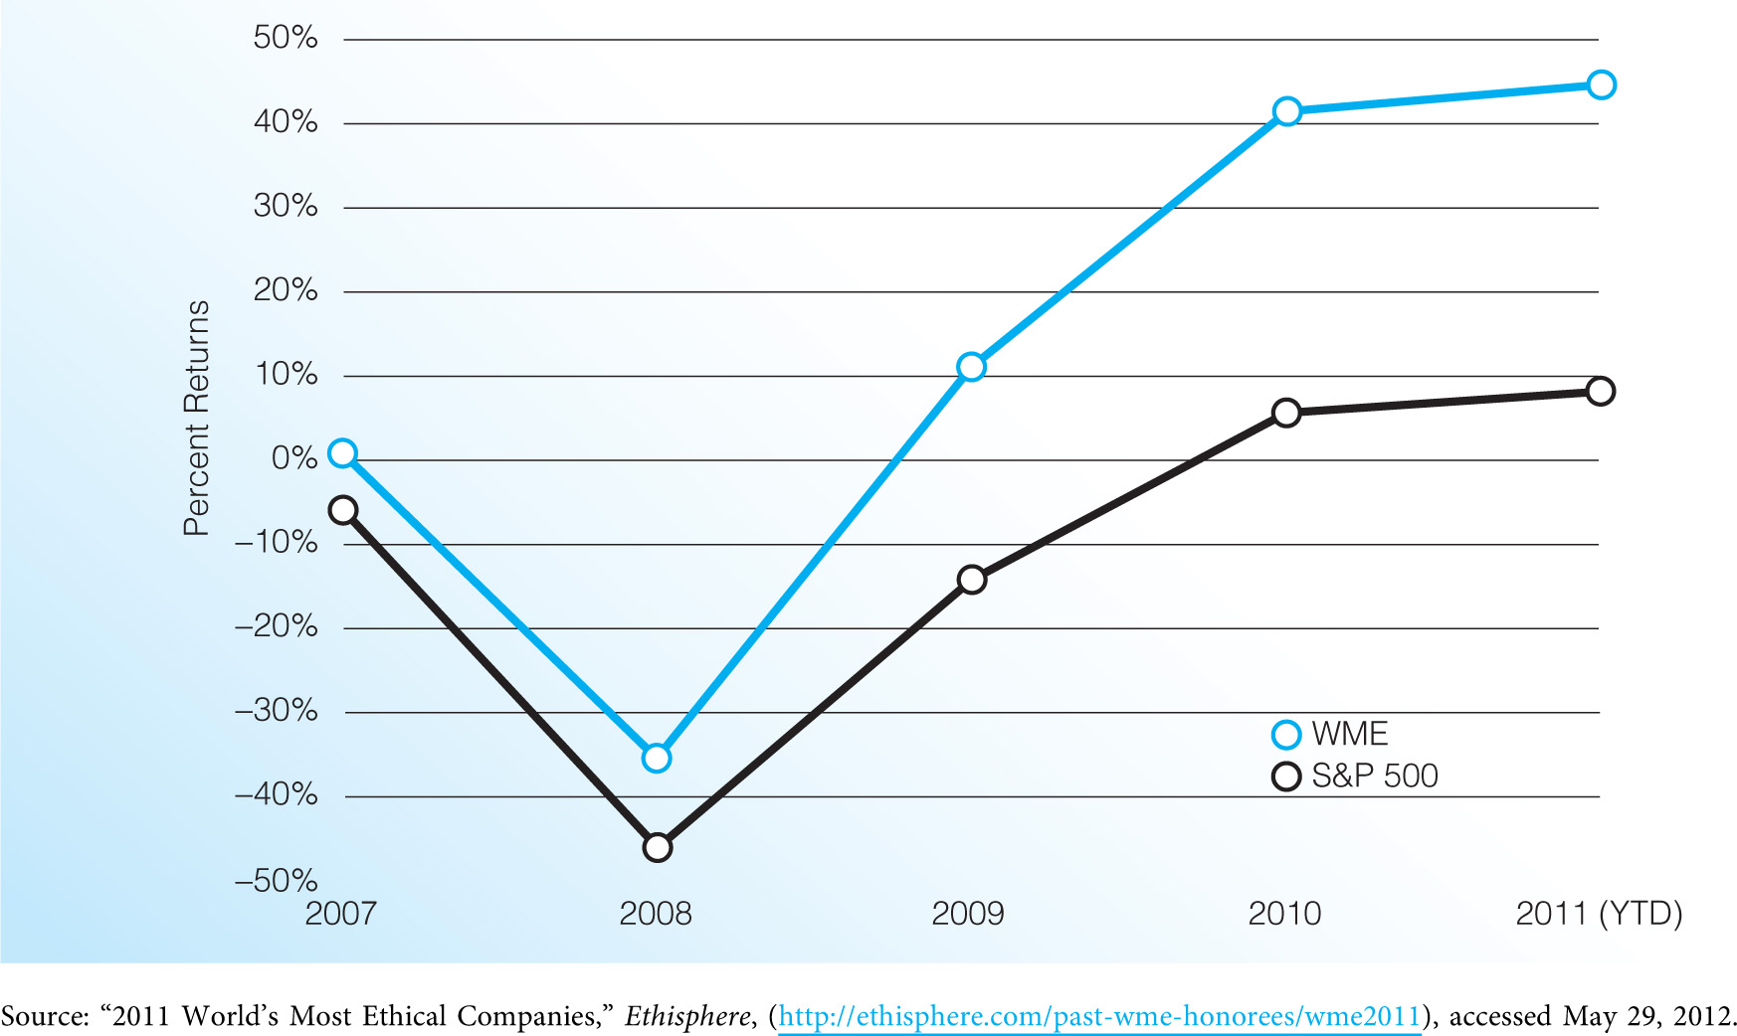
Performance of World’s Most Ethical Companies (Exhibit 8.6)

Slide 24
What is the relationship between marketing ethics and organizational performance? What are the elements of a strong ethical compliance program to support responsible marketing and a successful marketing strategy?

Slide 25
The Connection to Strategic Planning
Typically done through ethical compliance programs or integrity initiatives
Vested in the marketing plan, based on an understanding of:
Risks associated with misconduct
Ethical and social consequences of strategic choices
Values of organizational members and stakeholders
Manifested through actions … not just words

