Slide 1
FOOD MICROBIOLOGY
CLS 416
Notes:
the study of the microorganisms that inhabit, create, or contaminate food, including the study of microorganisms causing food spoilage

Slide 2
Principle of food microbiology
Food supply consists basically of plants and animals or product derived from them, it is understandable that our food supply can contain microorganism in interaction with food.
These microorganisms use food supply as a source of nutrients for their own growth. These will cause 2 possibilities:
Deterioration of food (“spoilage”)
OR
Food industry,beneficial to human

Slide 3
What is the impact of microorganisms on food?
Good (desirable) | Bad (undesirable)
Food bioprocessing | Foodborne disease
Food biopreservation | Food spoilage
Probiotics
Good (desirable):
Food bioprocessing- food industry.
Foods produced by using biological processes. In this process. Microorganisms are used to produce different types of fermented food using raw materials from animal and plant sources (this process known as “starter culture”)
Microbial enzymes are also being used to produce food and food additives

Slide 4
Food biopreservation
Is adding food biological preservative, by using antimicrobial metabolites (taken from certain microorganisms in order to control pathogenic and spoilage microorganisms in foods).
Probiotics
Is a concentrated supplement of beneficial live cells of bacterial (friendly bacteria) culture taken orally intended to improve our health by promoting our body’s natural immunity and improving digestion.
Increase absorption of minerals & vitamins.
Example of probiotics in food:
foodMilk- baby milk nowadays is added with Lactobacillus acidophilus and Bifidus bacteria.
Cheese- friendly bacteria that is added in cheese is Lactobacillus.
Notes:
Advantage of probiotics: 1- increasing the absorption of mineral and vitamins and it also can improve digestion system 2-support out immune system

Slide 5
BAD (UNDESIRABLE)
Foodborne disease
Is a disease cause by consumption of contaminate during various stage of handling between production and consumption by many pathogenic microorganisms (bacteria, molds and viruses).
Food spoilage
Contamination of food due to:
Growth of microorganisms in food
OR
The action of microbial heat stable enzymes
• Microorganisms use food as a source of nutrients for their own growth.

Slide 6
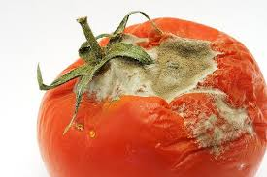
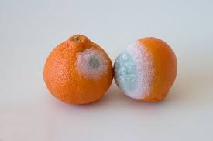
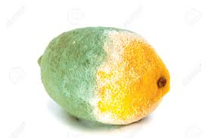
How microorganisms can cause spoilage of the food?
microorganisms use the food as their source of nutrients for growth. By increasing their numbers, utilizing nutrients, producing enzymatic changes and contributing off flavours by means of breakdown of a product or synthesis of new compounds; microorganisms can spoil the food.

Slide 7
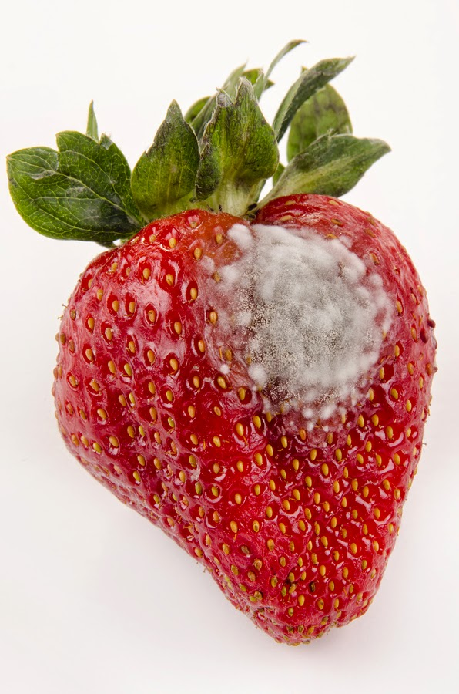
FOOD SPOILAGE
Food spoilage can be defined as any changes in the visual, smell and texture of food that makes it unacceptable for consumption.
Foods are subject to attack by microorganisms in a variety of ways. Such attack is harmful to the quality of food
Foods are organic substance and hence provide adequate nutrients for the growth of wide varieties of microbes
The physical and chemical characteristics of food and how it is stored determine the susceptibility to microbial attack.

Slide 8
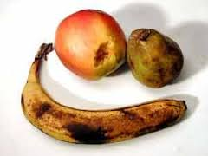
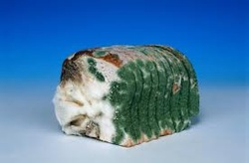
TYPE OF FOOD SPOILAGE
a. Physical spoilage
Dehydration of vegetable
b. Chemical spoilage
• Oxidation of fat
• Browning of fruits and vegetables
c. Microbial spoilage
• Growth of microorganisms
• Enzyme production

Slide 9
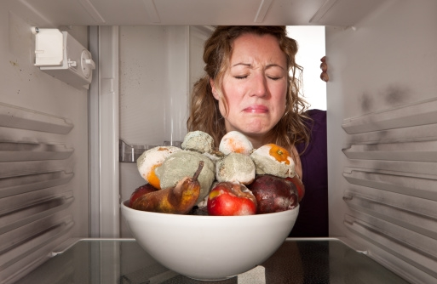
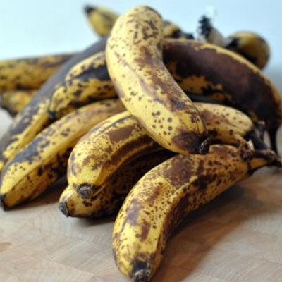
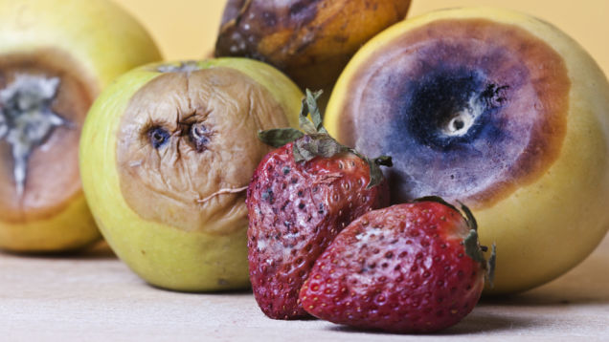
CRITERIA / PARAMETERS ASSOCITED WITH FOOD SPOILAGE
Odour
Texture
Shape
Formation of slime
Colour
Flavour
Gas production

