Slide 1
FOOD-BORNE DISEASEs
Cls 416

Slide 2
FOOD-BORNE DISEASEs
Food-borne illness is defined as any illness occures due to the consumption of contaminated food or beverages.
food borne microbial pathogen, or a preformed microbial toxin, or another poison such as a poisonous chemical that contaminated the food and/or beverage, leads to one of the many different food borne illnesses.

Slide 3
FOOD-BORNE DISEASE
More than 250 different food borne diseases have been described.
Most of these diseases are infections, caused by a variety of bacteria, viruses, and parasites. Other diseases are poisonings, caused by harmful toxins or chemicals that have contaminated the food, for example, poisonous mushrooms or heavy metal contamination.

Slide 4
FOOD-BORNE PATHOGENS
Protozoa
Giardia lamblia Entamoeba histolytica
Helminthes Taenia spp
Viruses Norwalk virus Hepatitis A virus
Prions new variant CJD
Bacteria Toxin producing: Clostridium botulinum, Staphylococcus aureus Infectious: Salmonella spp., Listeria monocytogenes, shigella, E.coli, Salmonella typhi

Slide 5
Classification of food borne diseases
Food borne diseases are classified into:
Food borne infections and
Food borne intoxications

Slide 6
Food borne infections vs. intoxication
Infections
Bacterial / Viral / parasite
Invade and or multiply in lining of intestine or
secerte an enterotoxin
S/s – Diarrhea , nausea, vomiting , abdominal cramps, fever
Communicable-spreads from person to person
Factors-inadequate cooking, cross contamination , poor personal hygiene , bare hand contact
Intoxications
toxins ( natural / preformed bacterial / chemical)
No invasion or multiplication
S/s – Vomiting , nausea, diarrhea, weakness, resp. failure , numbness, sensory/motor dysfunction
Not communicable
Factors-inadequate cooking , improper handling temperatures

Slide 7
Organisms associated with food borne disease
Intoxication
poisoning
Bacteria
- Staph aureus
-C. botulinum
- Bacillus cereus
Fungi (mycotoxins)
-Aspergillus,
- Fusarium,
- penicillium
Infection
Bacteria
-Campylobacter
-Salmonella
-Vibrio
-Listeria monocytogenes
-Yersinina enterocolitica
-Shigella
Viruses
- Norovirus
-Rotaviruses
-Hepatitis Avirus

Slide 8
Food- borne infection
Food borne infections are caused by the entrance of pathogenic microorganisms contaminating food into the body, and the reaction of the body tissues to their presence.
These can either be fungal, bacterial, viral or parasitic
Mycotic food borne infections include Candida spp., Sporothrix spp. etc..
Viral food borne infections include hepatitis A , Norwak virus and poliomyelitis virus

Slide 9
FOOD BORNE INTOXICATIONS
These are diseases caused by consumption of food containing:
Biotoxicants which are found in tissues of certain plants and animals.
Metabolic products (toxins) formed and excreted by microorganisms (such as bacteria, fungi and algae), while they multiply in food, or in gastrointestinal tract of man.
Poisonous substances, which may be intentionally or unintentionally added to food during production, processing, transportation or storage.

Slide 10
Food Infections
Etiology | Incubation period | Clinical findings | Characteristic food
Bacillus cereus | 6-24 hours | watery diarrhoea | Meat, poultry, rice
Clostridium perfringens | 10-15 hours | watery diarrhoea | Meat, poultry, pie, stews
Salmonella sp. | 12-48 hours | Enteritis, enterotoxin | Poultry, eggs, meat
Salmonella typhi Salmonella paratyphi | 14-21 days | Enteric fever | Fecal-oral, (human) Carriers, water, food
Shigella sp. | 12-48 hours | Dysentery, invasion, enterotoxin | Fecal-oral, (human) water

Slide 11
Food Infection----cont
Etiology | Incubation period | Clinical findings | Characteristic food
Vibrio parahemolyticus | 10-24 hours | watery diarrhoea | shellfish
Vibrio cholerae | 12-36 hours | enterotoxin(rice water stool) watery diarrhoea, dehydration, vomiting | water (Fecal oral)
Campylobacter sp. | 3-5 days | Enterotoxin dysentary | Poultry, milk
Yersinia enterocolytica | 1-2 days | Vomiting , diarrhoea, bacterimia | Pork & meat, raw milk, leftover foods
E.Coli (ETEC,) ( EHEC) | 12-24 hours | Travelars diarrhoea Haemorrhagic colitis , Kidney failure | water,, raw vegetables, meat, water

Slide 12
FOOD BORNE INTOXICATIONS
Food borne intoxications have short incubation periods (minutes to hours) and are characterized by lack of fever.
Food borne intoxications can be classified into:
Bacterial intoxications
Fungal intoxications
Chemical intoxication
Plant toxicants, and
Poisonous animals.

Slide 13
Food (Bacterial) intoxication poisoning
Etiology | Incubation period | Clinical Findings | Characteristic Food
Bacillus cereus | 1-6 hours | Vomiting, Diarroea | Fried rice
Staph aureus | 1-8 hours | Vomiting, Diarroea | Meat,custards, mayonaise
Clostridium botulinum | 1-4 days | Neuromuscular paralysis | Canned food Vegetables, fruits, meat,fish (alkaline pH)

Slide 14
Food- borne infection Prions
Prions-proteinaceous infectious particles.
They contain proteins but no DNA, and are linked to a group of diseases called the TRANSMISSIBLE SPONGIFORM ENCEPHALOPATHIES= cause breakdown of the nerve cells.
A prion is essentially a variation on a normal protein which is folded in an unusual way.
It causes disease not by replicating, but by triggering other proteins to also turn into prions
This chain reaction of changes eventually leads to the build up of plaques in the nervous system, and the symptoms of spongiform disease.

Slide 15
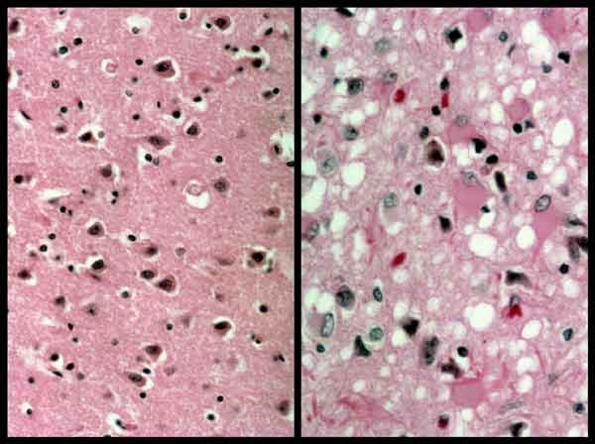
Food borne infection Prions
Vacuoles in affected brain tissue

Slide 16
KURU
It is caused by an infectious protein(Prion) found in contaminated human brain tissue.
First recognised among New Guinea tribesman in the 1950s.
In the local language, kuru means ‘shivering’ or ‘trembling’ this reflected the severe loss of coordination associated with the disease, which was fatal within 2 years of onset.
The disease is caused by ritual cannibalism, particularly by women and children, who consume the brains of dead relatives.
Notes:
kuru had a long incubation period; it was years or even decades before an infected person showed symptoms. Because kuru mainly affected the cerebellum, which is responsible for coordination, the usual first symptoms were an unsteady gait, tremors, and slurred speech. (Kuru is the Fore word for shiver.) Unlike most of the other TSEs, dementia was either minimal or absent. Mood changes were often present. Eventually, individuals became unable to stand or eat, and they died in a comatose state from 6 to 12 months after the first appearance of symptoms.

Slide 17
VIRAL FOOD-BORNE INFECTIONS
Viruses are common pathogens transmitted through food.
Hepatitis A and Norwalk-like virus (Novovirus) are the most important viral food borne pathogens.
These viruses are highly infectious and may lead to widespread outbreaks

Slide 18
Infectious hepatitis A
The incubation period is long, being an average of 30 days (range 15-50 days).
It is a systemic infection characterized by gastrointestinal manifestations and liver injury, fever, malaise anorexia, nausea, abdominal discomfort, bile in urine and jaundice.
The duration of the disease could be from a few weeks to several months

Slide 19
Norwalk-like virus (Novovirus) food borne infection
Novovirus infection is relatively mild with an incubation period of 3 days.
Clinical manifestations/symptoms include vomiting and diarrhea, and rarely convulsions.
Asymptomatic infection are common and may contribute to the spread of the infection.
Infections have resulted from consumption of raw oyesters.

