Slide 1
Chapter 3
GC 101
Java Fundamentals

Slide 2
Basics of Java Environment
The environment
The language
Java applications programming Interface API
Various class libraries

Slide 3
Processing a Java Program
A Java program undergoes several stages :
Editing: use Java code and save in a text file named
className .java ( source program ).
2. Compiling : the compiler checks the source program for any syntax errors then translates the program into code understood by interpreter called bytecode saved in a file named className.class
3. Loading : the .class file is loaded into computer main memory for execution, and connected to all classes.
4. Verifying : to validate and secure against damage .
5. Interpreting :the Interpreter reads and translates each bytecode instruction into machine language and then executes it , one instruction at a time .

Slide 4
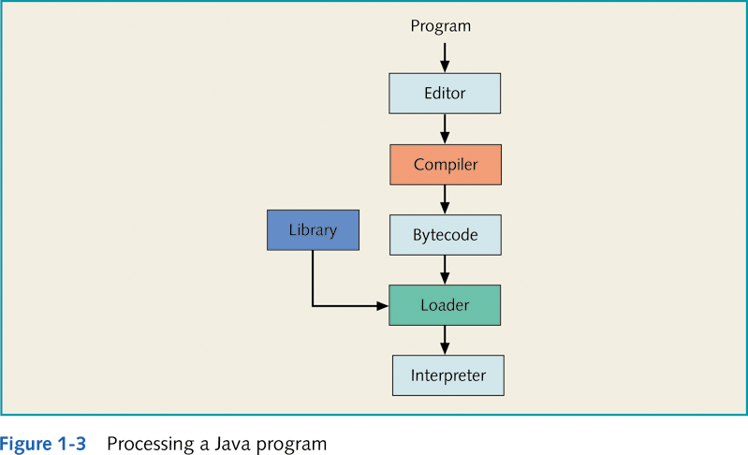
Processing a Java Program

Slide 5
Processing a Java Program
Java Virtual Machine (JVM): A hypothetical computer developed to make Java programs machine independent ( i.e run on many different types of computer platforms ).
Bytecode is the machine language for the JVM .

Slide 6
Processing a Java Program
Two types of Java programs:
Applications : standalone programs stored and executed on a local computer .
Applets : small programs stored on remote computers that users connect to via a WWW browser.
Applets are loaded into the browser , executed then discarded .

Slide 7
What does a Java program look like? Example 1
A simple Java application:
an application executes using the Java interpreter.
The basic unit of a Java program is a class.
Every Java program must have at least one class .
Each class begins with a class declaration that defines data and methods for the class . We’ll talk about this more later.

Slide 8
What does a Java program look like? Example 1
Here’s a class called Welcome:
public class Welcome
{
// This is a comment.
}
It’s a convention that the name of a class starts with a capital letter.
You’ll meet other conventions along the way!!
At the moment, we’ve defined a class that does nothing. The line with
the // in front of it is not translated by the compiler - it’s called a comment
and it’s ignored.
So let’s make our program do something!

Slide 9
What does a Java program look like? Example 1
public class Welcome
{
public static void main(String [] args)
{
System.out.print(“Welcome to Java”);
}
}
We’ve now added a main method to our class. We’ve also used a number of words that have a special meaning to Java: class, public, static, void and String.
The line System.out.print(“Welcome to Java ”) is an instruction to print the sentence Welcome to Java on the screen.
The double quotes (“) are not printed out as they are used to inform the compiler that Welcome to Java is a String.
Then our program exits.

Slide 10
What does a Java program look like? Example 1
public static void main (String args[]) is a part of every Java application program.
Java applications automatically begin executing at main()
The void before main() means that main will not return any info .
A Java class must contain one main method if it is an application .

Slide 11
What does a Java program look like? Let’s make it work !
1. Type the program into a text editor
2. Save as Welcome.java
3. Compile into byte codes
javac Welcome.java
4. Execute byte codes
java Welcome

Slide 12
What does a Java program look like? Let’s work it !

Slide 13
What does a Java program look like? Remember !
Upper case and lower case are very important! Java is case-sensitive. ( A is NOT similar to a)
Your class name MUST MATCH YOUR FILE NAME.
You only use the class name when you invoke Java but you use the file name when you invoke the compiler (Javac).
A file cannot contain two public classes.

Slide 14
What does a Java program look like? Example 2
public class ASimpleJavaProgram
{
public static void main(String[] args)
{
System.out.println("My first Java program.");
System.out.println("The sum of 2 and 3 = " + 5);
System.out.println("7 + 8 = " + (7 + 8));
}
}
Class name
Body of class
Heading of method main

Slide 15
What does a Java program look like? Example 2
A Java output statement causes the program to evaluate whatever is in the parentheses and display the result on screen .
+ is used to concatenate the strings . The system automatically converts the number 5 into a string ,joins that string with the first string ,and displays it .

Slide 16
What does a Java program look like? Example 2
The parentheses around 7+8 causes the system to add the numbers 7 and 8 ,resulting in 15 .
The number 15 is then converted to string 15 and joined with string “7+8”= “ .
Sample Run:
My first Java program.
The sum of 2 and 3 = 5
7 + 8 = 15

Slide 17
Special Symbols
public class Message
{
public static void main(String[] arg)
{
System.out.println("This is a message");
}
}
Note: Blank is a special symbol.

Slide 18
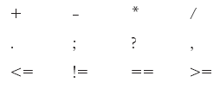
Other Special Symbols

Slide 19
Word Symbols( reserved words)
public class Message
{
public static void main(String[] arg)
{
System.out.println("This is a message");
}
}
Also called reserved words or keywords.
They are words that mean something special to Java.
Cannot be redefined.
Always lowercase.

Slide 20
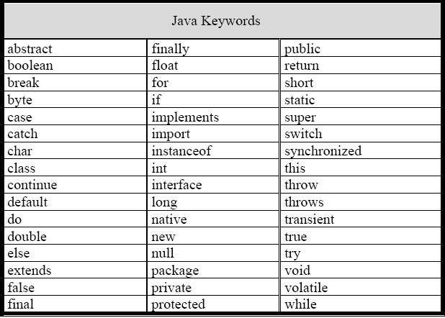
Java Reserved Words

Slide 21
Java Identifiers
public class Message
{
public static void main(String[] arg)
{
System.out.println("This is a message");
}
}
They are names that we introduce in our program
Some are predefined; others are defined by the user.
Consists of:
Letters: (a → z) ( A → Z)
Digits (0 → 9)
The underscore character (_)
Must begin with a letter, underscore, or the dollar sign.

Slide 22
Java Identifiers
Java identifiers can be any length.
Unlike reserved words, predefined identifiers can be redefined, but it would not be wise to do so.
Some predefined identifiers:
print, println, next, nextLine
Names should be descriptive:
• Message – the name of a program that prints out a message.
• System.out.println – the name for a part of Java that prints a line of output to the screen.

Slide 23
Illegal Identifiers
Note:
White space, breaks up the program into words, e.g. the two reserved
words static void, rather than staticvoid, which would be assumed
to be an identifier !

