Slide 1
Chapter 6
GC 101
Strings

Slide 2
The class String
Contains operations to manipulate strings.
String:
Sequence of zero or more characters.
Enclosed in double quotation marks.
Is processed as a single unit .
Null or empty strings have no characters. “ “
Every character has a relative position , the first character is in position 0 .

Slide 3
The class String
Java system automatically makes the class String available (i.e no need to import this class )
Example :
String name = "text";
String name = expression;
Examples: String name = "Marla Singer"; int x = 3; int y = 5; String point = "(" + x + ", " + y + ")";
Java Programming: From Problem Analysis to Program Design, Second Edition
3
Notes:
3

Slide 4
Indexes
Characters of a string are numbered with 0-based indexes:
String name = "P. Diddy";
The first character's index is always 0
The last character's index is 1 less than the string's length
index | 0 | 1 | 2 | 3 | 4 | 5 | 6 | 7
char | P | . |  | D | i | d | d | y

Slide 5
The class String
Length of the string is the number of characters in it .
When determining the length of a string , blanks count .
Example :
“ “ ➔ has length = 0
“abc” ➔ has length = 3 , position of a = 0 ,b= 1 , c= 2
“a boy” ➔ has length = 5

Slide 6
String Operations
The length() method returns the length of the string.
Eg:
System.out.println(“Hello”.length()); // prints 5
The + operator is used to concatenate two or more strings.
Eg:
String myname = “Harry”
String str = “My name is” + myname+ “.”;
CSM-Java Programming-I Lesson-1

Slide 7
String methods
Method name | Description
indexOf(str) | index where the start of the given string appears in this string (-1 if it is not there)
length() | number of characters in this string
substring(index1, index2) or substring(index1) | the characters in this string from index1 (inclusive) to index2 (exclusive); if index2 omitted, grabs till end of string
toLowerCase() | a new string with all lowercase letters
toUpperCase() | a new string with all uppercase letters
These methods are called using the dot notation:
String gangsta = "Dr. Dre";
System.out.println(gangsta.length()); // 7

Slide 8
String method examples
String s1 = "Stuart Reges";
String s2 = "Marty Stepp";
System.out.println(s1.length()); // 12
System.out.println(s1.indexOf("e")); // 8
System.out.println(s1.substring(7, 10)) // "Reg"
String s3 = s2.substring(2, 8);
System.out.println(s3.toLowerCase()); // "rty st"
Given the following string:
// index 0123456789012345678901
String book = "Building Java Programs";
How would you extract the word "Java" ?
How would you extract the first word from any string?

Slide 9
Some Commonly Used String Methods
String mystr=new String("programming with Java is fun");
System.out.println(mystr);
System.out.println(mystr.charAt(3));
System.out.println(mystr.indexOf('J'));
System.out.println(mystr.indexOf(‘j'));
programming with Java is fun
g
17
-1
Java Programming: From Problem Analysis to Program Design, Second Edition
9
Notes:
9

Slide 10
Some Commonly Used String Methods
Java Programming: From Problem Analysis to Program Design, Second Edition
10
Notes:
10

Slide 11
Example
String mystr=new String("programming with Java is fun");
System.out.println(mystr);
System.out.println(mystr.indexOf('a',10));
System.out.println(mystr.indexOf("with"));
System.out.println(mystr.indexOf("ing"));
programming with Java is fun
18
12
8

Slide 12
Modifying strings
Methods like substring, toLowerCase, etc. create/return a new string, rather than modifying the current string.
String s = "lil bow wow";
s.toUpperCase();
System.out.println(s); // lil bow wow
To modify a variable, you must reassign it:
String s = "lil bow wow";
s = s.toUpperCase();
System.out.println(s); // LIL BOW WOW

Slide 13
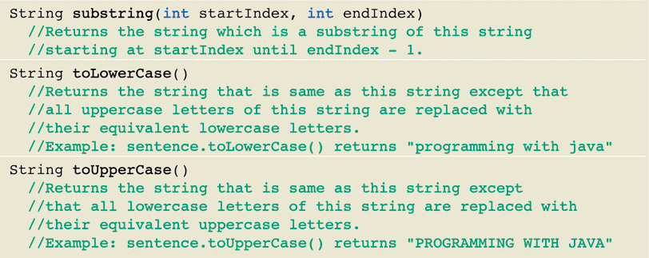
Some Commonly Used String Methods
Java Programming: From Problem Analysis to Program Design, Second Edition
13
Notes:
13

Slide 14
Examples on string methods
String s1 , s2 , s3 ;
s1 = “abcdefeg” ;
System.out.println( s1.length() ); // 8
System.out.println(s1.charAt(3)); //d
System.out.println(s1.indexOf(‘e’)); //4
System.out.println(s1.indexOf(“cd”)); //2
System.out.println(s1.toUpperCase()); //ABCDEFEG
Notes:
14

Slide 15
Examples on string methods
System.out.println(s1.substring(1 , 4)); //bcd
System.out.println(s1 + “xyz”); // abcdefegxyz
System.out.println( s1.replace(‘d’ ,’D’)); // abcDefeg
System.out.println(s1.charAt(4) ); // e
System.out.println(s1.indexOf(‘b’)); // 1
System.out.println(s1.indexOf(‘e’,5)); // 6
15
Notes:
15

Slide 16
char vs. int
All char values are assigned numbers internally by the computer, called ASCII values.
Examples:
'A' is 65, 'B' is 66, ' ' is 32
'a' is 97, 'b' is 98, '*' is 42
Mixing char and int causes automatic conversion to int.
'a' + 10 is 107, 'A' + 'A' is 130

Slide 17
char vs. String
"h" is a String 'h' is a char (the two behave differently)
String is an object; it contains methods
String s = "h";
s = s.toUpperCase(); // 'H'
int len = s.length(); // 1
char first = s.charAt(0); // 'H'
char is primitive; you can't call methods on it
char c = 'h';
c = c.toUpperCase(); // ERROR: "cannot be dereferenced"
Notes:
17

