Slide 1
If statements

Slide 2
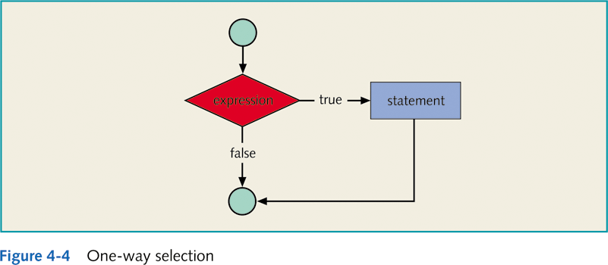
One-Way Selection
Example:
char grade=‘’
if ( score >= 90 )
grade = ‘A’;

Slide 3
Example if-statement: find absolute value
import java.util.Scanner;
public class If1
{
public static void main(String[] args)
{
Scanner in = new Scanner(System.in);
int a;
System.out.print("Enter an integer value: ");
a = in.nextInt(); // Read in an integer from keyboard
System.out.print("Input value = ");
System.out.println(a);
if ( a < 0 ) // If-statement
a = -a; // Negate a ONLY if a < 0
System.out.print("It's absolute value = ");
System.out.println(a);
}
}

Slide 4
Two-Way Selection
Syntax:
if (expression)
statement1;
else
statement2;
else statement must be paired with an if.

Slide 5
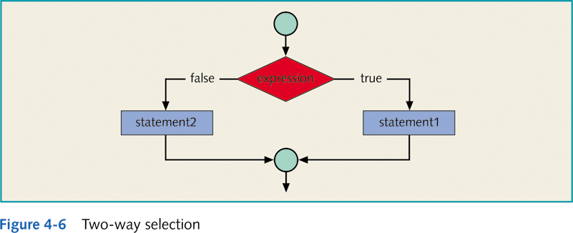
Two-Way Selection
Example:
boolean positive, negative;
if (number >= 0 )
positive = true;
else //number < 0
negative =true;

Slide 6
Multiple Selection: Nested if
Example4_23 :
if ( GPA >= 2.0 )
if (GPA >= 3.9)
System.out.println(“Dean Honor list”);
else
System.out.println(“GPA below graduation requirement”);
If GPA = 3.8 what will be printed?
GPA below graduation requirement

Slide 7
Multiple Selection: Nested if
Example4_23 : (rewritten)
if ( GPA >= 2.0 )
{
if (GPA >= 3.9)
System.out.println(“Dean Honor list”);
}
else
System.out.println(“GPA below graduation requirement”);
Now, if GPA = 3.8 what will be printed?

Slide 8
public class Test {
public static void main(String args[]){
int x = 30;
if( x == 10 ){
System.out.print("Value of X is 10");}
else if( x == 20 ){
System.out.print("Value of X is 20");}
else if( x == 30 ){
System.out.print("Value of X is 30");}
else{
System.out.print("This is else statement");
}
}
}

Slide 9
