Slide 1
ENGINEERING MANAGEMENT (GE 404)
بسم الله الرحمن الرحيم
Tutorial # 4
Allocate and Level Resources
(Part 1)
(Resource Smoothing)
Instructor: Eng.Alothman
Notes:
This is a title slide.

Slide 2
Resource leveling and allocation measures

Slide 3
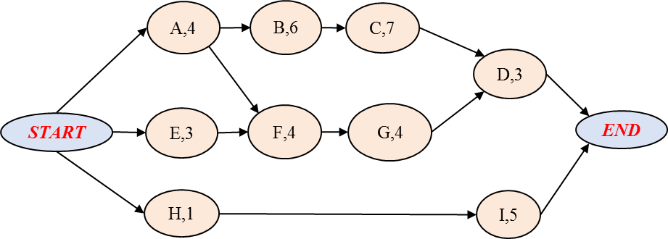
Example1:
For a small Engineering project listed below, it is required to do the following:
Draw the ES , LS project schedule using Time- scaled network?
How many Worker(s)/day you should use in this project?
c) Within only two trials, level the project Resource and draw result?
Activity | Depends on | Time, day | Resource, Worker/day
A | None | 4 | 2
B | A | 6 | 3
C | B | 7 | 3
D | C, G | 3 | 4
E | None | 3 | 3
F | A, E | 4 | 2
G | F | 4 | 2
H | None | 1 | 3
I | H | 5 | 2

Slide 4
A) ES -Time scale network
 | Earlest Start project schedule using Time- scaled network
 | 1 | 2 | 3 | 4 | 5 | 6 | 7 | 8 | 9 | 10 | 11 | 12 | 13 | 14 | 15 | 16 | 17 | 18 | 19 | 20 | 21
A
R2
B
R3
C
R3
D
R4
E
R3
F
R2
G
R2
H
R3
I
R2
R | 8 | 7 | 7 | 4 | 7 | 7 | 5 | 5 | 5 | 5 | 5 | 5 | 3 | 3 | 3 | 3 | 3 | 4 | 4 | 4
∑R | 8 | 15 | 22 | 26 | 33 | 40 | 45 | 50 | 55 | 60 | 65 | 70 | 73 | 76 | 79 | 82 | 85 | 89 | 93 | 97
R² | 64 | 49 | 49 | 16 | 49 | 49 | 25 | 25 | 25 | 25 | 25 | 25 | 9 | 9 | 9 | 9 | 9 | 16 | 16 | 16
∑R² | 64 | 113 | 162 | 178 | 227 | 276 | 301 | 326 | 351 | 376 | 401 | 426 | 435 | 444 | 453 | 462 | 471 | 487 | 503 | 519

Slide 5
LS -Time scale network
 | Latest Start project schedule using Time- scaled network
 | 1 | 2 | 3 | 4 | 5 | 6 | 7 | 8 | 9 | 10 | 11 | 12 | 13 | 14 | 15 | 16 | 17 | 18 | 19 | 20 | 21
A
R2
B
R3
C
R3
D
R4
E
R3
F
R2
G
R2
H
R3
I
R2
R | 2 | 2 | 2 | 2 | 3 | 3 | 6 | 6 | 6 | 5 | 5 | 5 | 5 | 5 | 8 | 7 | 7 | 6 | 6 | 6
∑R | 2 | 4 | 6 | 8 | 11 | 14 | 20 | 26 | 32 | 37 | 42 | 47 | 52 | 57 | 65 | 72 | 79 | 85 | 91 | 97
R² | 4 | 4 | 4 | 4 | 9 | 9 | 36 | 36 | 36 | 25 | 25 | 25 | 25 | 25 | 64 | 49 | 49 | 36 | 36 | 36
∑R² | 4 | 8 | 12 | 16 | 25 | 34 | 70 | 106 | 142 | 167 | 192 | 217 | 242 | 267 | 331 | 380 | 429 | 465 | 501 | 537
B) Measure resource requirement

Slide 6
c) 1st trial for leveling
 | step 1- moving task H to start end of 3rd period
 | 1 | 2 | 3 | 4 | 5 | 6 | 7 | 8 | 9 | 10 | 11 | 12 | 13 | 14 | 15 | 16 | 17 | 18 | 19 | 20 | 21
A
R2
B
R3
C
R3
D
R4
E
R3
F
R2
G
R2
H
R3
I
R2
R | 5 | 5 | 5 | 5 | 7 | 7 | 7 | 7 | 7 | 5 | 5 | 5 | 3 | 3 | 3 | 3 | 3 | 4 | 4 | 4
∑R | 5 | 10 | 15 | 20 | 27 | 34 | 41 | 48 | 55 | 60 | 65 | 70 | 73 | 76 | 79 | 82 | 85 | 89 | 93 | 97
R² | 25 | 25 | 25 | 25 | 49 | 49 | 49 | 49 | 49 | 25 | 25 | 25 | 9 | 9 | 9 | 9 | 9 | 16 | 16 | 16
∑R² | 25 | 50 | 75 | 100 | 149 | 198 | 247 | 296 | 345 | 370 | 395 | 420 | 429 | 438 | 447 | 456 | 465 | 481 | 497 | 513

Slide 7
2nd trial for leveling
 | step 2- moving task I to start end of 12th period
 | 1 | 2 | 3 | 4 | 5 | 6 | 7 | 8 | 9 | 10 | 11 | 12 | 13 | 14 | 15 | 16 | 17 | 18 | 19 | 20 | 21
A
R2
B
R3
C
R3
D
R4
E
R3
F
R2
G
R2
H
R3
I
R2
R | 5 | 5 | 5 | 5 | 5 | 5 | 5 | 5 | 5 | 5 | 5 | 5 | 5 | 5 | 5 | 5 | 5 | 4 | 4 | 4
∑R | 5 | 10 | 15 | 20 | 25 | 30 | 35 | 40 | 45 | 50 | 55 | 60 | 65 | 70 | 75 | 80 | 85 | 89 | 93 | 97
R² | 25 | 25 | 25 | 25 | 25 | 25 | 25 | 25 | 25 | 25 | 25 | 25 | 25 | 25 | 25 | 25 | 25 | 16 | 16 | 16
∑R² | 25 | 50 | 75 | 100 | 125 | 150 | 175 | 200 | 225 | 250 | 275 | 300 | 325 | 350 | 375 | 400 | 425 | 441 | 457 | 473

Slide 8
C) Leveling result
The graphs shows the resource is nearly constant over time, and has been leveled.

Slide 9
Example2:
The Activity given in table below represent a section of work being undertaken by a subcontractor. The activities’ predecessor, duration, early start, total float, free float and labor requirement are also listed. The labor profile made up of the preferred limits chosen by subcontract is shown in figure below.
a)What are the scheduled timings of the activities that satisfy the preferred profile?
Activity | Depends on | Duration | ES | TF | FF | No. of Labour
K | - | 4 | 0 | - | - | 2
L | K | 2 | 4 | 19 | 7 | 3
M | K | 6 | 4 | 9 | - | 4
N | K | 9 | 4 | - | - | 4
O | N | 10 | 13 | - | - | 4
P | M | 3 | 10 | 12 | - | 3
Q | M | 8 | 10 | 9 | 9 | 4
R | L,P | 2 | 13 | 12 | 12 | 2
S | O | 4 | 23 | - | - | 2
T | Q,R,S | 2 | 27 | - | - | 1

Slide 10
Activity | Depends on | Duration | ES | TF | FF | No. of Labor
K | - | 4 | 0 | - | - | 2
L | K | 2 | 4 | 19 | 7 | 3
M | K | 6 | 4 | 9 | - | 4
N | K | 9 | 4 | - | - | 4
O | N | 10 | 13 | - | - | 4
P | M | 3 | 10 | 12 | - | 3
Q | M | 8 | 10 | 9 | 9 | 4
R | L,P | 2 | 13 | 12 | 12 | 2
S | O | 4 | 23 | - | - | 2
T | Q,R,S | 2 | 27 | - | - | 1
ES – time diagram
1 | 2 | 3 | 4 | 5 | 6 | 7 | 8 | 9 | 10 | 11 | 12 | 13 | 14 | 15 | 16 | 17 | 18 | 19 | 20 | 21 | 22 | 23 | 24 | 25 | 26 | 27 | 28 | 29
K (2)
N (4)
O (4)
S (2)
T (1)
L (3)
M (4)
P (3)
Q (4)
R(2)
Activities (L, M, P, Q, R are to be moved to satisfy load profile
1 | 2 | 3 | 4 | 5 | 6 | 7 | 8 | 9 | 10 | 11 | 12 | 13 | 14 | 15 | 16 | 17 | 18 | 19 | 20 | 21 | 22 | 23 | 24 | 25 | 26 | 27 | 28 | 29
K (2)
N (4)
O (4)
S (2)
T (1)
L (3)
M (4)
P (3)
Q (4)
R(2)

Slide 11
b)Consider the resource profile given above and calculate:
Sum of squares of resource profile (∑R²)
Cumulative usage of resource(∑R)
Average daily requirement, Effectiveness and Critically Index.
time | 1 | 2 | 3 | 4 | 5 | 6 | 7 | 8 | 9 | 10 | 11 | 12 | 13 | 14 | 15 | 16 | 17 | 18 | 19 | 20 | 21 | 22 | 23 | 24 | 25 | 26 | 27 | 28 | 29
R | 2 | 2 | 2 | 2 | 4 | 4 | 7 | 7 | 8 | 8 | 8 | 8 | 8 | 8 | 8 | 8 | 8 | 8 | 8 | 8 | 8 | 8 | 7 | 5 | 5 | 4 | 4 | 1 | 1
∑R | 2 | 4 | 6 | 8 | 12 | 16 | 23 | 30 | 38 | 46 | 54 | 62 | 70 | 78 | 86 | 94 | 102 | 110 | 118 | 126 | 134 | 142 | 149 | 154 | 159 | 163 | 167 | 168 | 169
R² | 4 | 4 | 4 | 4 | 16 | 16 | 49 | 49 | 64 | 64 | 64 | 64 | 64 | 64 | 64 | 64 | 64 | 64 | 64 | 64 | 64 | 64 | 49 | 25 | 25 | 16 | 16 | 1 | 1
∑R² | 4 | 8 | 12 | 16 | 32 | 48 | 97 | 146 | 210 | 274 | 338 | 402 | 466 | 530 | 594 | 658 | 722 | 786 | 850 | 914 | 978 | 1042 | 1091 | 1116 | 1141 | 1157 | 1173 | 1174 | 1175
$$Average daily requirement, Dr=\frac{Total men (∑R)}{Project duration (D)}=\frac{169}{29}=5.83\frac{workers}{day}=6$$
$$Effectiveness=Dr2 ∗D=\left(5.83\right)2 ∗29=984.86$$
$$Time Criticallity Index=\frac{5.83}{6}=0.972 ;when Dr=6$$

Slide 12
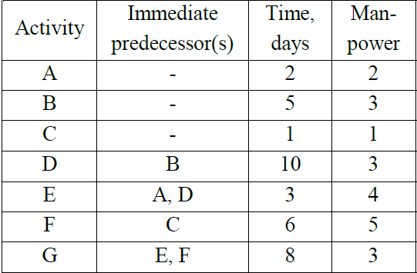
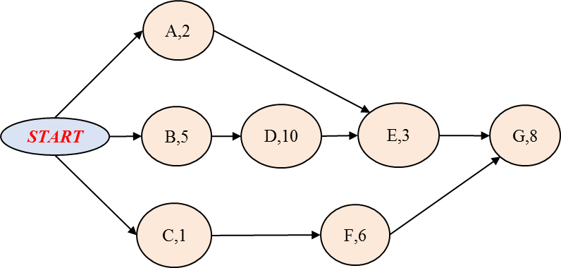
Example3:
Develop Time- scaled network for a given project listed in the table,then find :
i. average daily requirement;
ii. Critical Index
iii. Effectiveness value

Slide 13
Cont.
 | Earlest Start project schedule using Time- scaled network
 | 1 | 2 | 3 | 4 | 5 | 6 | 7 | 8 | 9 | 10 | 11 | 12 | 13 | 14 | 15 | 16 | 17 | 18 | 19 | 20 | 21 | 22 | 23 | 24 | 25 | 26
B
R3
D
R3
E
R4
G
R3
A
R2
C
R1
F
R5
R | 6 | 10 | 8 | 8 | 8 | 8 | 8 | 3 | 3 | 3 | 3 | 3 | 3 | 3 | 3 | 4 | 4 | 4 | 3 | 3 | 3 | 3 | 3 | 3 | 3 | 3
∑R | 6 | 16 | 24 | 32 | 40 | 48 | 56 | 59 | 62 | 65 | 68 | 71 | 74 | 77 | 80 | 84 | 88 | 92 | 95 | 98 | 101 | 104 | 107 | 110 | 113 | 116
R² | 36 | 100 | 64 | 64 | 64 | 64 | 64 | 9 | 9 | 9 | 9 | 9 | 9 | 9 | 9 | 16 | 16 | 16 | 9 | 9 | 9 | 9 | 9 | 9 | 9 | 9
∑R² | 36 | 136 | 200 | 264 | 328 | 392 | 456 | 465 | 474 | 483 | 492 | 501 | 510 | 519 | 528 | 544 | 560 | 576 | 585 | 594 | 603 | 612 | 621 | 630 | 639 | 648
$$Average daily requirement, Dr=\frac{Total men (∑R)}{Project duration (D)}=\frac{116}{26}=4.462\frac{workers}{day}=5$$
$$Effectiveness=Dr2 ∗D=\left(4.462\right)2 ∗26=517.54$$
$$ES Time Criticallity Indeex=\frac{4.462}{5}=0.892 ;when Dr=5$$

Slide 14
Thank You
Questions Please

