Slide 1
ENGINEERING MANAGEMENT (GE 404)
بسم الله الرحمن الرحيم
Tutorial # 5
Allocate and Level Resources
(Part 2)
(Limited Resource Allocation)
Instructor: Eng.Alothman
Notes:
This is a title slide.

Slide 2
Form for solution
Time | 1 | 2 | 3 | 4 | 5 | 6 | 7 | 8 | 9 | 10 | 11 | 12 | 13 | 14 | 15 | 16 | 17 | 18 | 19 | 20 | 21 | 22 | 23 | 24 | 25 | 26 | 27 | 28 | 29 | 30 | 31
EAS
OSS
use
R

Slide 3
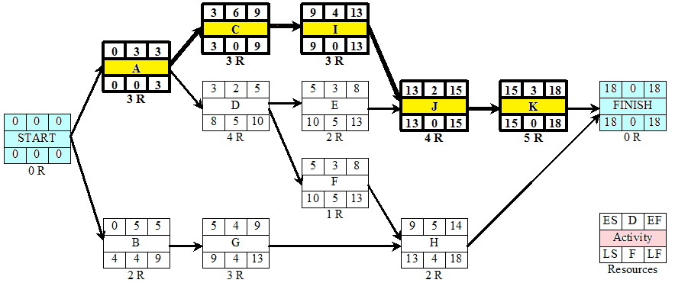
Example1:
The work of a small engineering project is planned according to the AON shown below. The labour requirement of each activity is shown below each activity box. What will be the minimum contract duration if no more than 6 labors can be made available for the work and if it is assumed that having started an activity it must be completed without a break?

Slide 4
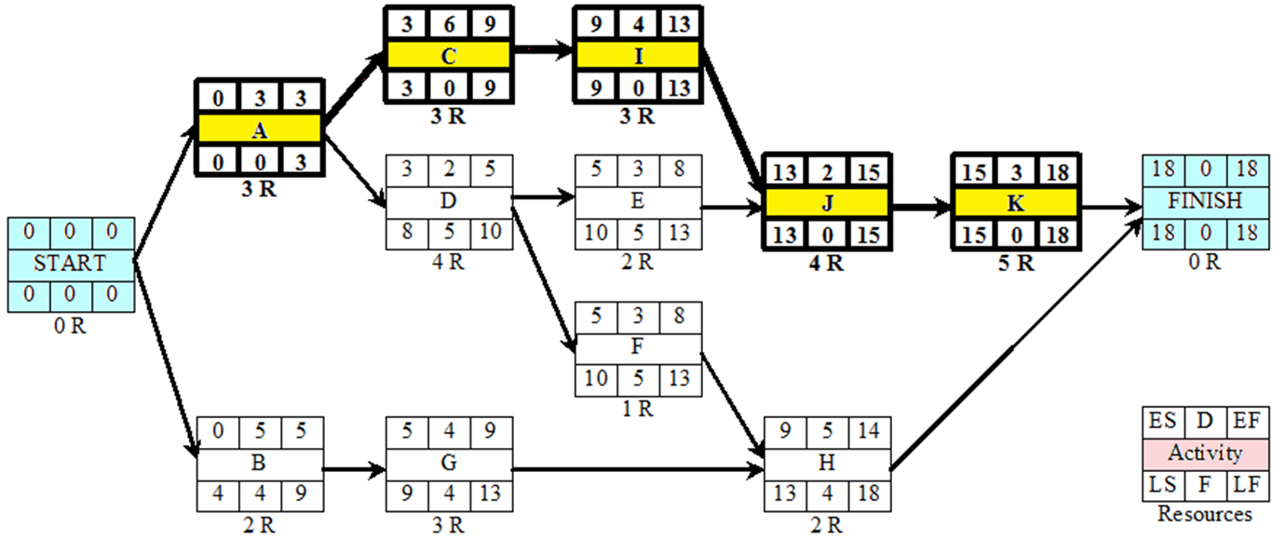
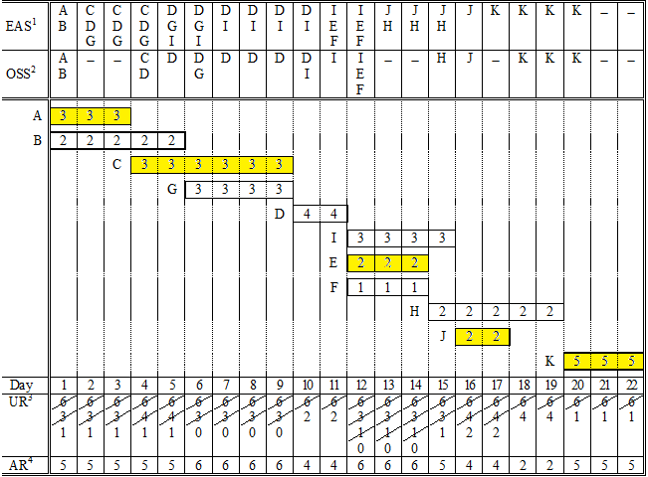

Slide 5
Example2:
The program of a small contract is given in table below. Each activity requires the continues use of mechanical excavator throughout its duration. What will be the minimum contract duration if no more than two excavators can be made available for the work and if it is assumed that having start activity it must be completed without a break.
EAS | A | B C D | C | E C | E G | E F | F | F | F I | I H | H | H | H | J
OSS | A | D B |  | C | G | E |  |  | F | I |  |  | H | J
 | A
 |  |  | D
 |  | B
 |  |  |  | C
 |  |  |  |  |  | G
 |  |  |  |  |  |  | E
 |  |  |  |  |  |  |  |  |  |  | F
 |  |  |  |  |  |  |  |  |  |  | I
 |  |  |  |  |  |  |  |  |  |  |  |  | H
 |  |  |  |  |  |  |  |  |  |  |  |  |  | J
Day | 1 | 2 | 3 | 4 | 5 | 6 | 7 | 8 | 9 | 10 | 11 | 12 | 13 | 14 | 15
 | 1 | 2 | 2 | 2 | 2 | 2 | 2 | 2 | 2 | 2 | 2 | 2 | 2 | 1
Activity | Depends on | Duration | ES | TF
A | - | 1 | 0 | 0
B | A | 2 | 1 | 3
C | A | 2 | 1 | 3
D | A | 3 | 1 | 0
E | B | 4 | 3 | 3
F | C | 5 | 3 | 3
G | D | 4 | 4 | 0
H | E | 1 | 7 | 3
I | G | 3 | 8 | 0
J | H, I, G | 1 | 11 | 0

Slide 6
Thank You
Questions Please

