Slide 1
ENGINEERING MANAGEMENT (GE 404)
بسم الله الرحمن الرحيم
Lecture #1
Course Description and Introduction
Notes:
This is a title slide.

Slide 2
Contents
Objectives of the present lecture
About the Instructor
Course Description
Course Learning Outcomes (CLO)
Outcome Assessment
Project Definition
Characteristics of a Project
Management and its functions
Levels of Management
Project Management
Project Management Institute
Main Resources
Project Stake Holders
Critical success factors
Assessing success of the Project
A Real life application
Further reading

Slide 3
Objectives of the Present lecture
To provide an overview of the course contents
To discuss the course learning outcomes
To give an overview of Project Management

Slide 4
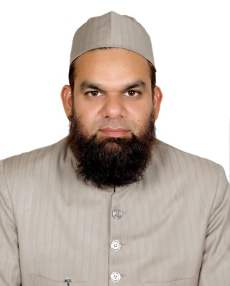
About the Instructor
Name: Prof. Dr. Awad Ali Al-Karni
Department: Civil Engineering
Office: 2A6
Tel: 46-77041
Email: akarni@ksu.edu.sa
Website: http://fac.ksu.edu.sa/akarni
Office Hours: Displayed on the office wall.

Slide 5
Course Description
Introduction to project management objectives
Project participants and project life cycle
Planning engineering projects
Scheduling using activity-on-node and precedence methods
Resource leveling and allocation
Project time-cost trade-off
Updating construction schedules
Project time and cost control
Contractual and organizational approaches including definition of organizational responsibilities of project participants

Slide 6
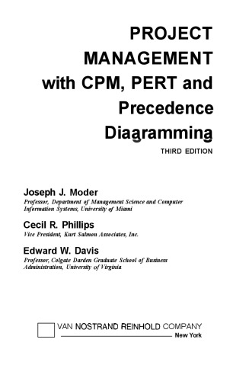
Text Book
Project Management with CPM, PERT, and Precedence Diagramming
by
J. J. Moder
C. R. Philips
and
E.W. Davis
Edition: Third
Publisher:
VAN NOSTRAND REINHOLD COMPANY, NY

Slide 7
Other Book
Construction Planning and Scheduling
by
Jimmie Hinze
Edition: Fourth
Publisher: Pearson, 2011

Slide 8
Course Learning Outcomes
Students completing this course successfully will be able to:
Use bar chart technique to formulate a complete plan for a project
Apply activity-on-node network, and precedence diagram to schedule a project
Level and allocate project resources
Shorten project duration
Monitor an engineering project for purpose of time and cost control
Use computer software for preparing project schedules
Understand principles of project organization and contractual relationships

Slide 9
Outcome Assessment
Two Midterm Exams 50%
Homeworks and Quizzes 10%
Final Exam 40%

Slide 10
Midterm Exams
First Midterm
Date: 28-Jumada’II-1438 (27-March-2017)
Day: Monday
Time: 6:30 PM – 8:00 PM
Second Midterm
Date: 12-Shaban-1437 (08-May-2017)
Day: Monday
Time: 7:00 PM – 8:30 PM
Notes:
12/08/1438H (08/05/2017G)

Slide 11
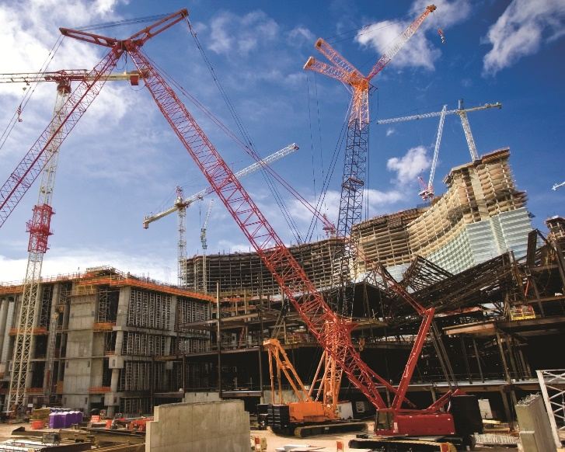
Project Definition
A project is a set of tasks or activities related to the achievement of some planned objective
Other Definitions:
A project is a temporary endeavor undertaken to create a unique product or service or result (PMI)
A combination of human and non-human resources pooled together to achieve a specific purpose and deliverables
A project is a one-shot, time-limited, goal-directed, major undertaking requiring the commitment of varied skills and resources
Notes:
Project: a planned piece of work
Endeavor: synonym strive
Undertaking: a task or project, especially one that is important and/or difficult

Slide 12
Characteristics of a Project
A project has a unique purpose
A project is temporary
A project require resources
A project has a primary sponsor or customer
A project involves uncertainty

Slide 13
Examples of Projects
Construction of building and infrastructure
Villas; Malls; Hospitals; Dams; Tunnels; Bridges; power plants; Refineries etc.
Development of a software product
Software for the registration of students in the university
Manufacturing of Aircrafts
Commercial plane; cargo planes; Fighter planes etc.

Slide 14
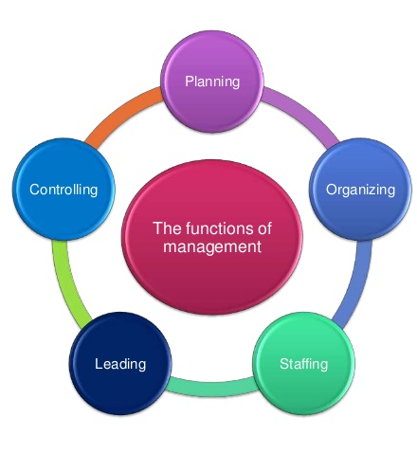
Management and its Functions
Management is a process concerned with the achievement of goals or objectives. It includes:
Planning - deciding what is to be done
Organizing – (implementation) making arrangements
Staffing - selecting the right people for the job
Leading/Directing - giving instructions
Controlling/Monitoring - checking progress against plans and taking action to remedy hold ups
Note: Motivating is also considered one of the functions of management, because without motivation, employees cannot work effectively.
Notes:
Hold-up synonym: delay

Slide 15
Levels of Management
The main levels of management are:
Top level
Middle level
Lower/Supervisory level

Slide 16
Levels of Management (Contd.)
Top Level Management
The managers working at this level have maximum authority.
It includes group of crucial persons essential for leading and directing the efforts of other people. For example, Managing Director, General Manager, President, Vice President, Chief Executive Officer (C.E.O.) etc.
Middle Level Management
This level of management consists of departmental heads such as purchase department head, sales department head, marketing manager etc.
People of this group are responsible for executing the plans and policies made by top level.
Low Level Management
Their authority is limited. The quality and quantity of output depends upon the efficiency of this level of managers.
Managers of this group actually carry on the work or perform the activities according to the plans of top and middle level management. Supervisors, clerks etc. come under this group.
They pass on the instruction to workers and report to the middle level management.

Slide 17
Involvement % of the different levels of management
Figure below shows the involvement % of the different levels of management for:
(Planning vs. controlling)
(conceptual vs. technical)
Planning
Control
Conceptual
Technical
Top Level
Management
Middle Level
Management
Low Level
Management

Slide 18
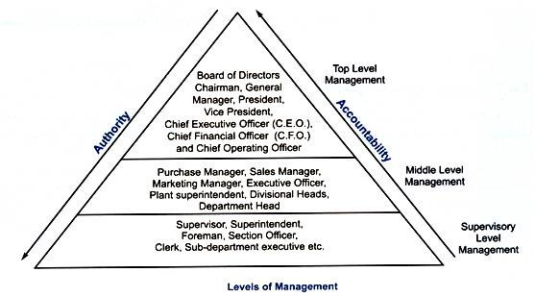
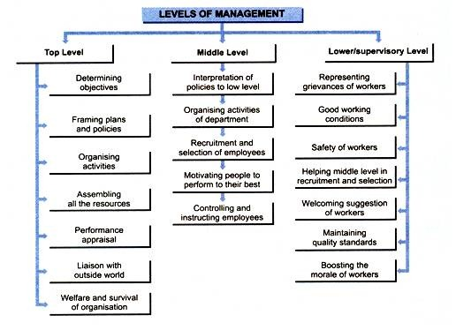
Summary (Levels of Management)

Slide 19
Project Management
Project management, is the application of knowledge, skills, tools, and techniques to project activities to meet the project requirements.
Project Management involves
Planning,
Organizing
Staffing
Directing; and
Controlling
Project management major constraints are
Time
Cost
Performance of the end product

Slide 20
Project Management Main (Function) Activities
Planning
Objectives
Resources
Work break-down schedule
Organization
Scheduling
Project activities
Start & end times
Network
Controlling
Monitor, compare, revise, action

Slide 21
Project Manager
A project manager is the person who has the overall responsibility for the successful
Initiation,
Planning,
Design,
Execution,
Monitoring,
Controlling, and
Closure of a project.

Slide 22
Project Management Institute (PMI)
Project Management Institute is the world's leading not-for-profit professional organization for Project Management.
PMI provides services including the development of standards, research, education, publication, hosting conferences and training seminars, and providing accreditation in project management.
Project Management Institute
Founded | 1969
Type | Professional Organization
Focus | Project management
Location | Newton Square, Pennsylvania, United States
Area served | Worldwide
Method | Certification, Industry standards, Conferences, Publications
Members | 341,900+
Employees | 51–200 employees
Slogan | "Making project management indispensable for business results”
Website | www.pmi.org
Notes:
Indispensable: Essential

Slide 23
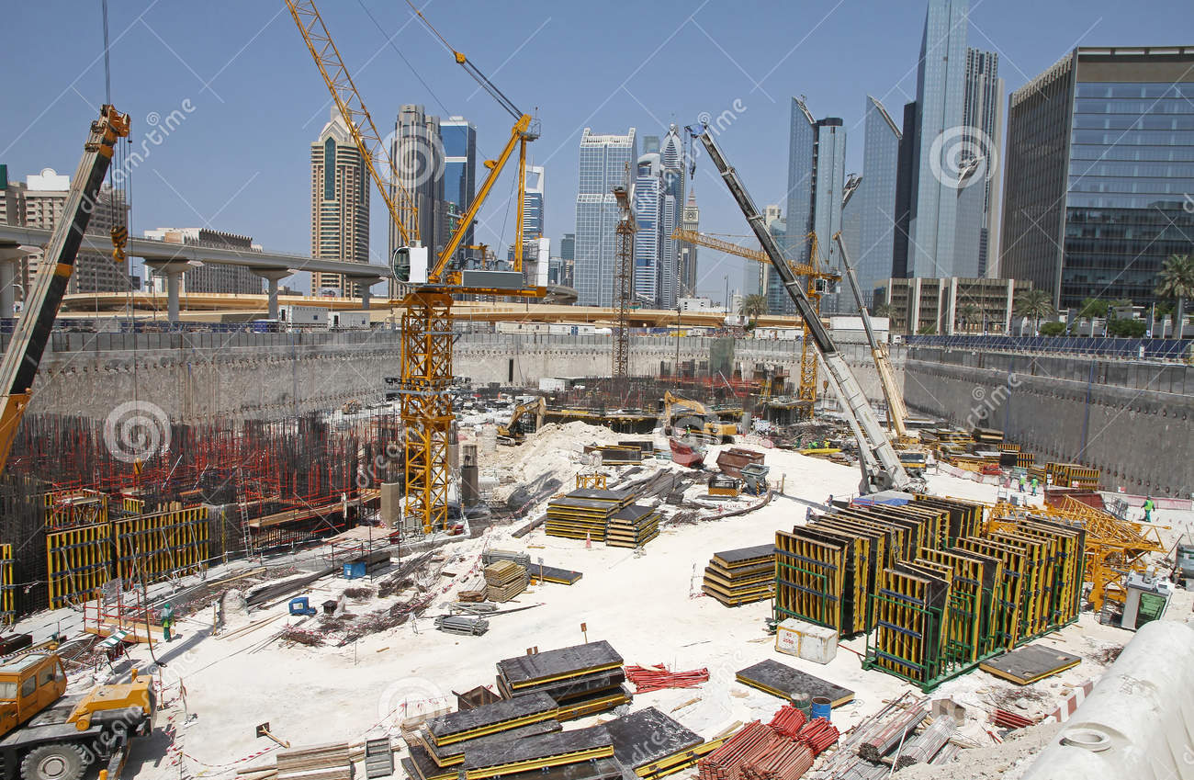
Main Resources (3Ms)
Money
Materials & Machines
Man Power
Notes:
Second image shows a construction yard stock

Slide 24
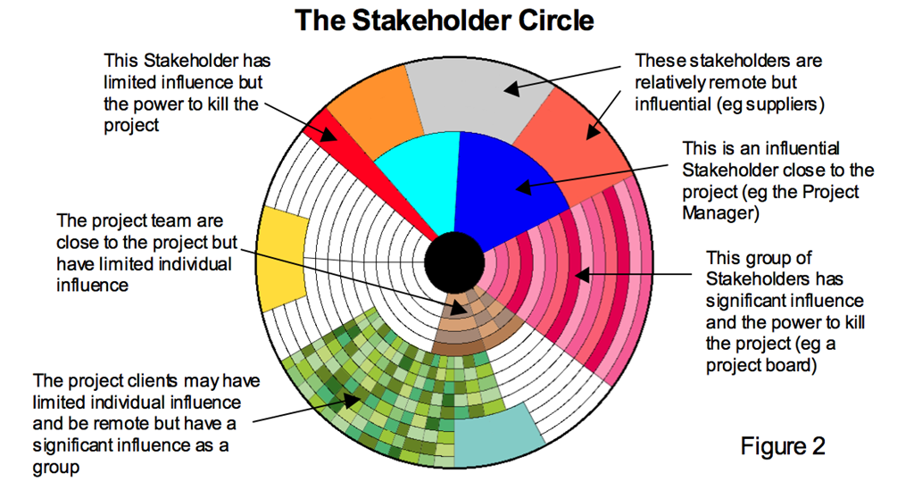
Project Stakeholders
Project sponsor
Project owner
Project manager
Customer/user
Functional managers
Performing organization
Project management team
Internal and external contractors
Suppliers and vendors
Government agencies and media
Notes:
Stakeholder: Synonyms: Investor, shareholder, sponsor, participant, Interested party
a person or company that is involved in a particular organization, project, system, etc., especially because they have invested money in it.
Ex. All our employees are stakeholders in the company.

Slide 25
Critical Success Factors for Different Project Objectives
Scope
Cost
Time
Quality
Scope
Good Will
Quality
Safety
Cost
Time
Notes:
In project management the term scope has two distinct uses- Project Scope and Product Scope.
Scope involve getting information required to start a project, and the features the product would have that would meet its stakeholders requirements.
Project Scope
"The work that needs to be accomplished to deliver a product, service, or result
Product Scope
"The features and functions that characterize a product, service, or result.

Slide 26
Assessing Success of a Project
Here are the six factors for measuring the success of a project:
Schedule
Within schedule?
Scope
Budget
This is often the most important factor for many projects. In the end, did you stick to the budget?
Team satisfaction
Keeping the team happy means if I do need them to work a late night here and there, they won't do it begrudgingly.
Customer satisfaction
Quality of work
The quality of one project often affects another, If you deliver a strong product, your client will tell people about it, and that's where your next project should come from.
Notes:
Begrudgingly: = grudgingly in a way that is given or done unwillingly
synonym reluctantly She grudgingly admitted that I was right.
Check pronunciation: grudgingly

Slide 27
A Real Life Application
What is Construction Management?
A lot of work goes into constructing a building, but how is it all managed and facilitated?

Slide 28
Further Reading
Read more about the Project Management Institute (PMI) from:
www.pmi.org

Slide 29
Thank You
Questions Please

