Slide 1
ENGINEERING MANAGEMENT (GE 404)
بسم الله الرحمن الرحيم
Lecture #2
Project Life Cycle and Time Management Process
Notes:
This is a title slide.

Slide 2
Contents
Objectives of the present lecture
Project Management and Project Participants
Project Management Hierarchy
Project Life Cycle
Work Breakdown Structure (WBS)
Further reading

Slide 3
Objectives of the Present lecture
To provide an overview of the Project life cycle
To discuss Work Breakdown Structure (WBS)
To give an overview of Time Management Process

Slide 4
Project Management and Project Participants
Project management is the discipline of managing a series of tasks within a given amount of time and within a budget
Project participants consist of all the individuals entities who either:
Work on the project directly, such as team members, consultants, contractors, and the sub-contractors
Influence the project directly, such as the internal project stakeholders (including functional managers and executives), the project sponsor, and the customer/client
Usually, the project participants are all listed in the project management hierarchy of the project.
Notes:
The difference between project stakeholders and project participants is that the former include the individuals/entities who have indirectly a stake in the success of the project (such as the end users) while the latter doesn't.

Slide 5
Project Management Hierarchy
A project management hierarchy is the hierarchy of roles in a project (based on leadership).
By looking at the project management hierarchy, one can understand who reports to who and who has authority (implied or explicit) over who in the project.
For example, here's the project management hierarchy in an web project: Project Owner Project Sponsor Project Manager Team Leader Database Architect Programmer Designer HTML Developer
In the above example, we understand that the HTML Developer reports to the team leader, who in turn reports to the project manager, and who finally reports to the project sponsor and the project owner.
There is no standard/generic project management hierarchy, but PM hierarchies for the same industry are very similar.

Slide 6
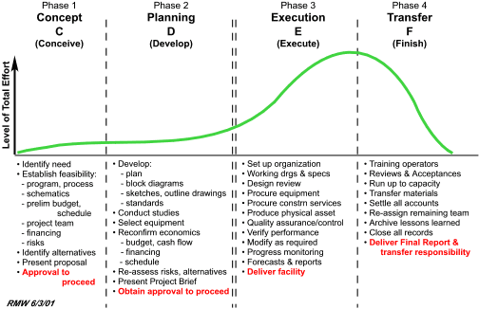
Project Life Cycle
The project life cycle consists of four phases:
Phase 1: Initiation/Concept
Phase 2: Planning
Phase 3: Execution (including monitoring and controlling)
Phase 4: Transfer/Closure

Slide 7
Initiation Phase
The Initiation phase begins by defining the
Scope, purpose, objectives, resources, deliverables, timescales and structure of the project.
The next step is to develop a Business Case, including several possible solutions and a cost/benefit analysis for each.
A Feasibility Study should then be carried out to ensure that the chosen solution is feasible and has an acceptable level of risk.
The next step is to define the Terms of Reference, followed by the appointment of the Project team.
The final step is to carry out Phase Review before seeking approval to proceed.
Notes:
In project management the term scope has two distinct uses- Project Scope and Product Scope.
Scope involve getting information required to start a project, and the features the product would have that would meet its stakeholders requirements.
Project Scope
"The work that needs to be accomplished to deliver a product, service, or result
Product Scope
"The features and functions that characterize a product, service, or result.

Slide 8
Planning Phase
Planning is the process of thinking systematically about the future in order to decide what our goals are, and how we are going to achieve them.
Thus planning involves making preparations, and deciding the best course of action for a project.
The first step of the Planning phase is the creation of a detailed Project Plan which the project manager will refer throughout the project to monitor and control time, cost and quality.
The project manager will then create the following plans:
Resource Plan: to identify the staffing, equipment and materials needed
Financial Plan: to quantify the financial expenditure required
Quality Plan: to set quality targets and specify Quality Control methods
Risk Plan: to identify risks and plan actions needed to minimise them
Acceptance Plan: to specify criteria for accepting deliverables
Finally, a Phase Review is carried out to approve the start of the Project Execution phase.

Slide 9
Execution Phase
During the Project Execution phase the project team produces the deliverables while the project manager monitors and controls the project delivery by undertaking:
Time Management: tracking and recording time spent on tasks against the Project Plan
Cost Management: identifying and recording costs against the project budget
Quality Management: reviewing the quality of the deliverables and management processes
Change Management: reviewing and implementing requests for changes to the project
Risk Management: assessing the level of project risk and taking action to minimize it
Issue Management: identifying and resolving project issues
Acceptance Management: identifying the completion of deliverables and gaining the customers acceptance
Communications Management: keeping stakeholders informed of project progress, risks and issues

Slide 10
Closure Phase
Once the customer has accepted the deliverables and a Phase Review has been carried out to determine whether the project objectives have been achieved, the project is ready for Closure.
A Project Closure Report should list all of the actions required.
When this has been approved, the listed actions are completed to release project resources, hand over deliverables, and inform all stakeholders that the project is now closed.

Slide 11
Evaluation
Shortly after the project has been closed, an Evaluation (also known as a Post-Implementation Review) should be carried out to determine the project's overall success and find out whether the benefits stated in the original Business Case were actually realised.
Any lessons learned should be documented for future projects.

Slide 12
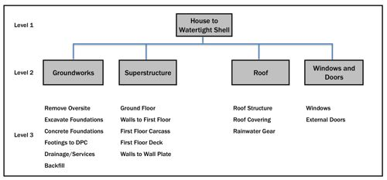
Work Breakdown Structure (WBS)
The Project Management Body of Knowledge (PMBOK) defines the work breakdown structure as A deliverable oriented hierarchical decomposition of the work to be executed by the project team.
The work breakdown structure visually defines the scope into manageable chunks that a project team can understand.
Figure shows a sample WBS with three levels defined.

Slide 13
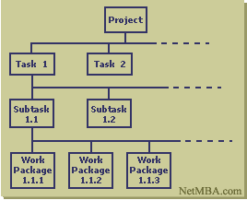
WBS (Contd.)
A work breakdown structure starts with the project as the top level deliverable and is further decomposed into sub-deliverables
The top level thus represents the final deliverable or project
The sub-deliverables are further decomposed to the specific work packages required to produce the sub- deliverable.
The work package represents the list of tasks or "to-dos" to produce the specific unit of work.

Slide 14
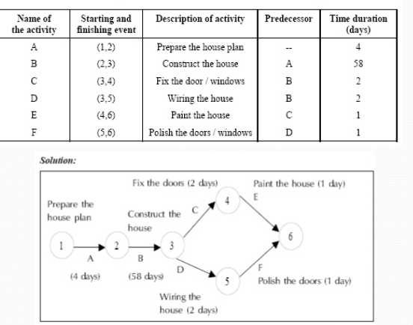
Definition of Activity and Event
Activity is a single work step (element) that has a recognizable beginning and end and requires time and resource for its accomplishment.
An Event marks the point in time when an activity completes.
Sequence of Activities for House construction project (Network diagram)
Note: Activity is often used as an alternative term for task.

Slide 15
Time Management Process
Time is the most valuable resource in a project.
Every delivery that you are supposed to make is time-bound. Therefore, without proper time management, a project can head towards a disaster.
Scheduling is the easiest way of managing project time.
In this approach, the activities of the project are estimated and the durations are determined based on the resource utilization for each activity.
Cost always plays a vital role in time management. This is due to the fact that schedule over-runs are quite expensive.

Slide 16
Steps of the Time Management Process
Time management is a key responsibility of a project manager. Following are the main steps in the project time management process:
Defining Activities
Sequencing Activities
Resource Estimating for Activities
Duration and Effort Estimation
Development of the Schedule
Schedule Control

Slide 17
Defining Activities
First of all, the high-level requirements are broken down into high-level tasks or deliverables.
Then the high-level tasks/deliverables are broken down into activities and presented in the form of WBS (Work Breakdown Structure).

Slide 18
Sequencing Activities
The activities identified in the previous step should be sequenced based on the execution order.
When sequencing, the activity interdependencies should be considered.

Slide 19
Resource Estimating for Activities
The estimation of amount and the types of resources required for activities is done in this step.

Slide 20
Duration and Effort Estimation
This is one of the key steps in the project planning process. Since estimates are all about the time (duration), this step should be completed with a higher accuracy.
Once the activity estimates are completed, critical path of the project should be identified in order to determine the total project duration. This is one of the key inputs for the project time management.

Slide 21
Development of the Schedule
Activity sequence, duration of each activity and the resource requirements/allocation for each activity are the most important factors.
In case if you perform this step manually, you may end up wasting a lot of valuable project planning time. There are many software packages, such as Microsoft Project, that will assist you to develop reliable and accurate project schedule.
As part of the schedule, you will develop a Gantt chart in order to visually monitor the activities and the milestones.

Slide 22
An Example of a Construction Schedule

Slide 23
Schedule Control
No project in the practical world can be executed without changes to the original schedule.
Therefore, it is essential to update the project schedule with ongoing changes.

Slide 24
Work Breakdown Structure Video
This video demonstrates how to create WBS using MindView software

Slide 25
Further Reading
Wysocki, R K, Effective Project Management, Wiley
Heerkens, G R, Project Management, McGraw-Hill

Slide 26
Thank You
Questions Please

