Slide 1
ENGINEERING MANAGEMENT (GE 404)
بسم الله الرحمن الرحيم
Lecture #3
Scheduling and Bar Chart
Notes:
This is a title slide.

Slide 2
Contents
Objectives of the present lecture
Planning and Scheduling
Activity and Event
Scheduling Techniques
Bar Charts
Critical Path and Critical Activities
Problems
Further reading

Slide 3
Objectives of the Present lecture
To provide an overview of scheduling
To discuss how to draw bar chart
To discuss advantages and shortcomings of bar charts

Slide 4
Planning and Scheduling
Planning is the process of thinking systematically about the future in order to decide what our goals are, and how we are going to achieve them.
Scheduling is the process showing relationship of activities and determining of the project duration time and the project activities starting and finishing timings.

Slide 5
Planning versus Scheduling
Planning
Scheduling
Planning can be thought of as determining “what” is going to be done, including “how”, “where,” and by “whom.”
The majority of the work associated with defining how the project effort will proceed called “planning”
In scheduling, this information is needed in order to determine “when”.
Scheduling consists of determining the time needed for each of the planned tasks and the overall length of the project schedule.

Slide 6
Purpose of Scheduling
Ensure that all activities are planned
Their order of performance is accounted for
The activity time estimates are recorded
The overall project time is developed

Slide 7
What we consider in Scheduling
How long the project is expected to take?
When each activity should be started and ended?
How resources can be used properly?
What are the critical bottlenecks in the project?
Notes:
A bottleneck is a stage in a process that causes the entire process to slow down or stop.

Slide 8
Project Scheduling Principles
Project scheduling is carried out before a project begins
It involves (1) identifying tasks, (2) estimating duration and (3) allocating resources
Once the project is underway, the schedule may need to be revised based on initial progress
The revision is done by creating milestones
This ensures (1) cost estimates and (2) time constraints are maintained at a specific level of quality and scope

Slide 9
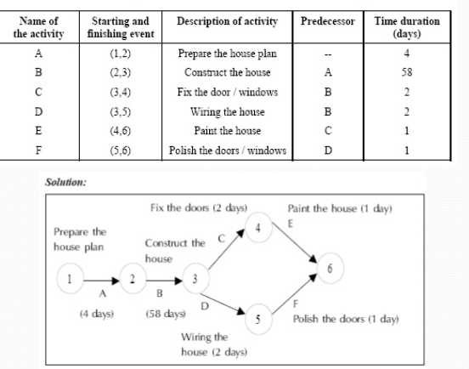
Activity and Event
Activity is a single work step (element) that has a recognizable beginning and end and requires time and resource for its accomplishment.
An Event marks the point in time when an activity completes.
Sequence of Activities for House construction project (Network diagram)
Note: Activity is often used as an alternative term for task.

Slide 10
Note
Predecessor activities mean coming before
Successor activities mean coming after
The duration of an activity is the time that will be consumed in completing a task
Overlap the activities to reduce the project time

Slide 11
Activity Duration
One of the following tools and techniques can be used for estimating the activity duration:
Expert judgment
Quantitative calculations
Duration of activity (D) = Quantity of work / [Production rate of a crew or equipment ×No. of crews]
Where production rate = Quantity produced in unit of time
Duration of activity (D) = Quantity of work × Unit rate productivity of a crew or equipment
Where unit rate productivity = Time needs to produce one unit of output
Time unit (days, weeks etc.) is employed to specify activity duration.

Slide 12
Scheduling Techniques
Bar Charts and Linked Bar Charts
Network Model (Analysis)
Activity on arrow (AOA)
Activity on node (AON)
Precedence Diagram
Line of Balance
Time-location Diagram

Slide 13
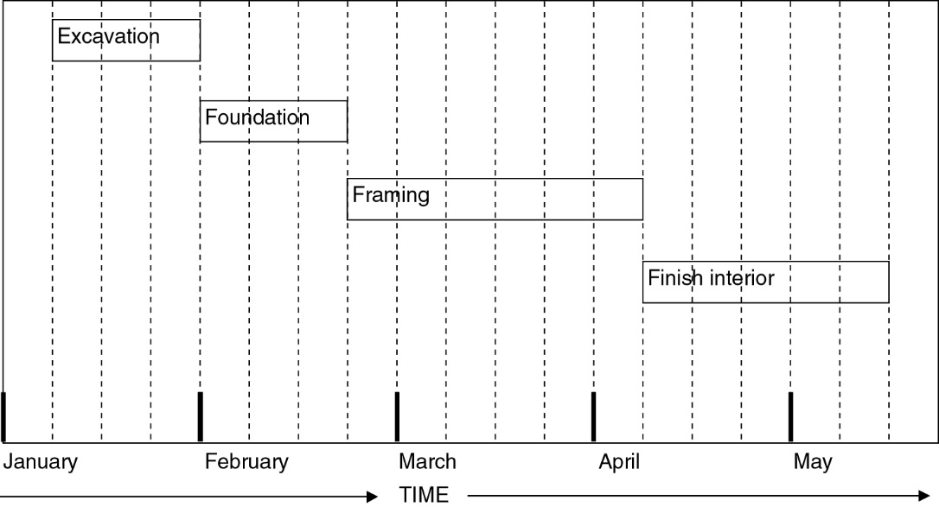
Bar Charts
Henry Gantt developed a method of relating a list of activities to a timescale in a very effective manner, by drawing bar charts.
Activities are presented as bars on the chart, while across the top or bottom of the chart is a time line.
For each activity, a bar is drawn from the activity’s starting time until its ending time.
Its primary advantage is that its simple graphic representation allows one to grasp schedule information quickly and easily.
Bar charts are the most commonly employed and readily recognized scheduling models in use today.
Bar chart showing General Construction Work Tasks
The activity sequencing is for an apartment, and one can easily see when each activity is to begin and when is to be completed.

Slide 14
Bar Charts (Contd.)
This simple example shows at a glance how the different activities relate to each other.
Note that the activities are time scaled and have been superimposed over a calendar.
With the timescale presentation, a bar chart shows operations and the time consumed by each operation.
Bar chart showing General Construction Work Tasks

Slide 15
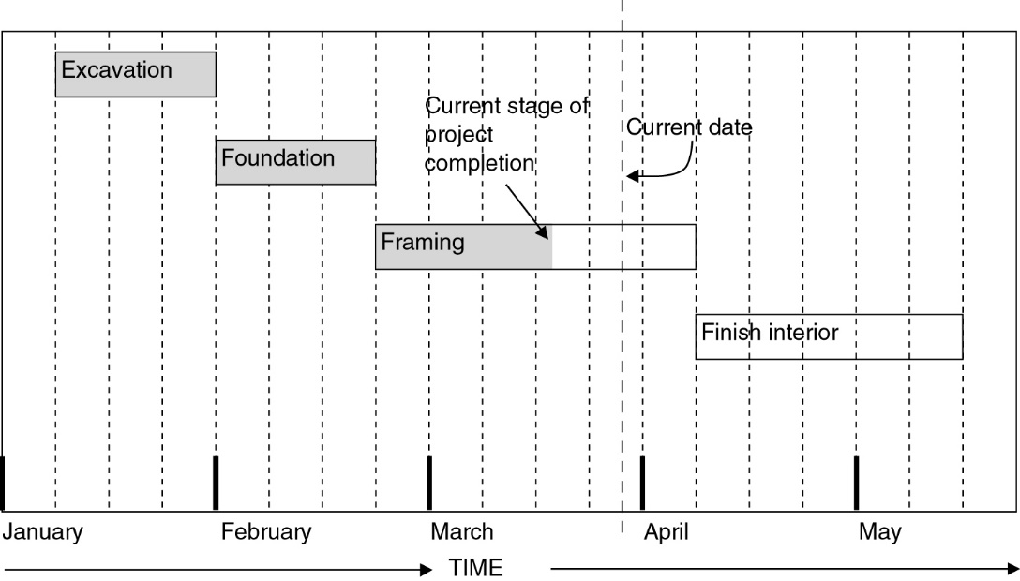
Use of Bar Chart in showing Scheduled versus Actual Progress
Bar Chart can also show the scheduled versus actual progress.
The heavy-dashed vertical line represents the current date, and the shaded portions of the activities indicate the amount of work that has been completed by the current date.
It is obvious that the project is slightly behind schedule.
The progress on the framing activity has not met expectations.
It is evident that the project can be completed on time by accelerating the work effort on framing, finishing interiors, or both.
This information is easy to grasp from this bar chart, and there is little chance of misinterpretation.
Bar chart showing scheduled versus actual performance
Adjustments to the schedule may be warranted if the delay in project completion(about 1 week) is not acceptable.

Slide 16
Uses of Bar Chart
Showing the order of the different activities
Showing when operations should start and finish
Checking what labor or equipment are needed and when
Checking out delivery dates for materials
Explaining to everyone concerned what and when is due to happen
Forecasting cash flow
During execution, the chart can be used to control the work

Slide 17
Advantages of Bar Chart
A major strength of bar charts is the ability to clearly and quickly present the status of a project
No extensive training is required to learn how to extract information from them

Slide 18
Shortcoming of Bar Charts
Very cumbersome as the number of activities, increases
Difficult to use for forecasting the effects of changes
No indication where management attention should be focused
Ineffective for project shortening

Slide 19
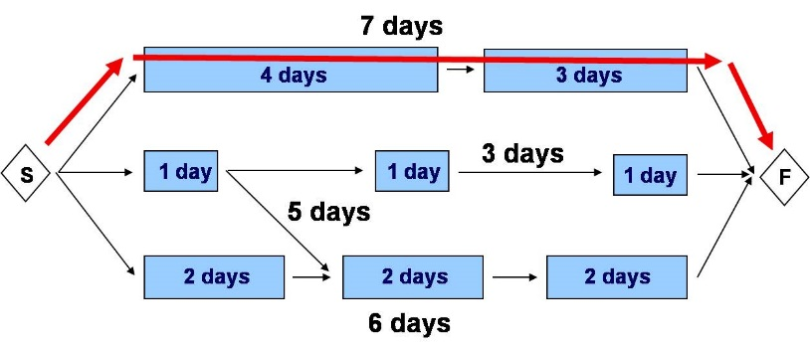
Critical Path and Critical Activity
Critical Path
Longest sequence of activities which must be completed on time for the project to complete on due date
Critical Activity
A critical activity is any activity that is on the critical path. If there is a delay in any of these activities then the whole project will be delayed
Note: An activity on the critical path cannot be started until its predecessor activity is complete; if it is delayed for a day the entire project will be delayed for a day unless the activity following the delayed activity is completed a day earlier.

Slide 20
How to identify critical path in a bar chart
Start with the last activity
Draw a vertical line from the i^{th} node of the last activity
The activities whose j nodes touch the vertical line, are potential critical activity
Proceed in this manner until you reach time 0
i
j

Slide 21
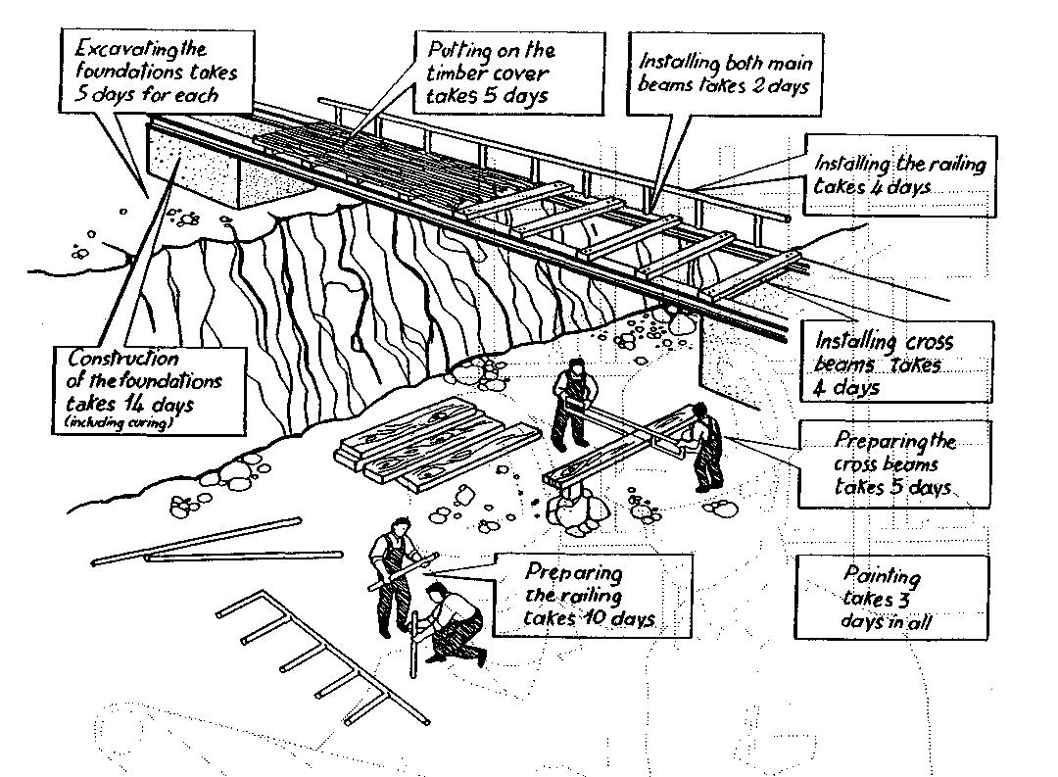
Bar Chart for Building a Bridge

Slide 22
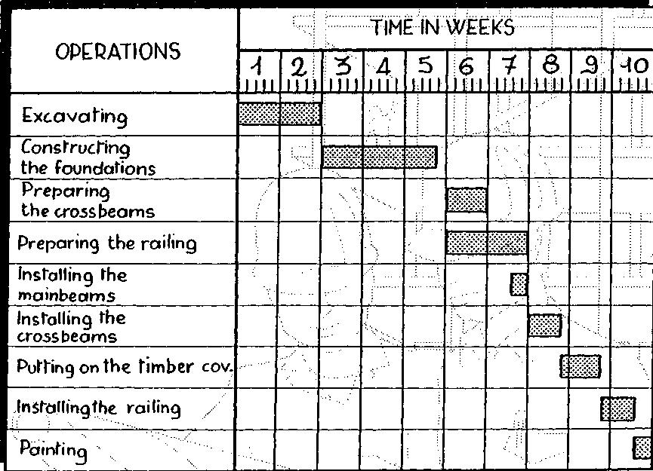
Bar Chart

Slide 23
Problem-1
Draw Gantt bar chart for a small Engineering project listed below and find
(a) Total duration of the project
(b) Critical activities
Activity | Depends on | Time (Weeks)
A | None | 4
B | A | 6
C | B | 7
D | C | 3
E | None | 3
F | A, E | 4

Slide 24
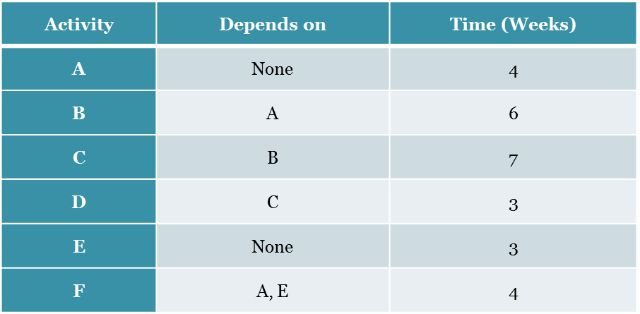
Solution
Activity | Duration (Wks) | 1 | 2 | 3 | 4 | 5 | 6 | 7 | 8 | 9 | 10 | 11 | 12 | 13 | 14 | 15 | 16 | 17 | 18 | 19 | 20 | 21
A | 4
B | 6
C | 7
D | 3
E | 3
F | 4
Project Duration = 20 weeks Ans.
Critical Activities = A, B, C, and D. Ans.

Slide 25
Problem-2
For the following project draw Gantt bar chart if the project starts on Monday 15/6/2015. Identify the critical activities and find the total duration of the project in terms of number of (i) working days; and (ii) Calendar days. Consider that workdays are six days a week (Saturday – Thursday).
Activity | Depends on | Time (days)
A | None | 2
B | A | 3
C | None | 3
D | B,C | 2
E | C | 1
F | E,B | 3

Slide 26
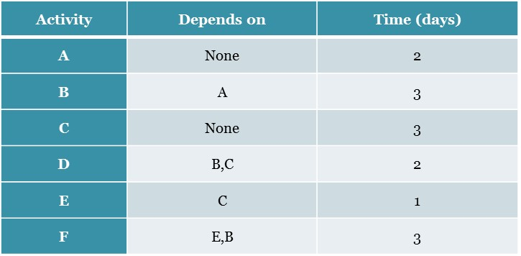
Solution
Act. | Dur. | SAT | SUN | MON | TUE | WED | THU | FRI | SAT | SUN | MON | TUE | WED | THU | FRI
A | 2
B | 3
C | 3
D | 2
E | 1
F | 3
Project Duration:
Calendar days = 9 Ans.
Working days = 8 Ans.
Critical Activities: A, B and F. Ans.

Slide 27
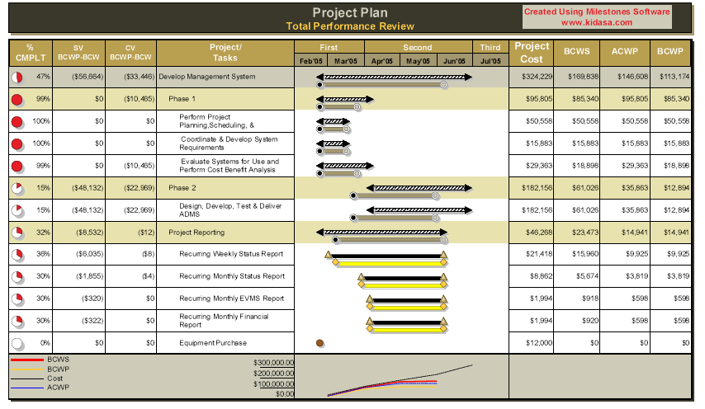
Software generated bar charts

Slide 28
Further Reading
Read more about the scheduling and bar charts from
Jimmie W. Hinze. “Construction Planning and Management,” Fourth Edition, 2012, Pearson.

Slide 29
Thank You
Questions Please

