Slide 1
ENGINEERING MANAGEMENT (GE 404)
بسم الله الرحمن الرحيم
Lecture #4
Scheduling Networks- AON
Notes:
This is a title slide.

Slide 2
Contents
Objectives of the present lecture
Activities versus events
Duration versus Event
Constraints
Network Modeling Technique
Steps in building a network model
Early Start, Early Finish and Early Finish and Early Start Times
Float Times
Developing AON Network
Problems
Further reading

Slide 3
Objectives of the Present lecture
To provide an overview of CPM based Network Modeling Techniques
To discuss steps involved in drawing AON network diagrams
To discuss how to calculate Early/Late Start/Finish Times
To learn how to identify critical path in AON network diagrams

Slide 4
Activities versus Events
Activities
Events
Activities consume time.
Events simply occur at a point in time
The point in time at which an activity can start may be considered an event
The point in time or instant at which an activity is completed can also be considered an event

Slide 5
Duration versus Event
Duration
Event
The duration of an activity is the period of time that will be consumed in completing a task
The duration of the activity includes the time at which the activity begins and continues to the point in time at which it is completed.
An event is the point in time or an instant at which the status of completion of a project or activity can be defined.
The starting time for an activity, which is also an event, defines that point in time at which an activity can begin.

Slide 6
Constraints
A number of different constraints must be acknowledged by the project team. The common constraints are:
Physical Constraints
Resource Constraints
Productivity Constraints
Safety Constraints
Financial Constraints
Environmental Constraints
Management Constraints
Contractual Constraints
Regulatory Constraints

Slide 7
Impact of Constraints
Introduction of excessive constraints in network logic can have the following impacts on a project:
Reduce scheduling flexibility
Lengthen project duration
Generally increase project cost
Confuse basic scheduling logic

Slide 8
Network Modeling Technique—CPM
CPM is the most popular network modeling technique
In CPM technique, each activity is assigned a specific duration and calculations through the network provide a single, specific duration for the project as a whole
CPM identifies those chains of activities (the critical paths) in the project that control how long the project will take
There are two popular variations of CPM
Activity-on-Arrow (A-on-A), or an arrow diagram
This name is given to this traditional technique because activities are represented in the network as arrows or lines
Activity-on-Node or Precedence technique
This method defines the activities as boxes (nodes in the network), which are connected together by lines (links).
This technique has got popularity because of the availability of microcomputer software, which makes it very easy to use.

Slide 9
Steps in Building a Network Model
Define activities
Order activities
Establish activity relationships; draw a network diagram
Determine quantities; assign durations to activities
Assign resources and costs
Calculate early and late start/finish times
Compute float values and identify the critical path
Schedule activity start/finish times

Slide 10
Defining Activities
Production/Construction Activities
These are activities that relate directly to the physical effort of creating the project
These activities use traditional resources of labor and materials
Procurement Activities
These activities include arranging for the acquisition of materials, money, equipment, and workforce
Management Activities
Activities such as preparing inspection reports, processing shop drawing approvals, tracking submittal approvals, developing as-built drawings, providing certifications on factory tests performed, and a variety of similar tasks.

Slide 11
Ordering Activities
For each identified activity, the following must be determined:
Which activities must precede it?
Which activities must follow it?
Which activities can be concurrent with it?

Slide 12
Assigning Durations to Activities
The duration of an activity is the estimated time that will be required to complete it
Duration of the activity can be computed as:
An alternative is to use historical Quantitative data from actual projects the firm has previously undertaken

Slide 13
Early Start, Early Finish and Late Finish and Late Start Times
The "Early Start" (ES) or "Earliest Start" of an activity is the earliest time that the activity can possibly start allowing for the time required to complete the preceding activities.
The "Early Finish" (EF) or "Earliest Finish" of an activity is the earliest possible time that it can be completed and is determined by adding that activity's duration to its early start time.
The “Late Finish" (LF) or "Latest Finish" of an activity is the very latest that it can finish and allow the entire project to be completed by a designated time or date.
The “Late Start” (LS) or "Latest Start" of an activity is the latest possible time that it can be started if the project target completion date is to be met and is obtained by subtracting the activity's duration from its latest finish time.

Slide 14
Calculation of Early and Late times
Early
Late
Direction: Proceed from project end to project start, from right to left.
Name: This process is called the “backward pass".
Assumption: Each activity finishes as late as possible without delaying project completion.
The LF value of each activity is obtained first and is entered into lower right portion of the activity box.
The LS is obtained by subtracting the activity duration from the LF value. LS = LF - D
In case of burst activities LF value is equal to the earliest (or smallest) of the LS times of the activities following.
Direction: Proceed from project start to project finish, from left to right.
Name: This process is called the "forward pass".
Assumption: every activity will start as early as possible. That is to say, each activity will start just as soon as the last of its predecessors is finished.
The ES value of each activity is determined first.
The EF time is obtained by adding the activity duration to the ES time. EF = ES + D
In case of merge activities the earliest possible start time is equal to the latest (or largest) of the EF values of the immediately preceding activities.

Slide 15
Float Times —Free and Total Floats
Float (or leeway) is a measure of the time available for a given activity above and beyond its estimated duration.
The free float of an activity is found by subtracting its earliest finish time from the earliest start time of the activities directly following:
FF_{i} = Min. (ES_{j}) - EF_{i}
The Total float of an activity is obtained by subtracting its ES time from its LS time. Subtracting the EF from the LF gives the same result.
Total float (TF) = LS - ES = LF - EF
An activity with zero total float has no spare time and is, therefore, one of the operations that controls project completion time.
Activities with zero total float are called critical activities.

Slide 16
Free and Total Floats
Free Float or activity Float
Total Float or Path Float
Free float is the amount of time that an activity’s completion time may be delayed without affecting the earliest start of succeeding activity
Free float is “owned” by an individual activity
Total float is the amount of time that an activity’s completion may be delayed without affecting the earliest start of any activity on the network critical path
Total float is shared by all activities along a slack path
Total path float time for activity (i-j) is the total float associated with a path

Slide 17
Activity Box
Duration
Earliest
Finishing
Date
Earliest
Starting
Date
EF | D | ES
FF | Activity ID
LF | TF | LS
Free Float
Predecessor
Successor
Latest
Starting
Date
Latest
Finishing
Date
Total Float
The format for activity box is not standardized, so one need only to adopt a format that is comfortable for a particular application

Slide 18
Critical Activity and Critical Path
Critical activity is quickly identified as one whose two start times at the left of the activity box are equal. Also equal are the two finish times at the right of the activity box.
The critical activities must form a continuous path from project beginning to project end, this chain of critical activities is called the Critical Path.
The critical path is the longest path in the network.
The critical path is normally indicated on the diagram in some distinctive way such as with colors, heavy lines, or double lines.
Any delay in the finish date of a critical activity, for whatever reason, automatically prolongs project completion by the same amount.

Slide 19
Subcritical paths
Subcritical paths have varying degree of path float and hence depart from criticality by varying amounts
Subcritical paths can be found in the following way:
Sort the activities in the network by their path float, placing those activities with a common path float in the same group
Order the activities within a group by early start time
Order the groups according to the magnitude of their path float, small values first

Slide 20
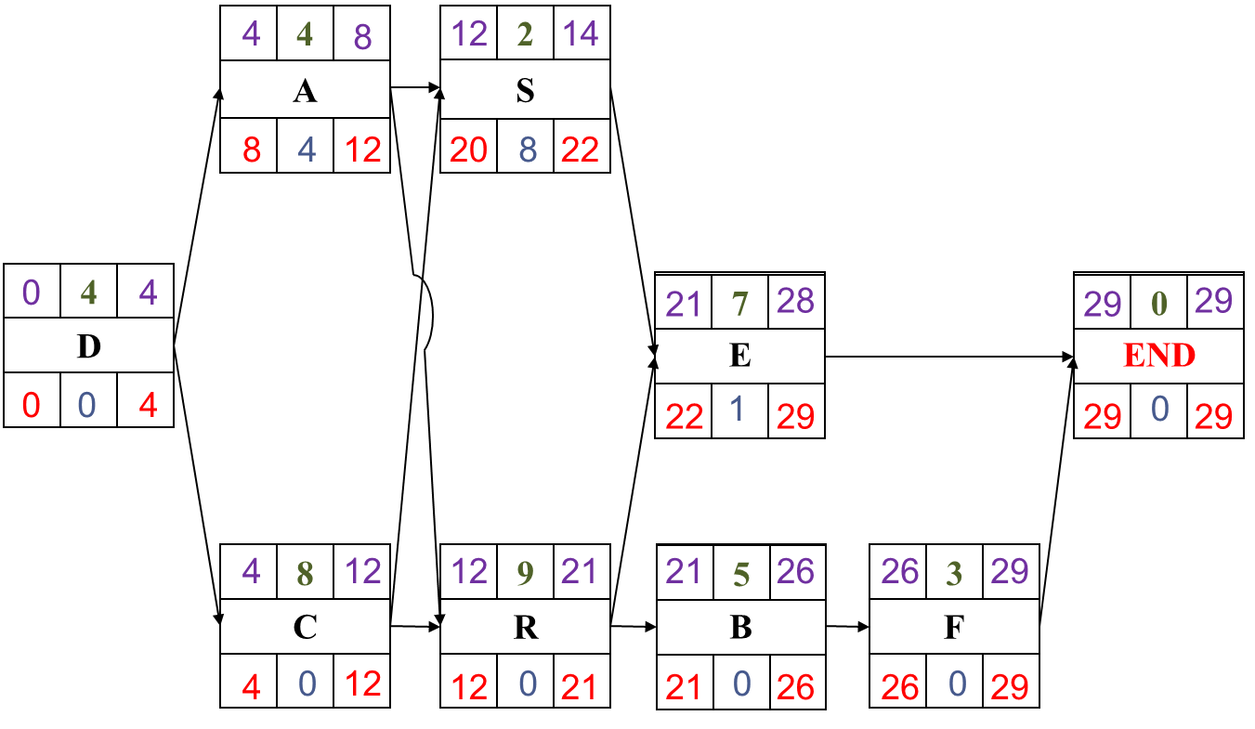
Activity-on-Node (AON) Network
The most common type of network schedule in use today is the Activity-on-Node
Activities are represented by nodes, drawn in any desired shape
Lines represent “Activity links,” used to represent dependencies between activities
The principal advantage of the activity on node network is that it eliminates the need for dummies
The diagram is “read” from left to right

Slide 21
Developing AON Network
The general developing of a network is from start to finish, from project beginning on the left to project completion on the right.
A horizontal diagram format is the standard format
The sequential relationship of one activity to another is shown by the dependency lines between them.
The length of the lines between activities has no significance.
Arrowheads are not always shown on the dependency lines because of the obvious left to right flow of time.
Dependency lines that go backward from one activity to another (looping) should not be used.
Crossovers occur when one dependency line must cross over another to satisfy job logic.

Slide 22
Note
Each activity in the network must be preceded either by the start of the project or by the completion of a previous activity.
Each path through the network must be continuous with no gaps, discontinuities, or dangling activities.
All activities must have at least one activity following, except the activity that terminates the project.
Each activity should have a unique numerical designation (activity code).
Activity code is shown in the central part of the activity box, with the numbering proceeding generally from project start to finish.
Notes:
Dangling: hanging

Slide 23
Problem-1
The activity list shown below represents the activities, the job logic and the activities’ durations of a small project. Draw an activity on node network to represent the project.
Activity | Depends on | Duration (days)
A B C E F D S R | D R D R, S B, C None A, C A, C | 4 5 8 7 3 4 2 9
ES
t
EF
Activity
LS
TF
LF

Slide 24
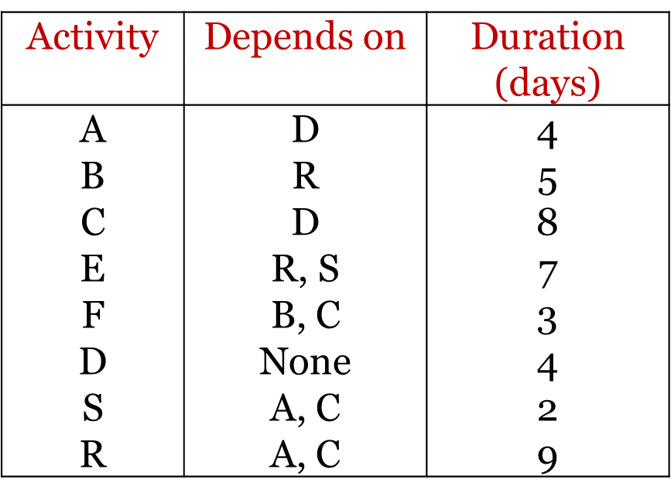
Solution Step-1: Draw Activity diagram
ES
t
EF
Activity
LS
TF
LF
4
2
A
S
When you have to draw an activity diagram. Pick the first activity and then see on which it depends and then see on which these (i.e. predecessors) depend. For example, to draw activity A, see activity D then see on which activity D depends and so on.
D
4
7
0
E
END
C
R
B
F
8
9
5
3

Slide 25
Step-2: Calculate ES and EF and Project duration
EF = ES + D
In forward pass you may encounter merge activities (e.g. S and R are merging to E) whereas in backward pass you can encounter burst activities (e.g. A and C are bursting from D)
4
4
12
2
14
A
S
8
Largest EF
D
4
4
21
7
28
29
0
29
E
END
4
12
12
21
21
26
26
29
C
R
B
F
8
9
5
3

Slide 26
Step-3: Calculate LS and LF
LS = LF - D
4
4
12
2
14
A
S
8
8
12
20
22
D
0
4
4
E
END
21
7
28
29
0
29
0
4
22
29
29
29
4
12
12
21
21
26
26
29
C
R
B
F
8
9
5
3
4
12
12
21
21
26
26
29
Smallest LS

Slide 27
Step-4: Calculate Total Float
Total float (TF) = LS - ES = LF - EF
4
4
12
2
14
A
S
8
8
4
12
20
8
22
D
0
4
4
E
END
21
7
28
29
0
29
0
0
4
22
1
29
29
0
29
4
12
12
21
21
26
26
29
C
R
B
F
8
9
5
3
4
0
12
12
0
21
21
0
26
26
0
29

Slide 28
Step-5: Identify Critical Path
4
4
12
2
14
A
S
8
8
4
12
20
8
22
D
0
4
4
E
END
21
7
28
29
0
29
0
0
4
22
1
29
29
0
29
4
12
12
21
21
26
26
29
C
R
B
F
8
9
5
3
4
0
12
12
0
21
21
0
26
26
0
29

Slide 29
Problem-2
Draw AON diagram to represent the following project. Calculate occurrence times of events (i.e. activity times), and activity and path floats. Also determine the critical path and the degree of criticality of other float paths.
Activity | Preceding Activity | Time (days)
A | None | 5
B | A | 7
C | A | 4
D | A | 8
E | B | 6
F | D | 8
G | E, C, F | 3
H | G | 4
I | G | 6
ES
t
EF
Activity
LS
TF
LF

Slide 30
Solution Step 1: Activity on node network
5
7
12
12
6
18
24
4
28
B
E
H
8
3
15
15
3
21
26
2
30
0
5
5
5
4
9
21
3
24
30
0
30
A
C
G
END
0
0
5
17
12
21
21
0
24
30
0
30
5
8
13
13
8
21
24
6
30
D
F
I
5
0
13
13
0
21
24
0
30

Slide 31
Step 2: Activity times and activity floats
Activity | ES | EF | LF | LS | TF | FF
A | 0 | 5 | 5 | 0 | 0 | 0
B | 5 | 12 | 15 | 8 | 3 | 0
C | 5 | 9 | 21 | 17 | 12 | 12
D | 5 | 13 | 13 | 5 | 0 | 0
E | 12 | 18 | 21 | 15 | 3 | 3
F | 13 | 21 | 21 | 13 | 0 | 0
G | 21 | 24 | 24 | 21 | 0 | 0
H | 24 | 28 | 30 | 26 | 2 | 2
I | 24 | 30 | 30 | 24 | 0 | 0

Slide 32
Step 3: Critical path and subcritical paths
Activity | ES | EF | LF | LS | TF | Criticality
A | 0 | 5 | 5 | 0 | 0 | Critical Path
D | 5 | 13 | 13 | 5 | 0
F | 13 | 21 | 21 | 13 | 0
G | 21 | 24 | 24 | 21 | 0
I | 24 | 30 | 30 | 24 | 0
H | 24 | 28 | 30 | 26 | 2 | a “near critical” path
B | 5 | 12 | 15 | 8 | 3 | Third most critical path
E | 12 | 18 | 21 | 15 | 3
C | 5 | 9 | 21 | 17 | 12 | Path having most float

Slide 33
Problem-3
The activity list shown below represents the activities, the job logic and the activities’ durations of a small project. Draw an activity on node network to represent the project.
Activity | Description | Immediate Predecessors | Time (weeks)
A | Build internal components | — | 2
B | Modify roof and floor | — | 3
C | Construct collection stack | A | 2
D | Pour concrete and install frame | A, B | 4
E | Build high-temperature burner | C | 4
F | Install pollution control system | C | 3
G | Install air pollution device | D, E | 5
H | Inspect and test | F, G | 2
ES
t
EF
Activity
LS
TF
LF

Slide 34
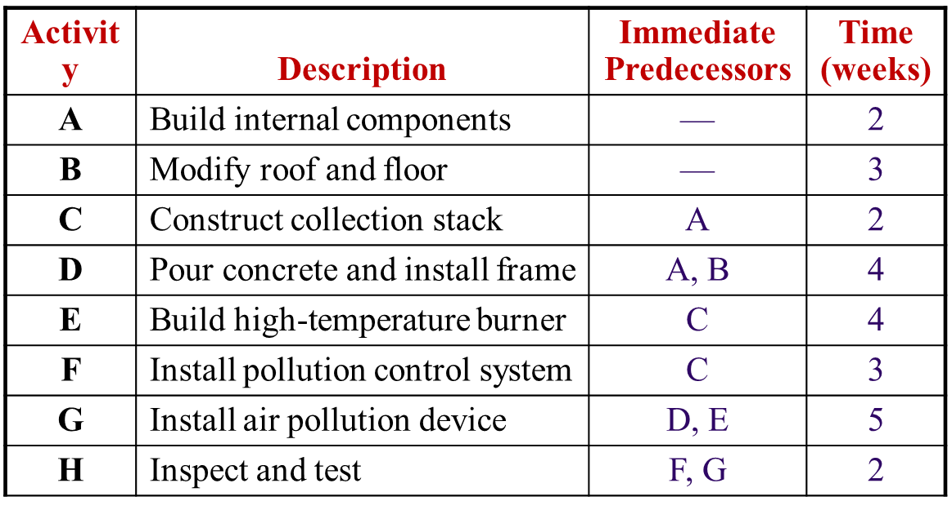
Solution Step-1: Draw Activity diagram
2
2
3
A
C
F
H
2
Start
0
4
E
B
D
G
3
4
5

Slide 35
Step-2: Calculate ES and EF and Project duration
0
2
2
2
2
4
4
3
7
A
C
F
ES
13
15
H
2
0
0
4
8
Start
0
4
E
MAX(EF of Preceding activities 7,8)
0
3
3
7
8
13
B
D
G
3
4
5

Slide 36
Step-3: Calculate LS and LF
LS = LF - D
0
2
2
2
2
4
4
3
7
A
C
F
0
2
2
4
10
13
13
15
H
2
0
0
4
8
Start
0
4
LF = Min(LS of activities 4,10)
E
13
15
0
0
4
8
LF = EF of Project
0
3
3
7
8
13
B
D
G
3
4
5
1
4
4
8
8
13

Slide 37
Step-4: Calculate Total Float
Total float (TF) = LS - ES = LF - EF
Slack = LS – ES or
Slack = LF – EF
0
2
2
2
2
4
4
3
7
A
C
F
0
0
2
2
0
4
10
6
13
13
15
H
2
0
0
4
8
Start
0
4
E
13
0
15
0
0
0
4
8
0
LF = EF of Project
0
3
3
7
8
13
B
D
G
3
4
5
1
1
4
4
1
8
8
0
13

Slide 38
Step-5: Identify Critical Path
0
2
2
2
2
4
4
3
7
A
C
F
0
0
2
2
0
4
10
6
13
13
15
H
2
0
0
4
8
Start
0
4
E
13
0
15
0
0
0
4
0
8
0
3
3
7
8
13
B
D
G
3
4
5
1
1
4
4
1
8
8
0
13

Slide 39
Step-6: Calculate Slack Time (Float Time)
Earliest Earliest Latest Latest On Start Finish Start Finish Slack Critical Activity ES EF LS LF LS – ES Path
A 0 2 0 2 0 Yes
B 0 3 1 4 1 No
C 2 4 2 4 0 Yes
D 3 7 4 8 1 No
E 4 8 4 8 0 Yes
F 4 7 10 13 6 No
G 8 13 8 13 0 Yes
H 13 15 13 15 0 Yes

Slide 40
GANTT CHART SCHEDULE
(ES –EF )
 | ACTIVITY | 1 | 2 | 3 | 4 | 5 | 6 | 7 | 8 | 9 | 10 | 11 | 12 | 13 | 14 | 15 | 16
A | Build internal components
C | Construct collection stack
E | Build high-temperature burner
G | Install air pollution device
H | Inspect and test
B | Modify roof and floor
D | Pour concrete and install frame
F | Install pollution control system
GANTT CHART SCHEDULE
(LS –LF )
 | ACTIVITY | 1 | 2 | 3 | 4 | 5 | 6 | 7 | 8 | 9 | 10 | 11 | 12 | 13 | 14 | 15 | 16
A | Build internal components
C | Construct collection stack
E | Build high-temperature burner
G | Install air pollution device
H | Inspect and test
B | Modify roof and floor
D | Pour concrete and install frame
F | Install pollution control system

Slide 41
Calendar Date Schedule
Activity times (ES, EF, LS, LF) obtained from previous calculations are expressed in terms of expired working days.
For purposes of project directing, monitoring and control, it is necessary to convert these times to calendar dates on which each activity is expected to start and finish.
This is done with the aid of a calendar on which the working days are numbered consecutively, starting with number 1 on the anticipated start date and skipping weekends and holidays.

Slide 42
Advantages and Disadvantages of Network Diagram
Advantages
Show precedence well
Reveal interdependencies not shown in other techniques
Ability to calculate critical path
Ability to perform “what if” exercises
Disadvantages
Default model assumes resources are unlimited
You need to incorporate this yourself (Resource Dependencies) when determining the “real” Critical Path
Difficult to follow on large projects

Slide 43
Note (a Constraint)
Question:
The last activity in a chain has no successor (there is only the project end date) and this activity has some positive number as a Total Float value.
What should be the Free Float value for this activity ?
Answer:
Good scheduling practice requires an end Milestone for the project. The last activity should have a successor (i.e., the Milestone) and every activity should be able to trace a link form its successor to this Milestone.
If the Milestone has float, as Rafael says, the FF and TF are equal; the constraint acts as the successor.
This construct would also mean the critical path as a positive float value.
Note: This situation should be considered as constraint that project duration is different from EF time of the last activity (calculated through forward pass calculation).
The critical path in such case is that path which has minimum total float.

Slide 44
Alternative definitions of FF and TF
https://www.youtube.com/watch?v=YboHkzVphzs

Slide 45
Further Reading
Read more about the scheduling network models from:
Jimmie W. Hinze. “Construction Planning and Management,” Fourth Edition, 2012, Pearson.

Slide 46
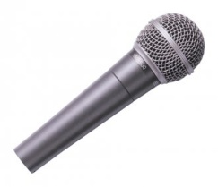
Thank You
Questions Please

