Slide 1
ENGINEERING MANAGEMENT (GE 404)
بسم الله الرحمن الرحيم
Lecture #8
Time-Cost Trade-Offs
Notes:
This is a title slide.

Slide 2
Contents
Objectives of the present lecture
Time-Cost Trade-offs
Reasons to reduce project duration
Methods to reduce project duration
Types of Costs and project time-cost relationship
Project crashing and cost slope
Compression or Crashing the project schedule
Basic steps in project crashing
Network interaction limit (Nil)
Network compression algorithm
Problem
Further reading

Slide 3
Objectives of the Present lecture
To discuss project time-cost relationship
To explain the steps involved in project crashing

Slide 4
Time-Cost Trade-offs (Time-Cost Relationship)
There is a relationship between a project’s time to completion and its cost.
By understanding the time-cost relationship, one is better able to predict the impact of a schedule change on project cost.
Time-cost trade-off, in fact, is an important management tool for overcoming one of the critical path method limitations of being unable to bring the project schedule to a specified duration.
Notes:
Trade-off (between something and something) the act of balancing two things that are opposed to each other
a trade-off between increased production and a reduction in quality

Slide 5
Reasons to Reduce Project Durations
To avoid late penalties
To realize incentives for timely or early competition of a project
To beat the competition to the market (influences Bid price)
To free resources for use on other projects
To reduce the indirect costs
To complete a project when weather conditions make it less expensive

Slide 6
Methods to reduce Durations
Overtime: Have the existing crew work overtime. This increase the labor costs due to increase pay rate and decrease productivity.
Hiring and/or Subcontracting:
Bring in additional workers to enlarge crew size. This increases labor costs due to overcrowding and poor learning curve.
Add subcontracted labor to the activity. This almost always increases the cost of an activity unless the subcontracted labor is far more efficient.
Use of advanced technology: Use better/more advanced equipment. This will usually increase costs due to rental and transport fees. If labor costs (per unit) are reduced, this could reduce costs.

Slide 7
Types of Costs
Direct Costs
Direct costs are those directly associated with project activities such as cost of labor, equipment and materials, salaries.
If the duration of activities is decreased in order to decrease project completion time, the direct cost generally increase since more resources must be allocated to accelerate the activity.
Indirect Costs
Indirect costs are those overhead costs that are not directly associated with specific project activities such as office space, administrative staff, and taxes.
Such costs tend to be relatively steady per unit time over the life of the project.
Total indirect costs increase as the project duration increases.
Note: Project cost is the sum of the direct and indirect costs.
Notes:
Overhead or overheads: Regular costs that you have when you are running a business or an organization, such as rent, electricity, wages, etc.
Steady: Constant

Slide 8
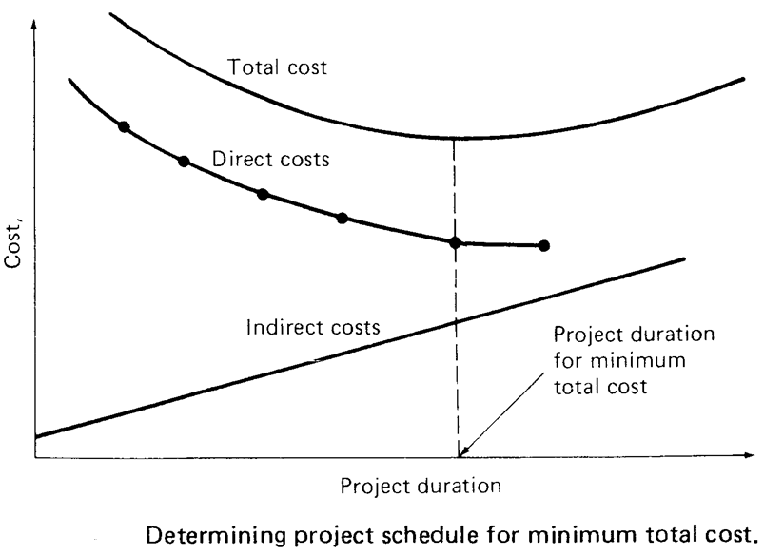
Project Time-Cost Relationship
Note: It should never be assumed that the quantity of resources deployed and the task duration are inversely related.
Thus one should never automatically assume that the work that can be done by one man in 16 weeks can actually be done by 16 men in one week.

Slide 9
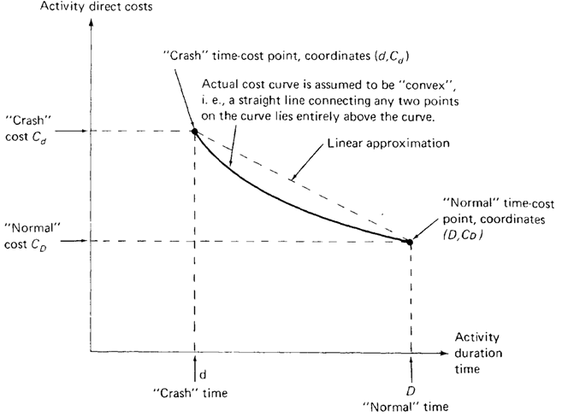
Project Crashing and Cost Slope
Shortening the duration of a project is called project crashing
The minimum possible duration of an activity (which implies maximum cost) is called the Crashed duration and corresponding cost is called Crashed cost
Thus the crash time is the shortest time in which an activity can be completed
Duration of an activity which implies minimum direct cost is called the normal duration and corresponding cost is called normal cost
The slope of the line connecting the normal point (lower point) and the crash point (upper point) is called the cost slope of the activity.
The slope of this line can be calculated mathematically by knowing the coordinates of the normal and crash points.
Notes:
Crash: a sudden serious fall in the value of something

Slide 10
Problem-1
Activity Cost
Calculate the Crash cost/ week for the shown linear time-cost trade-off for an activity.
Crash
$34,000 —
$33,000 —
$32,000 —
$31,000 —
$30,000 —
—
Crash Cost, C_{d}
Normal
Normal Cost, C_{D}
| | |
1 2 3 Time (Weeks)
Crash Time, d
Normal Time, D

Slide 11
Solution

Slide 12
Compressing or Crashing the Project-Schedule
Compressing or Crashing the project schedule refers to the acceleration of the project activities in order to complete the project sooner.
The time required to complete a project is determined by the critical path, so to compress a project schedule one must focus on critical path activities.

Slide 13
Basic Steps in Project Crashing
Compute the crash cost per time period
Using current activity times, find the critical path and identify the critical activities
If there is only one critical path, then select the activity on this critical path that (a) can still be crashed, and (b) has the smallest crash cost per period.
If there is more than one critical path, then select one activity from each critical path such that (a) each selected activity can still be crashed, and (b) the total crash cost of all selected activities is the smallest.
Note that the same activity may be common to more than one critical path.
Update all activity times. If the desired due date has been reached, stop. If not, return to Step 2.

Slide 14
Problem-2
For the small project shown in the table, it is required reduce the project duration by
(i) 2 periods.
(ii) 5 periods.
Activity | Precedence | Normal |  | Crash
 |  | Time, day | Cost, $ | Time, day | Cost, $
A | - | 4 | 210 | 3 | 280
B | - | 8 | 400 | 6 | 560
C | A | 6 | 500 | 4 | 600
D | A | 9 | 540 | 7 | 600
E | B,C | 4 | 500 | 1 | 1100
F | C | 5 | 150 | 4 | 240
G | E | 3 | 150 | 3 | 150
H | D,F | 7 | 600 | 6 | 750
 |  | Σ | 3050 |  | 4280

Slide 15
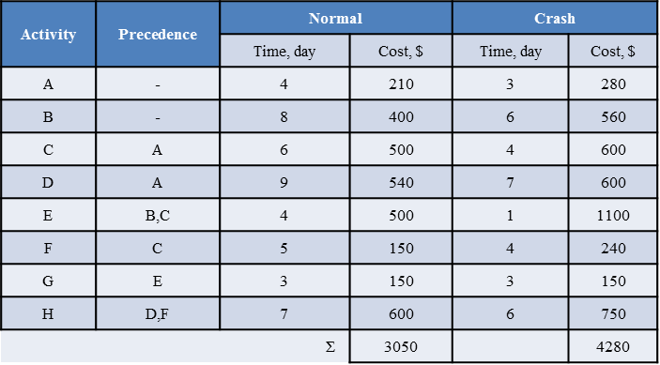
Solution Step 1: Develop Network
9
D
4
6
5
7
A
C
F
H
START
FINISH
8
4
3
B
E
G

Slide 16
Step 2:Calculate Times and Find CP
4
9
13
D
6
2
15
0
4
4
4
6
10
10
5
15
15
7
22
A
C
F
H
0
0
4
4
0
10
10
0
15
15
0
22
0
0
0
22
0
22
START
FINISH
0
0
0
0
8
8
10
4
14
14
3
17
22
0
22
B
E
G
7
7
15
15
5
19
19
5
22
Activity | A | B | C | D | E | F | G | H
Total float | 0 | 7 | 0 | 2 | 5 | 0 | 5 | 0
Free float | 0 | 2 | 0 | 2 | 0 | 0 | 5 | 0
Project completion time = 22 working days
Critical Path: A, C, F, H.

Slide 17
Step 3: Calculate Cost Slope
Activity | Precedence | Normal |  | Crash
 |  | Time, day | Cost, $ | Time, day | Cost, $
A | - | 4 | 210 | 3 | 280
B | - | 8 | 400 | 6 | 560
C | A | 6 | 500 | 4 | 600
D | A | 9 | 540 | 7 | 600
E | B,C | 4 | 500 | 1 | 1100
F | C | 5 | 150 | 4 | 240
G | E | 3 | 150 | 3 | 150
H | D,F | 7 | 600 | 6 | 750
 |  | Σ | 3050 |  | 4280
Cost Slope, $/day
70
80
50
30
200
90
**
150
Note:
1- G can not expedite
2- Among the critical activities the lowest slope is for activity C, so it can be expedited on critical path by 2 periods

Slide 18
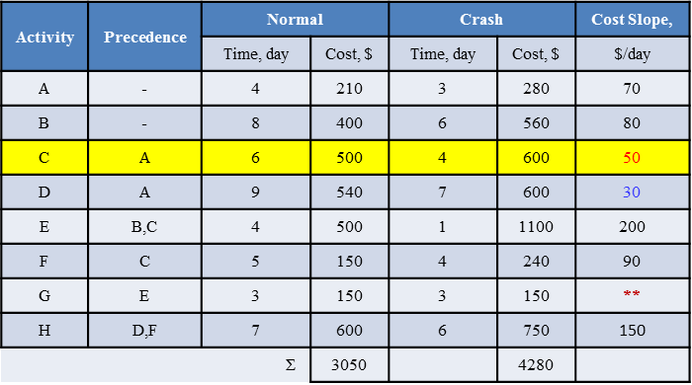
Step 4(a): Reduce 2 periods of activity C Solution-(i)
ES
LS
Activity
4
9
13
EF
TF
LF
D
Crash limit (d @ cost)
4
0
13
increase of cost (2×50) = $100
0
4
4
4
4
8
8
5
13
13
7
20
A
C
F
H
0
0
4
4
0
8
8
0
13
13
0
20
0
0
0
20
0
20
START
FINISH
0
0
0
0
8
8
8
4
12
12
3
15
20
0
20
B
E
G
5
5
13
13
5
17
17
5
20
Activity | A | B | C | D | E | F | G | H
Total float | 0 | 5 | 0 | 0 | 5 | 0 | 5 | 0
Free float | 0 | 0 | 0 | 0 | 0 | 0 | 5 | 0
Project completion time = 20 working days
Critical Path: A, C, F, H. & A, D, H

Slide 19
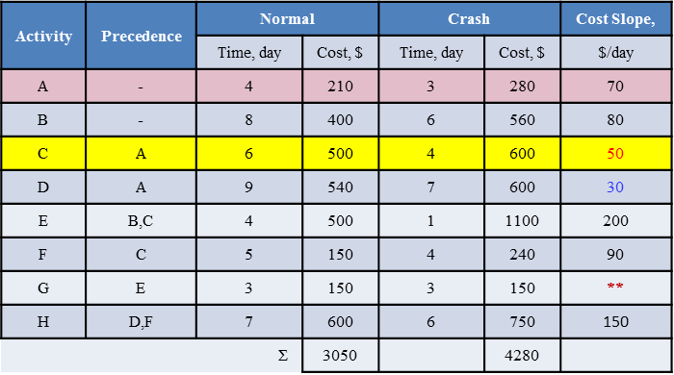
Step 4(b): Reduce 1 period of activity A
Increase of cost = $70
3
9
12
D
3
0
12
0
3
3
3
4
7
7
5
12
12
7
19
A
C
F
H
0
0
3
3
0
7
7
0
12
12
0
19
0
0
0
19
0
19
START
FINISH
0
0
0
0
8
8
7
4
11
11
3
14
19
0
19
B
E
G
8
4
12
12
5
16
16
5
19
Activity | A | B | C | D | E | F | G | H
Total float | 0 | 4 | 0 | 0 | 5 | 0 | 5 | 0
Free float | 0 | 0 | 0 | 0 | 0 | 0 | 5 | 0
Project completion time = 19 working days
Critical Path: A, C, F, H. & A, D, H

Slide 20
Step 4(c): Reduce 1 period of 2 activities (D,F)
Increase of cost (30+90) = $120
3
8
11
D
3
0
11
0
3
3
3
4
7
7
4
11
11
7
18
A
C
F
H
0
0
3
3
0
7
7
0
11
11
0
18
0
0
0
18
0
18
START
FINISH
0
0
0
0
8
8
7
4
11
11
3
14
18
0
18
B
E
G
3
3
11
11
4
15
15
4
18
Activity | A | B | C | D | E | F | G | H
Total float | 0 | 3 | 0 | 0 | 4 | 0 | 4 | 0
Free float | 0 | 0 | 0 | 0 | 0 | 0 | 4 | 0
Project completion time = 18 working days
Critical Path: A, C, F, H. & A, D, H

Slide 21
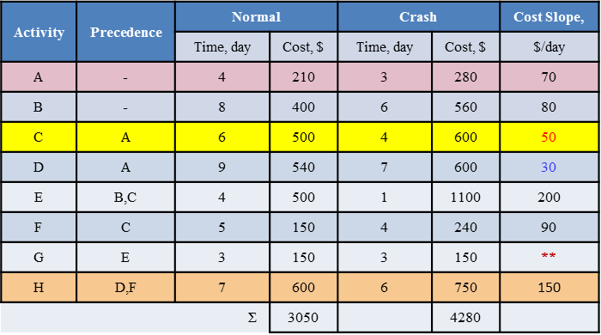
Step 4(d): Reduce 1 period of activity H
Increase of cost = $150
3
8
11
D
3
0
11
0
3
3
3
4
7
7
4
11
11
6
17
A
C
F
H
0
0
3
3
0
7
7
0
11
11
0
17
0
0
0
17
0
17
START
FINISH
0
0
0
0
8
8
7
4
11
11
3
14
17
0
17
B
E
G
2
2
10
10
3
14
14
3
17
Project completion time = 17 working days
Critical Path: A, C, F, H. & A, D, H
Activity | A | B | C | D | E | F | G | H
Total float | 0 | 2 | 0 | 0 | 3 | 0 | 3 | 0
Free float | 0 | 0 | 0 | 0 | 0 | 0 | 3 | 0

Slide 22
Step 5: Solution (ii)
Cycle | Activity | Time | cost | Total cost | Duration
0 | - |  |  | 3050 | 22
1 | C | 2 | 100 | 3150 | 20
2 | A | 1 | 70 | 3220 | 19
3 | D,F | 1 | 30+90 | 3340 | 18
4 | H | 1 | 150 | 3490 | 17
Reduction of project duration from 22 to 17 days increases the cost to $3490.
Activity | Precedence | Normal |  | Crash |  | Cost Slope,
 |  | Time, day | Cost, $ | Time, day | Cost, $ | $/day
A | - | 4 | 210 | 3 | 280 | 70
B | - | 8 | 400 | 6 | 560 | 80
C | A | 6 | 500 | 4 | 600 | 50
D | A | 9 | 540 | 7 | 600 | 30
E | B,C | 4 | 500 | 1 | 1100 | 200
F | C | 5 | 150 | 4 | 240 | 90
G | E | 3 | 150 | 3 | 150 | **
H | D,F | 7 | 600 | 6 | 750 | 150
 |  | Σ | 3050 |  | 4280

Slide 23
Network Interaction Limit (Nil)

Slide 24
Network Compression Algorithm
Determine normal project duration, cost and Critical Path
Compute the cost slope and shorten the Critical Activities beginning with the activity having the lowest cost-slope
Determine the compression limit (Nil), organize the data in the tabular form and update the project network
When a new Critical path is formed:
Shorten the combination of activity which Falls on both Critical Paths, OR
Shorten one activity from each of the critical paths. Use the combined cost of shortening both activities when determining if it is cost effective to shorten the project.
At each shortening cycle, compute the new project duration and project cost
Continue until no further shortening is possible
Tabulate and Plot the Indirect project Cost on the same time-cost graph; and add direct and indirect cost to find the project cost at each duration
Use the total project cost-time curve to find the optimum time

Slide 25
Note
For large network, use criticality theorem to eliminate the noncritical paths that do not need to be crashed.
Eliminate Activities with having TF > the required project reduction time.

Slide 26
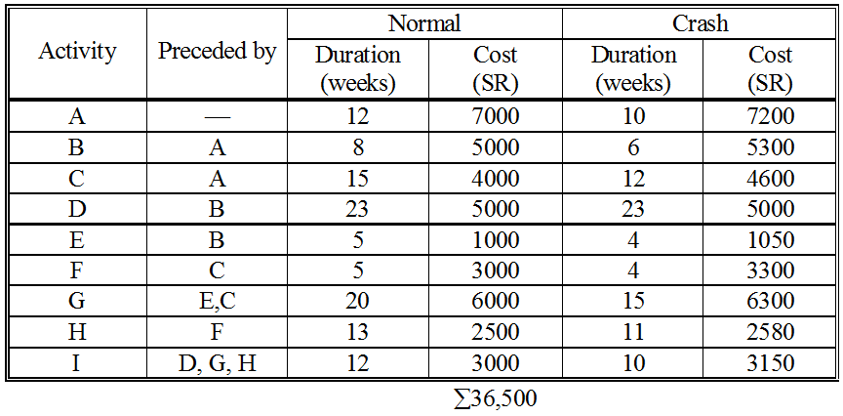
Problem-3
The durations and direct costs for each activity in the network of a small construction contract under both normal and crash conditions are given below. Establish the least cost for expediting the contract. Determine the optimum duration of the contract assuming the indirect cost amounts SR 125/week.
38470

Slide 27
We have one critical path, A-C-G- I.
Either crash A at cost SR 100/week or
crash C at cost SR 200/week or
crash G at cost SR 60/week or
crash I at cost SR 75/week.
Solution
Cycle #1
20
23
43
D
4
24
4
47
0
0
12
12
12
8
20
20
5
25
27
20
47
47
12
59
A
B
E
G
I
0
0
12
14
2
22
22
2
27
27
0
47
47
0
59
2@100
2@150
1@50
5@60
2@75
2
12
15
27
27
5
32
32
13
45
C
F
H
ES
D
EF
12
0
27
29
2
34
34
2
47
Activity
3@200
1@300
2@40
LS
TF
LF
Crash limit
Cycle # | Activity to Shorten | Can Be Shortened | Nil | Weeks Shortened | Cost per Week | Cost for Cycle | Total Cost | Project Duration
0 | − | − | − | − | − | − | 36,500 | 59
1 | G | 5 | 2 | 2 | 60 | 120 | 36,620 | 57
Notes:
Those paths which are not passing through G are parallel paths.

Slide 28
Now we have two critical paths:
A-C-F-H-I and A-C-G- I.
Either crash A at cost SR 100/week or
crash C at cost SR 200/week or
crash I at cost SR 75/week or
crash F and G at cost SR 360/week or
crash H and G at cost SR 100/week.
Cycle #2
20
23
43
D
2
22
2
45
0
0
12
12
12
8
20
20
5
25
27
18
45
45
12
57
A
B
E
G
I
0
0
12
14
2
22
22
2
27
27
0
47
45
0
55
2@100
2@150
1@50
3@60
2@75
12
15
27
27
5
32
32
13
45
C
F
H
ES
D
EF
12
0
27
27
0
32
32
0
45
Activity
3@200
1@300
2@40
LS
TF
LF
Crash limit
Cycle # | Activity to Shorten | Can Be Shortened | Nil | Weeks Shortened | Cost per Week | Cost for Cycle | Total Cost | Project Duration
0 | − | − | − | − | − | − | 36,500 | 59
1 | G | 5 | 2 | 2 | 60 | 120 | 36,620 | 57
2 | I | 2 | − | 2 | 75 | 150 | 36,770 | 55

Slide 29
Now we have two critical paths:
A-C-F-H-I and A-C-G- I.
Either crash A at cost SR 100/week or
crash C at cost SR 200/week or
crash F and G at cost SR 360/week or
crash H and G at cost SR 100/week.
Cycle #3
20
23
43
D
2
22
2
45
0
0
12
12
12
8
20
20
5
25
27
18
45
45
10
55
A
B
E
G
I
0
0
12
14
2
22
22
2
27
27
0
45
45
0
55
2@100
2@150
1@50
3@60
0
12
15
27
27
5
32
32
13
45
C
F
H
ES
D
EF
12
0
27
27
0
32
32
0
45
Activity
3@200
1@300
2@40
LS
TF
LF
Crash limit
Cycle # | Activity to Shorten | Can Be Shortened | Nil | Weeks Shortened | Cost per Week | Cost for Cycle | Total Cost | Project Duration
0 | − | − | − | − | − | − | 36,500 | 59
1 | G | 5 | 2 | 2 | 60 | 120 | 36,620 | 57
2 | I | 2 | − | 2 | 75 | 150 | 36,770 | 55
3 | A | 2 | − | 2 | 100 | 200 | 36,970 | 53

Slide 30
Now we have two critical paths:
A-C-F-H-I and A-C-G- I.
Either crash C at cost SR 200/week or
crash F and G at cost SR 360/week or
crash H and G at cost SR 100/week.
Cycle #4
18
23
41
D
2
20
2
43
0
0
10
10
10
8
18
18
5
23
25
18
43
43
10
53
A
B
E
G
I
0
0
10
12
2
20
20
2
25
25
0
43
43
0
53
0
2@150
1@50
3@60
0
10
15
25
25
5
30
30
13
43
C
F
H
ES
D
EF
10
0
25
25
0
30
30
0
43
Activity
3@200
1@300
2@40
LS
TF
LF
Crash limit
Cycle # | Activity to Shorten | Can Be Shortened | Nil | Weeks Shortened | Cost per Week | Cost for Cycle | Total Cost | Project Duration
0 | − | − | − | − | − | − | 36,500 | 59
1 | G | 5 | 2 | 2 | 60 | 120 | 36,620 | 57
2 | I | 2 | − | 2 | 75 | 150 | 36,770 | 55
3 | A | 2 | − | 2 | 100 | 200 | 36,970 | 53
4 | H, G | 2 | 2 | 2 | 60+40 | 200 | 37,170 | 51

Slide 31
Now we have three critical paths;
A-C-F-H-I, A-C-C- I, and A-B-D- I.
Either crash C and B at cost SR 350/wk or
crash F, G and B at cost SR 510/wk.
Cycle #5
18
23
41
D
18
0
41
0
0
10
10
10
8
18
18
5
23
25
16
41
41
10
51
A
B
0
E
G
I
0
0
10
10
0
18
20
2
25
25
0
41
41
0
51
0
2@150
1@50
1@60
0
10
15
25
25
5
30
30
11
41
C
F
H
ES
D
EF
10
0
25
25
0
30
30
0
41
Activity
3@200
1@300
0
LS
TF
LF
Crash limit
Cycle # | Activity to Shorten | Can Be Shortened | Nil | Weeks Shortened | Cost per Week | Cost for Cycle | Total Cost | Project Duration
0 | − | − | − | − | − | − | 36,500 | 59
1 | G | 5 | 2 | 2 | 60 | 120 | 36,620 | 57
2 | I | 2 | − | 2 | 75 | 150 | 36,770 | 55
3 | A | 2 | − | 2 | 100 | 200 | 36,970 | 53
4 | G, H | 2 | 2 | 2 | 60+40 | 200 | 37,170 | 51
5 | B, C | 2 | − | 2 | 150+200 | 700 | 37,870 | 49

Slide 32
Final Results
16
23
39
D
16
0
39
0
0
10
10
10
6
16
16
5
21
23
16
39
39
10
49
A
B
E
G
I
0
0
10
10
0
16
18
2
23
23
0
39
39
0
49
0
0
1@50
1@60
0
10
13
23
23
5
28
28
11
39
C
F
H
ES
D
EF
10
0
23
23
0
28
28
0
39
Activity
1@200
1@300
0
LS
TF
LF
Crash limit
Cycle # | Project Duration | Direct Cost | Indirect Cost | Total Cost
0 | 59 | 36500 | 7375 | 43875
1 | 57 | 36620 | 7125 | 43745
2 | 55 | 36770 | 6875 | 43645
3 | 53 | 36970 | 6625 | 43595
4 | 51 | 37170 | 6375 | 43545
5 | 49 | 37870 | 6125 | 43995

Slide 33
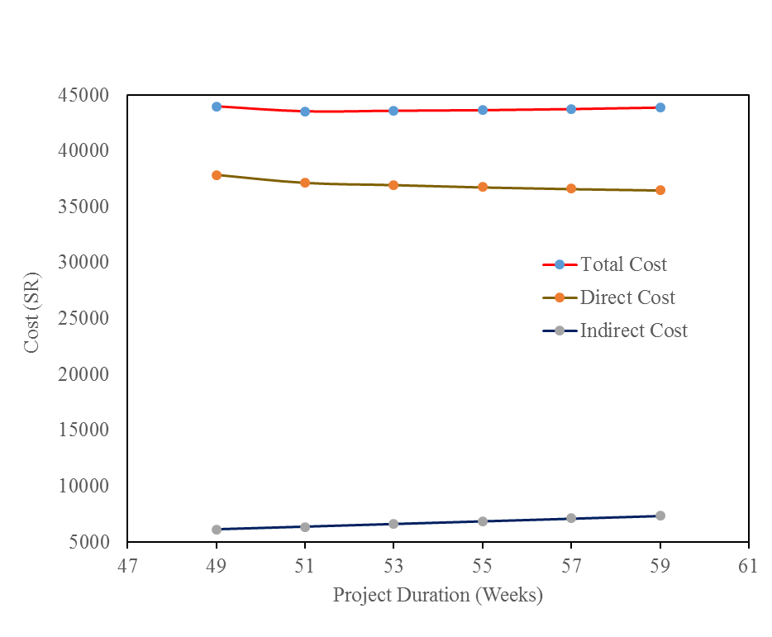
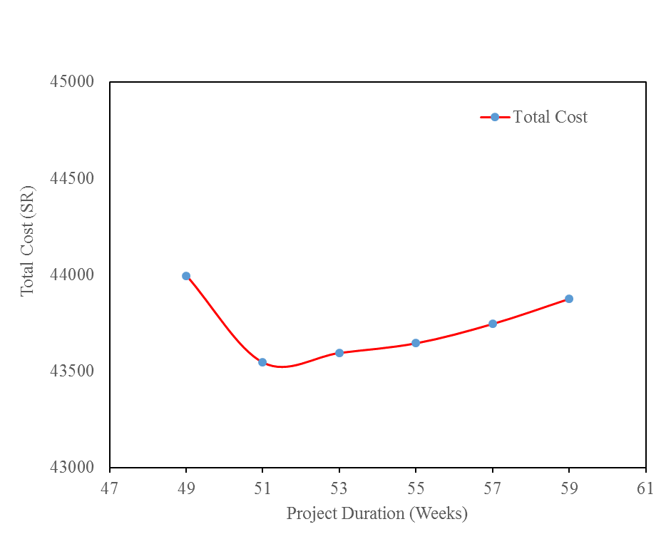
Project Optimal Duration

Slide 34
Home Work
Data on small maintenance project is given as below: On completion, the project will give a return of SR110/day. Using time-cost trade-off method, how much would you like to compress the project for maximizing the return (ignore the Indirect cost effect)? Show all calculations.
Activity | Depends | Normal |  | Crash
 | on | Time | Cost | Time | Cost
A | − | 6 days | SR700 | 4 days | SR800
B | − | 4 days | 400 | 4 days | 400
C | − | 5 days | 650 | 4 days | 700
D | A | 8 days | 625 | 5 days | 700
E | B | 10 days | 200 | 7 days | 350
F | B | 7 days | 500 | 5 days | 700
G | C | 3 days | 600 | 3 days | 600
H | D, E | 6 days | 300 | 5 days | 400
I | F, G | 7 days | 350 | 4 days | 425
Hint: If the project is compressed by n days, the return amount will be n*110 and total cost after compressing by n days will be obtained by the routine procedure. That n has to be searched which makes the difference of the above two costs maximum.

Slide 35
Further Reading
Read more about the Time-Cost Trade-offs from:
Jimmie W. Hinze. “Construction Planning and Management,” Fourth Edition, 2012, Pearson.

Slide 36
Thank You
Questions Please

