Slide 1
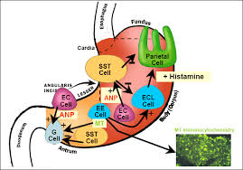
Gastric Secretion

Slide 2
Gastric secretion
Gastric secretion (Gastric juice):
The digestive fluid secreted by the glands of the
stomach., a thin colorless, acidic liquid containing
primarily hydrochloric acid, pepsinogen, and intrinsic
factor plus mucus.
Gastric juice convert the gastric contents to a
semiliquid mass called chyme.
PH is low, about 0.7 -3.8

Slide 3
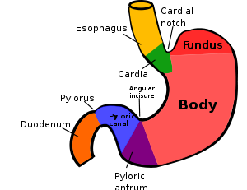
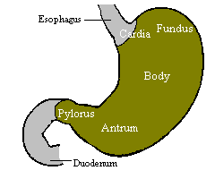
The stomach is a small, 'J'-shaped pouch with walls made of thick, elastic muscles, which stores and helps break down food
The stomach is divided into 4 section

Slide 4
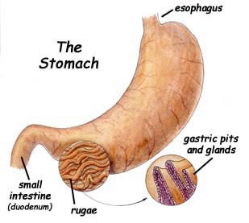
The inner surface of the stomach is thrown
Into long folds called rogue.
Microscopic examination of
the gastric mucosa shows that is
likewise folded.
The openings of these folds
into the stomach lumen are called
gastric pits.
The cells that line the folds deeper in the mucosa secrete various products into the stomach, these cells form the exocrine gastric glands.

Slide 5
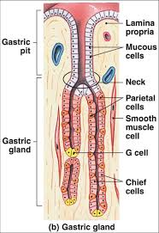

Slide 6
Gastric glands contain several types of cells that secrete different products:
● Goblet cells: secrete mucus
● Parietal cells: principally secrete hydrochloric acid
(HCl) and intrinsic factor.
Function of HCl:
1- Makes gastric juice very acidic
2-This acid is important for activation of pepsinogen
( Pepsin is more active at pH about 2.0 .)
3 - inactivation of ingested microorganisms such as bacteria.
4 - Denatures ingested proteins (alter the tertiary structure)
so they become more digestible.
The intrinsic factor, a glycoprotein secreted by
parietal cells that is necessary for intestinal absorption
of vitamin B12.

Slide 7
●Chief cells: secrete pepsinogen
Once secreted, pepsinogen is activated by stomach acid into the active protease pepsin, which is largely responsible for the stomach's ability to initiate digestion of proteins.
●G cells:
Secrete the hormone gastrin into the blood
(Gastrin is a hormone that stimulate acid secretion by the stomach).
●D cells:
secrete the hormone somatostatin.

Slide 8
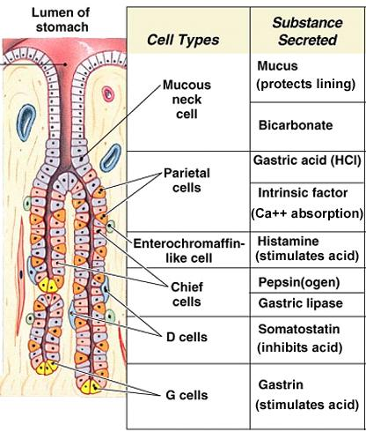

Slide 9
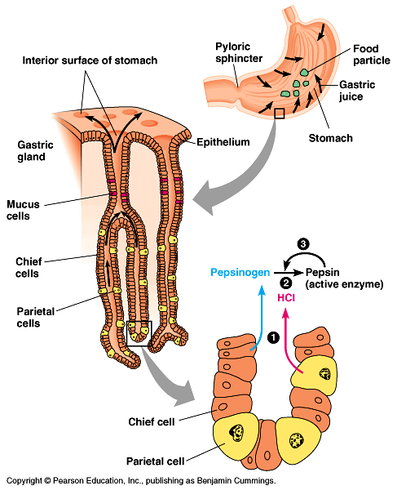

Slide 10
- The exocrine secretions of the gastric cells,
together with large amount of water form a highly
acidic solution known as gastric juice.

Slide 11
Composition of gastric secretions
Gastric juice is a mixture of water ,HCl , electrolytes
and organic substances.
The gastric juice is 97-99% water
The remainder consist of inorganic salts ,and organic components that include ,mucin, digestive enzymes
(e.g., pepsin).

Slide 12
Basic Mechanism of Hydrochloric Acid Secretion.
The parietal cells secrete hydrochloric acid with a pH of approximately 0.8 .
At this PH the hydrogen ion concentration is about four million times that of the arterial blood.

Slide 13
As a result of contact with gastric HCI, proteins are denatured; i.e, the tertiary protein structure is lost as a result of the destruction of hydrogen bonds.
This allows the polypeptide chain to unfold , making it more accessible to the actions of proteolytic enzymes (proteases).
The low pH also has the effect of destroying most microorganisms entering the gastrointestinal tract.

Slide 14
Secretion of Pepsin.
The principal enzyme secreted by the peptic cells is pepsin.
This is formed inside the cells in the form of pepsinogen, which has no digestive activity. However, once pepsinogen is secreted and comes in contact with previously formed pepsin in the presence of hydrochloric acid, it is immediately activated to form active pepsin.
Pepsin is an active proteolytic enzyme (for digesting proteins) in a highly acid medium (optimum pH = 2.0), but above a pH of about 5 it has little proteolytic activity and soon becomes completely inactivated.
Therefore, hydrochloric acid secretion is just as necessary as pepsin secretion for protein digestion in the stomach.

Slide 15
Rennin (Chymosin, Rennet)
Coagulates Milk
Rennin is important in the digestive process of infants because
it prevents the rapid passage of milk from the stomach.
In the presence of calcium, rennin changes the casein of milk irreversibly to a paracasein, which is then acted on by pepsin.
Rennin is reported to be absent from the stomach of adults.

Slide 16
Secretion of Mucus in the Stomach.
The pyloric glands are structurally similar to the gastric glands, but contain very few peptic and parietal cells.
Instead, they contain mainly mucous cells that are identical with the mucous neck cells of the gastric glands.
These cells secrete a thin mucus, which protects the stomach wall from digestion by the gastric enzymes.
In addition, the surface of the stomach mucosa between the gastric and pyloric glands has a continuous layer of mucous cells that secrete large quantities of a far more viscid and alkaline mucus that coats the mucosa with a mucous gel layer over 1 mm. thick, thus providing a major shell of protection for the stomach wall as well as contributing to lubrication of food transport.

Slide 17
HCl
• converts pepsinogen to pepsin for chemical digestion
• provides optimal pH environment for pepsin
• destroys some bacteria
• promotes the absorption of Fe²⁺
Pepsinogen (precursor of pepsin)
digestion of proteins
Mucus
forms a protective barrier
Intrinsic factor
for intestinal absorption of vitamin B12.

Slide 18
Regulation of Gastric Secretion
Neural and hormonal mechanisms regulate the
release of gastric juice.
Regulation of gastric secretion is divided into three
phases:
- The cephalic phase
- The gastric phase
- The intestinal phase
Notes:
18

Slide 19
The cephalic phase:
- smelling, chewing, and swallowing food sends
impulses via specific nerves to the stomach.
-This cause acid secretion from parietal cells and
gastrin release from G cells (in which gastrin
indirectly stimulating parietal cell acid secretion).
The gastric phase
is mainly result of gastric distention (when food enter
stomach)
-Distention of the stomach stimulates the parietal cells.
The intestinal phase
responds to arriving chyme, and moderates gastric
activity

Slide 20
Stimulation of Gastric secretion by Gastrin
When food enters the stomach, or when the nerves are stimulated, the antral portion of the stomach mucosa secretes the hormone gastrin, a large polypeptide.
The food causes release of this hormone in two ways:
The actual bulk of the food distends the stomach, and this causes the hormone to be released.
Certain substances – such as, partially digested proteins, caffeine, and so forth – also cause gastrin to be liberated from the antral mucosa.

Slide 21
Gastrin is absorbed into the blood and carried out into the gastric glands, where it stimulates mainly the parietal cells but to a slight extent the peptic (Chief) cells also.
The parietal cells increase their rate of hydrochloric acid secretion as much as eight-fold, and the peptic cells increase their rate of enzyme secretion two-to four-fold.
Histamine, present in gastric mucosal cells also stimulates acid secretion.

Slide 22
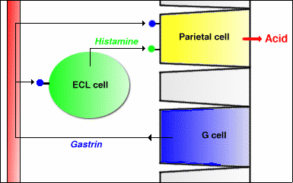

Slide 23
Acid gastric reflux ( heart burn)
Too much acid gives a feeling of heart burn know as acid gastric reflux
There is back flow of stomach content (acid) upward into esophagus
symptoms: pain and inflammation.
Gerd: Gastroesophageal Reflux Disorder
( extreme reflux)
Can be associated with certain food, medication
20% of adult have heart burn

Slide 24
Treatment
1- Prevent acid from being secreted
antacid main ingredient (Mg⁺² )
neutralize the acid by increasing the PH to 3
( short acting)
2- Long Acting Medication

Slide 25
Peptic ulcers
Erosions of the mucous membranes of the stomach or
duodenum produced by action of HCl.
Causes:
Ulcers can be caused by:
• Infection with a type of bacteria called
Helicobacter pylori (H.pylori).
• Use of anti-inflamatory drugs such as aspirin.
• tumors

Slide 26
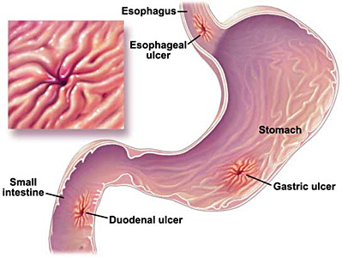

Slide 27
Symptoms:
When symptoms occur, they may include:
- burning pain in the middle or upper stomach between
meals or at night.
- Nausea, vomiting
-In severe cases:
-dark or black stool (due to bleeding)
- severe pain in the middle to upper abdomen
- it can be treated by:
By medicines: • to kill the H. Pylori bacteria (if present)
• to reduce acid levels in the stomach.

Slide 28
Peptic Carcinoma
Stomach cancer begins when cancer cells form in the inner lining of your stomach. These cells can grow into a tumor. Also called gastric cancer, the disease usually grows slowly over many years

Slide 29
What Causes Stomach Cancer?
Scientists don’t know exactly what makes cancer cells start growing in the stomach. But they do know a few things that can raise your risk for the disease.
Infection with a common bacteria, H. pylori, which causes ulcers.
Inflammation in your gut called gastritis.
Long-lasting anemia.
Growths in your stomach called polyps also can make you more likely to get cancer

Slide 30
Other things that seem to play a role in raising the risk include:
Smoking
Being overweight or obese
A diet high in smoked, pickled, or salty foods
Stomach surgery for an ulcer
Certain genes
Working in coal, metal, timber, or rubber industries

Slide 31
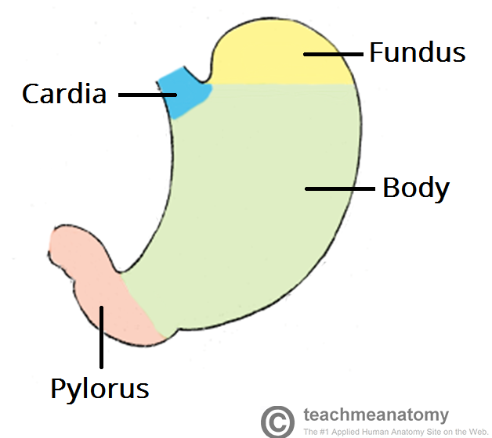

Slide 32
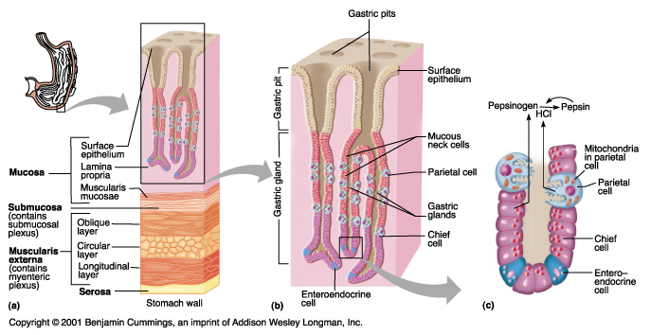

Slide 33
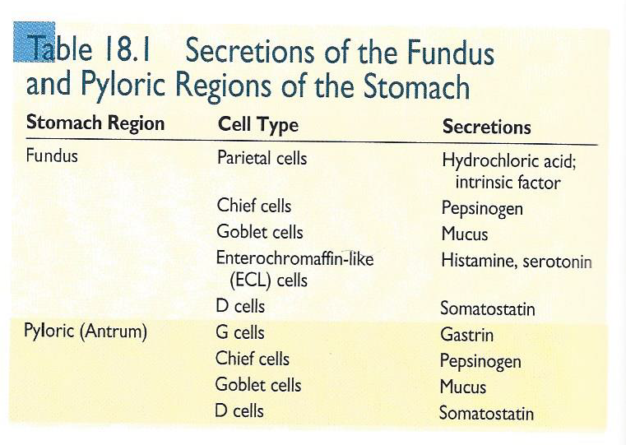

Slide 34
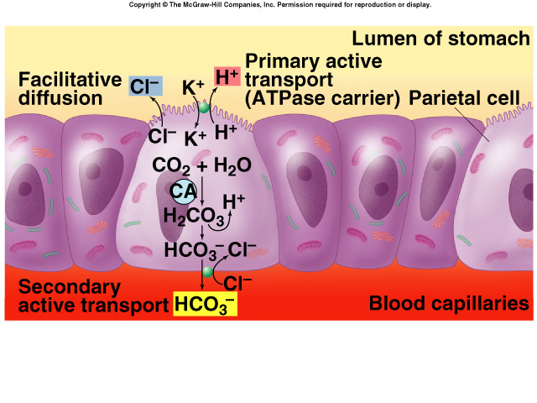

Slide 36
https://www.youtube.com/watch?v=LKuNokt9B1Q
https://www.youtube.com/watch?v=lnVjXuyM6xk

