Slide 1
Viral hepatitis
The word “hepatitis” means inflammation of the liver
There are five main types of viral hepatitis: A, B, C, D, E
•
Hepatitis A and E are typically caused by ingestion of contaminated food or water
Hepatitis B, C and D are typically caused by contact
with contaminated blood or body fluids
In particular viral hepatitis types B and C lead to chronic disease in hundreds of millions of people and, together, are the most common cause of liver cirrhosis and cancer

Slide 2
Hepatitis B Virus (HBV)
Hepatitis B causes acute hepatitis (short term and/or severe) and chronic infection(lingering-may not be severe) leading to chronic liver disease.
The acute illness causes liver inflammation, jaundice( yellowing of the skin, eyes, etc) , and (rarely) death.
HBV is transmitted in blood, by sexual intercourse and from mother to child.
•

Slide 3
classification
family : hepadnaviridae contains tow genera:
1- Genus :Orthohepadnavirus.
2- Genus: Avihepadnavirus.

Slide 4
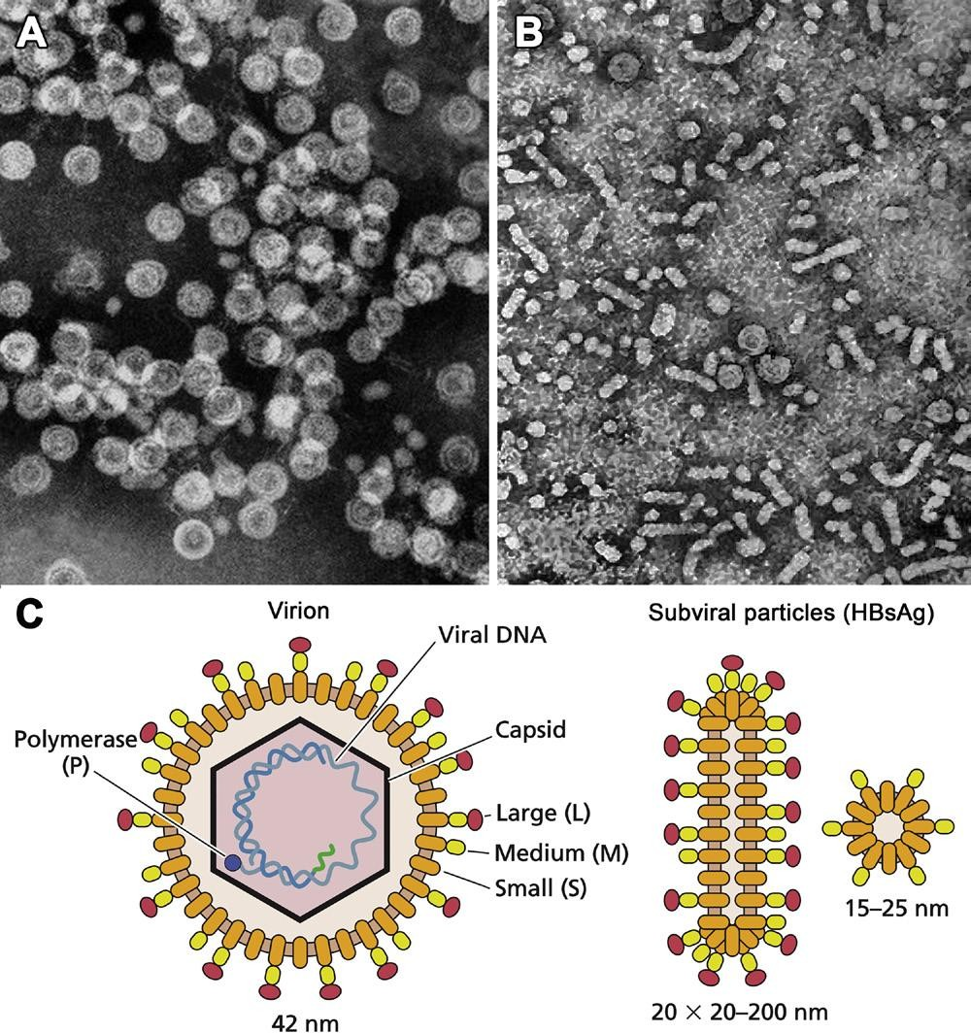
Structure and genome
Spherical, enveloped virion, 42 nm, enclosing inner icosahedral 27 nm nucleocapsid (core) composed of 180 capsomeres
Hepadnaviruses code for three major antigens, designated
surface **(HBsAg), core (HBcAg), and e (HBeAg).
*Envelope contains the glycoprotein, hepatitis B surface protein (HBsAg) of three different size species with common C-termini, L-, M-, and S-HBsAg
*Core contains the phosphoprotein, hepatitis B core protein HBcAg, plus polymerase with three enzyme activities: reverse transcriptase, DNA polymerase,
and RNase
Virions and subviral particles of hepatitis B virus. (A) Negative contrast electron microscopy of purified intact (B) Negative contrast electron microscopy of subviral particles—hepatitis B surface protein (HBsAg) (C) Model of an intact virion and subviral particles showing constituents.

Slide 5
Laboratory diagnosis
1- Liver Chemistry tests:
AST, ALT, ALP, and total Bilirubin(rise in acute phase)
alanine transaminase (ALT) and aspartate transaminase (AST), alkaline phosphatase (ALP), (Enzymes-Liver Function)
2- Serology: 1-BY using ELISA
detect viral antigens or antibodies
1) HBsAg :- It is the first marker to appear in blood after
infection.
2) Anti-HBs(HBsAb):- Disappearance of HBsAg and the appearance of anti-HBs signals recovery from HBV infection, non-infectivity.

Slide 6
2- Serology: 1-BY using ELISA
3) Anti-HBc :- IgM anti-HBc appears shortly after HBsAg is
detect (HBcAg alone dose not appear in serum)
IgM-HBc may also or can persist for 3-6 months or longer.
IgG-HBc also appear during acute hepatitis B but persist
indefinitely.
4) HBeAg :-
HBeAg appear in blood concurrently with HBsAg, or soon afterwards.
HBeAg indicate viral replication and infectivity.

Slide 7
2- By using Radio-immunoassay
This technique uses an immune reaction [Antigen – Antibody
reaction] to estimate a ligand Ag + Ag* + Ab
AgAb + Ag*Ab + Ag + Ab*
A mixture is prepared of radioactive antigen and antibodies against that antigen.
Known amounts of unlabeled ("cold") antigen are added to samples of the mixture. These compete for the binding sites of the antibodies.
At increasing concentrations of unlabeled antigen, an increasing amount of radioactive antigen is displaced from the antibody molecules. The antibody-bound antigen is separated from the free antigen in the supernatant fluid, and the radioactivity of each is measured by Gamma Counter

Slide 8
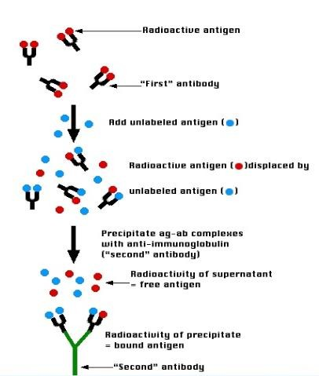
https://www.youtube.com/watch?v=Cs1LvCyEGKg
From 1 to 4 min (Basic principle)
Notes:
From 1 to 4 min (Basic principle)

Slide 9
-PCR : to measure the amount of HBV DNA
-Liver Biopsy:
to determine grade(Inflammation) and stage(Fibrosis) in chronic Hepatitis
-Isolation :HBV replication in primary cultures of human hepatocytes, but virus culture impracticable for routine diagnostic use.
•

Slide 10
Prevention
vaccination:
highly effective recombinant vaccines.
Hepatitis B immunoglobulin (HBIG|):
exposed within 48 hours of the incident/neonates
whose mothers are HBsAg and HBeAg positive.
Other measures:
screening of blood donors, blood and body fluid
precautions.

Slide 11
Treatment
Acute hepatitis B infection does not usually require treatment because most adults clear the infection spontaneously .
On the other hand, treatment of chronic infection may be necessary to reduce the risk of cirrhosis and liver cancer.
Although none of the available drugs can clear the infection, they can stop the virus from replicating, thus minimizing liver damage.
Antiviral drugs
lamivudine (Epivir),
adefovir (Hepsera),
tenofovir (Viread),
interferon alpha-2a

