Slide 1
Hirsutism
Mohanad Musaad Alsuhaim
434100432

Slide 2
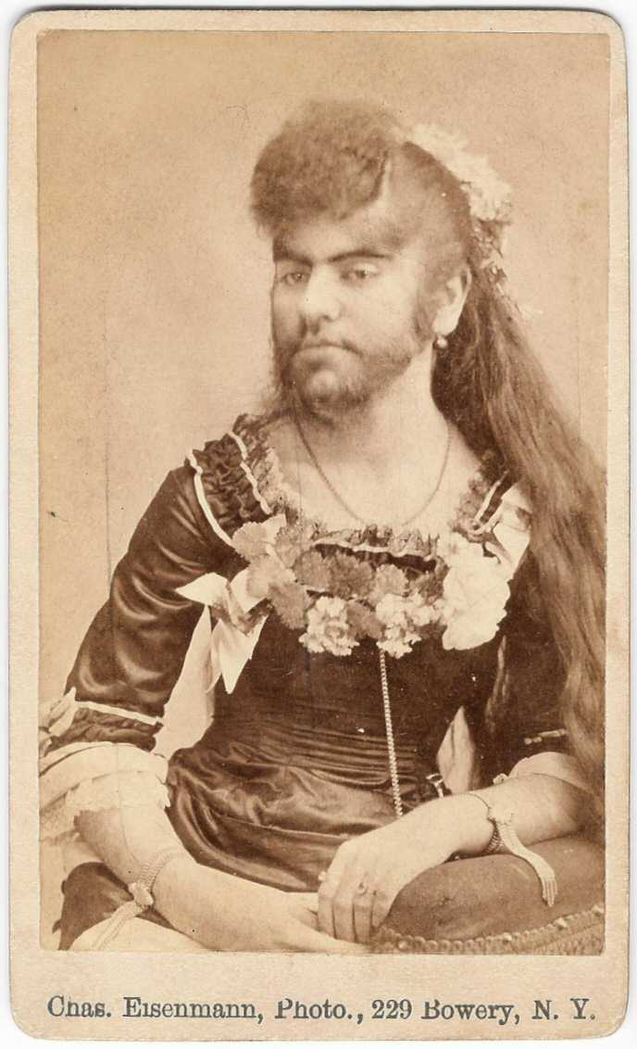
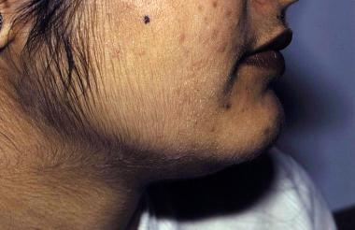
Definition: Hirsutism refers to the growth of coarse, dark hair in areas where women typically grow fine hair or no hair at all: above the lip and on the chin, chest, abdomen, and back. other signs may develop over time, a process called virilization. Signs of virilization may include: -Deepening voice -Balding -Acne -Decrease in breast size -Enlargement of the clitoris

Slide 3
Three types of Hair :
Lanugo : Body hair seen in the fetus and newborn
Vellus : Fine adult hair covering the body
Terminal hair : Thick pigmented hair of scalp and pubic area
Role of Androgen:
Androgens prolong the growth phase of hair and promote their conversion from vellus to terminal type.

Slide 4
Etiology: The main cause is excess Androgen level in the
blood which in turn converted to other metabolites.
Hirsutism affects 70-80% of women with androgen excess.
# Causes:
Polycystic ovary syndrome (PCOS)
Cushing's syndrome
Congenital adrenal hyperplasia
Tumors
-Functioning Adrenal tumor
Medications
-Steroid: Corticosteroids
-Anti-seizure: Phenytoin
-Others: Cyclosporin
Hirsutism

Slide 5
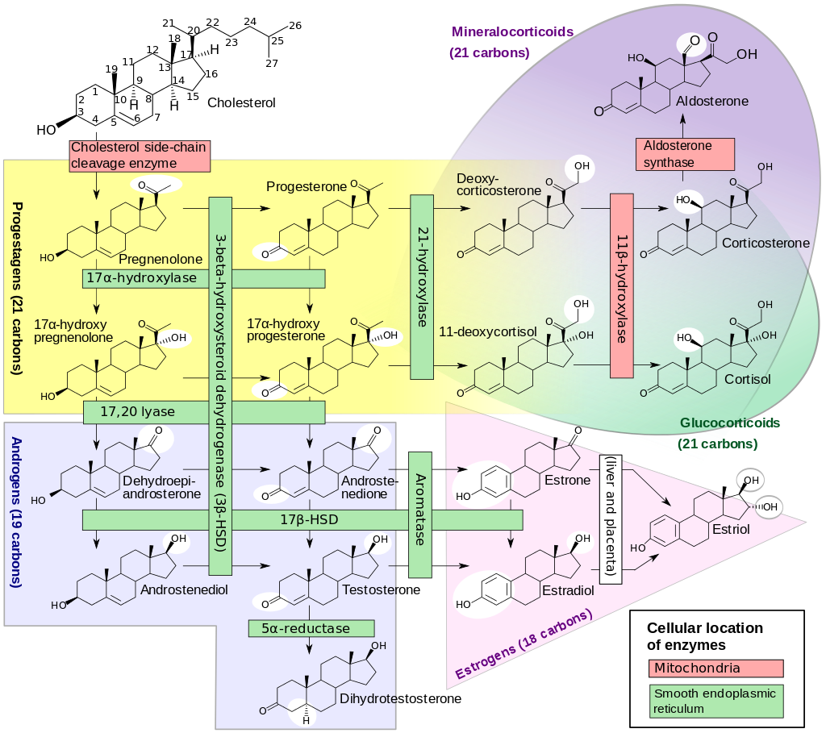

Slide 6
Treatment:
-Anti-Androgen: spironolactone
-Topical cream: Eflornithine
Procedures: To remove unwanted hair permanently, options include:
-Electrolysis
-Laser therapy

Slide 7
Thank you
☺

