Slide 1
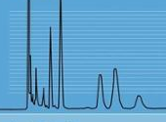
Homework 2
General Chemistry
Chem 101
Name:
ID Number:
Section:

Slide 2
Question 1
How many protons, neutrons and electrons are in the following isotopes ⁶³Cu, ¹³⁰Ba, and ²⁰²Hg?

Slide 3
Question 2
What does P₄ signify? How does it differ from 4P?
P: Phosphorus

Slide 4
Question 3
Write the empirical formula for caffeine (C₈H₁₀N₄O₂), a stimulant found in tea and coffee.

Slide 5
Question 4
Name these compounds:
(a) FeO
(b) Ag₂CO₃
(c) FeCl₃ • 6H₂O

