Slide 1
How to search NCBI

Slide 2
Objective of this lecture
To learn how to conduct a search in NCBI website

Slide 3
General guidelines when searching
Write the query in the search box.
Add more words, to retrieve specific results.
Use Boolean functions: AND, OR, NOT to get specific results.
You can search by accession numbers only.
You can search by gi numbers only.
Always use Advanced option.
Advanced options differ according to the database.

Slide 4
Importance of using Boolean functions or many specific words when you search

Slide 5
How to go to NCBI
Open Google and search for NCBI

Slide 6
NCBI

Slide 7
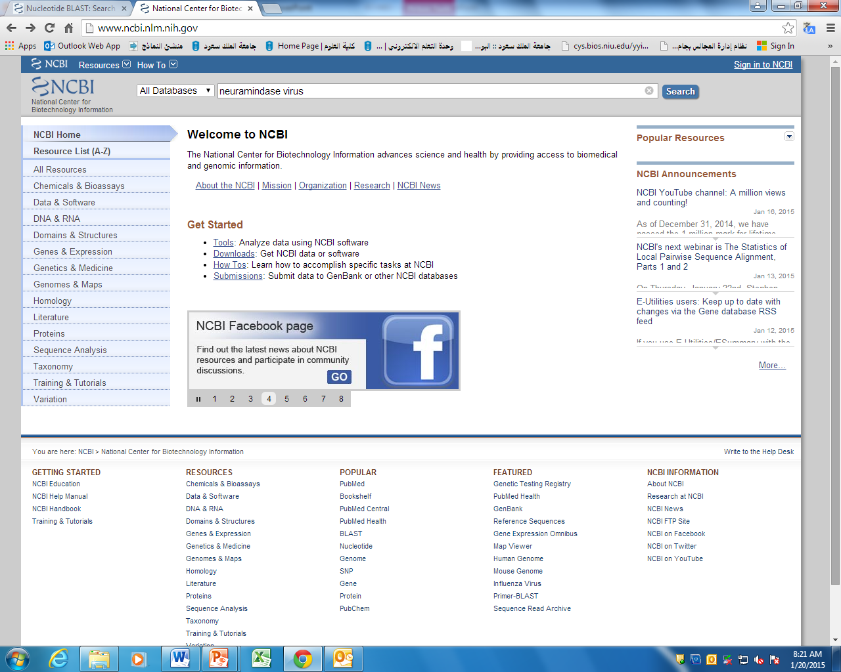
Working with NCBI
Query

Slide 8
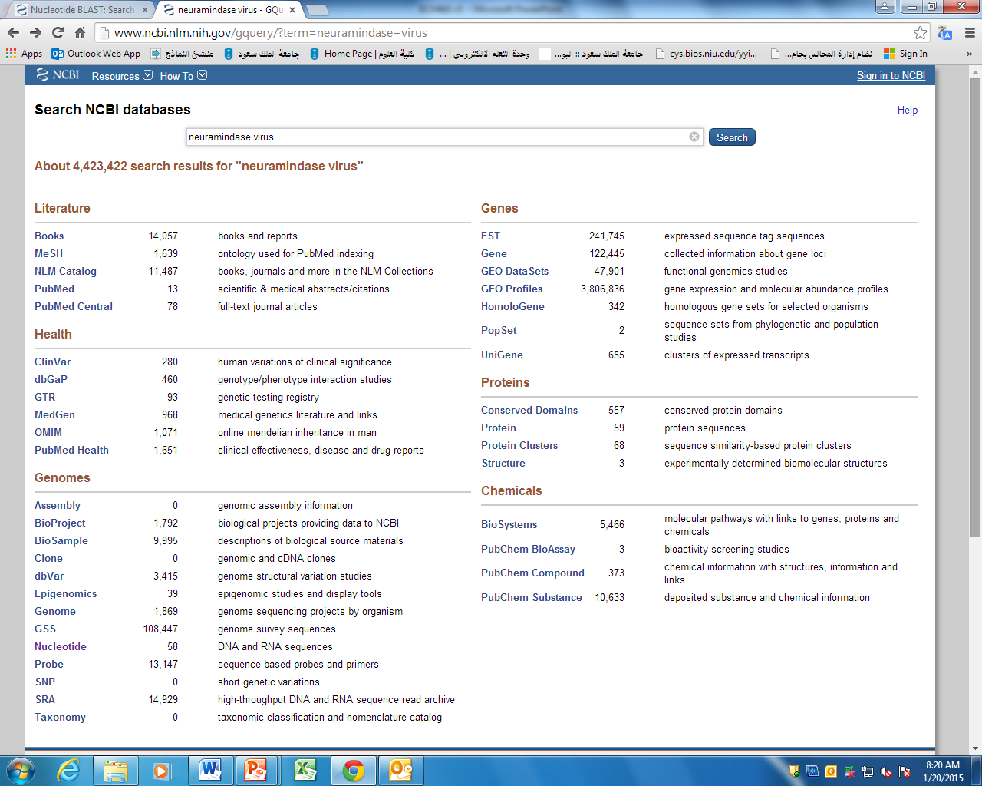
Genes
Literature (pubmed)
Gene
Health
Proteins
Protein
Genomes (Nucleotides)
Nucleotides

Slide 9
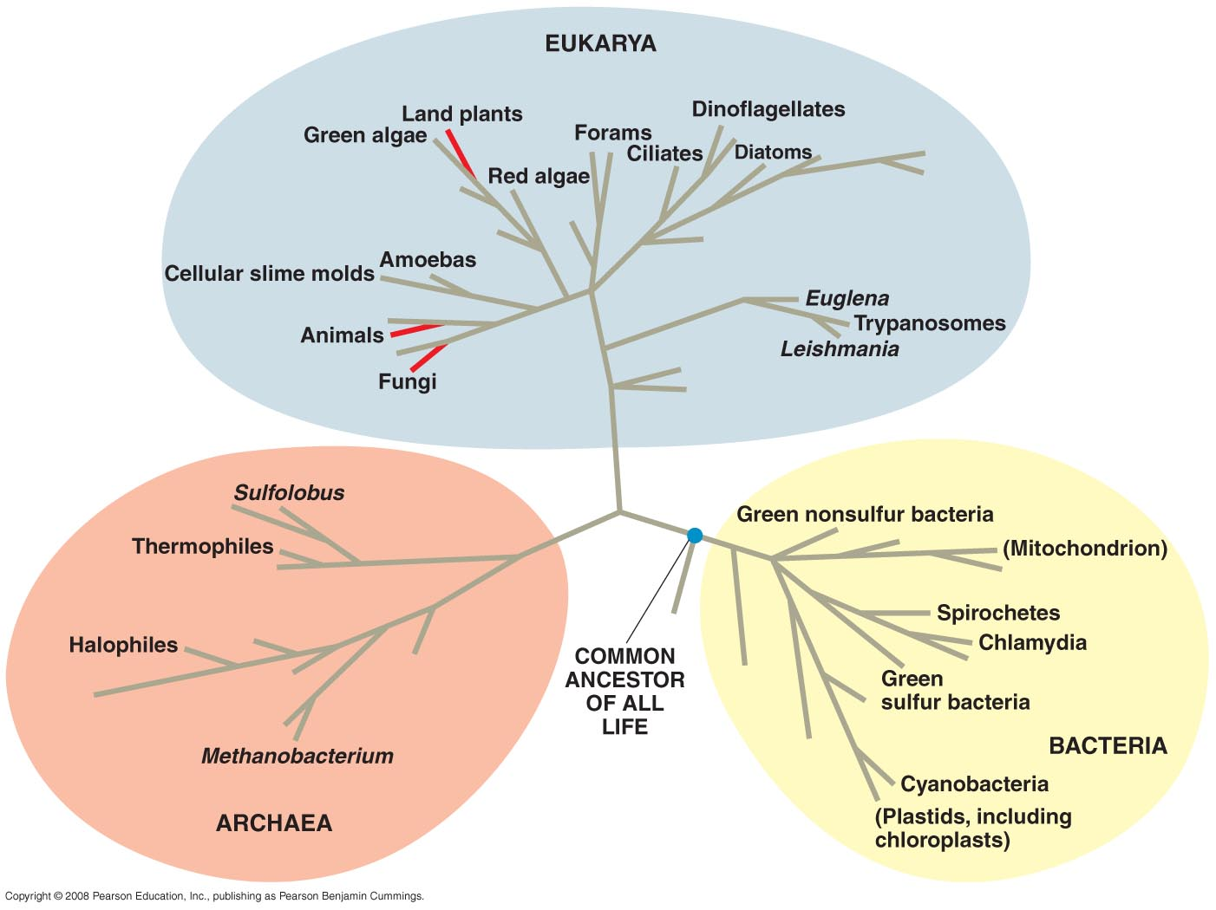
The three domain of life

Slide 10
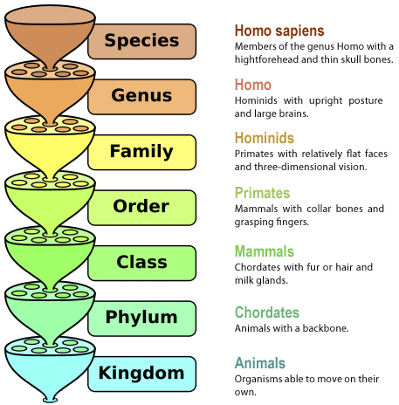
Latin or Scientific names

Slide 11
Latin Name | English Name
Escherichia coli (E. coli) | Type of Gram-negative Bacteria
Oryza sativa (O. sativa) | Rice
Rattus norvegicus (R. norvegicus) | Rat
Bos taurus (B. taurus) | cattle
Homo sapiens (H. sapiens) | human
The number of chromosomes per organism differs.
It is not related to its size.

Slide 12
How to know the Latin names & chromosome number of an organism?
There are so many different approaches to this questions
How to search NCBI databases?
Open “Taxonomy” database.
Write the query in the search box.
Add more words in the search to be specific.
Click search and retrieve specific results.
Use Advanced option whenever possible.

Slide 13
NCBI Taxonomy database

Slide 14
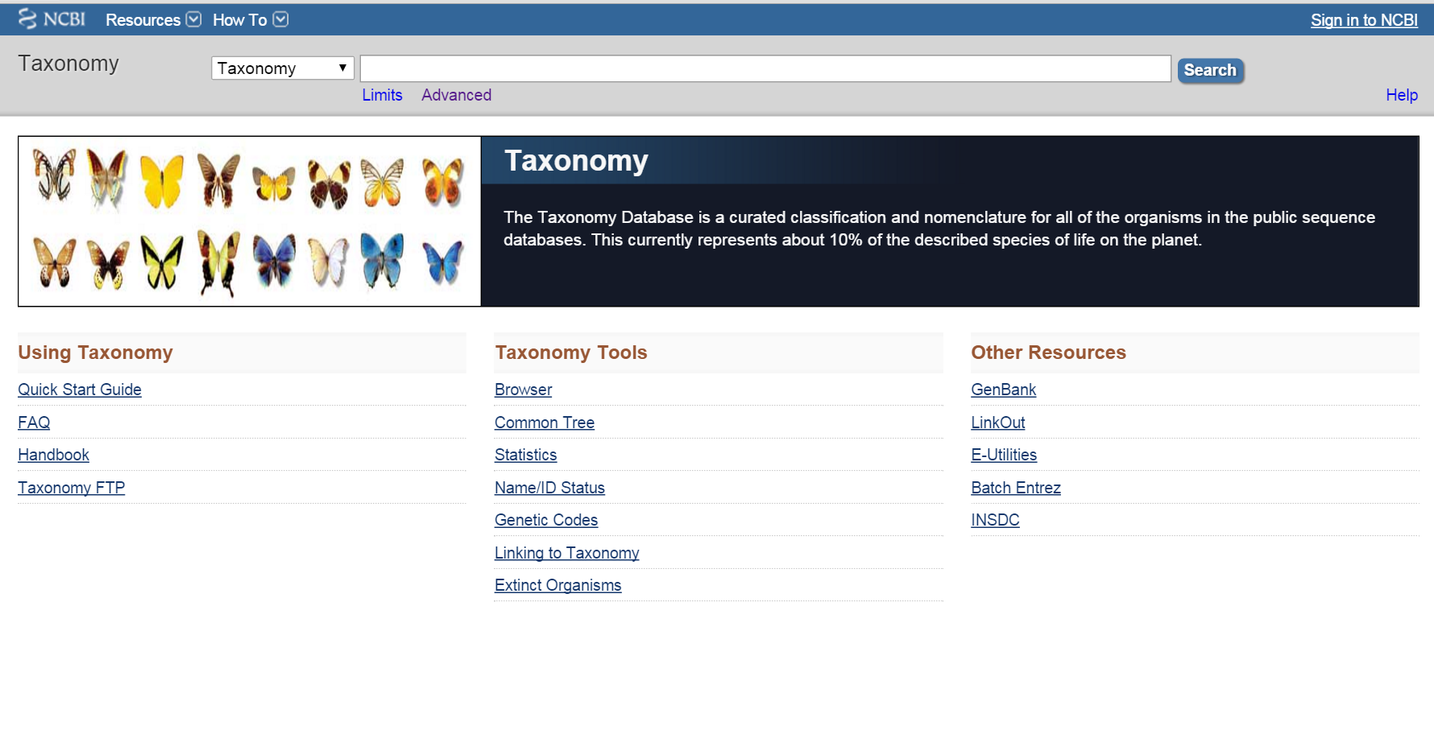
Select Taxonomy and then search

Slide 15
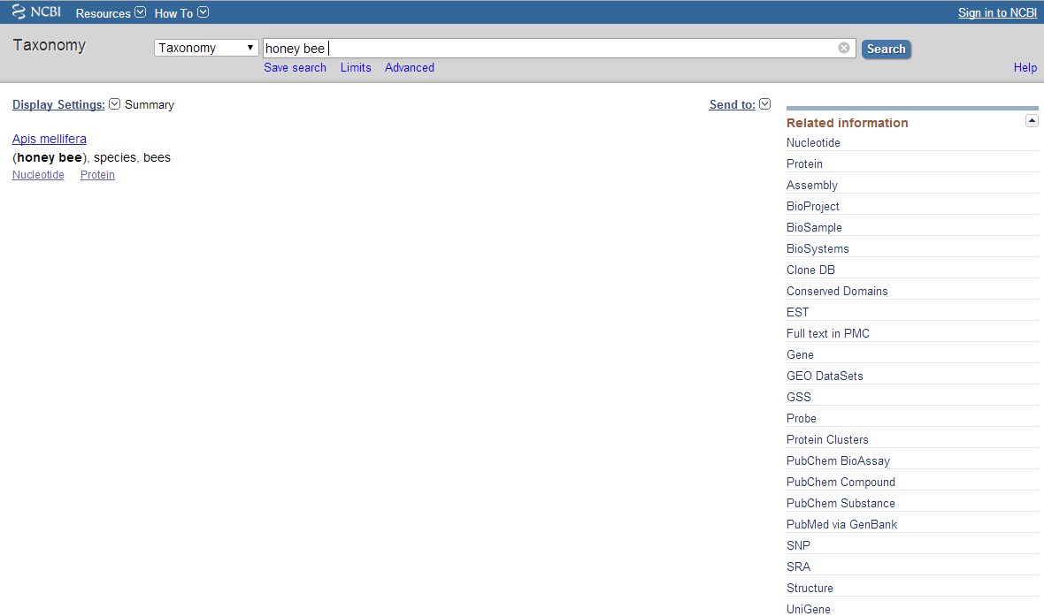
Taxonomy database
Database
Query
Latin Name
Click here to download file
Accessing all nucleotides & proteins of that organism
Related information
Always use advanced options to get specific results

Slide 16
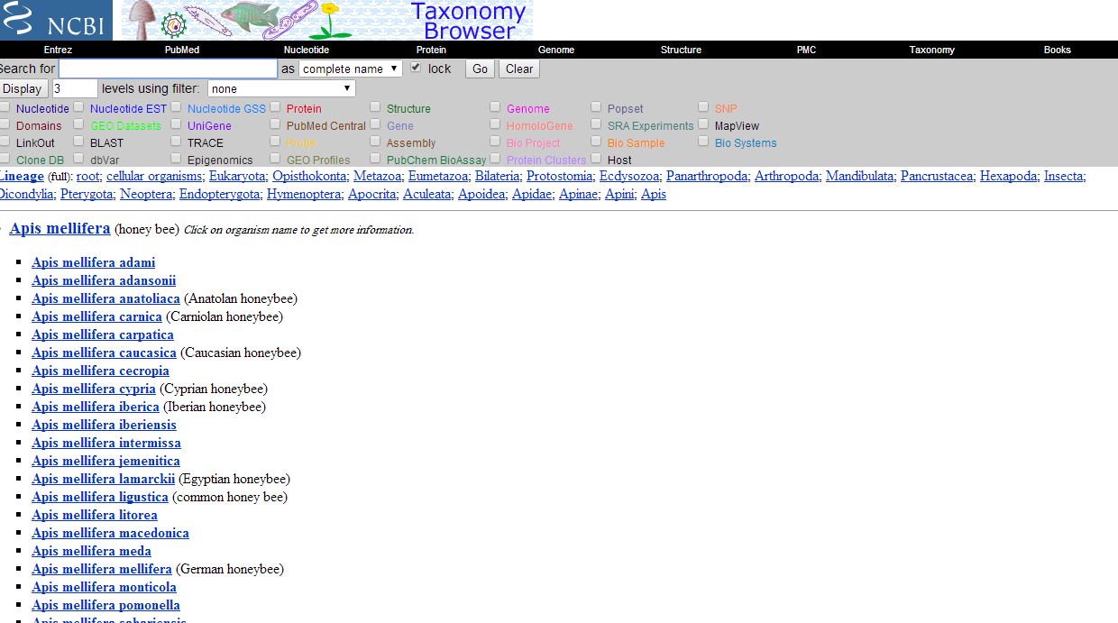

Slide 17
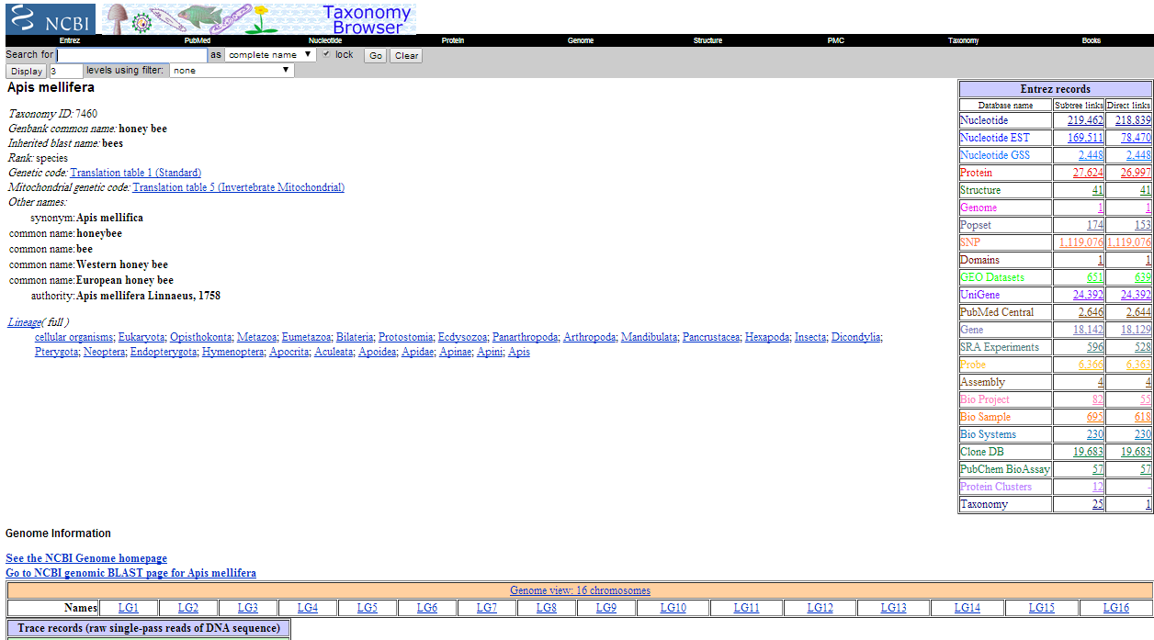
Link to all databases of that organism,
like accessing all of its proteins
Number of chromosomes

Slide 18
Home work
Find the GenBank file format.
Amino acid abbreviation used in fasta sequence.
DNA abbreviation in sequences.
Due next lecture!!!

