Slide 1
Insurance Market Developments
Omair Alvi, MA, FSA
Insurance Advisor, SAMA

Slide 2
Agenda
1. Roadmap for an Actuary
2. Insurance Market
3. Telematics
4. Introduction to Life Insurance Products

Slide 3
Roadmap for an Actuary

Slide 4
Typical Development Roadmap for an Actuary in Saudi
The following demonstrates an overview of a typical development roadmap for an Actuary in Saudi.
Studying for Exams
…
Successful Completion of all Requirements
Eligibility
Actuarial Exam Body
First Job
5 Years-------------------Avg. 6-7 Years-------------------10 Years
Bachelor’s Degree (expected)
It is expected all students to have a Bachelor’s Degree (preferably in Actuarial Science)
Selection of the Actuarial Examination Body
Graduates can select either ‘US’ (SOA/CAS) or ‘UK’ (IFoA) examination body
Most graduates in Saudi opt for US (SOA) as their bachelor’s degree follows the ‘US’ curriculum (for initial exams)
Starts working
full time
Actuarial students have the dual responsibility of working full time and also studying to pass actuarial exams
Few initial exams passed at graduation to help in job search.
To be covered by an ‘Actuarial Study Program’ (ASP)
Most markets and most major insurance companies with actuarial resources have some form of an Actuarial Study Program (ASP).
ASP broadly covers three main items:
Study Support
Financial Support
Professional Development
ASP to greatly assist actuarial resources to qualify - note exam passing rate is low worldwide (<50%).
Supported by:
1) Company Actuarial Function (AF)
On the Job Training
Study Mentoring
External Consultants
/Appointed Actuaries

Slide 5
‘Sample’ Actuarial Study Program (ASP)
Actuarial Study Program
Study Support
Financial Support
Professional Development
CPD Credits Post-Qualification
Participation in International events
Participation in local events
In-house training by actuaries
Qualification Bonus
Promotion upon passing exams
Salary increases upon passing exams
Higher starting pay
Study Mentors
Study Material & Exam Fees
Leave before exams
Study days

Slide 6
Benefits to Employers along the Journey
Actuarial students will be productive during the complete journey to becoming fully qualified. The table below provides an overview
of the expected tasks to be completed by actuarial students as they work towards full qualification.
Task / Years of Experience | 1-2 Years | 3-4 Years | 5-6 Years | 7+ Years
Data Checks & Review
Performing Analysis
Drafting Reports
Drawing Conclusions
Review of Work Performed by others students
Supporting qualified actuaries in their work
Review of Reports from Appointed Actuaries
Study Mentoring & On The Job Training
Peer Review of work of another Actuary
Product Approvals (Life Insurance)
Technical Sign-Off

Slide 7
Where do Actuaries Work?
Insurance & Reinsurance Companies:
Typically a good place to start your first job!
They are expected to hire qualified actuaries and students in Saudi to serve the market better.
Actuarial work is usually done in-house with some support from external actuaries.
33 insurance companies Saudi
3 Life Insurance Companies
13 Composite Insurance Companies (Life + Non-Life)
16 Non-Life Insurance Companies
1 Reinsurance Company
Actuarial Consulting Firms:
Typically a good place to start your first job!
They are expected to hire qualified actuaries and students in Saudi to serve the market better.
The main role of such companies is to provide support to insurance companies as an when needed.
At least 3 such companies currently with few more expected to open soon
Audit Firms
Typically a good place to start your first job!
Audit firms are responsible for signing off the financial statements of insurance companies.
Audit firms are expected to hire qualified actuaries and students in Saudi to serve the market better.
Regulators, Pension Companies etc
Usually requires some prior work experience (unless a separate department exists with qualified actuaries dedicated to develop actuarial students).

Slide 8
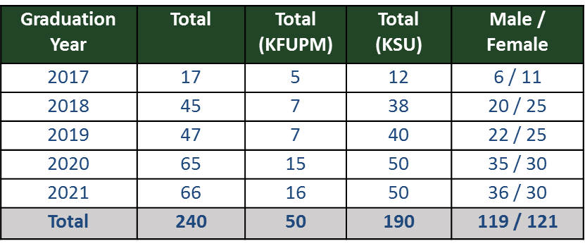
Actuarial Resources in Saudi
The table on the right shows the number of graduates (actuarial science) expected in the next few years in Saudi.
There are total 63 Actuarial Resources currently working in Saudi Insurance market.
Qualified Actuaries
6 Qualified (1 Saudi)
Part-Qualified
7 Associates (1 Saudi)
Students
50 total
- 31 Saudi (21 Male & 10 Female)
- 19 Non-Saudis (18 Male & 1 Female)
Overall Resources
33 Saudi
30 Non-Saudi

Slide 9
Distribution of Actuarial Resources by Departments in Saudi

Slide 10
Insurance Market

Slide 11
Insurance Market
Life
Life Insurance (Long Term)
Currently has the smallest share of GWP
Non-Life:
Health Insurance (1 Year) – Compulsory
Largest share of GWP of 53%
Motor Insurance (1 Year) – Compulsory
Second largest share of GWP of 32%
Other General Insurance (1 Year)
All other general lines has 12% share of GWP
Overall Insurance GWP of SAR 27.6 Billion (USD 7.37 Billion)
Compulsory Lines accounts for 85% of the GWP

Slide 12
Insurance Market

Slide 13
Telematics

Slide 14
Evolution of Telematics
The introduction of telematics to the insurance industry has changed the way drivers insure their vehicles.
Usage-based insurance (UBI) has become increasingly popular in many countries, including the US, Italy, South Africa and the UK.
UBI (also known as pay as you drive) is where the insurance cost depends upon the type of vehicle used, driving behaviour, mileage etc.
In 2015, close to 12 million consumers globally subscribed to UBI, and the same is expected to grow to 142 million globally by 2023.
The reason for growth is simple; it help drivers save money and dramatically improves road safety.

Slide 15
What is Telematics?
It is one of the oldest “IOT” (Internet of things) solutions but in constant progress…..

Slide 16
What is Telematics?
The basic idea of telematics auto insurance is that a driver's behavior is monitored directly while the person drives.
The telematics device measure a number of elements of interest to underwriters, actuaries and data scientists: miles driven; time of day; where the vehicle is driven (GPS); rapid acceleration; hard braking; hard cornering; and air bag deployment.
The level of data collected generally reflects the telematics technology employed and the policyholders’ willingness to share personal data.
The insurance company then assesses the data and provide periodic report to the client (and charges insurance premium accordingly).
The insurance company then can take actions to improve the overall health, profitability and productivity of the fleet.
Example: a driver who drives long distance at high speed will be charged a higher rate than a driver who drives short distances a slower speeds.

Slide 17
How this technology works?
Installation of Telematics device
Retrieving driver’s behavior and vehicle Information
Processing and analyzing data while maintaining confidentiality
Periodic report to the client
Actions to improve overall fleet profitability and safety by the client

Slide 18
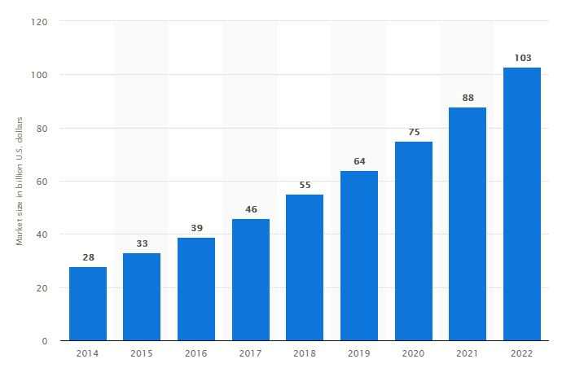
Estimated size of the global vehicle telematics market between 2014-2022
In USD Billion

Slide 19
What are the benefits of Telematics?
Enhance safety
Improve driver attitude
Maintenance predication
Reduce vehicle maintenance
Emergency responses
Accident investigation

Slide 20
What are the challenges of Telematics?
Rates of hardware and software
Batteries service life
Meeting all telematics standards
Negotiating with Telecommunication companies
Negotiating with Big data analysis companies

Slide 21
Life Insurance Products

Slide 22
Life Insurance Products
Conventional Products
Takaful Products

Slide 23
Life Insurance Products
Conventional Life Insurance
There are two basic forms of conventional life insurance:
Term Insurance (Protection Only)
Permanent Insurance (Protection & Savings).
- Whole Life
- Endowment
- Universal Life
- Variable Universal Life/Unit-Linked
Riders/Supplementary Benefits:
Accidental Death Benefit (ADB)
Waiver of Premium (WP)
Critical Illness (CI)
Disability / Disability Income:
Permanent Total Disability (PTD)
Permanent Partial Disability (PPD)
Temporary Total Disability (TTD)

Slide 24
Life Insurance Products
Summary Table
The different types of features available in a life insurance policies include:
Features:
Death Benefit
Investment in the market
Cash Value (Guaranteed)
Flexible Payments
Low Monthly Premium
Fund Choices
Term
Whole Life
Endowment
Universal Life
Unit-Linked
* | * | * | * | *
 |  |  |  | *
 | * | * | *
 |  |  | * | *
*
 |  |  |  | *

Slide 25
Life Insurance Products
2. Takaful Insurance
There are two types of Takaful Insurance plans:
Family Takaful:
Family Takaful (Protection, Protection & Savings)
Investment linked Takaful (Protection & Savings)
Child Education Takaful (Protection & Savings)
Medical & Health Takaful
General Takaful:
Motor Takaful
Property Takaful
Engineering & Marine Takaful
Personal Accident Takaful
Other

Slide 26
Questions?

