Slide 1
GC201 Visual Programming

Slide 2
Lecturer
Nouf M. Almunyif
E-mail: nalmunyif@yahoo.com
Website: http://fac.ksu.edu.sa/nalmunyif
Office : building 26 –first floor-lab 2
Don’t forget to update your phone number in edugate !
And activate your academic Email

Slide 3
Resources
Handouts & lecture notes
Text Book : Visual Basic 2010 how to program by Deitel

Slide 4
Warnings
Attendance is very important !! You are allowed to miss 25% of your lectures only or you will not be allowed to enter the final
Late attendance is not considered

Slide 5
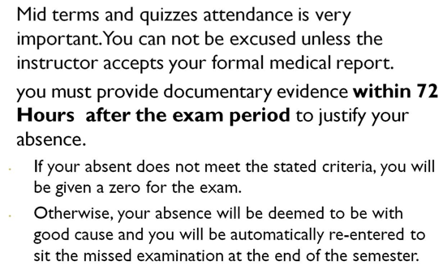
Warnings

Slide 6
Warnings
Tutorial and lab sheets work is not group work !! Study for it.

Slide 7
Grade
subject | marks
Mid1 | 15
Mid2 | 15
Class Quizzes | 10
Lab sheets | 5
Lab Evaluations | 10
Tutorials | 5
total | 60
Final lab | 10
Final exam | 30
total | 40

Slide 8
Lab
Your solutions to the weekly sheet should be printed and not hand-typed.
If it is more than one page it should be stapled. Keep your sheets neat and tidy.
You should hand your programs in a CD attached to the sheet
Both your sheet and CD should be labeled with these information:
Name
ID
Sheet number
Course name
Section

Slide 9
Cheating
قال الرسول صلى الله عليه و سلم : ( من غشنا فليس منا )
أي خير ترتجي إذا تخلى عنكِ الرسول صلى الله عليه و سلم و أعلن البراءة منكِ ؟

Slide 10
Cheating
If two or more assignments are found to be copied, then each student will get zero mark irrespective of whether she copied or did herself and allowed to copy.
if the Cheating repeated for the second time I will start using the minus !
You are not allowed to copy from a former student or the internet.

