Slide 1
Introduction to Programming Using Python PART 1
MIS 201 Management Information Systems
Lab Session 1

Slide 2
Outline
Why programming?
Python basics: comments, numbers, strings, and variables
Operations and expression: logical operators, order of execution, and expressions
Control flow: conditional execution using “if” statements

Slide 3
Why Programming?
Steve Jobs once said, "Everybody […] should learn how to program a computer... because it teaches you how to think."
Software and applications are everywhere!
Operating systems (Windows, MacOS, Android, iOS, etc.)
Business or home solutions/software
Enterprise applications
Mobile apps (smartphones, tablets, etc.)
Internet of Things (IoT)
Cars, smart homes, security systems, etc.
Reference: https://www.entrepreneur.com/article/289248

Slide 4
Why Programming?
Three Reasons Why Everyone Should Learn Programming
Coding develops structured and creative thinking
Break every problem down to bits and understand better. You start thinking logically, and this gives rise to more creative solutions…
Programming makes things easier for you
Turn manual tasks into automated tasks to simplify the work.
Learning to program teaches you persistence
When you learn computer programming, you start seeing problems in the light of solutions. Your brain starts functioning in that way… Programmers have to think logically about a problem…
Reference: https://www.entrepreneur.com/article/289248

Slide 5
A Map of Programming Languages

Slide 6
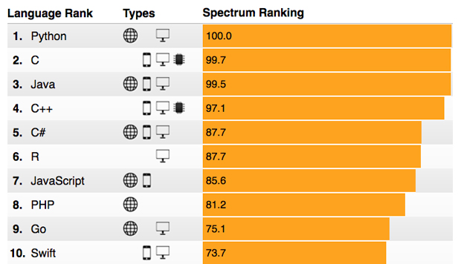
Python Overview
Python is one of those rare languages which can claim to be both simple and powerful.
Python is:
Simple
Easy to learn
Free and Open Source
High-level Language
Portable
Interpreted
Object Oriented
Extensible
Embeddable
Extensive Libraries

Slide 7
Python Basics
Comments
Using the sign # in the beginning of lines
Numbers
Integers: 1, 53, or 3921
Floats: 4.92
scientific format 52.3E-4 = 52.3*10⁻⁴ = 0.00523
Strings
Single and double quotes
Triple quotes (multiple lines)
String format method
age = 20
name = 'Swaroop’
print('{0} was {1} years old when he wrote this book'.format(name, age))
print('Why is {0} playing with that python?'.format(name))
Output:
Swaroop was 20 years old when he wrote this book
Why is Swaroop playing with that python?

Slide 8
Python Basics
Variables
The first character of the identifier must be a letter or an underscore (_)
The rest of the identifier name can consist of letters, underscores (_), or digits (0-9)
Identifier names are case-sensitive.
Examples of valid identifiers:
Name
name_2_3
Invalid (why?):
2things
my-name
a1b2&c3

Slide 9
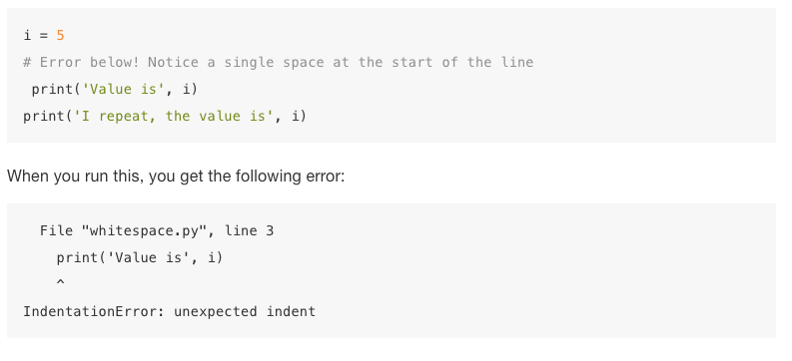
Python Basics
Indentation
Whitespaces (a space or a tab) are important in Python. A space at the beginning of the line is called indentation. Leading whitespace at the beginning of the logical line is used to determine the indentation level of the logical line, which in turn is used to determine the grouping of statements.

