Slide 1
Lectures of Stat -106
(Biostatistics)
Text book
Biostatistics
Basic Concepts and Methodology for the Health Sciences
By
Wayne W. Daniel
Prepared By:
Sana A. Abunasrah
Sabunasrah@ksu.edu.sa

Slide 2
Chapter 1
Introduction To
Biostatistics

Slide 3
Key words :
  Statistics , data , Biostatistics,
  Variable ,Population ,Sample

Slide 4
Introduction
Some Basic concepts
Statistics is a field of study concerned with
1- collection, organization, summarization and analysis of data.
2- drawing of inferences about a body of data when only a part of the data is observed.
Statisticians try to interpret and
communicate the results to others.

Slide 5
Data:
The raw material of Statistics is data.
We may define data as figures. Figures result from the process of counting or from taking a measurement.
For example:
- When a hospital administrator counts the number of patients (counting).
- When a nurse weighs a patient (measurement)

Slide 6
* A variable:
It is a characteristic that takes on different values in different persons, places, or things.
For example:
- heart rate,
- the heights of adult males,
- the weights of preschool children,
- the ages of patients seen in a dental clinic.

Slide 7
* Biostatistics:
The tools of statistics are employed in many fields:
business, education, psychology, agriculture, economics, … etc.
When the data analyzed are derived from the biological science and medicine,
we use the term biostatistics to distinguish this particular application of statistical tools and concepts.

Slide 8
Types of variables
Quantitative
Qualitative
Quantitative Variables
It can be measured in the usual sense.
For example:
- the heights of adult males,
- the weights of preschool children,
the ages of patients seen in a
dental clinic.
Qualitative Variables
Many characteristics are not capable of being measured. Some of them can be ordered (called ordinal) and Some of them can’t be ordered (called nominal).
For example:
- classification of people into socio-economic groups
-.hair color

Slide 9
Types of quantitative variables
Discrete
Continuous
A discrete variable
is characterized by gaps or interruptions in the values that it can assume.
For example:
- The number of daily admissions to a general hospital,
The number of decayed, missing or filled teeth per child
in an
elementary
school.
A continuous variable
can assume any value within a specified relevant interval of values assumed by the variable.
For example:
Height,
weight,
skull circumference.
No matter how close together the observed heights of two people, we can find another person whose height falls somewhere in between.

Slide 10
Types of qualitative variables
Nominal
Ordinal
As the name implies it consist of “naming” or classifies into various mutually exclusive categories
For example:
- Male - female
Sick - well
Married – single - divorced
.Whenever qualitative observation
Can be ranked or ordered according to some criterion.
For example:
Blood pressure
(high-good-low)
Grades (Excellent – V.good –good –fail)

Slide 11
* A population:
It is the largest collection of values of a random variable for which we have an interest at a particular time.
For example:
The weights of all the children enrolled in a certain elementary school.
Populations may be finite or infinite.

Slide 12
* A sample:
It is a part of a population.
For example:
The weights of only a fraction of these children.

Slide 13
Exercises
Question (6) – Page 17
Question (7) – Page 17
“ Situation A , Situation B “

Slide 14
Exercises:
Q6: For each of the following variables indicate whether it is quantitative or qualitative variable:
(a)The blood type of some patient in the hospital. Qualitative Nominal
(b) Blood pressure level of a patient.
(Qualitative ordinal)

Slide 15
(c) Weights of babies born in a hospital
during a year. Quantitative continues
(d) Gender of babies born in a hospital during a year. Qualitative nominal
(e) The distance between the hospital to the house Quantitative continues
(f) Under-arm temperature of day-old infants born in a hospital. Quantitative continues

Slide 16
Q7: For each of the following situations,
answer questions a through d:
(a) What is the population?
(b) What is the sample in the study?
(c) What is the variable of interest?
(d) What is the type of the variable?
Situation A: A study of 300 households in a small southern town revealed that if she has school-age child present.

Slide 17
All households in a small (a) Population:
southern town.
300 households in a small (b) Sample:
southern town.
(c) Variable: Does households had school age child present.
(d) Variable is qualitative nominal.

Slide 18
Situation B: A study of 250 patients admitted to a hospital during the past year revealed that, on the average, the patients lived 15 miles from the
hospital.
(a) Population: All patients admitted to a hospital during the past year.
(b) Sample: 250 patients admitted to a hospital during the past year.

Slide 19
(c) Variable: Distance the hospital live away from the hospital
Variable is Quantitative continuous. (d)

Slide 20
Choose the right answer:
1-The variable is a
a. subset of the population.
b. parameter of the population.
c. relative frequency.
d. characteristic of the population to be measured.
e. class interval.
2-Which of the following is an example of discrete variable
a. the number of students taking statistics in this term at ksu.
b. the time to exercise daily.
c. whether or not someone has a disease
d. height of certain buildings
e. Level of education

Slide 21
3.Which of the following is not an example of discrete variable
a. the number of students at the class of statistics.
b. the number of times a child cry in a certain street.
c. the time to run a certain distance.
d. the number of buildings in a certain street.
e. number of educated persons in a family.
4.Which of the following is an example of qualitative variable
a. the blood pressure level.
b. the number of times a child brush his/her teeth.
c. whether or not someone fail in an exam.
d. Weight of babies at birth.
e. the time to run a certain distance.

Slide 22
5.The continuous variable is a
a. variable with a specific number of values.
b. variable which cant be measured.
c. variable takes on values within intervals.
d. variable with no mode.
e. qualitative variable.
6. which of the following is an example of continuous variable
a. The number of visitors of the clinic yesterday.
b. The time to finish the exam.
c. The number of patients suffering from certain disease.
d. Whether or not the answer is true.

Slide 23
7. The discrete variable is
a-qualitative variable.
b-variable takes on values within interval.
C-variable with a specific number of values.
d-variable with no mode.
8-Which of the following is an example of nominal variable :
a-age of visitors of a clinic.
b-The time to finish the exam.
c-Whether or not a person is infected by influenza.
d-Weight for a sample of girls .

Slide 24
9-The nominal variable is a
a-A variable with a specific number of values
b-Qualitative variable that can’t be ordered.
c-variable takes on values within interval.
d-Quantitative variable .
10-Which of the following is an example of nominal variable :
a-The number of persons who are injured in accident.
b-The time to finish the exam.
c-Whether or not the medicine is effective.
d-Socio-economic level.

Slide 25
11-The ordinal variable is :
a-variable with a specific number of values.
b-variable takes on values within interval.
c-Qualitative variable that can be ordered.
d-Variable that has more than mode.

Slide 26
Chapter ( 2 )
Strategies for understanding the meanings of Data
Pages( 19 – 27)

Slide 27
Key words
frequency table, bar chart ,range
width of interval , mid-interval
Histogram , Polygon

Slide 28
Descriptive Statistics
Frequency Distribution for Discrete Random Variables
Example:
Suppose that we take sample of size 16 from children in a primary school and get the following data about the number of their decayed teeth,
3,5,2,4,0,1,3,5,2,3,2,3,3,2,4,1
To construct a frequency table
We need three columns:
1.Variable name
2.Frequency (f):how manmber 3.Relative frequency(R.f)=
Frequency / n
Relative Frequency | Frequency | No. of decayed teeth
0.0625 0.125 0.25 0.3125 0.125 0.125 | 1 2 4 5 2 2 | 0 1 2 3 4 5
1 | 16=n | Total

Slide 29
Representing the simple frequency table using the bar chart
We can represent the above simple frequency table using the bar chart.
We can get :
The sample size?
Number of children with decayed teeth=2?
Relative frequency of children with decayed teeth =4?

Slide 30
2.3 Frequency Distribution for Continuous Random Variables
For large samples, we can’t use the simple frequency table to represent the data.
We need to divide the data into groups or intervals or classes.
So, we need to determine:
The range (R).
It is the difference between the largest and the smallest observation in the data set.[R=Max –Min]

Slide 31
Frequency (f) | Class interval
11 | 30 – 39
46 | 40 – 49
70 | 50 – 59
45 | 60 – 69
16 | 70 – 79
1 | 80 – 89
189 | Total
Sum of frequency
=sample size=n

Slide 32
The Cumulative Frequency:
It can be computed by adding successive frequencies.
The Cumulative Relative Frequency:
It can be computed by adding successive relative frequencies.

Slide 33
For the above example, the following table represents the cumulative frequency, the relative frequency, and the cumulative relative frequency.

Slide 34
R.f= freq/n
Cumulative Relative Frequency | Relative Frequency R.f | Cumulative Frequency | Frequency Freq (f) | Class interval
0.0582 | 0.0582 | 11 | 11 | 30 – 39
- | 0.2434 | 57 | 46 | 40 – 49
0.6720 | - | 127 | - | 50 – 59
0.9101 | 0.2381 | - | 45 | 60 – 69
0.9948 | 0.0847 | 188 | 16 | 70 – 79
1 | 0.0053 | 189 | 1 | 80 – 89
 | 1 |  | 189 | Total

Slide 35
Example :
From the above frequency table, complete the table then answer the following questions:
1-The number of objects with age less than 50 years ?
2-The number of objects with age between 40-69 years ?
3-Relative frequency of objects with age between 70-79 years ?
4-Relative frequency of objects with age more than 69 years ?
5-The percentage of objects with age between 40-49 years ?

Slide 36
6- The percentage of objects with age less than 60 years ?
7-The Range (R) ?
8- Number of intervals (K)?
9- The width of the interval ( W) ?

Slide 37
Displaying grouped frequency distributions
Grouped frequency distributions can be displayed by
Histogram
Polygon (For frequency or relative frequency distributions)
Curves
Representing the grouped frequency table using the Histogram

Slide 38
Representing the grouped frequency table using the Polygon

Slide 39
[H.W] the following histogram show the frequency distribution of pathologic tumor size ( in cm) for a sample of 110 cancer patients:

Slide 41
Exercises
Pages : 31 – 34
H.W. :2.3.2, 2.3.6 , 2.3.7(a)

Slide 42
Exercises:
Q2.3.5: The following table shows the number of hours 45 hospital patients slept following the administration of a certain
anesthetic.
(a) From these
data construct:
* A relative
frequency
distribution
Frequency | Class Interval
21 | 1-5
16 | 6-10
6 | 11-15
2 | 16-20
45 | Total

Slide 43
(b) How many of the measurements are greater than 10? Ans: 8
(c) What percentage of the measurements are between 6-15 ?
Ans: 49%
(d) What proportion of the measurement is less than or equal 15? Ans: 0.96

Slide 44
Section (2.4) :
Descriptive Statistics Measures of Central Tendency
Page 38 - 41

Slide 45
key words:
Descriptive Statistic, measure of central tendency ,statistic, parameter, mean (μ) ,median, mode.

Slide 46
The Statistic and The Parameter
A Statistic:
It is a descriptive measure computed from the data of a sample.
A Parameter:
It is a a descriptive measure computed from the data of a population.
Since it is difficult to measure a parameter from the population, a sample is drawn of size n, whose values are χ ₁ , χ ₂ , …, χ _{n}. From this data, we measure the statistic.

Slide 47
Measures of Central Tendency
A measure of central tendency is a measure which indicates where the middle of the data is.
The three most commonly used measures of central tendency are:
The Mean, the Median, and the Mode.
The Mean :
It is the average of the data.

Slide 48
The Population Mean:
μ = which is usually unknown, then we use the
sample mean to estimate or approximate it.
The Sample Mean:
=
Example:
Here is a random sample of size 10 of ages, where
χ ₁ = 42, χ ₂ = 28, χ ₃ = 28, χ ₄ = 61, χ ₅ = 31,
χ ₆ = 23, χ ₇ = 50, χ ₈ = 34, χ ₉ = 32, χ ₁₀ = 37.
= (42 + 28 + … + 37) / 10 = 36.6

Slide 49
Properties of the Mean:
Uniqueness. For a given set of data there is one and only one mean.
Simplicity. It is easy to understand and to compute.
Affected by extreme values. Since all values enter into the computation.
Example: Assume the values are 115, 110, 119, 117, 121 and 126. The mean = 118.
But assume that the values are 75, 75, 80, 80 and 280. The mean = 118, a value that is not representative of the set of data as a whole.

Slide 50
The Median:
When ordering the data, it is the observation that divide the set of observations into two equal parts such that half of the data are before it and the other are after it.
* If n is odd, the median will be the middle of observations. It will be the (n+1)/2 ^{th} ordered observation.
When n = 11, then the median is the 6th observation.
* If n is even, there are two middle observations. The median will be the mean of these two middle observations. It will be the mean of the [ (n/2) ^{th} , (n/2 +1) ^{th} ]ordered observation.
When n = 12, then the median is the 6.5th observation, which is an observation halfway between the 6th and 7th ordered observation.

Slide 51
Example:
For the same random sample, the ordered observations will be as:
23, 28, 28, 31, 32, 34, 37, 42, 50, 61.
Since n = 10, then the median is the 5.5th observation, i.e. = (32+34)/2 = 33.
Properties of the Median:
Uniqueness. For a given set of data there is one and only one median.
Simplicity. It is easy to calculate.
It is not affected by extreme values as is the mean.

Slide 52
The Mode:
It is the value which occurs most frequently.
If all values are different there is no mode.
Sometimes, there are more than one mode.
Example:
For the same random sample, the value 28 is repeated two times, so it is the mode.
Properties of the Mode:
Sometimes, it is not unique.
It may be used for describing qualitative data.
It is not affected by extreme values

Slide 53
Examples
Find the mean and the mode for the following Relative Frequency?
Mode = 7
(has the higher frequency)
Age(x) | frequency (f) | X f
5 6 7 10 | 2 3 4 1 | 10 18 28 10
Total | 10 | 66

Slide 54
Examples
Find the mean and the mode for the following grouped
Frequency table?
Mode :interval( 7 – 9 )
(can't give exact number only the interval with higher Frequency)
Age | Frequency (f) | Midpoint (X) | X f
- 3 4 - 6 7 - 9 10 - 12 | 2 1 4 3 | 2 5 8 11 | 4 5 32 33
Total | 10 | _ | 74

Slide 55
Examples
Find the mean and the mode for the following bar chart?
Solution :
Mode = 3
(has the higher frequency)

Slide 57
key words:
Descriptive Statistic, measure of dispersion , range ,variance, coefficient of variation.

Slide 58
2.5. Descriptive Statistics – Measures of Dispersion:
A measure of dispersion conveys information regarding the amount of variability present in a set of data.
Note:
If all the values are the same
→ There is no dispersion .
2. If all the values are different
→ There is a dispersion:
a).If the values close to each other
→The amount of Dispersion small.
b) If the values are widely scattered
→ The Dispersion is greater.

Slide 59
Ex. Figure 2.5.1 –Page 43
** Measures of Dispersion are :
1.Range (R).
2. Variance.
3. Standard deviation.
4.Coefficient of variation (C.V).

Slide 60
1.The Range (R):
Range =Largest value- Smallest value =
Note:
Range concern only onto two values
Example 2.5.1 Page 40:
Refer to Ex 2.4.2.Page 37
Data:
43,66,61,64,65,38,59,57,57,50.
Find Range?
Range=66-38=28

Slide 61
2.The Variance:
It measure dispersion relative to the scatter of the values a bout there mean.
a) Sample Variance ( ) :
,where is sample mean
Example 2.5.2 Page 40:
Refer to Ex 2.4.2.Page 37
Find Sample Variance of ages , = 56
Solution:
S²= [(43-56) ² +(66-43) ²+…..+(50-56) ² ]/ 10
= 900/10 = 90

Slide 62
b)Population Variance ( ) :
where , is Population mean
3.The Standard Deviation:
is the square root of variance=
Sample Standard Deviation = S =
b) Population Standard Deviation = σ =

Slide 63
Note:
You can use the calculator to find :
1.Mean
2.Variance
3. Standard deviation
How to use calculator is in the Appendix) )

Slide 64
4.The Coefficient of Variation (C.V):
Is a measure use to compare the dispersion in two sets of data which is independent of the unit of the measurement .
where S: Sample standard deviation.
: Sample mean.

Slide 65
Example 2.5.3 Page 46:
Suppose two samples of human males yield the following data:
Sampe1 Sample2
Age 25-year-olds 11year-olds
Mean weight 145 pound 80 pound
Standard deviation 10 pound 10 pound

Slide 66
We wish to know which is more variable.
Solution:
c.v (Sample1)= (10/145)*100= 6.9
c.v (Sample2)= (10/80)*100= 12.5
Then age of 11-years old(sample2) is more variation

Slide 67
Exercises
Pages : 52 – 53
Questions: 2.5.1 , 2.5.2 ,2.5.3
H.W. :2.5.4 , 2.5.5, 2.5.6, 2.5.14
* Also you can solve in the review questions page 57:
Q: 12,13,14,15,16, 19

Slide 68
Exercises:
For each of the data sets in the following exercises Use calculator if possible))compute:
(a) The mean
(b) The median
(c) The mode
(d) The range
(e) The variance
(f) The standard deviation
(g) The coefficient of variation

Slide 69
Q2.5.3:
Butz et al. (A-10) evaluated the duration of benefit derived from the use of noninvasive positive-pressure ventilation by patients with amyotrophic lateral sclerosis on symptoms, quality of life, and survival. One of the variables of interest is partial pressure of arterial carbon dioxide (PaCO2). The values below ( mm of Hg ) reflect the result of baseline testing on 30 subjects as established by arterial blood gas analyses.

Slide 70
seven rat pups from the experiment involving the carotid artery.
500 570 560 570 450 560 570
(a) The mean (b) The median
Ans: 540 Ans: 560
(c) The mode (d) The range
Ans: 570 Ans: 120
(e) The variance (f) The standard deviation
Ans: 2200 Ans: 46.90
(g) The coefficient of variation Ans: 8.69%

Slide 71
H.W :Q2.5.1:
Porcellini et al. (A-8) studied 13 HIV-positive patients who were treated with highly active antiretroviral therapy (HAART) for at least 6 months. The CD4 T cell counts ( ) at baseline for the 13 subjects are listed below.
230 205 313 207 227 245 173
58 103 181 105 301 169

Slide 72
Q2.5.2:H.W Shrair and Jasper (A-9) investigated whether decreasing the venous return in young rats would affect ultrasonic vocalizations (USVs). Their research showed no significant change in the number of ultrasonic vocalizations when blood was removed from either the superior vena cava or the carotid artery. Another important variable measured was the heart rate (bmp) during the withdrawal of blood. The data below presents the heart rate of

Slide 73
40.0 47.0 34.0 42.0 54.0 48.0 53.6 56.9 58.0 45.0 54.5 54.0 43.0 44.3
53.9 41.8 33.0 43.1 52.4 37.9 34.5
40.1 33.0 59.9 62.6 54.1 45.7 40.6 56.6 59.0
(a) The mean (b) The median
Ans: 47.72 Ans: 46.35
(c) The mode (d) The range
Ans: 33, 54 Ans: 29.6

Slide 74
(e) The variance (f) The standard deviation
Ans: 84.135 Ans: 9.17251
(g) The coefficient of variation
(H.W)Q2.5.4:
According to Starch et al. (A-11), hamstring tendon grafts have been the “weak link” in anterior cruciate ligament reconstruction. In a controlled laboratory study, they compared two techniques for reconstruction : either an interference screw or a central sleeve and

Slide 75
screw on the tibial side. For eight cadaveric knees, the measurements below represent the required force ( in Newtones) at which initial failure of graft strands occurred for the central sleeve and screw technique.
172.5 216.63 212.62 98.97 66.95 239.76 19.57 195.72
(a) The mean (b) The median
Ans: 152.84 Ans: 184.11
(c) The mode (d) The range
Ans: no mode Ans: 220.19

Slide 76
(e) The variance (f) The standard deviation
Ans: 6494.732 Ans: 80.5899
(g) The coefficient of variation Ans: 52.73%
Q2.5.5:
Cardosi et al. (A-12) performed a 4 years retrospective review of 102 women undergoing radical hysterectomy for cervical or endometrial cancer. Catheter-associated urinary tract infection was observed in 12 of the subjects. Below are the numbers of

Slide 77
postoperative days until diagnosis of the infection for each subject experiencing an infection.
16 10 49 15 6 15 8 19 11 22 13 17
(a) The mean (b) The median
Ans: 16.75 Ans: 15
(c) The mode (d) The range
Ans: 15 Ans: 43
(e) The variance (f) The standard deviation
Ans: 124.0227 Ans: 11.1365
(g) The coefficient of variation Ans: 66.49%

Slide 78
Q2.5.6: The purpose of a study by Nozama et al. (A-13) was to evaluate the outcome of surgical repair of pars interarticularis defect by segmental wire fixation in young adults with lumbar spondylolysis. The authors found that segmental wire fixation historically has been successful in the treatment of nonathletes with spondylolysis, but no information existed on the results of this type of surgery in athletes. In a retrospective study, the authors found 20 subjects who had the surgery between 1993 and 2000. For these subjects, the data below

Slide 79
represent the duration in months of follow-up care after the operation.
103 68 62 60 60 54 49 44 42 41 38 36 34 30 19 19 19 19 17 16
(a) The mean (b) The median
Ans: 41.5 Ans: 39.5
(c) The mode (d) The range
Ans: 19 Ans: 87
(e) The variance (f) The standard deviation
Ans: 490.264 Ans: 22.1419

Slide 80
(g) The coefficient of variation Ans: 53.35%
Q2.5.14:
In a pilot study, Huizinga et al. ( A-14) wanted to gain more insight into the psychosocial consequences for children of a parent with cancer. For the study, 14 families participated in semistructured interviews and completed standardized questionnaires. Below is the age of the sick parent with cancer (in years) for the 14 families.

Slide 81
37 48 53 46 42 49 44 38 32 32 51 51 48 41
(a) The mean (b) The median
Ans: 43.7143 Ans: 45
(c) The mode (d) The range
Ans: 32, 51 Ans: 21
(e) The variance (f) The standard deviation
Ans: 48.0659 Ans: 6.93296
(g) The coefficient of variation Ans: 15.8597%

Slide 82
Chapter 3
Probability
The Basis of the Statistical inference

Slide 83
Key words:
Probability, objective Probability,
subjective Probability, equally likely
Mutually exclusive, multiplicative rule
Conditional Probability, independent events, Bayes theorem

Slide 84
3.1 Introduction
The concept of probability is frequently encountered in everyday communication. For example, a physician may say that a patient has a 50-50 chance of surviving a certain operation. Another physician may say that she is 95 percent certain that a patient has a particular disease.
Most people express probabilities in terms of percentages.
But, it is more convenient to express probabilities as fractions. Thus, we may measure the probability of the occurrence of some event by a number between 0 and 1.
The more likely the event, the closer the number is to one. An event that can't occur has a probability of zero, and an event that is certain to occur has a probability of one.

Slide 85
3.2 : Some definitions of probability
1.Equally likely outcomes:
Are the outcomes that have the same chance of occurring.
2.Mutually exclusive:
Two events are said to be mutually exclusive if they cannot occur simultaneously such that
A B =Φ .

Slide 86
The universal Set (S): The set all possible outcomes.
The empty set Φ : Contain no elements.
The event ,E : is a set of outcomes in S which has a certain characteristic.
Classical Probability : If an event can occur in N mutually exclusive and equally likely ways, and if m of these possess a triat, E, the probability of the occurrence of event E is equal to m/ N .
P(A)=n(A)/n(S)
For Example: in the rolling of the die , each of the six sides is equally likely to be observed . So, the probability that a 4 will be observed is equal to 1/6.

Slide 87
Relative Frequency Probability:
Def: If some posses is repeated a large number of times, n, and if some resulting event E occurs m times , the relative frequency of occurrence of E , m/n will be approximately equal to probability of E .
P(E) = m/n .

Slide 88
3.3 Elementary Properties of Probability:
Given some process (or experiment ) with n mutually exclusive events E₁, E₂, E₃,…………, E_{n}, then
1-P(E_{i} ) 0, i= 1,2,3,……n
2- P(E₁ )+ P(E₂) +……+P(E_{n} )=1
3- P(E_{i} +E_{J} )=P(E_{i} )+ P(E_{J} )
E_{i} ,E_{J} are mutually exclusive

Slide 89
Rules of Probability
1-Addition Rule
P(A U B)= P(A) + P(B) – P (A∩B )
2- If A and B are mutually exclusive (disjoint) ,then
P (A∩B ) = 0
Then , addition rule is
P(A U B)= P(A) + P(B) .
3- Complementary Rule
P(A' )= 1 – P(A)
where, A' = = complement event
Consider example 3.4.1 Page 63

Slide 90
Table 3.4.1 in Example 3.4.1
Total | Later >18 (L) | Early = 18 (E) | Family history of Mood Disorders
63 | 35 | 28 | Negative(A)
57 | 38 | 19 | Bipolar Disorder(B)
85 | 44 | 41 | Unipolar (C)
113 | 60 | 53 | Unipolar and Bipolar(D)
318 | 177 | 141 | Total

Slide 91
Find the following probabilities:
1. P(C) =
2.P(L) =
=(3.P(A^{c}
E) = ∩ 3.P(A
4.P(L U D)=
B) = ∩ 5.P(A
E) =∩ 6.P(L
=(A^{c} ∩ 7.P(E
=(U A^{c} 8.P(L

Slide 92
**Answer the following questions:
Suppose we pick a person at random from this sample.
1-The probability that this person will be 18-years old?
2-The probability that this person has family history of mood orders Unipolar(C)?
3-The probability that this person has no family history of mood orders Unipolar( )?
4-The probability that this person is 18-years old or has no family history of mood orders Unipolar (C))?
5-The probability that this person is more than18-years old and has family history of mood orders Unipolar and Bipolar(D)?

Slide 93
Conditional Probability:
P(A\B) is the probability of A assuming that B has happened.
P(A\B)= , P(B)≠ 0
P(B\A)= , P(A)≠ 0

Slide 94
Example 3.4.2 Page 64
From previous example 3.4.1 Page 63 , answer
suppose we pick a person at random and find he is 18 years (E),what is the probability that this person will be one with Negative family history of mood disorders (A)?
suppose we pick a person at random and find he has family history of mood (D) what is the probability that this person will be 18 years (E)?

Slide 95
Calculating a joint Probability :
Example 3.4.3.Page 64
Suppose we pick a person at random from the 318 subjects. Find the probability that he will early (E) and has Negative family history of mood disorders (A).
Exercise: Example 3.4.5.Page 66
Exercise: Example 3.4.6.Page 67

Slide 96
Independent Events:
If A has no effect on B, we said that A,B are independent events.
Then,
1- P(A∩B)= P(B)P(A)
2- P(A\B)=P(A)
3- P(B\A)=P(B)

Slide 97
Example 3.4.7 Page 68
In a certain high school class consisting of 100 students60 , 40 of them are boys, it is observed that 24 girls and 16 boys wear eyeglasses . If a student is picked at random from this class
1.The probability that the student wears eyeglasses ,
2.What is the probability that a student picked at random wears eyeglasses given that the student is a boy?
3.What is the probability of the joint occurrence of the events of wearing eye glasses and being a girl?

Slide 98
Solution
Take the following symbols:
not a boy = girl :B : is boy. B^{C}
not were glasses:G:were glasses G^{C}
n(s)=100 ,n(B)=40,n(G∩ B)=16,
n(G∩ B^{C} )=24
Total | B^{C} | B
n(G) | n(B^{C}∩G) | n(B∩G) | G
n(G^{C}) | n(B^{C}∩G^{C}) | n(B∩G^{C}) | G^{C}
n(S) | (n(B^{C} | n(B) | Total

Slide 99
1.P(G)=
=2.P(G/B)
=(3.P(G∩B^{C}
Total | B^{C} | B
 | 24 | 16 | G
 |  |  | G^{C}
100 |  | 40 | Total

Slide 100
Example 3.4.8 Page 69
Suppose that of 1200 admission to a general hospital during a certain period of time,750 are private admissions. If we designate these as a set A, then compute P(A) , P( ).
Exercise: Example 3.4.9.Page 76

Slide 101
Marginal Probability:
Definition:
Given some variable that can be broken down into m categories designated
by and another jointly occurring variable that is broken down into n categories designated by
, the marginal probability of with all the categories of B . That is,
for all value of j
Example 3.4.9.Page 76
Use data of Table 3.4.1, and rule of marginal Probabilities to calculate P(E).,P(L),P(A),…..

Slide 102
Exercise:
Page 76-77
Questions :
3.4.1, 3.4.3,3.4.4
H.W.
3.4.5 , 3.4.7

Slide 103
Q3.4.1: In a study of violent victimization of women and men, Porcelli et al. (A-2) collected information from 679 women and 345 men aged 18 to 64 years at several family practice centers in the metropolitan Detroit area. Patients filled out a health history questionnaire that included a question about victimization. The following table shows the sample subjects cross-classified by sex and type of violent victimization reported. The victimization categories are defined as no victimization, partner victimization (and not by others), victimization by persons other than

Slide 104
partners (friends, family members, or strangers), and those who reported multiple victimization.
(a) Suppose we pick a subject at random from this group. What is the probability that this subject will be a women?
Total | Multiple Victimization (T) | Nonpartners (N) | Partners (P) | No Victimization (V)
679 | 18 | 16 | 34 | 611 | Women (W)
345 | 10 | 17 | 10 | 308 | Men (M)
1024 | 28 | 33 | 44 | 919 | Total

Slide 105
(b) What do we call the probability calculated in part a?
(c) Show how to calculate the probability asked for in part a by two additional methods.
(d) If we pick a subject at random, what is probability that the subject will be a women and have experienced partner abuse?
(e) What do we call the probability calculated in part d?
(f) Suppose we picked a man at random. Knowing this information, what is the probability that he

Slide 106
experienced abuse from nonpartners?
(g) What do we call the probability calculated in part f?
(h) Suppose we pick a subject at random. What is the probability that it is a man or someone who experienced abuse from a partner?
(i) What do we call the method by which you obtained the probability in part h?

Slide 107
H.WQ3.4.3: Fernando et al. (A-3) studied drug-sharing among injection drug users in the South Bronx in New York City. Drug users in New York City use the term “split a bag” or “get down on a bag” to refer to the practice of diving a bag of heroin or other injectable substances. A common practice includes splitting drugs after they are dissolved in a common cooker, a procedure with considerable HIV risk. Although this practice is common, little is known about the prevalence of such practices. The researchers asked injection drug users in four neighborhoods in the South Bronx if they ever

Slide 108
“got down on” drugs in bags or shots. The results classified by gender and splitting practice are given below:
State the
following
probabilities in
words and calculate:
(a) Ans: 0.3418
(b) Ans: 0.8746
(c) Ans: 0.6134
Total | Never Split Drugs | Split Drugs | Gender
673 | 324 | 349 | Male
348 | 128 | 220 | Female
1021 | 452 | 569 | Total

Slide 109
(d) Ans: 0.6592
Q3.4.4: Laveist and Nuru-Jeter (A-4) conducted a study to determine if doctor-patient race concordance was associated with greater satisfaction with care. Toward that end, they collected a national sample of African-American, Caucasian, Hispanic, and Asian-American respondents. The following table classifies the race of the subjects as well as the race of their physician:

Slide 110
(a) What is the probability that a randomly selected subject will have an Asian/Pacific-Islander physician? Ans: 0.1533
Patient Race
Total | Asian-American | Hispanic | African-American | Caucasian | Physician’s Race
1796 | 175 | 406 | 436 | 779 | White
196 | 5 | 15 | 162 | 14 | African-American
166 | 2 | 128 | 17 | 19 | Hispanic
417 | 203 | 71 | 75 | 68 | Asian/Pacific-Island
145 | 4 | 56 | 55 | 30 | Other
2720 | 389 | 676 | 745 | 910 | Total

Slide 111
(b) What is the probability that an African-American subject will have an African- American physician?
Ans: 0.2174
(c) What is the probability that a randomly selected subject in the study will be Asian-American and have an Asian/Pacific-Islander physician? Ans: 0.075
(d) What is the probability that a subject chosen at random will be Hispanic or have a Hispanic physician? Ans: 0.2625
(e) Use the concept of complementary events to find the probability that a subject chosen at

Slide 112
random in the study does not have a white physician? Ans: 0.3397
Q3.4.5:
If the probability of left-handedness in a certain group of people is 0.5, what is the probability of right-handedness (assuming no ambidexterity)?

Slide 113
Q3.4.6:
The probability is 0.6 that a patient selected at random from the current residents of a certain hospital will be a male. The probability that the patient will be a male who is in for surgery is 0.2. A patient randomly selected from current residents is found to be a male; what is the probability that the patient is in the hospital for surgery?
Ans: 0.3333

Slide 114
Q3.4.7:
In a certain population of hospital patients the probability is 0.35 that a randomly selected patient will have heart disease. The probability is 0.86 that a patient with heart disease is a smoker. What is the probability that a patient randomly selected from the population will be a smoker and have heart disease?
Ans: 0.301

Slide 115
Baye's Theorem
Pages 79-83

Slide 116
In this case if the patient has to do a blood test in the laboratory, some time the result is
Positive(he has the disease) and if the result is negative
(he doesn't has the disease)

Slide 117
So, we have the following cases
 | The patient has the disease (D) | The patient doesn't has the disease ( D )
Lab result is Negative (T) | wrong result | Specificity A symptom P(T|D)
Lab result is positive ( T ) | Sensitivity A symptom P(T|D) | wrong result

Slide 118
Definition.1
The sensitivity of the symptom
This is the probability of a positive result given that the subject has the disease. It is denoted by P(T|D)
Definition.2
The specificity of the symptom
This is the probability of negative result given that the subject does not have the disease. It is denoted by P(T|D)

Slide 119
Definition 3:
The predictive value positive of the symptom
This is the probability that the subject has the disease given that the subject has a positive screening test result.
It is calculated using bayes theorem through the following formula
Where P(D) is the rate of the disease

Slide 120
Which is given by
P(D) = 1 – P(D)
P(T/ D) = 1 - P(T/ D)
Note that the numerator is equal to sensitivity times rate of the disease, while the denominator is equal to sensitivity times rate of the disease plus 1 minus the specificity times one minus the rate of the disease

Slide 121
Definition.4
The predictive value negative of the symptom
This is the probability that a subject does not have the disease given that the subject has a negative screening test result .It is calculated using Bayes Theorem through the following formula
where,

Slide 122
Example 3.5.1 page 82
A medical research team wished to evaluate a proposed screening test for Alzheimer’s disease. The test was given to a random sample of 450 patients with Alzheimer’s disease and an independent random sample of 500 patients without symptoms of the disease. The two samples were drawn from populations of subjects who were 65 years or older. The results are as follows.
Test Result | Yes (D) | No ( ) | Total
Positive(T) | 436 | 5 | 441
Negativ( ) | 14 | 495 | 509
Total | 450 | 500 | 950

Slide 123
In the context of this example
What is a false positive?
A false positive is when the test indicates a positive result (T) when the person does not have the disease
b) What is the false negative?
A false negative is when a test indicates a negative result ( ) when the person has the disease (D).
c) Compute the sensitivity of the symptom.
d) Compute the specificity of the symptom.

Slide 124
e) Suppose it is known that the rate of the disease in the general population is 11.3%. What is the predictive value positive of the symptom and the predictive value negative of the symptom
The predictive value positive of the symptom is calculated as
The predictive value negative of the symptom is calculated as
Notes:
124

Slide 125
Exercise:
Page 83
Questions :
3.5.1, 3.5.2
H.W.:
Page 87 : Q4,Q5,Q7,Q9,Q21

Slide 126
Q3.5.1; A medical research team wishes to assess the usefulness of a certain symptom (call it S) in the diagnosis of a particular disease. In a random sample of 775 patients with the disease, 744 reported having the symptom. In an independent random sample of 1380 subjects without the disease, 21 reported that they had the symptom.
(a) In the context of this exercise, what is a false positive?
(b) What is a false negative?

Slide 127
(c) Compute the sensitivity of the symptom.
(d) Compute the specificity of the symptom.
(e) Suppose it is known that the rate of the diseases in the general population is 0.001. what is the predictive value positive of the symptom?
(f) What is the predictive value negative of the symptom?

Slide 128
(h) What do you conclude about the predictive value of the symptom on the basis of the results obtained in part g?
Q3.5.2:
Dorsay and Helms (A-6) performed a retrospective study of 71 knees scanned by MRI. One of the indicators they examined was the absence of the “bow-tie sign” in the MRI as evidence of a bucket-handle or “bucket-handle type” tear of the meniscus.

Slide 129
In the study, surgery confirmed that 43 of the 71 cases were bucket-handle tears. The cases may be cross-classified by “bow-tie sign” status and surgical results as follows:
Total | Tear Surgically Confirmed As Not Present ( ) | Tear Surgically Confirmed (D)
48 | 10 | 38 | Positive Test (absent bow-tie sign) (T)
23 | 18 | 5 | Negative Test (bow-tie present)( )
71 | 28 | 43 | Total

Slide 130
(a) What is the sensitivity of testing to see if the absent bow-tie sign indicates a meniscal tear?
Ans: 0.8837
(b) What is the specificity of testing to see if the absent bow-tie sign indicates a meniscal tear?
Ans: 0.6229
(c) What additional information would you need to determine the predictive value of the test?

Slide 131
(d) Suppose it is known that the rate of the disease in the general population is 0.1, what is the predictive value positive of the symptom? Ans: 0.20659
(e) What is predictive value negative of the symptom? Ans: 0.9797

Slide 132
Chapter 4:
Probabilistic features of certain data Distributions
Pages 93- 111

Slide 133
Key words
Probability distribution , random variable ,
Bernolli distribution, Binomail distribution,
Poisson distribution

Slide 134
The Random Variable (X):
When the values of a variable (height, weight, or age) can’t be predicted in advance, the variable is called a random variable.
An example is the adult height.
When a child is born, we can’t predict exactly his or her height at maturity.

Slide 135
4.2 Probability Distributions for Discrete Random Variables
Definition:
The probability distribution of a discrete random variable is a table, graph, formula, or other device used to specify all possible values of a discrete random variable along with their respective probabilities.

Slide 136
The Cumulative Probability Distribution of X, F(x):
It shows the probability that the variable X is less than or equal to a certain value,
F(x)=P(X ≤ x).

Slide 137
Example 4.2.1 page 94:
F(x)= P(X≤ x) | P(X=x) ( f/n=) | Frequeny (f) | Number of Programs
0.2088 | 0.2088 | 62 | 1
0.3670 | 0.1582 | 47 | 2
0.4983 | 0.1313 | 39 | 3
0.6296 | 0.1313 | 39 | 4
0.8249 | 0.1953 | 58 | 5
0.9495 | 0.1246 | 37 | 6
0.9630 | 0.0135 | 4 | 7
1.0000 | 0.0370 | 11 | 8
 | 1.0000 | 297 | Total

Slide 138
Properties of probability distribution of discrete random variable.
1. 0 ≤ P(X = x) ≤ 1
2. ∑ P(X = x) =1
3. P(a ≤ X ≤ b)=P(X ≤ b)- P(X ≤ a-1)
4. P(X < b)= P(X ≤ b-1)

Slide 139
Example 4.2.2 page 96: (use table in example 4.2.1)
What is the probability that a randomly selected family will be one who used three assistance programs?
Example 4.2.3 page 96: (use table in example 4.2.1)
What is the probability that a randomly selected family used either one or two programs?

Slide 140
Example 4.2.4 page 98: (use table in example 4.2.1)
What is the probability that a family picked at random will be one who used two or fewer assistance programs?
Example 4.2.5 page 98: (use table in example 4.2.1)
What is the probability that a randomly selected family will be one who used fewer than four programs?
Example 4.2.6 page 98: (use table in example 4.2.1)
What is the probability that a randomly selected family used five or more programs?

Slide 141
Example 4.2.7 page 98: (use table in example 4.2.1)
What is the probability that a randomly selected family is one who used between three and five programs, inclusive?

Slide 142
Find the following probability
For the following probability distribution table:
P(X= 15) =
P(X = 10)=
P( X = 11)=
P(X <15)=
P(X > 10)=
P( 5≤ X ≤15)=
P(X ≤ 10.5) =
Mean =
P(X=x) | X
0.23 | 5
0.30 | 10
------- | 15
0.44 | 20

Slide 143
For the following probability distribution table:
Find:
P(X ≤ 6) =
P(X < 5)=
P( X = 7)=
P(X =5)=
P(X > 4)=
P( 4≤ X ≤ 6)=
Mean=
P(X ≤ x) | X
0.10 | 3
0.25 | 4
0.55 | 5
0.60 | 6
0.78 | 7
1 | 8

Slide 144
4.3 The Binomial Distribution:
The binomial distribution is one of the most widely encountered probability distributions in applied statistics. It is derived from a process known as a Bernoulli trial.
Bernoulli trial is :
When a random process or experiment called a trial can result in only one of two mutually exclusive outcomes, such as dead or alive, sick or well, the trial is called a Bernoulli trial.

Slide 145
The Bernoulli Process
A sequence of Bernoulli trials forms a Bernoulli process under the following conditions
1- Each trial results in one of two possible, mutually exclusive, outcomes. One of the possible outcomes is denoted (arbitrarily) as a success, and the other is denoted a failure.
2- The probability of a success, denoted by p, remains constant from trial to trial. The probability of a failure, 1-p, is denoted by q.
3- The trials are independent, that is the outcome of any particular trial is not affected by the outcome of any other trial

Slide 146
The probability distribution of the binomial random variable X, the number of successes in n independent trials is:
Where is the number of combinations of n distinct objects taken x of them at a time.
* Note: 0! =1

Slide 147
Properties of the binomial distribution
1. f(x) ≥ 0
2. ∑ f(x) =1
3.The parameters of the binomial distribution are n and p
4.µ = E(X)= n p
5. σ² = Var(X)= npq

Slide 148
Example 4.3.1 page 100
If we examine all birth records from the North Carolina State Center for Health statistics for year 2001, we find that 85.8 percent of the pregnancies had delivery in week 37 or later (full- term birth).
If we randomly selected five birth records from this population what is the probability that exactly three of the records will be for full-term births?
Exercise: example 4.3.2 page 104

Slide 149
Example 4.3.3 page 104
Suppose it is known that in a certain population 10 percent of the population is color blind. If a random sample of 25 people is drawn from this population, find the probability that
a) Two or fewer will be color blind.
b) 24 or more will be color blind
c) Between two and five inclusive will be color blind.
d) At most one will be color blind.
Exercise: example 4.3.4 page 106

Slide 150
4.4 The Poisson Distribution
If the random variable X is the number of occurrences of some random event in a certain period of time or space (or some volume of matter).
The probability distribution of X is given by:
f (x) =P(X=x) = ,x = 0,1,…..
The symbol e is the constant equal to 2.7183. (Lambda) is called the parameter of the distribution and is the average number of occurrences of the random event in the interval (or volume)

Slide 151
Properties of the Poisson distribution
1. f(x) ≥ 0
2. ∑ f(x) =1
3.The parameters of the poisson distribution is λ
4.µ = E(X)= λ
5. σ² = Var(X)= λ

Slide 152
Example 4.4.1 page 111
In a study of a drug -induced anaphylaxis among patients taking rocuronium bromide as part of their anesthesia, Laake and Rottingen found that the occurrence of anaphylaxis followed a Poisson model with =12 incidents per year in Norway .Find
1- The probability that in the next year, among patients receiving rocuronium, exactly three will experience anaphylaxis?

Slide 153
2- The probability that less than two patients receiving rocuronium, in the next year will experience anaphylaxis?
3- The probability that more than two patients receiving rocuronium, in the next 6-month
will experience anaphylaxis?
4- The expected value of patients receiving rocuronium, in the next year who will experience anaphylaxis.
5- The variance of patients receiving rocuronium, in the next year who will experience anaphylaxis
6- The standard deviation of patients receiving rocuronium, in the next year who will experience anaphylaxis

Slide 154
Example 4.4.2 page 111: Refer to example 4.4.1
1-What is the probability that at least three patients in the next year will experience anaphylaxis if rocuronium is administered with anesthesia?
2-What is the probability that exactly one patient in the next month will experience anaphylaxis if rocuronium is administered with anesthesia?
3-What is the probability that none of the patients in the next month will experience anaphylaxis if rocuronium is administered with anesthesia?

Slide 155
4-What is the probability that at most two patients in the next year will experience anaphylaxis if rocuronium is administered with anesthesia?
Exercises: examples 4.4.3, 4.4.4 and 4.4.5 pages111-113
Exercises: Questions 4.3.4 ,4.3.5, 4.3.7 ,4.4.1,4.4.5

Slide 156
Excercices:
Q4.3.4: Page 111
The same survey data base cited shows that 32 percent of U.S adults indicated that they have been tested for HIV at some points in their life .Consider a simple random sample of 15 adults selected at that time .Find the probability
that the number of adults who have been
tested for HIV in the sample would be:

Slide 157
Hint:

Slide 158
(a) Three (Ans. 0.1457)
(b) Less than two (Ans. 0.02477)
(c ) At most one (Ans. 0.02477)
(d) At least three (Ans. 0.9038)
(e) between three and five ,inclusive.

Slide 159
Q4.3.5
refer to Q4.3.4 , find the mean and the variance?
(Answer: mean = 4.8 ,
variance =3.264 )

Slide 160
Q 4.4.3 :
If the mean number of serious accidents per year in a large factory is five ,find the probability that the current year there will be:
Hint: f(x)=
(a) Exactly seven accidents per year
(b) Ten or more accidents per year
(c) No accident per 6 months
(d)fewer than one accidents per year.

Slide 161
For Q 4.4.3 :Q4.4.4
Find:
1.mean per 6-months
2. variance and standard
deviation per 3 months

Slide 162
4.5 Continuous Probability Distribution
Pages 114 – 127

Slide 163
Key words:
Continuous random variable, normal distribution , standard normal distribution , T-distribution

Slide 164
Now consider distributions of continuous random variables.

Slide 165
Properties of continuous probability Distributions:
1- Area under the curve = 1.
2- P(X = a) = 0 , where a is a constant.
3- Area between two points a , b
= P(a<x<b) .

Slide 166
4.6 The normal distribution:
It is one of the most important probability distributions in statistics.
The normal density is given by
, -∞ < x < ∞, - ∞ < µ < ∞, σ > 0
π, e : constants
µ: population mean.
σ : Population standard deviation.

Slide 167
Characteristics of the normal distribution: Page 111
The following are some important characteristics of the normal distribution:
1- It is symmetrical about its mean, µ.
2- The mean, the median, and the mode are all equal.
3- The total area under the curve above the x-axis is one.
4-The normal distribution is completely determined by the parameters µ and σ.

Slide 168
5- The normal distribution
depends on the two
parameters μ and σ.
determines the
location of
the curve.
(As seen in figure 4.6.3) ,
But, σ determines
the scale of the curve, i.e.
the degree of flatness or
peaked ness of the curve.
(as seen in figure 4.6.4)
μ₁
μ₂
μ₃
μ₁ < μ₂ < μ₃
σ₁
σ₂
σ₃
μ
σ₁ < σ₂ < σ₃

Slide 169
The Standard normal distribution:
Is a special case of normal distribution with mean equal 0 and a standard deviation of 1.
The equation for the standard normal distribution is written as
, - ∞ < z < ∞

Slide 170
Characteristics of the standard normal distribution
1- It is symmetrical about 0.
2- The total area under the curve above the x-axis is one.
3- We can use table (D) in the Appendix to find the probabilities and areas.

Slide 171
“How to use tables of Z”
Note that
The cumulative probabilities P(Z ≤ z) are given in
tables for -3.49 < z < 3.49. Thus,
P (-3.49 < Z < 3.49) ≅ 1.
For standard normal distribution,
P (Z > 0) = P (Z < 0) = 0.5
Example 4.6.1:
If Z is a standard normal distribution, then
P( Z < 2) = 0.9772
is the area to the left to 2
and it equals 0.9772.
2

Slide 172
Example 4.6.2:
P(-2.55 < Z < 2.55) is the area between
-2.55 and 2.55, Then it equals
P(-2.55 < Z < 2.55) =0.9946 – 0.0054
= 0.9892.
Example 4.6.2:
P(-2.74 < Z < 1.53) is the area between
-2.74 and 1.53.
P(-2.74 < Z < 1.53) =0.9370 – 0.0031
= 0.9339.
-2.55
0
2.55
-2.74
1.53

Slide 173
Example 4.6.3:
P(Z > 2.71) is the area to the right to 2.71.
So,
P(Z > 2.71) =1 – 0.9966 = 0.0034.
Example :
P(Z = 0.84) is the area at z = 0.84.
So,
P(Z = 0.84) = 0
2.71
0.84

Slide 174
Exercise
Given Standard normal distribution by using the tables :
4.6.1 :The area to the left of Z=2
4.6.2 :
The area under the curve Z =0, Z= 1.43
4.6.3 : P(Z ≥ 0.55)=
4.6.5 : P(Z < - 2.35)=

Slide 175
4.6.7 :
P( -1.95 < Z < 1.95 )=
4.6.10:
P( Z = 1.22) =

Slide 176
Given the following probabilities, find z1
4.6.11
P(Z ≤ z1) = 0.0055 (z1=-2.54)
4.6.12
P(-2.67≤ Z ≤ z1) = 0.9718 (z1=1.97)
4.6.13
P(Z > z1) = 0.0384 (z1=1.77)
4.6.11 :
P(z1 < Z ≤ 2.98) = 0.1117 (z1=1.21)

Slide 177
How to transform normal distribution (X) to standard normal distribution (Z)?
This is done by the following formula:
Example:
If X is normal with µ = 3, σ = 2. Find the value of standard normal Z, If X= 6?
Answer:

Slide 178
4.7 Normal Distribution Applications
The normal distribution can be used to model the distribution of many variables that are of interest. This allow us to answer probability questions about these random variables.
Example 4.7.1:
The ‘Uptime ’is a custom-made light weight battery-operated
activity monitor that records the amount of time an individual
spend the upright position. In a study of children ages 8 to 15
years. The researchers found that the amount of time children
spend in the upright position followed a normal distribution with
Mean of 5.4 hours and standard deviation of 1.3.Find

Slide 179
If a child selected at random ,then
1-The probability that the child spend less than 3
hours in the upright position 24-hour period
P( X < 3) = P( < ) = P(Z < -1.85) = 0.0322
-------------------------------------------------------------------------
2-The probability that the child spend more than 5
hours in the upright position 24-hour period
P( X > 5) = P( > ) = P(Z > -0.31)
= 1- P(Z < - 0.31) = 1- 0.3520= 0.648
-----------------------------------------------------------------------
3-The probability that the child spend exactly 6.2
hours in the upright position 24-hour period
P( X = 6.2) = 0

Slide 180
4-The probability that the child spend from 4.5 to 7.3 hours in the upright position 24-hour period
P( 4.5 < X < 7.3) = P( < < )
= P( -0.69 < Z < 1.46 ) = P(Z<1.46) – P(Z< -0.69)
= 0.9279 – 0.2451 = 0.6828
Hw…EX. 4.7.2 – 4.7.3

Slide 181
Exercise:
Questions : 4.7.1, 4.7.2
H.W : 4.7.3, 4.7.4, 4.7.6

Slide 182
Exercises
Q4.7.1 : For another subject (29-years old male) in the study by Diskin, aceton level were normally distributed with mean of 870 and standard deviation of 211 ppb. Find the probability that in a given day the subjects acetone level is :
(a) between 600 and 1000 ppb
(b) over 900 ppb
(c ) under 500 ppb (d) At 700 ppb

Slide 183
Q4.7.2: In the study of fingerprints an important quantitative characteristic is the total ridge count for the 10 fingers of an individual . Suppose that the total ridge counts of individuals in a certain population are approximately normally distributed with mean of 140 and a standard deviation of 50 .Find the probability that an individual picked at random from this population will have ridge count of :
(a) 200 or more
(Answer :0.0985)

Slide 184
(b) less than 200 (Answer :0.8849)
(c) between 100 and 200
(Answer :0.6982)
(d) between 200 and 250
(Answer :0.0934)

Slide 185
6.3 The T Distribution:
(167-173)
1- It has mean of zero.
2- It is symmetric about the
mean.
3- It ranges from -∞ to ∞.
0

Slide 186
4- compared to the normal distribution, the t distribution is less peaked in the center and has higher tails.
5- It depends on the degrees of freedom (n-1).
6- The t distribution approaches the standard normal distribution as (n-1) approaches ∞.
7- Can find values of t in the table (E) in the Appendix.

Slide 187
Examples
t (7, 0.975) = 2.3646
------------------------------
t (24, 0.995) = 2.7696
--------------------------
If P (T₍₁₈₎ > t) = 0.975,
then t = -2.1009
-------------------------
If P (T₍₂₂₎ < t) = 0.99,
then t = 2.508
0.025
0.975
t _{(7, 0.975)}
0.005
0.995
t _{(24, 0.995)}
0.025
0.975
t
0.01
0.99
t

Slide 188
Find :
t _{0.95,10} = 1.8125
---------------------------------
t _{0.975,18} = 2.1009
---------------------------------
t _{0.01,20} = - 2.528
---------------------------------
t _{0.10,29} = - 1.311
---------------------------------

Slide 189
6.4 Sampling Distributions:
6.4.1 Definition:
The probability distribution of a statistic is called a
sampling distribution.
6.4.1.1 Sampling Distributions of Means:

Slide 190
6.4.2 Definition:
6.4.2.1 Central Limit Theorem:
If is the mean of a random sample of size n taken from a population with mean µ and finite variance σ² , then the limiting form of the distribution of:
is approximately the standard normal distribution;

Slide 191
Example:
An electrical firm manufactures light bulbs that have a length of life that is approximately normally distributed with mean equal to 800 hours and a standard deviation of 40 hours. Find :
probability that a random sample of 16
bulbs will have an average life of less
than 775 hours.

Slide 192
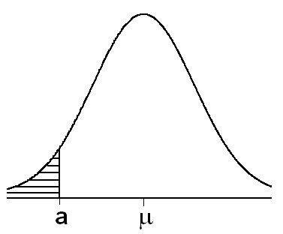
Solution:
Let X be the length of life and is the average life;

Slide 193
Sampling Distribution of the sample Proportion:
Let X= no. of elements of type A in the
sample
P= population proportion = no. of elements
of type A in the population / N
= sample proportion = no. of elements of
type A in the sample / n = x/n

Slide 194
3. For large n, we have:

Slide 195
Example:
If X is Binomial distribution with n=10,P= 0.1, find P
Solution:

Slide 196
Chapter 6
Using sample data to make estimates about population parameters (P162-172)

Slide 197
Key words:
Point estimate, interval estimate, estimator,
Confident level ,α , Confident interval for mean μ, Confident interval for two means,
Confident interval for population proportion P,
Confident interval for two proportions

Slide 198
6.1 Introduction:
Statistical inference is the procedure by which we reach to a conclusion about a population on the basis of the information contained in a sample drawn from that population.
To any parameter, we can compute two types of estimate: a point estimate and an interval estimate.
A point estimate is a single numerical value used to estimate the corresponding population parameter.
Note:
Point estimate for (µ ) is
Point estimate for (σ ) is S

Slide 199
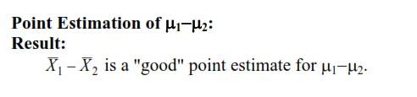
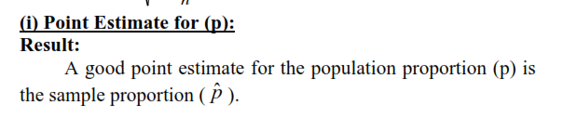
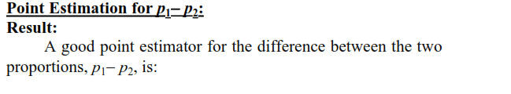


Slide 200
Definition:
An interval estimate consists of two numerical values defining a range of values that, with a specified degree of confidence, we feel includes the parameter being estimated.

Slide 201
6.2 Confidence Interval for a Population Mean: (C.I)
Suppose researchers wish to estimate the mean of some normally distributed population.
They draw a random sample of size n from the population and compute , which they use as a point estimate of μ.
Because random sampling involves chance, then can’t be expected to be equal to μ.
The value of may be greater than or less than μ.
It would be much more meaningful to estimate μ by an interval.

Slide 202
The 1-α percent confidence interval (C.I.) for μ:
We want to find two values L :Lower bound and U:Upper bound between which μ lies with high probability, i.e.
P( L ≤ μ ≤ U ) = 1-α

Slide 203
For example:
When,
α = 0.01,
then 1- α =
α = 0.05,
then 1- α =
α = 0.05,
then 1- α =

Slide 204
For example:
When,
(1- α )100%:Level of confident
(1- α )100% = 90%,
then α =
99%
then α =
80%
then α =

Slide 205
(1- α )100% confident interval for the mean μ :
When the value of sample size (n):
population is normal or not normal population is normal
( n ≥ 30 ) (n< 30)
σ is known σ is not known σ is known σ is not known

Slide 206
Example 6.2.1 Page 167:
Suppose a researcher , interested in obtaining an estimate of the average level of some enzyme in a certain human population, takes a sample of 10 individuals, determines the level of the enzyme in each, and computes a sample mean of approximately
Suppose further it is known that the variable of interest is approximately normally distributed with a variance of 45. We wish to estimate μ. (α=0.05)

Slide 207
Solution:
1- α=0.95→ α=0.05→ α/2=0.025,
variance = σ² = 45 → σ=√ 45,n=10
95%confidence interval for μ is given by:
P( - Z _{(1- α/2)} σ/√n < μ < + Z _{(1- α/2)} σ/√n) = 1- α
Z _{(1- α/2)} = Z _{0.975} = 1.96 (refer to table D)
Z _{0.975}(σ/√n) =1.96 (√ 45 / √10)=4.1578
22 ± 1.96 (√ 45 / √10) →
(22-4.1578, 22+4.1578) → (17.84, 26.16)
Exercise example 6.2.2 page 169

Slide 208
Example
The activity values of a certain enzyme measured in normal gastric tissue of 35 patients with gastric carcinoma has a mean of 0.718 and a standard deviation of 0.511.We want to construct a 90 % confidence interval for the population mean.
Solution:
Note that the population is not normal,
n=35 (n>30) n is large and σ is unknown ,s=0.511
1- α=0.90→ α=0.1
→ α/2=0.05→ 1-α/2=0.95,

Slide 209
Then 90% confident interval for μ is given by :
P( - Z _{(1- α/2)} s/√n < μ < + Z _{(1- α/2)} s/√n) = 1- α
Z _{(1- α/2)} = Z_{0.95} = 1.645 (refer to table D)
Z _{0.95}(s/√n) =1.645 (0.511/ √35)=0.1421
0.718 ± 1.645 (0.511) / √35→
(0.718-0.1421, 0.718+0.1421) →
(0.576,0.860).
Exercise example 6.2.3 page 164:

Slide 210
Example6.3.1 Page 174:
Suppose a researcher , studied the effectiveness of early weight bearing and ankle therapies following acute repair of a ruptured Achilles tendon. One of the variables they measured following treatment the muscle strength. In 19 subjects, the mean of the strength was 250.8 with standard deviation of 130.9
we assume that the sample was taken from is approximately normally distributed population. Calculate 95% confident interval for the mean of the strength ?

Slide 211
Solution:
1- α=0.95→ α=0.05→ α/2=0.025,
Standard deviation= S = 130.9 ,n=19
95%confidence interval for μ is given by:
P( - t _{(1- α/2),n-1} s/√n < μ < + t _{(1- α/2),n-1} s/√n) = 1- α
t _{(1- α/2),n-1} = t _{0.975,18} = 2.1009 (refer to table E)
t _{0.975,18}(s/√n) =2.1009 (130.9 / √19)=63.1
250.8 ± 2.1009 (130.9 / √19) →
(250.8- 63.1 , 22+63.1) → (187.7, 313.9)
Exercise 6.2.1 ,6.2.2
6.3.2 page 171

Slide 212
Exercise
Q6.2.1
We wish to estimate the average number of heartbeats per minute for a certain population using a 95% confidence interval . The average number of heartbeats per minute for a sample of 49 subjects was found to be 90 . Assume that these 49 patients is normally distributed with standard deviation of 10.
(answer :( 87.2 , 92.8)

Slide 213
Q6.2.2:
We wish to estimate the mean serum indirect bilirubin level of 4 -day-old infants using a 95% confidence interval . The mean for a sample of 16 infants was found to be 5.98 mg/100 cc .Assume that bilirubin level is approximately normally distributed with variance 12.25 mg/100 cc .
(answer :( 4.5406 , 7.4194)

Slide 214
Additional Exercise:
In a study of the effect of early Alzheimer’s disease on non declarative memory .For a sample of 8 subject was found that mean 8.5 with standard deviation 3. Find 99% confidence interval for mean ?

Slide 215
6.3 Confidence Interval for the difference between two Population Means: (C.I)
If we draw two samples from two independent population
and we want to get the confident interval for the
difference between two population means , then we have
the following cases :
a) When the population is normal
1) When the variance is known and the sample sizes is large or small, the C.I. has the form:

Slide 216
2) When variances are unknown but equal, and the sample size is small, the C.I. has the form:

Slide 217
Example 6.4.1 P174:
The researcher team interested in the difference between serum uric
and acid level in a patient with and without Down’s syndrome .In a
large hospital for the treatment of the mentally retarded, a sample of
12 individual with Down’s Syndrome yielded a mean of
mg/100 ml. In a general hospital a sample of 15 normal individual of
the same age and sex were found to have a mean value of
If it is reasonable to assume that the two population of values are
normally distributed with variances equal to 1 and 1.5,find the 95%
C.I for μ₁ - μ₂
Solution:
1- α=0.95→ α=0.05→ α/2=0.025 → Z _{(1- α/2)} = Z_{0.975} = 1.96
1.1±1.96(0.4282) = 1.1± 0.84 = ( 0.26 , 1.94 )

Slide 218
Example 6.4.1 P178:
The purpose of the study was to determine the effectiveness of an
integrated outpatient dual-diagnosis treatment program for
mentally ill subject. The authors were addressing the problem of substance abuse
issues among people with sever mental disorder. A retrospective chart review was
carried out on 50 patient ,the recherché was interested in the number of inpatient
treatment days for physics disorder during a year following the end of the program.
Among 18 patient with schizophrenia, The mean number of treatment days was 4.7
with standard deviation of 9.3. For 10 subject with bipolar disorder, the mean
number of treatment days was 8.8 with standard deviation of 11.5. We wish to
construct 99% C.I for the difference between the means of the populations
Represented by the two samples

Slide 219
Solution :
1-α =0.99 → α = 0.01 → α/2 =0.005 → 1- α/2 = 0.995
n₂ – 2 = 18 + 10 -2 = 26+ n₁
t _{(1- α/2),(n1+n2-2)} = t_{0.995,26} = 2.7787, then 99% C.I for μ₁ – μ₂
where
then
(4.7-8.8)± 2.7787 √102.33 √(1/18)+(1/10)
4.1 ± 11.086 =( - 15.186 , 6.986)
Exercises: 6.4.2 , 6.4.6, 6.4.7, 6.4.8 Page 180

Slide 220
6.5 Confidence Interval for a Population proportion (P):
A sample is drawn from the population of interest ,then compute the sample proportion such as
This sample proportion is used as the point estimator of the population proportion . A confident interval is obtained by the following formula

Slide 221
Example 6.5.1
The Pew internet life project reported in 2003 that 18%
of internet users have used the internet to search for
information regarding experimental treatments or
medicine . The sample consist of 1220 adult internet
users, and information was collected from telephone
interview. We wish to construct 98% C.I for the
proportion of internet users who have search for
information about experimental treatments or medicine

Slide 222
Solution :
1-α =0.98 → α = 0.02 → α/2 =0.01 → 1- α/2 = 0.99
Z _{1- α/2} = Z _{0.99} =2.33 , n=1220,
The 98% C. I is
0.18 ± 0.0256 = ( 0.1544 , 0.2056 )
Exercises: 6.5.1 , 6.5.3 Page 187

Slide 223
Exercise:
Q6.5.1:
Luna studied patients who were mechanically ventilated in the intensive care unit of six hospitals in buenos Aires ,Argentina. The researchers found that of 472 mechanically of ventilated patients ,63 had clinical evidence VAP. Construct 95% confidence interval for the proportion of all mechanically ventilated patients at these hospitals who may expected to develop VAP.

Slide 224
6.6 Confidence Interval for the difference between two Population proportions :
Two samples is drawn from two independent population
of interest ,then compute the sample proportion for each
sample for the characteristic of interest. An unbiased
point estimator for the difference between two population
proportions
A 100(1-α)% confident interval for P₁ - P₂ is given by

Slide 225
Example 6.6.1
Connor investigated gender differences in proactive and
reactive aggression in a sample of 323 adults (68 female
and 255 males ). In the sample ,31 of the female and 53
of the males were using internet in the internet café. We
wish to construct 99 % confident interval for the
difference between the proportions of adults go to
internet café in the two sampled population .

Slide 226
Solution :
1-α =0.99 → α = 0.01 → α/2 =0.005 → 1- α/2 = 0.995
Z _{1- α/2} = Z _{0.995} =2.58 , n_{F}=68, n_{M}=255,
The 99% C. I is
0.2481 ± 2.58(0.0655) = ( 0.07914 , 0.4171 )

Slide 227
Exercises:
Questions :
6.2.1, 6.2.2,6.2.5 ,6.3.2,6.3.5, 6.4.2
6.5.3 ,6.5.4,6.6.1

Slide 228
Chapter 7
Using sample statistics to Test Hypotheses about population parameters
Pages 215-233

Slide 229
Key words :
Null hypothesis H_{0,} Alternative hypothesis H_{A} , testing hypothesis , test statistic , P-value

Slide 230
Hypothesis Testing
One type of statistical inference, estimation, was discussed in Chapter 6 .
The other type ,hypothesis testing ,is discussed in this chapter.

Slide 231
Definition of a hypothesis
It is a statement about one or more populations .
It is usually concerned with the parameters of the population. e.g. the hospital administrator may want to test the hypothesis that the average length of stay of patients admitted to the hospital is 5 days

Slide 232
Definition of Statistical hypotheses
They are hypotheses that are stated in such a way that they may be evaluated by appropriate statistical techniques.
There are two hypotheses involved in hypothesis testing
Null hypothesis H₀: It is the hypothesis to be tested .
Alternative hypothesis H_{A} : It is a statement of what we believe is true if our sample data cause us to reject the null hypothesis

Slide 233
7.2 Testing a hypothesis about the mean of a population:
We have the following steps:
1.Data: determine variable, sample size (n), sample mean( ) , population standard deviation or sample standard deviation (s) if is unknown
2. Assumptions : We have two cases:
Case1: Population is normally or approximately normally distributed with known or unknown variance (sample size n may be small or large),
Case 2: Population is not normal with known or unknown variance (n is large i.e. n≥30).

Slide 234
3.Hypotheses:
we have three cases
Case I : H₀: μ=μ₀
H_{A}: μ μ₀
e.g. we want to test that the population mean is different than 50
Case II : H₀: μ = μ₀
H_{A}: μ > μ₀
e.g. we want to test that the population mean is greater than 50
Case III : H_{0:} μ = μ₀
H_{A}: μ< μ₀
e.g. we want to test that the population mean is less than 50

Slide 235
Testing hypothesis for the mean μ :
When the value of sample size (n):
population is normal or not normal population is normal
( n ≥ 30 ) (n< 30)
σ is known σ is not known σ is known σ is not known

Slide 236
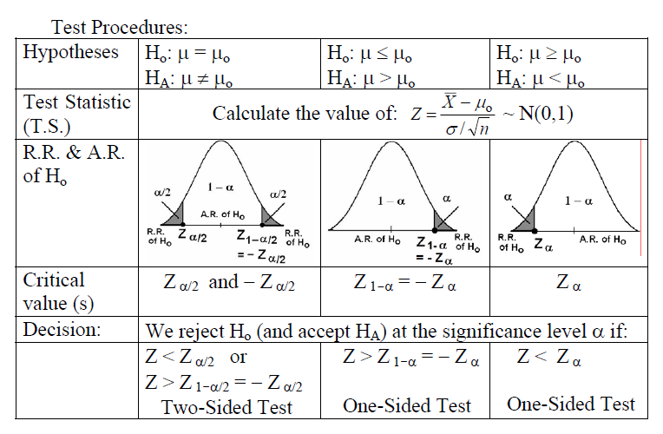

Slide 237
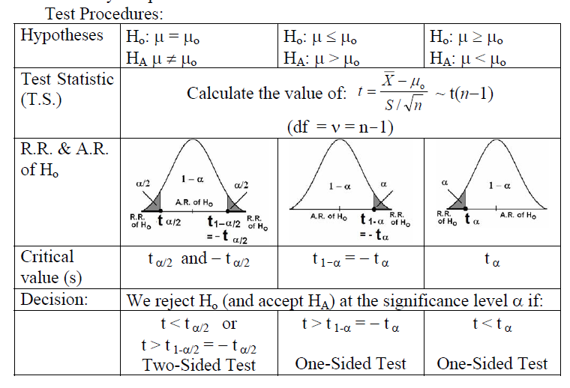

Slide 238
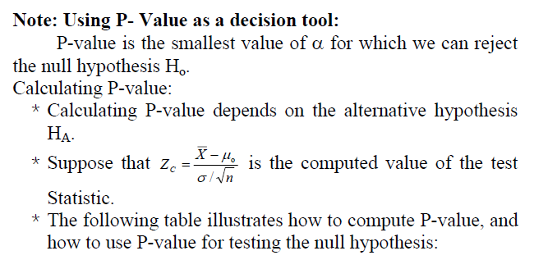
The Use of P – Values in Decision Definition Making::

Slide 239
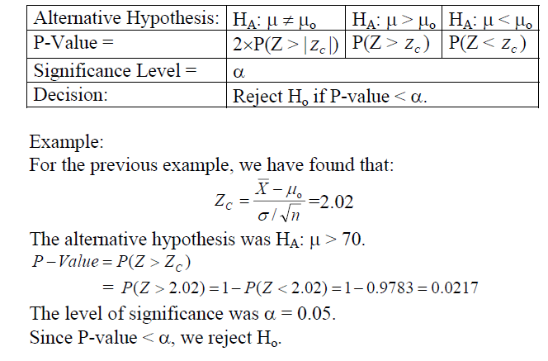

Slide 240
6.Decision :
If we reject H₀, we can conclude that H_{A} is true.
If ,however ,we do not reject H₀, we may conclude that H₀ is true.

Slide 241
An Alternative Decision Rule using the p - value Definition
The p-value is defined as the smallest value of α for which the null hypothesis can be rejected.
If the p-value is less than or equal to α ,we reject the null hypothesis (p ≤ α)
If the p-value is greater than α ,we do not reject the null hypothesis (p > α)

Slide 242
Example 7.2.1 Page 223
Researchers are interested in the mean age of a certain population.
A random sample of 10 individuals drawn from the population of interest has a mean of 27.
Assuming that the population is approximately normally distributed with variance 20,can we conclude that the mean is different from 30 years ? (α=0.05) .
If the p - value is 0.0340 how can we use it in making a decision?

Slide 243
Solution
1-Data: variable is age, n=10, =27 ,σ²=20,α=0.05
2-Assumptions: the population is approximately normally distributed with variance 20
3-Hypotheses:
H₀ : μ=30
H_{A}: μ 30

Slide 244
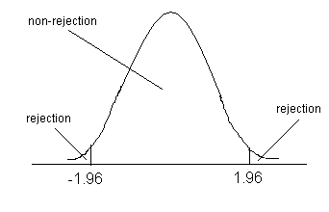
4-Test Statistic:
Z = -2.12
5.Decision Rule
The alternative hypothesis is
H_{A}: μ ≠ 30
Hence we reject H₀ if Z > Z_{1-0.025}= Z_{0.975}
or Z< - Z_{1-0.025} = - Z_{0.975}
Z_{0.975}=1.96(from table D)

Slide 245
6.Decision:
We reject H₀ ,since -2.12 is in the rejection region .
We can conclude that μ is not equal to 30
Using the p value ,we note that p-value =0.0340< 0.05,therefore we reject H0

Slide 246
Example7.2.2 page227
Referring to example 7.2.1.Suppose that the researchers have asked: Can we conclude that μ<30.
1.Data.see previous example
2. Assumptions .see previous example
3.Hypotheses:
H₀ μ =30
H_{ِA}: μ < 30

Slide 247
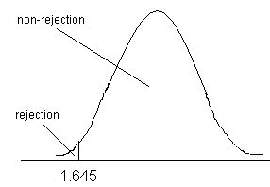
4.Test Statistic :
= = -2.12
5. Decision Rule: Reject H₀ if Z< - Z _{1-α}, where
Z _{1-α} = 1.645. (from table D)
6. Decision: Reject H₀ ,thus we can conclude that the population mean is smaller than 30.

Slide 248
Example7.2.4 page232
Among 157 African-American men ,the mean systolic blood pressure was 146 mm Hg with a standard deviation of 27. We wish to know if on the basis of these data, we may conclude that the mean systolic blood pressure for a population of African-American is greater than 140. Use α=0.01.

Slide 249
Solution
1. Data: Variable is systolic blood pressure, n=157 , =146, s=27, α=0.01.
2. Assumption: population is not normal, σ² is unknown
3. Hypotheses: H₀ :μ=140
H_{A}: μ>140
4.Test Statistic:
= = =2.78

Slide 250
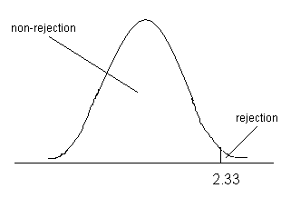
5. Decision Rule:
we reject H₀ if Z>Z_{1-α}
= Z_{0.99}= 2.33
(from table D)
6. Decision: We reject H₀.
Hence we may conclude that the mean systolic blood pressure for a population of African-American is greater than 140.

Slide 251
Exercises
Q7.2.1:
Escobar performed a study to validate a translated version of the Western Ontario and McMaster University index (WOMAC) questionnaire used with spanish-speaking patient s with hip or knee osteoarthritis . For the 76 women classified with sever hip pain. The WOMAC mean function score was 70.7 with standard deviation of 14.6 , we wish to know if we may conclude that the mean function score for a population of similar women subjects with sever hip pain is less than 75 . Let α =0.01

Slide 252
Solution :
1.Data :
2. Assumption :
3. Hypothesis :
4.Test statistic :

Slide 253
5.Decision Rule
6. Decision :

Slide 254
Exercises
Q7.2.3:
The purpose of a study by Luglie was to investigate the oral status of a group of patients diagnosed with thalassemia major (TM) . One of the outcome measure s was the decayed , missing, filled teeth index (DMFT) . In a sample of 18 patients ,the mean DMFT index value was 10.3 with standard deviation of 7.3 . Is this sufficient evidence to allow us to conclude that the mean DMFT index is greater than 9 in a population of similar subjects?
Let α =0.1

Slide 255
Solution :
1.Data :
2. Assumption :
3. Hypothesis :
4.Test statistic :

Slide 256
5.Decision Rule
6. Decision :

Slide 257
For Q7.2.3:
Take the p- value = 0.22 , Use the P-value to make your decision ??

Slide 258
7.3 Hypothesis Testing :The Difference between two population mean :
We have the following steps:
1.Data: determine variable, sample size (n), sample means, population standard deviation or samples standard deviation (s) if is unknown for two population.
2. Assumptions : We have two cases:
Case1: Population is normally or approximately normally distributed with known or unknown variance (sample size n may be small or large),
Case 2: Population is not normal with known variances (n is large i.e. n≥30).

Slide 259
3.Hypotheses:
we have three cases
Case I : H₀: μ 1 = μ2 → μ ₁ - μ₂ = 0
H_{A}: μ _{1 ≠} μ ₂ → μ ₁ - μ _{2 ≠ 0}
e.g. we want to test that the mean for first population is different from second population mean.
Case II : H₀: μ 1 = μ2 → μ ₁ - μ₂ = 0
H_{A}: μ _{1 >} μ ₂ → μ ₁ - μ _{2 > 0}
e.g. we want to test that the mean for first population is greater than second population mean.
Case III : H₀: μ 1 = μ2 → μ ₁ - μ₂ = 0
H_{A}: μ _{1 <} μ ₂ → μ ₁ - μ _{2 < 0}
e.g. we want to test that the mean for first population is greater than second population mean.

Slide 260
4.Test Statistic:
Case 1: Two population is normal or approximately normal
σ² is known σ² is unknown if ( n₁ ,n₂ large or small) ( n₁ ,n₂ small)
Population variances equal
where

Slide 261
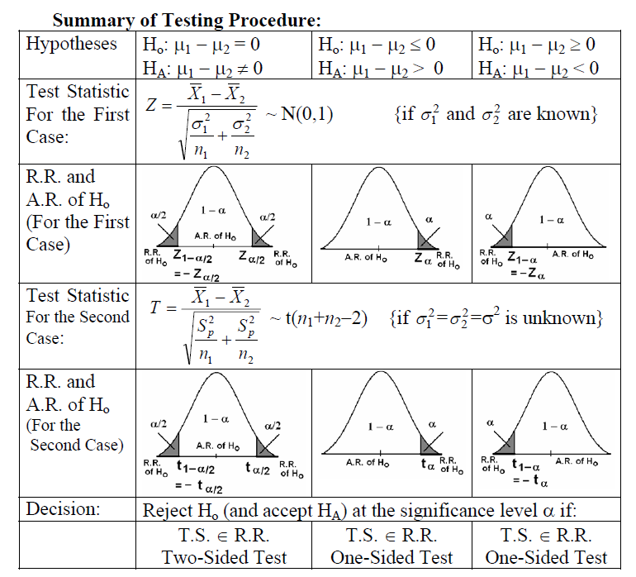

Slide 262
6. Conclusion:
reject or accept to reject H₀

Slide 263
Example7.3.1 page238
Researchers wish to know if the data have collected provide sufficient evidence to indicate a difference in mean serum uric acid levels between normal individuals and individual with Down’s syndrome. The data consist of serum uric reading on 12 individuals with Down’s syndrome from normal distribution with variance 1 and 15 normal individuals from normal distribution with variance 1.5 . The mean are and α=0.05.
Solution:
1. Data: Variable is serum uric acid levels, n₁=12 , n₂=15, σ²₁=1, σ²₂=1.5 ,α=0.05.

Slide 264
2. Assumption: Two population are normal, σ²₁ , σ²₂ are known
3. Hypotheses:
H₀: μ 1 = μ2 → μ ₁ - μ₂ = 0
H_{A}: μ _{1 ≠} μ ₂ → μ ₁ - μ _{2 ≠ 0}
4.Test Statistic:
= = 2.57

Slide 265
5. Decision Rule:
Reject H ₀ if Z >Z_{1-α/2} or Z< - Z_{1-α/2}
Z_{1-α/2=} Z_{1-0.05/2=} Z_{0.975=}1.96 (from table D)
6-Conclusion: Reject H₀ since 2.57 > 1.96
Or if p-value =0.102→ reject H₀ if
p < α → then reject H₀

Slide 266
Example7.3.2 page 240
The purpose of a study by Tam, was to investigate wheelchair
Maneuvering in individuals with over-level spinal cord injury (SCI)
And healthy control (C). Subjects used a modified a wheelchair to
incorporate a rigid seat surface to facilitate the specified
experimental measurements. The data for measurements of the
left ischial tuerosity (عظام الفخذ وتأثيرها من الكرسي المتحرك) for SCI and control C are shown below
169 | 150 | 114 | 88 | 117 | 122 | 131 | 124 | 115 | 131 | C
143 | 130 | 119 | 121 | 130 | 163 | 180 | 130 | 150 | 60 | SCI

Slide 267
We wish to know if we can conclude, on the basis of the above data that the mean of left ischial tuberosity for control C lower than mean of left ischial tuerosity for SCI, Assume normal populations equal variances. α=0.05, p-value = -1.33

Slide 268
Solution:
1. Data:, n_{C}=10 , n_{SCI}=10, S_{C}=21.8, S_{SCI}=133.1 ,α=0.05.
(calculated from data)
2.Assumption: Two population are normal, σ²₁ , σ²₂ are unknown but equal
3. Hypotheses:
H₀: μ _{C} = μ _{SCI} → μ _{C} - μ _{SCI} = 0
H_{A}: μ _{C <} μ _{SCI} → μ _{C} - μ _{SCI < 0}

Slide 269
4.Test Statistic:
Where,

Slide 270
5. Decision Rule:
Reject H ₀ if T< - T_{1-α,(n1+n2 -2)}
T_{1-α,(n1+n2 -2) =} T_{0.95,18 =} 1.7341
(from table E)
6-Conclusion: Fail to reject H₀
since -0.569 < - 1.7341
Or
Fail to reject H₀ since p = -1.33 > α =0.05

Slide 271
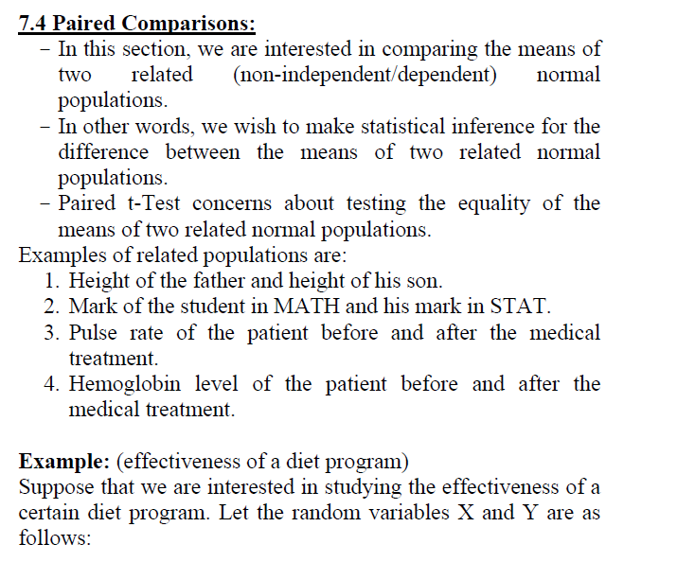

Slide 272
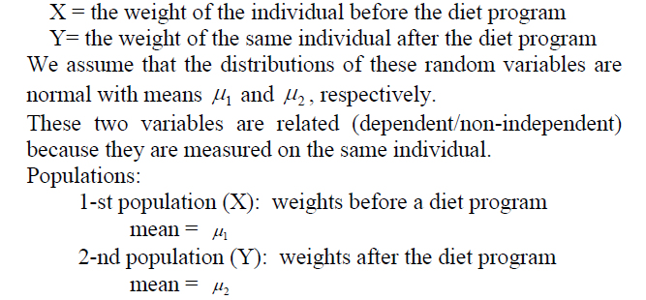

Slide 273
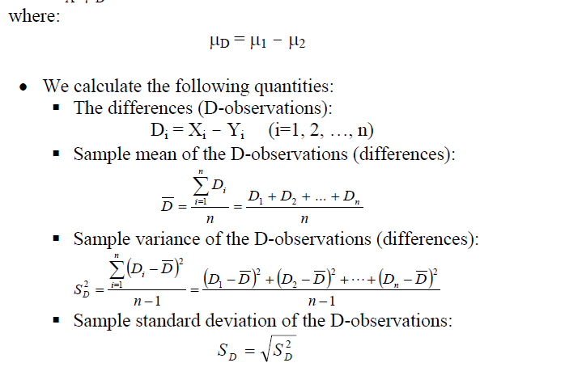

Slide 274
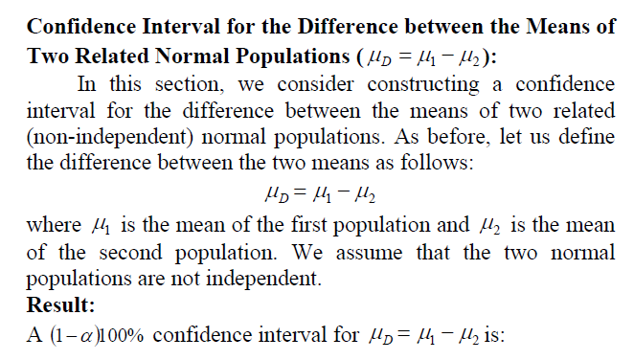

Slide 275
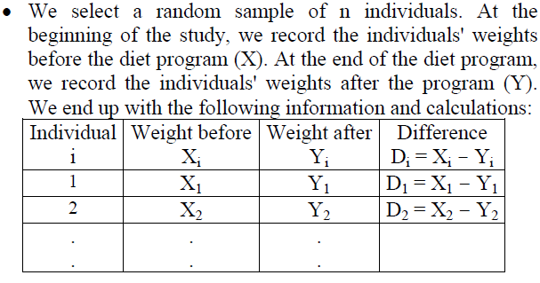

Slide 276
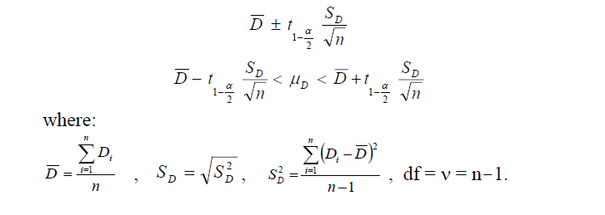

Slide 277
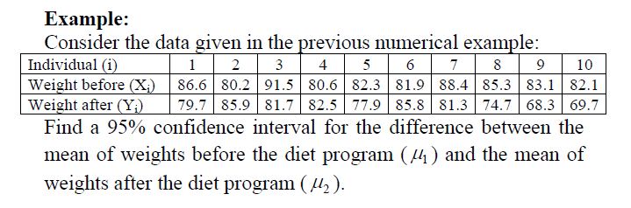

Slide 278
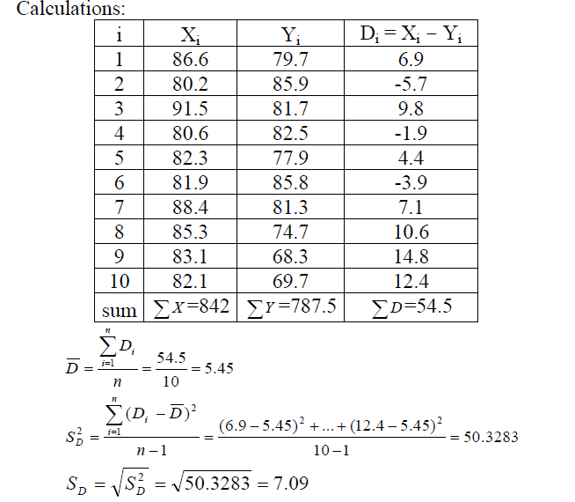
Solution:

Slide 279
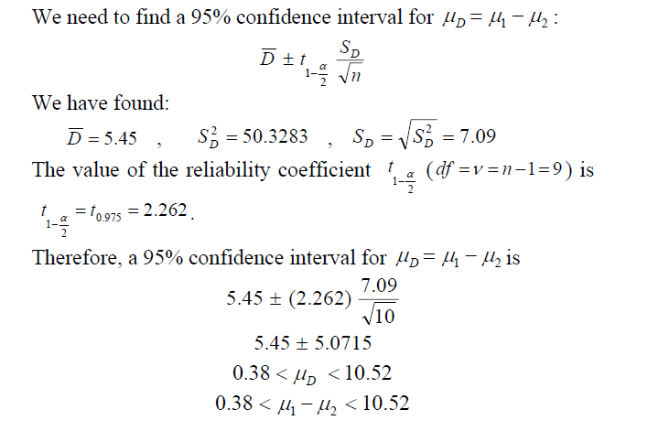

Slide 280
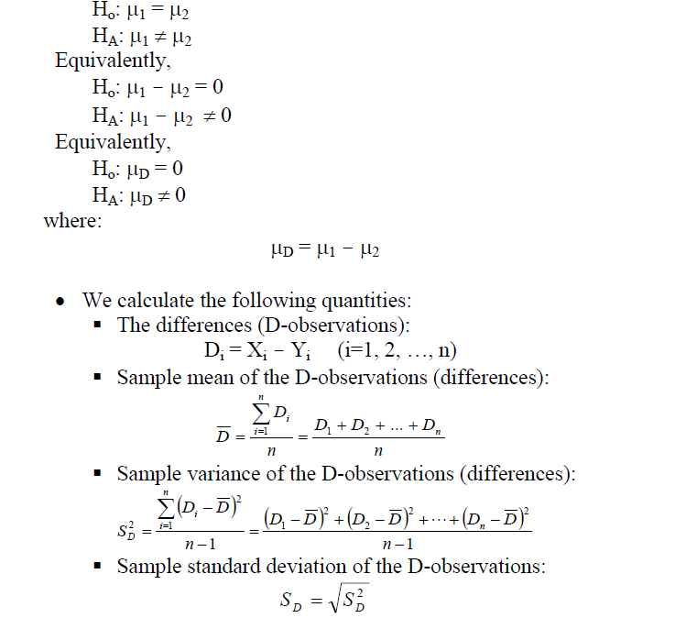

Slide 281
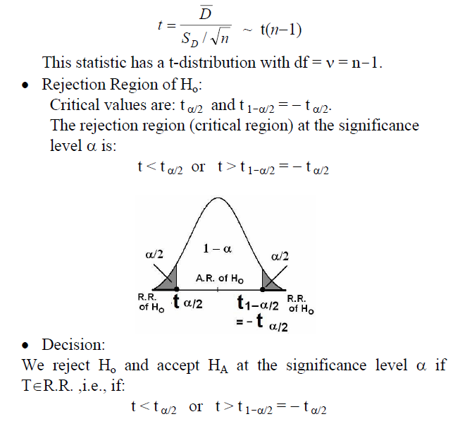
Test statistic is

Slide 282
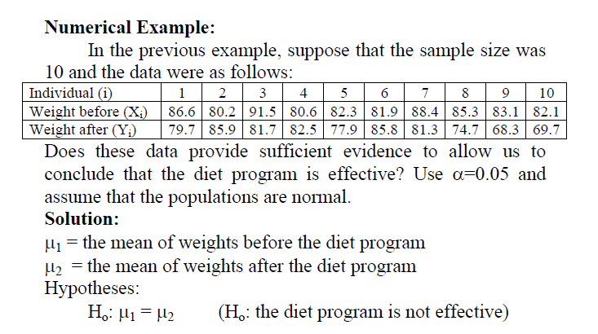

Slide 283
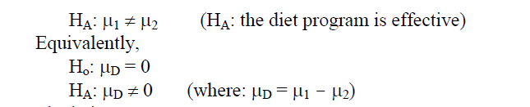

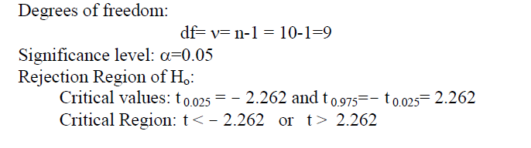

Slide 284
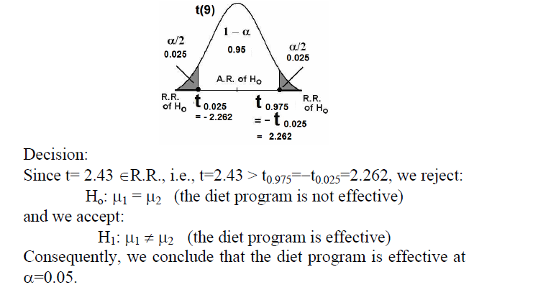

Slide 285
7.5 Hypothesis Testing A single population proportion:
Testing hypothesis about population proportion (P) is carried out
in much the same way as for mean when condition is necessary for
using normal curve are met
We have the following steps:
1.Data: sample size (n), sample proportion( ) , P₀
2. Assumptions :normal distribution ,

Slide 286
3.Hypotheses:
we have three cases
Case I : H₀: P = P₀
H_{A}: P ≠ P₀
Case II : H₀: P = P₀
H_{A}: P > P₀
Case III : H₀: P = P₀
H_{A}: P < P₀
4.Test Statistic:
Where H₀ is true ,is distributed approximately as the standard normal

Slide 287
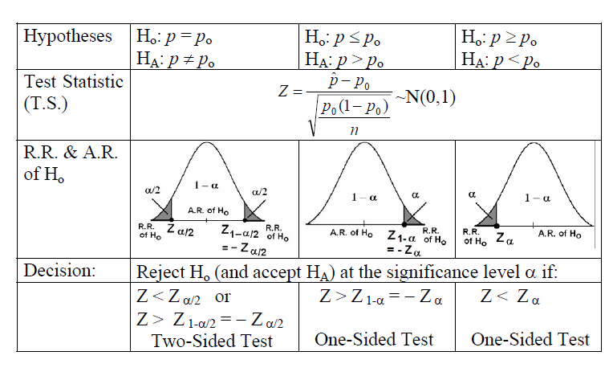

Slide 288
Example7.5.1 page 259
Wagen collected data on a sample of 301 Hispanic women
Living in Texas .One variable of interest was the percentage
of subjects with impaired fasting glucose (IFG). In the
study,24 women were classified in the (IFG) stage .The article
cites population estimates for (IFG) among Hispanic women
in Texas as 6.3 percent .Is there sufficient evidence to
indicate that the population Hispanic women in Texas has a
prevalence of IFG higher than 6.3 percent ,let α=0.05
Solution:
1.Data: n = 301, p₀ = 6.3/100=0.063 ,a=24,
q₀ =1- p₀ = 1- 0.063 =0.937, α=0.05

Slide 289
2. Assumptions : is approximately normaly distributed
3.Hypotheses:
we have three cases
H₀: P = 0.063
H_{A}: P > 0.063
4.Test Statistic :
5.Decision Rule: Reject H₀ if Z>Z_{1-α}
Where Z_{1-α} = Z_{1-0.05} =Z_{0.95}= 1.645

Slide 290
6. Conclusion: Fail to reject H₀
Since
Z =1.21 > Z_{1-α=}1.645
Or ,
If P-value = 0.1131,
fail to reject H₀ → P > α

Slide 291
Exercises:
Questions : Page 234 -237
7.2.1,7.8.2 ,7.3.1,7.3.6 ,7.5.2 ,,7.6.1
H.W:
7.2.8,7.2.9, 7.2.11, 7.2.15,7.3.7,7.3.8,7.3.10
7.5.3,7.6.4

Slide 292
Exercises
Q7.5.2:
In an article in the journal Health and Place, found that among 2428 boys aged from 7 to 12 years, 461 were over weight or obese. On the basis of this study ,can we conclude that more than 15 percent of boys aged from 7 to 12 years in the sampled population are over weight or obese?
Let α =0.1

Slide 293
Solution :
1.Data :
2. Assumption :
3. Hypothesis :
4.Test statistic :

Slide 294
5.Decision Rule
6. Decision :

Slide 295
7.6 Hypothesis Testing :The Difference between two population proportion:
Testing hypothesis about two population proportion (P_{1,,} P₂ ) is
carried out in much the same way as for difference between two
means when condition is necessary for using normal curve are met
We have the following steps:
1.Data: sample size (n_{1 و}n₂), sample proportions( ),
Characteristic in two samples (x₁ , x₂),
2- Assumption : Two populations are independent .

Slide 296
3.Hypotheses:
we have three cases
Case I : H₀: P₁ = P₂ → P₁ - P₂ = 0
H_{A}: P₁ ≠ P₂ → P₁ - P₂ ≠ 0
Case II : H₀: P₁ = P₂ → P₁ - P₂ = 0
H_{A}: P₁ > P₂ → P₁ - P₂ > 0
Case III : H₀: P₁ = P₂ → P₁ - P₂ = 0
H_{A}: P₁ < P₂ → P₁ - P₂ < 0
4.Test Statistic:
Where H₀ is true ,is distributed approximately as the standard normal

Slide 297
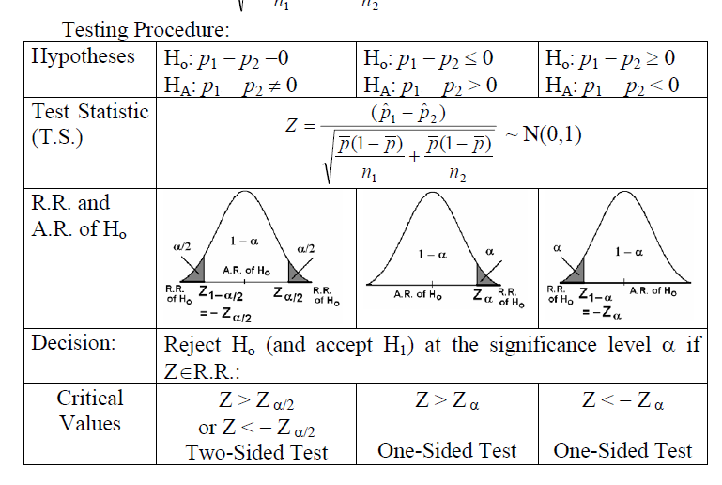

Slide 298
Example7.6.1 page 262
Noonan is a genetic condition that can affect the heart growth,
blood clotting and mental and physical development. Noonan examined
the stature of men and women with Noonan. The study contained 29
Male and 44 female adults. One of the cut-off values used to assess
stature was the third percentile of adult height .Eleven of the males fell
below the third percentile of adult male height ,while 24 of the female
fell below the third percentile of female adult height .Does this study
provide sufficient evidence for us to conclude that among subjects with
Noonan ,females are more likely than males to fall below the respective
of adult height? Let α=0.05
Solution:
1.Data: n _{M} = 29, n _{F} = 44 , x _{M}= 11 , x _{F}= 24, α=0.05

Slide 299
2- Assumption : Two populations are independent .
3.Hypotheses:
Case II : H₀: P_{F} = P_{M} → P_{F} - P_{M} = 0
H_{A}: P_{F} > P_{M} → P_{F} - P_{M} > 0
4.Test Statistic:
5.Decision Rule:
Reject H₀ if Z >Z_{1-α} , Where Z_{1-α} = Z_{1-0.05} =Z_{0.95}= 1.645
6. Conclusion: Fail to reject H₀
Since Z =1.39 > Z_{1-α=}1.645
Or , If P-value = 0.0823 → fail to reject H₀ → P > α

Slide 300
Exercises:
Questions : Page 234 -237
7.2.1,7.8.2 ,7.3.1,7.3.6 ,7.5.2 ,,7.6.1
H.W:
7.2.8,7.2.9, 7.2.11, 7.2.15,7.3.7,7.3.8,7.3.10
7.5.3,7.6.4

Slide 301
Chapter 9
Statistical Inference and The
Relationship between two variables
Prepared By : Dr. Shuhrat Khan

Slide 302
REGRESSION
CORRELATION
ANALYSIS OF VARIANCE
Regression, Correlation and Analysis of Covariance are all statistical techniques that use the idea that one variable say, may be related to one or more variables through an equation. Here we consider the relationship of two variables only in a linear form, which is called linear regression and linear correlation; or simple regression and correlation. The relationships between more than two variables, called multiple regression and correlation will be considered later.
Simple regression uses the relationship between the two variables to obtain information about one variable by knowing the values of the other. The equation showing this type of relationship is called simple linear regression equation. The related method of correlation is used to measure how strong the relationship is between the two variables is.
302
EQUATION OF REGRESSION

Slide 303
Line of Regression
Simple Linear Regression:
Suppose that we are interested in a variable Y, but we want to know about its relationship to another variable X or we want to use X to predict (or estimate) the value of Y that might be obtained without actually measuring it, provided the relationship between the two can be expressed by a line.’ X’ is usually called the independent variable and ‘Y’ is called the dependent variable.
We assume that the values of variable X are either fixed or random. By fixed, we mean that the values are chosen by researcher--- either an experimental unit (patient) is given this value of X (such as the dosage of drug or a unit (patient) is chosen which is known to have this value of X.
By random, we mean that units (patients) are chosen at random from all the possible units,, and both variables X and Y are measured.
We also assume that for each value of x of X, there is a whole range or population of possible Y values and that the mean of the Y population at X = x, denoted by µ_{y/x} , is a linear function of x. That is,
µ_{y/x} = α +βx
DEPENDENT VARIABLE
INDEPENDENT VARIABLE
TWO RANDOM VARIABLE
OR
BIVARIATE
RANDOM
VARIABLE

Slide 304
ESTIMATION
Estimate α and β.
Predict the value of Y at a given value x of X.
Make tests to draw conclusions about the model and its usefulness.
We estimate the parameters α and β by ‘a’ and ‘b’ respectively by using sample regression line:
Ŷ = a+ bx
Where we calculate
We select a sample of
n observations (x_{i},y_{i})
from the population,
WITH
the goals

Slide 305

B =
ESTIMATION AND CALCULATION OF CONSTANTS , ‘’a’’ AND ‘’b’’

Slide 306
EXAMPLE
investigators at a sports health centre are interested in the relationship between oxygen consumption and exercise time in athletes recovering from injury. Appropriate mechanics for exercising and measuring oxygen consumption are set up, and the results are presented below:
  x variable

Slide 307
exercise time (min) 0.5 1.0 1.5 2.0 2.5 3.0 3.5 4.0 4.5 5.0 | y variable oxygen consumption 620 630 800 840 840 870 1010 940 950 1130

Slide 308


calculations
or

Slide 309
Pearson’s Correlation Coefficient
With the aid of Pearson’s correlation coefficient (r), we can determine the strength and the direction of the relationship between X and Y variables,
both of which have been measured and they must be quantitative.
For example, we might be interested in examining the association between height and weight for the following sample of eight children:

Slide 310
Height and weights of 8 children
Child | Height(inches)X | Weight(pounds)Y
A | 49 | 81
B | 50 | 88
C | 53 | 87
D | 55 | 99
E | 60 | 91
F | 55 | 89
G | 60 | 95
H | 50 | 90
Average | ( = 54 inches) | ( = 90 pounds)

Slide 311
Scatter plot for 8 babies

Slide 312
Table : The Strength of a Correlation
Value of r (positive or negative) Meaning
_______________________________________________________
0.00 to 0.19 A very weak correlation
0.20 to 0.39 A weak correlation
0.40 to 0.69 A modest correlation
0.70 to 0.89 A strong correlation
0.90 to 1.00 A very strong correlation
________________________________________________________

Slide 313
FORMULA FOR CORRELATION COEFFECIENT ( r )
With Pearson’s r,
means that we add the products of the deviations to see if the positive products or negative products are more abundant and sizable. Positive products indicate cases in which the variables go in the same direction (that is, both taller or heavier than average or both shorter and lighter than average);
negative products indicate cases in which the variables go in opposite directions (that is, taller but lighter than average or shorter but heavier than average).

Slide 314





Computational Formula for Pearsons’s Correlation Coefficient r
Where SP (sum of the product), SSx (Sum of the squares for x) and SSy (sum of the squares for y) can be computed as follows:

Slide 315



Child X Y X² Y² XY
A 12 12 144 144 144 B 10 8 100 64 80 C 6 12 36 144 72 D 16 11 256 121 176 E 8 10 64 100 80 F 9 8 81 64 72 G 12 16 144 256 192 H 11 15 121 225 165
∑ 84 92 946 1118 981

Slide 316
Table 2 : Chest circumference and Birth Weight of 10 babies
X(cm) y(kg) x² y² xy
___________________________________________________
22.4 2.00 501.76 4.00 44.8
27.5 2.25 756.25 5.06 61.88
28.5 2.10 812.25 4.41 59.85
28.5 2.35 812.25 5.52 66.98
29.4 2.45 864.36 6.00 72.03
29.4 2.50 864.36 6.25 73.5
30.5 2.80 930.25 7.84 85.4
32.0 2.80 1024.0 7.84 89.6
31.4 2.55 985.96 6.50 80.07
32.5 3.00 1056.25 9.00 97.5
TOTAL
292.1 24.8 8607.69 62.42 731.61

Slide 317

Checking for significance
There appears to be a strong between chest circumference and birth weight in babies.
We need to check that such a correlation is unlikely to have arisen by in a sample of ten babies.
Tables are available that gives the significant values of this correlation ratio at two probability levels.
First we need to work out degrees of freedom. They are the number of pair of observations less two, that is (n – 2)= 8.
Looking at the table we find that our calculated value of 0.86 exceeds the tabulated value at 8 df of 0.765 at p= 0.01. Our correlation is therefore statistically highly significant.

Slide 318
Chapter 12
Analysis of Frequency Data
An Introduction to the Chi-Square
Distribution
Prepared By : Dr. Shuhrat Khan

Slide 319
TESTS OF INDEPENDENCE
    To test whether two criteria of classification are independent . For example socioeconomic status and area of residence of people in a city are independent.
    We divide our sample according to status, low, medium and high incomes etc. and the same samples is categorized according to urban, rural or suburban and slums etc.
    Put the first criterion in columns equal in number to classification of 1st criteria ( Socioeconomic status) and the 2nd in rows, where the no. of rows equal to the no. of categories of 2nd criteria (areas of cities).

Slide 320
The Contingency Table
Table Two-Way Classification of sample
First Criterion of Classification →
Second Criterion ↓ | 1 | 2 | 3 | ….. | c | Total
1 2 3 . . r | N11 N21 N31 . . Nr1 | N12 N22 N32 . . Nr2 | N13 N 23 N33 . . Nr3 | ……………...…… | N1c N2c N3c . . N rc | N1. N2. N3. . . Nr.
Total | N.1 | N.2 | N.3 | …… | N.c | N

Slide 321
Observed versus Expected Frequencies
Oi j : The frequencies in ith row and jth column given in any contingency table are called observed frequencies that result form the cross classification according to the two classifications.
ei j :Expected frequencies on the assumption of independence of two criterion are calculated by multiplying the marginal totals of any cell and then dividing by total frequency
Formula:

Slide 322
Chi-square Test
After the calculations of expected frequency,
Prepare a table for expected frequencies and use Chi-square
Where summation is for all values of r xc = k cells.
D.F.: the degrees of freedom for using the table are (r-1)(c-1) for α level of significance
Note that the test is always one-sided.

Slide 323
Example 12.401(page 613)
The researcher are interested to determine that preconception use of folic acid and race are independent. The data is:
Observed Frequencies Table Expected frequencies Table
 | Yes | no | Total
White Black Others | (282)(559)/636 =247.86 (282)(56)/636 =24.83 (282)((21) =9.31 | (354)(559)/636 =311.14 (354)(559) = 31.17 21x354/636 =11.69 | 559 56 21
total | 282 | 354 | 636
 | Use of Folic | Acid | total
 | Yes | No
White Black Other | 260 15 7 | 299 41 14 | 559 56 21
Total | 282 | 354 | 636

Slide 324
Calculations and Testing
Data: See the given table
Assumption: Simple random sample
Hypothesis: H0: race and use of folic acid are independent
HA: the two variables are not independent. Let α = 0.05
The test statistic is Chi Square given earlier
Distribution when H0 is true chi-square is valid with (r-1)(c-1) = (3-1)(2-1)= 2 d.f.
Decision Rule: Reject H0 if value of is greater than
= 5.991
Calculations:

Slide 325
Conclusion
Statistical decision. We reject H0 since 9.08960> 5.991
Conclusion: we conclude that H0 is false, and that there is a relationship between race and preconception use of folic acid.
P value. Since 7.378< 9.08960< 9.210, 0.01<p <0.025
We also reject the hypothesis at 0.025 level of significance but do not reject it at 0.01 level.
Solve Ex12.4.1 and 12.4.5 (p 620 & P 622)

Slide 326
ODDS RATIO
In a retrospective study, samples are selected from those who have the disease called ‘cases’ and those who do not have the disease called ‘controls’ . The investigator looks back (have a retrospective look) at the subjects and determines which one have (or had) and which one do not have (or did not have ) the risk factor.
The data is classified into 2x2 table, for comparing cases and controls for risk factor ODDS RATIO IS CALCULATED
ODDS are defined to be the ratio of probability of success to the probability of failure.
The estimate of population odds ratio is

Slide 327
ODDS RATIO
Where a, b, c and d are the numbers given in the following table:
We may construct 100(1-α)%CI for OR by formula:
Risk Factor ↓ | Sample |  | Total
 | Cases | Control
Present | a | b | a + b
Absent | c | d | c + d
Total | a + c | b + d

Slide 328
Example 12.7.2 for Odds Ratio
Example 12.5.7.2 page 640: Data relates to the obesity status of children aged 5-6 and the smoking status of their mothers during pregnancy
Hence OR for table
is :
Obesity status
Smoking status(during Pregnancy) | cases | Non-cases | Total
Smoked throughout | 64 | 342 | 406
Never smoked | 68 | 3496 | 3564
Total | 132 | 3838 | 3970

Slide 329
Confidence Interval for Odds Ratio
The (1-α) 100% Confidence Interval for Odds Ratio is:
Where
For Example 12.5.7.2 we have: a=64, b=342, c=68, d=3496 , therefore:
Its 95% CI is:
or (7.12, 13.00)

Slide 330
Interpretation of Example 12.7.2 Data
The 95% confidence interval (7.12, 13.00)
mean that we are 95% confident that the population odds ratio is somewhere between 7.12 and 13.00
Since the interval does not contain 1, in fact contains values larger than one, we conclude that, in Pop. Obese children (cases) are more likely than non-obese children ( non-cases) to have had a mother who smoked throughout the pregnancy.
Solve Ex 12.7.4 (page 646)

Slide 331
Interpretation of ODDS RATIO
The sample odds ratio provides an estimate of the relative risk of population in the case of a rare disease.
The odds ratio can assume values between 0 to ∞.
A value of 1 indicate no association between risk factor and disease status.
A value greater than one indicates increased odds of having the disease among subjects in whom the risk factor is present.

Slide 332
Chapter 13
Special Techniques for use when population parameters and/or population distributions are unknoen
pages 683-689
Prepared By : Dr. Shuhrat Khan

Slide 333
NON-PARAMETRIC STATISTICS
The t-test, z-test etc. were all parametric tests as they were based n the assumptions of normality or known variances.
When we make no assumptions about the sample population or about the population parameters the tests are called non-parametric and distribution-free.

Slide 334
ADVANTAGES OF NON-PARAMETRIC STATISTICS
Testing hypothesis about simple statements (not involving parametric values) e.g.
The two criteria are independent (test for independence)
The data fits well to a given distribution (goodness of fit test)
Distribution Free: Non-parametric tests may be used when the form of the sampled population is unknown.
Computationally easy
Analysis possible for ranking or categorical data (data which is not based on measurement scale )

Slide 335
The Sign Test
This test is used as an alternative to t-test, when normality assumption is not met
The only assumption is that the distribution of the underlying variable (data) is continuous.
Test focuses on median rather than mean.
The test is based on signs, plus and minuses
Test is used for one sample as well as for two samples

Slide 336
Example
(One Sample Sign Test)
Score of 10 mentally retarded girls
We wish to know
if Median of population is
different from 5.
Solution:
Data: is about scores of 10
mentally retarded girls
Assumption: The measurements are continuous variable.
Girl | Score | Girl | Score
1 2 3 4 5 | 4 5 8 8 9 | 6 7 8 9 10 | 6 10 7 6 6

Slide 337
Continued…….
Hypotheses: H0: The population median is 5
    HA: The population median is not 5
    Let α = 0.05
Test Statistic: The test statistic for the sign test is either the observed number of plus signs or the observed number of minus signs. The nature of the alternative hypothesis determines which of these test statistics is appropriate. In a given test, any one of the following alternative hypotheses is possible:
    HA: P(+) > P(-) one-sided alternative
    HA: P(+) < P(-) one-sided alternative
    HA: P(+) ≠ P(-) two-sided alternative

Slide 338
Continued…….
If the alternative hypothesis is HA: P(+) > P(-) a sufficiently small number of minus signs causes rejection of H0. The test statistic is the number of minus signs.
If the alternative hypothesis is HA: P(+) < P(-) a sufficiently small number of plus signs causes rejection of H0. The test statistic is the number of plus signs.
If the alternative hypothesis is HA: P(+) ≠ P(-) either a sufficiently small number of plus signs or a sufficiently small number of minus signs causes rejection of the null hypothesis. We may take as the test statistic the less frequently occurring sign.

Slide 339
Continued…….
    Distribution of test statistic: If we assign a plus sign to those scores that lie above the hypothesized median and a minus to those that fall below.
    Decision Rule: Let k = minimum of pluses or minuses. Here k = 1, the minus sign.
    For HA: P(+) > P(-) reject H0 if, when H0 if true, the probability of observing k or fewer minus signs is less than or equal to α.
Girl | 1 | 2 | 3 | 4 | 5 | 6 | 7 | 8 | 9 | 10
Score relative to median = 5 | - | 0 | + | + | + | + | + | + | + | +

Slide 340
Continued…….
For HA: P(+) > P(-) reject H0 if, when H0 if true, the probability of observing k or fewer minus signs is less than or equal to α.
For HA: P(+) < P(-), reject H0 if the probability of observing, when H0 is true, k or fewer plus signs is equal to or less than α.
For HA: P(+) ≠ P(-) , reject H0 if (given that H0 is true) the probability of obtaining a value of k as extreme as or more extreme than was actually computed is equal to or less than α/2.
Calculation of test statistic: The probability of observing k or fewer minus signs when given a sample of size n and parameter p by evaluating the following expression:
P (X ≤ k | n, p) =

Slide 341
Continued…….
For our example we would compute
Statistical decision: In Appendix Table B we find
    P (k ≤ 1 | 9, 0.5) = 0.0195
Conclusion: Since 0.0195 is less than 0.025, we reject the null hypothesis and conclude that the median score is not 5.
p value: The p value for this test is 2(0.0195) = 0.0390, because it is two-sided test.

Slide 342
SIGN TEST----Paired Data
This is used an alternative to t-test for paired observations, when the underlying assumptions of t test are not met.
Null Hypothesis to be tested the median difference is zero.
OR
P (Xi > Yi ) = P (Yi > Xi )
Subtract Yi from Xi , if Yi is less than Xi , the sign of the difference is (+), if Yi is greater than Xi , the sign of the difference is ( - ), so that
H₀ : P(+) = P(-) = 0.5
TEST STATISTIC: As before is k, the no of least occurring of Plus or minus signs.

Slide 343
SIGN TEST----Example 13.3.2
A dental research team matched 12 pairs of 24 patients in age, sex, intelligence. Six months later random evaluation showed the following score (low score score is higher level of hygiene)
H0 : P(+) = P(-) = 0.5
1.Data. Scores of dental hygiene, one member instructed how to brush and other remained uninstructed.
2. Assumption: the variable of dist is continues
3. Ho : The median of the difference is zero [P(+) =P(-)]
HA : The median of the difference is negative
[P(+) <P(-)]
pair no. | 1 | 2 | 3 | 4 | 5 | 6 | 7 | 8 | 9 | 10 | 11 | 12
instructed | 1.5 | 2.0 | 3.5 | 3.0 | 3.5 | 2.5 | 2.0 | 1.5 | 1.5 | 2.0 | 3.0 | 2.0
Not instructed | 2.0 | 2.0 | 4.0 | 2.5 | 4.0 | 3.0 | 3.5 | 3.0 | 2.5 | 2.5 | 2.5 | 2.5
Difference | - | 0 | - | + | - | - | - | - | - | - | + | -
Notes:
343

Slide 344
Continued…….
Let α be 0.05
4. Test Statistic: The test statistic is the number of plus signs which occurs less frequent. i.e. k = 2
5. Distribution of k is binomial with n= 11 (as one observation is discarded) and p= 0.5
6. Decision Rule: Reject H0 if P(k≤2| 11,0.5) ≤ 0.05.
7. Calculations:
P(k≤2/11,0.5)=
Table B or calculations show the probability is equal to 0.0327 which is less than 0.05, we
must reject H0 .
8. Conclusion: median difference is negative and instructions are beneficial
9. p value: Since it is one sided test the p-value is p= .0327

Slide 345
NON-PARAMETRIC STATISTICS
The t-test, z-test etc. were all parametric tests as they were based n the assumptions of normality or known variances.
When we make no assumptions about the sample population or about the population parameters the tests are called non-parametric and distribution-free.

Slide 346
EXAMPLE 1
Cardiac output (liters/minute) was measured by thermodilution in a simple random sample of 15 postcardiac surgical patients in the left lateral position. The results were as follows:
We wish to know if we can conclude on the basis of these data that the population mean is different from 5.05.
Solution:
1. Data. As given above
2. Assumptions. We assume that the requirements for the application of the Wilcoxon signed-ranks test are met.
3. Hypothesis.
H0: µ = 5.05
HA: µ ≠ 5.05
Let α = 0.05.
4.91 | 4.10 | 6.74 | 7.27 | 7.42 | 7.50 | 6.56 | 4.64
5.98 | 3.14 | 3.23 | 5.80 | 6.17 | 5.39 | 5.77

Slide 347
EXAMPLE 1
4. Test Statistic. The test statistic will be T + or T-, whichever is smaller, called the test statistic T.
5. Distribution of test statistic. Critical values of the test statistic are given in Table K of the Appendix.
6. Decision rule. We will reject H0 if the computed value of T is less than or equal to 25, the critical value n = 15, and α/2 = 0.0240, the closest value to 0.0250 in Table K.
7. Calculation of test statistic. The calculation of the test statistic is shown in Table.
8. Statistical decision. Since 34 is greater than 25, we are unable to reject H0.

Slide 348
Cardiac output | di = xi – 5.05 | Rank of |di | | Signed Rank of |di |
4.91 | -0.14 | 1 | -1
4.10 | -0.95 | 7 | -7
6.74 | +1.69 | 10 | +10
7.27 | +2.22 | 13 | +13
7.42 | +2.37 | 14 | +14
7.50 | +2.45 | 15 | +15
6.56 | +1.51 | 9 | +9
4.64 | -0.41 | 3 | -3
5.98 | +0.93 | 6 | +6
3.14 | -1.91 | 12 | -12
3.23 | -1.82 | 11 | -11
5.80 | +0.75 | 5 | +5
6.17 | +1.12 | 8 | +8
5.39 | +0.34 | 2 | +2
5.77 | +0.72 | 4 | +4
 | T+ = 86, T- = 34, T = 34

Slide 349
EXAMPLE 1
8. Statistical decision. Since 34 is greater than 25, we are unable to reject H0.
9. Conclusion. We conclude that the population mean may be 5.05
10. p value. From Table K we see that the p value is p = 2(0.0757) = 0.1514

Slide 350
EXAMPLE 2
A researcher designed an experiment to assess the effects of prolonged inhalation of cadmium oxide. Fifteen laboratory animals served as experimental subjects, while 10 similar animals served as controls. The variable of interest was hemoglobin level following the experiment. The results are shown in Table 2.
We wish to know if we can conclude that prolonged inhalation of cadmium oxide reduces hemoglobin level.

Slide 351
EXAMPLE 2
TABLE 2. HEMOGLOBIN DETERMINATIONS (GRAMS) FOR 25 LABORATORY ANIMALS
EXPOSED ANIMALS (X) | UNEXPOSED ANIMALS (Y)
14.4 | 17.4
14.2 | 16.2
13.8 | 17.1
16.5 | 17.5
14.1 | 15.0
16.6 | 16.0
15.9 | 16.9
15.6 | 15.0
14.1 | 16.3
15.3 | 16.8
15.7
16.7
13.7
15.3
14.0

Slide 352
EXAMPLE 2
Solution:
1. Data. See table above
2. Assumptions. We presume that the assumptions of the Mann-Whitney test are met.
3. Hypothesis.
H0: Mx ≥ My
HA: Mx < My
where Mx is the median of a population of animals exposed to cadmium oxide and My is the median of a population of animals not exposed to the substance. Suppose we let α = 0.05.

Slide 353
EXAMPLE 2
4. Test Statistic. The test statistic is
where n is the number of sample X observations and S is the sum of the ranks assigned to the sample observations from the population of X values. The choice of which sample’s values we label as X is arbitrary.

Slide 354
Sum of the Y ranks = S = 145
TABLE 2. ORIGINAL DATA AND RANKS
X | 13.7 | 13.8 | 14.0 | 14.1 | 14.1 | 14.2 | 14.4 |  |  | 15.3 | 15.3 | 15.6
Rank | 1 | 2 | 3 | 4.5 | 4.5 | 6 | 7 |  |  | 10.5 | 10.5 | 12
Y |  |  |  |  |  |  |  | 15.0 | 15.0
Rank |  |  |  |  |  |  |  | 8.5 | 8.5
X | 15.7 | 15.9 |  |  |  | 16.5 | 16.6 | 16.7
Rank | 13 | 14 |  |  |  | 18. | 19 | 20
Y |  |  | 16.0 | 16.2 | 16.3 |  |  |  | 16.8 | 16.9 | 17.1 | 17.4 | 17.5
Rank |  |  | 15 | 16 | 17 |  |  |  | 21 | 22 | 23 | 24 | 25

Slide 355
EXAMPLE 2
5. Distribution of test statistic. The critical values are given in Table K.
6. Decision Rule. Reject H0: Mx ≥ My, if the computed T is less than wα with n, the number of X observations; m the number of Y observations and α, the chosen level of significance.
If the null hypothesis were of the types
H0: Mx ≤ My
HA: Mx > My
Reject H0: Mx ≤ My if the computed T is greater than w1-α, where W1-α = nm - W α.

Slide 356
EXAMPLE 2
For the two-sided test situation with
H0: Mx = My
HA: Mx ≠ My
Reject H0: Mx = My if the computed value of T is either less than wα/2 or greater than w1-α/2 , where wα/2 is the critical value of T for n, m and α/2 given in Appendix II Table K and w1-α/2 = nm - wα/2.
For this example the decision rule of T is smaller than 45, the critical value of the test statistic for n = 15, m = 10, and α = 0.05 found in Table K.

Slide 357
EXAMPLE 2
7. Calculation of test statistic. We have S = 145, so that
8. Statistical Decision. When we enter Table K with n = 15, m = 10, and α = 0.05, we find the critical value of w1-α to be 45. Since 25 is less than 45, we reject H0.
9. Conclusion. We conclude that Mx is smaller than MY. This leads us to the conclusion that prolonged inhalation of cadmium oxide does reduce the hemoglobin level.
Since 22< 25 < 30, we have for this test
0.005 > p >0.001.

Slide 358
EXAMPLE 2
When either n or m is greater than 20 we cannot use Appendix Table K to obtain critical values for the Mann-Whitney test. When this is the case we may compute
And compare the result, for significance, with critical values of the standard normal distribution.

Slide 359
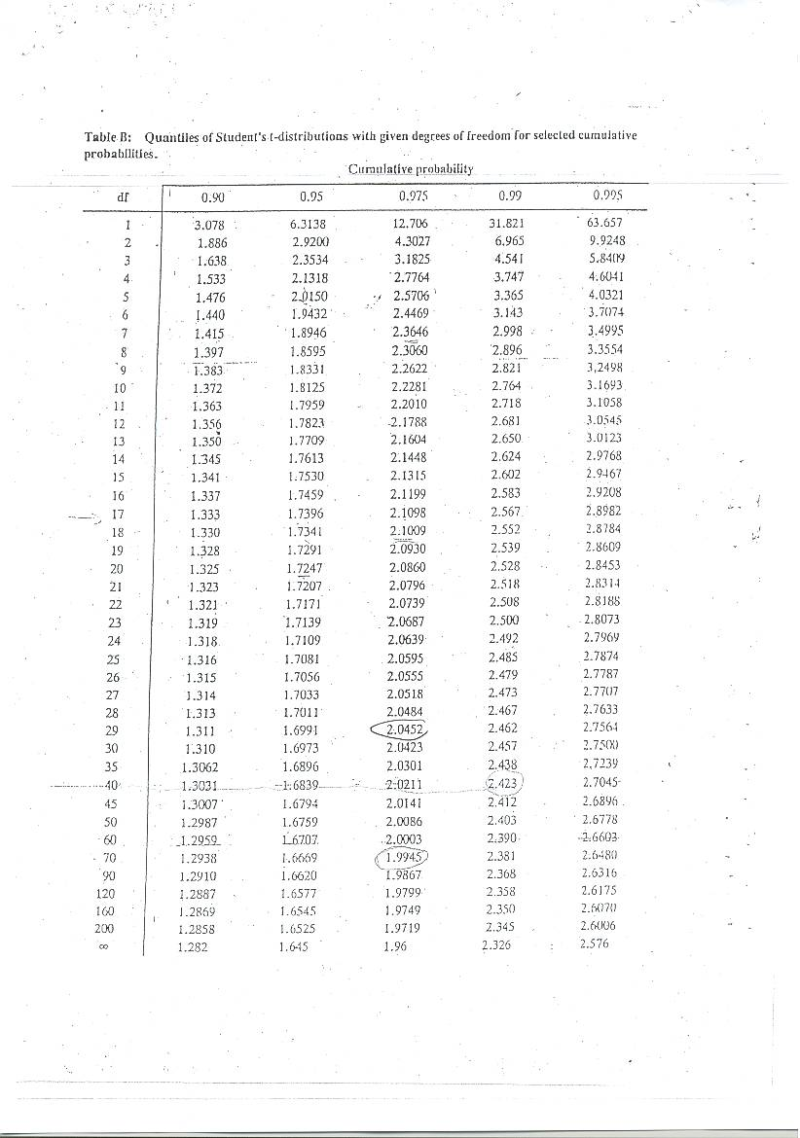

Slide 360
