Slide 1
Global Marketing Information Systems and Market Research
Chapter 6

Slide 2
Learning Objectives
Discuss the roles of IT, MIS, and big data in a global company’s decision-making processes.
Describe the various sources of market information, including direct perception.
Identify the individual steps in the traditional market research process and explain some of the ways global marketers adapt them.
Compare the way a multinational firm organizes the marketing research effort with the way a global or transnational firm approaches the organizing issue.
Explain how information’s role as a strategic asset affects the structure of global corporations.

Slide 3
Information Technology, Management Information System & Big Data
IT: An organization’s processes for creating, storing, exchanging, using, and managing information.
MIS: A means for gathering, analyzing and reporting relevant data to provide managers and other decision makers with a continuous flow of information about markets, customers, competitors and company operations.
Big Data: Extremely large data sets that can be subjected to computational analysis to reveal patterns and trends.
Notes:
Big data and big data analytics have long been the province of astronomers, meteorologists, and other members of the scientific community. It is only recently that big data collection and analysis been used in business situations. In particular, the exploding popularity of Facebook and other social media platforms has resulted in a wealth of big data. However, much of that data may be redundant or irrelevant, for a simple reason: The cost of data collection has dropped so dramatically that a company can amass data irrespective of a particular question, problem, or purpose that its marketers might have.

Slide 4
Business Intelligence Network
A component of MIS
Major Objective:
To enable interactive access to data, enable manipulation of these data, and to provide managers and analysts with the ability to conduct appropriate analysis. By analyzing historical and current data, situations, and performances, decision makers get valuable insights upon which they can base more informed and better decisions.
Notes:
Many companies with global operations have made significant investments in IT infrastructure in recent years. Such investment is typically directed at upgrading a company’s legacy computer hardware and software. Microsoft, SAP, Oracle, and IBM are some of the beneficiaries of this trend. All are global enterprises, and many of their customers are global as well. Vendors of complex software systems can find it difficult to achieve 100 percent customer satisfaction.

Slide 5
IT Infrastructure
Intranet: A private network that allows insiders or outsiders to share information securely and without paper
RTE: Real Time Enterprises are companies like Google, Amazon, FedEx that leverage big data
EDI: Electronic Data Interchange systems allow computer systems to speak the same language
Notes:
system allows a company’s business units to submit orders, issue invoices, and conduct business electronically with other company units as well as with outside companies. One of the key features of EDI is that its transaction formats are universal. This enables computer systems at different companies to speak the same language. Walmart is legendary for its sophisticated EDI system; for years, vendors had received orders from the retailer on personal computers using dial-up modems connected to third-party transmission networks. In 2002, Walmart informed vendors that it was switching to an Internet-based EDI system. The switch has saved both time and money; the modem-based system was susceptible to transmission interruptions, and the cost was between $0.10 and $0.20 per thousand characters transmitted. Any vendor that now wishes to do business with Walmart must purchase and install the necessary computer software.

Slide 6
IT Infrastructure
ECR: Efficient Consumer Response is a joint initiative of supply chain members to optimize the supply chain to benefit customers.
EPOS: Electronic Point of Sale data read on checkout scanners help firms identify sales patterns & geographical consumer preferences.

Slide 7
IT Infrastructure
CRM: Customer Relationship Management is a philosophy that values two-way communication between the company & the customer.
Touchpoints are any point of contact between the two.
360-degree view of the customer
SFA: Sales Force Automation software automates routine sales & marketing functions
Data warehouses
Notes:
Every point of contact (“touchpoint” in CRM-speak) that a company has with a consumer or business customer—via a Web site, a warranty card or sweepstakes entry, a payment on a credit card account, or an inquiry to a call center—is an opportunity to collect data. Likewise, every time a Spotify user clicks “play,” a data point is generated. CRM tools allow companies to determine which customers are most valuable and to react in a timely manner with customized product and service offerings that closely match customer needs. If implemented correctly, CRM can make employees more productive and enhance corporate profitability; it also benefits customers by providing value-added products and services.

Slide 8
Sources of Market Information
Personal Sources
As much as 2/3rd of corporate information
Executives based abroad, company subsidiaries and affiliates
Travel builds contacts and rapport
75% from face-to-face conversations

Slide 9
Direct Sensory Perception
Seeing, feeling, hearing, smelling, or tasting firsthand to find out what is going on in a country
“I believe it is part of any good marketer’s job to be in touch with their audience and their product. There’s no substitute for face-to-face, eye-to-eye, hand-to-hand.”
Cindy Spodek-Dickey
Microsoft Executive
Notes:
Some information is easily available from other sources, but sensory experience of it is needed for it to sink in. Often, the background information or context one gets from observing a situation can help fill in the big picture. For example, Walmart’s first stores in China stocked a number of products—extension ladders and giant bottles of soy sauce, for example—that were inappropriate for local customers. Joe Hatfield, Walmart’s top executive for Asia, began roaming the streets of Shenzhen in search of ideas. His observations paid off; when Walmart’s giant store in Dalian opened in April 2000, a million shoppers passed through its doors in the first week.They snapped up products ranging from lunch boxes to pizza topped with corn and pineapple.

Slide 10
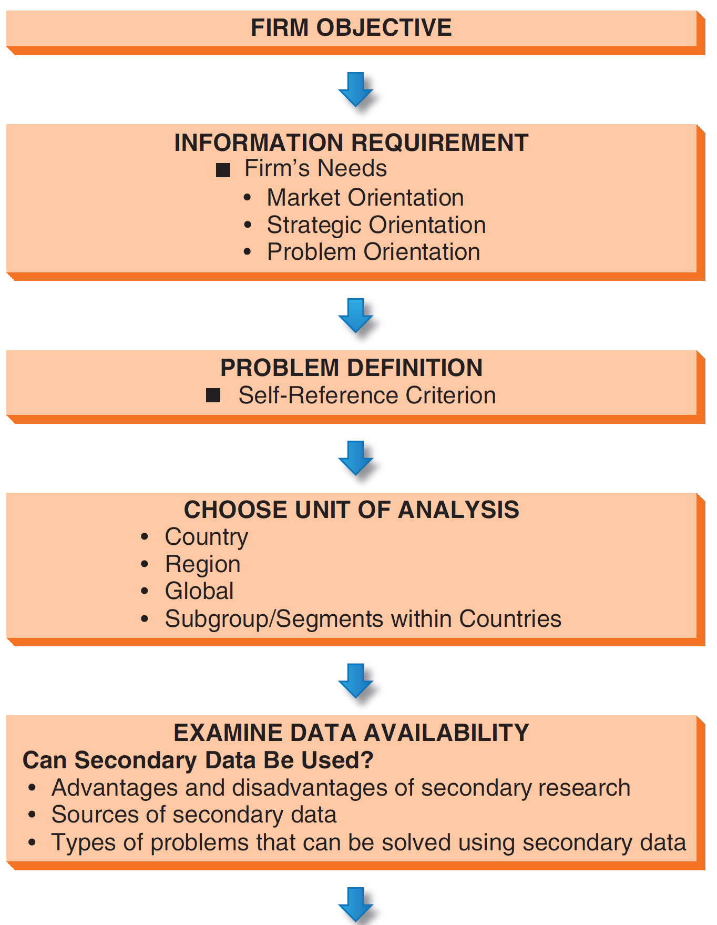
Formal Marketing Research

Slide 11
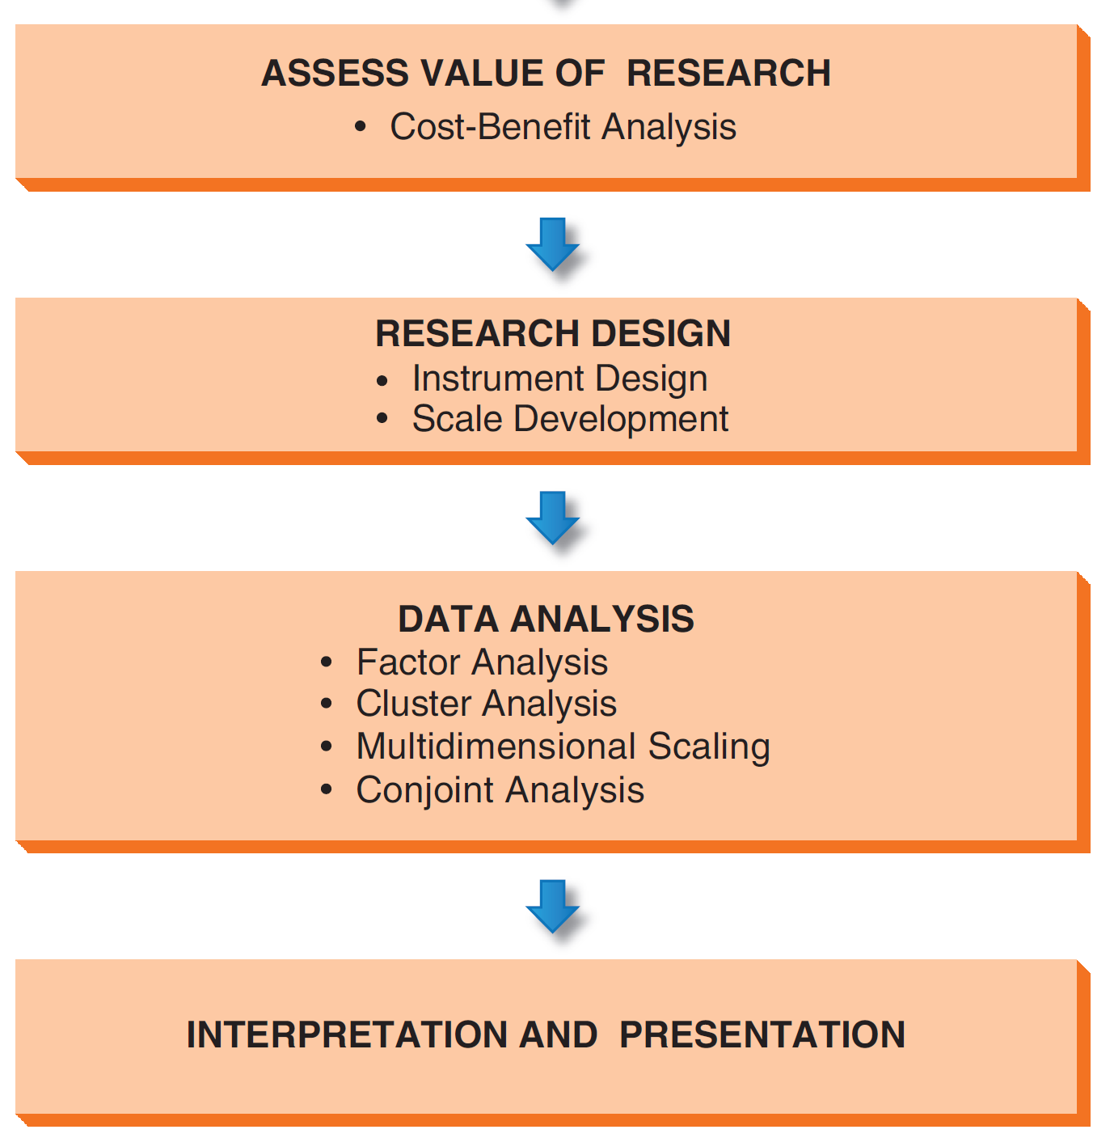
Formal Marketing Research, (cont.)

Slide 12
Step 1: Information Requirement

Slide 13
Step 2: Problem Definition
Be aware! The Self-Reference Criterion is at work when a person’s home-country values and beliefs influence the assessment of another country.
Mattel execs thought Japanese girls would like Barbie just like American girls. They didn’t.
Disney’s detailed code about personal appearance was an insult to French culture, individualism, and privacy when Disneyland Paris opened.

Slide 14
Step 3: Choose a Unit of Analysis
Single country
Region
Global
City, state, or province

Slide 15
Step 4: Examine Data Availability
U.S. Government Resources
National Trade Data Base (Dept. of Commerce)
Bureau of Economic Analysis
Census Bureau
Eurostat
Canadian Trade Commissioner Service
Statistical Yearbook of the United Nations
CIA World Factbook
MarketResearch.com

Slide 16
Secondary Data
Data from sources that already exist - they have not been gathered for the specific research project
Minimal effort and cost
Possible problems
accuracy
Availability
timeliness
comparability of data

Slide 17
Step 5: Assess Value of Research
If secondary data are not available, managers may conduct further studies
Assess the cost of research vs. what the information is worth
Would the company enter the market without spending big money on research?
Small markets may merit only modest research expense
Notes:
When data are not available through published statistics or studies, management may wish to conduct further study of the individual country market, region, or global segment. However, collecting information costs money. Thus, the marketing research plan should also spell out what this information is worth to the company in dollars (or euros, or yen, etc.) compared with what it would cost to collect it. What will the company gain by collecting these data? What would be the cost of not getting the data that could be converted into useful information? Research requires an investment of both money and managerial time, and it is necessary to perform a cost-benefit analysis before proceeding further. In some instances, a company will pursue the same course of action no matter what the research reveals. Even when more information is needed to ensure a high-quality decision, a realistic cost estimate of a formal study may reveal that the cost to perform research is simply too high.
The small markets around the world pose a special problem for the researcher. The relatively low profit potential in smaller markets justifies only modest expenditures for marketing research. Therefore, the global researcher must devise techniques and methods that keep expenditures in line with the market’s profit potential. The researcher is often pressured to discover economic and demographic relationships that can lead to estimates of demand based on a minimum of information. It may also be necessary to use inexpensive survey research that sacrifices some elegance or statistical rigor to achieve results within the constraints of the smaller market research budget.

Slide 18
Step 6: Research Design
Primary Data
when secondary data not available
provides accurate data which give exact answers to a given research problem
Possible problems
difficulties in gaining the data
cost
more time is necessary to gather the data

Slide 19
Step 6: Research Design
Use multiple indicators rather than a single measure
Individual companies should develop customized indicators specific to the industry, product market, or business model
Always conduct comparative assessments in multiple markets
Observations of purchasing patterns, other behavior should weigh more heavily that reports or opinions about purchase intention or price sensitivity
Notes:
Use multiple indicators rather than a single measure. This approach will decrease the level of uncertainty for decision makers. As the saying goes, “There are three sides to every story: your side, my side, and the truth.” A land surveyor can pinpoint the location of a third object given the known location of two objects. This technique, known as triangulation, is equally useful in global market research.
Individual companies should develop customized indicators specific to the industry, product market, or business model. Such indicators should leverage a company’s previous experience in global markets. For example, in some developing markets Mary Kay Cosmetics uses the average wage of a female secretary as a basis for estimating income potential for its beauty consultants.
Always conduct comparative assessments in multiple markets. Do not assess a particular market in isolation. Comparative assessment enables management to develop a “portfolio” approach in which alternative priorities and scenarios can be developed. For example, to better understand Czech consumers in general, a company might also conduct research in nearby Poland and Hungary. By contrast, if a brewing company wished to learn more about beer consumption patterns in the Czech Republic, it might also conduct research in Ireland and Germany, where per capita beer consumption is high.
Observations of purchasing patterns and other behavior should be weighted more heavily than reports or opinions regarding purchase intention or price sensitivity. Particularly in developing markets, it is difficult to accurately survey consumer perceptions

Slide 20
Qualitative Research Use
To provide consumer understanding; to “get close” to the consumer
To describe the social and cultural contexts of consumer behavior, including cultural, religious, and political factors that impact decision making
To identify core-brand equity and “get under the skin” of brands
To “mine” the consumer and identify what people really feel

Slide 21
Issues in Data Collection
Standardization vs. Extension of Marketing Mix?
Demand & profit potential may depend on whether the market is existing or potential
Existing Markets are being served by one or more companies
Potential Markets
Latent: An undiscovered segment
Incipient : A market will emerge is an economic, demographic, political, or sociocultural trend continues
Notes:
A latent market is, in essence, an undiscovered segment. It is a market in which demand would materialize if an appropriate product were made available. In a latent market, demand is zero before the product is introduced. In the case of existing markets such as the one for minivans previously described, the main research challenge is to understand the extent to which the competition fully meets customer needs. With latent markets, initial success is not based on a company’s competitiveness. Rather, it depends on the prime-mover advantage—a company’s ability to uncover the opportunity and launch a marketing program that taps the latent demand.
An incipient market is a market that will emerge if a particular economic, demographic, political, or sociocultural trend continues. A company is not likely to succeed if it offers a product in an incipient market before the trends have taken root. After the trends have had a chance to gain traction, the incipient market will become latent and, later, existing. The concept of incipient markets can also be illustrated by the impact of rising income on demand for automobiles and other expensive consumer durables. As per capita income rises in a country, the demand for automobiles will also rise. Therefore, if a company can predict a country’s future rate of income growth, it can also predict the growth rate of its automobile market.

Slide 22
Research Methodologies
Survey Research: Qualitative or Quantitative
Make use Back or Parallel translation technique to insure accuracy
Consumer Panel: Respondents behavior tracked over time; Nielsen Media tracks television audience measurement (TAM)
Observation: Trained observers or a mechanical device (video camera) watch & record actual or potential consumers
Focus Groups: Moderator leads 6-10 person discussion
Scale Development: Likert scale; be aware of bias
Sampling: Convenience or Quota samples
Notes:
Survey research utilizes questionnaires designed to elicit quantitative data (“How much would you buy?”), qualitative responses (“Why would you buy?”), or both. Survey research is often conducted by means of a questionnaire distributed through the mail, asked over the telephone, or asked in person. Many good marketing research textbooks provide details on questionnaire design and administration.
In global market research, a number of survey design and administration issues may arise. When using the telephone as a research tool, it is important to remember that what is customary in one country may be impossible in others because of infrastructure differences, cultural barriers, or other reasons. For example, telephone directories or lists may not be available; also, important differences may exist between urban dwellers and people in rural areas. In China, for example, the Ministry of Information Industry reports that 77 percent of households in coastal areas have at least one fixed-line telephone; in rural areas, the number is only 40 percent.
At a deeper level, culture shapes attitudes and values in a way that directly affects people’s willingness to respond to interviewer questions. Open-ended questions may help the researcher identify a respondent’s frame of reference. In some cultures, respondents may be unwilling to answer certain questions or they may intentionally give inaccurate answers.
In focus group research, a trained moderator facilitates discussion of a product concept, a brand’s image and personality, an advertisement, a social trend, or another topic with a group of 6 to 10 people. Global marketers can use focus groups to arrive at important insights.
Even with standard data-gathering techniques, the application of a particular technique may differ from country to country. Matthew Draper, vice president at New Jersey–based Total Research Corporation, cites “scalar bias” as a major problem: “There are substantial differences in the way people use scales, and research data based on scales such as rating product usefulness on a scale of 1 to 10 is therefore frequently cluttered with biases disguising the truth.” For example, while the typical American scale would equate a high number such as 10 with “most” or “best” and 1 with “least,” Germans prefer scales in which 1 is “most/best.” Also, while American survey items pertaining to spending provide a range of figures, Germans prefer the opportunity to provide an exact answer
When collecting data, researchers generally cannot administer a survey to every possible person in the designated group. A sample is a selected subset of a population that is representative of the entire population. The two best-known types of samples are probability samples and nonprobability samples. A probability sample is generated by following statistical rules that ensure that each member of the population under study has an equal chance—or probability—of being included in the sample. The results of a probability sample can be projected to the entire population with statistical reliability reflecting sampling error, degree of confidence, and standard deviation. The results of a nonprobability sample cannot be projected with statistical reliability. One form of nonprobability sample is a convenience sample. As the name implies, researchers select people who are easy to reach.

Slide 23
Data Analysis
Data must be cleaned & tabulated
Factor analysis
Cluster analysis
Perceptual mapping
Conjoint analysis
Comparative analysis
Market estimation by analogy
Comparative analysis
Cluster analysis

Slide 24
Step 8: Interpretation & Presentation
The report should clearly link to the problem or opportunity indentified in Step 1
Use language with which managers are comfortable
Simplify complex quantitative analysis

Slide 25
Current Issues in Global Marketing Research
Comparability means that research can be used for valid comparisons between countries
Emic analysis studies a culture from within
Etic analyis is detached & used in multi-country studies

