Slide 1
Global Marketing and the Digital Revolution
Chapter 15

Slide 2
Learning Objectives
List the major innovations and trends that contributed to the digital revolution.
Define “convergence” and give an example.
Define value network and explain the differences between sustaining technologies and disruptive technologies.
Identify current trends in global e-commerce and explain how global companies are expanding their presence on the Web.
Explain the key issues facing a company when designing and implementing a Web site.
Identify the most important new products and services that have been introduced in the past decade.

Slide 3
The Digital Revolution: A Brief History
1937 to 1942: World’s first electronic digital computer was developed at Iowa State University
1947: The transistor was invented
1948: Information Theory established binary digits could encode information media using 1s & 0s
1950s: Invention of the silicon chip (integrated circuit)
1970s: The decade for companies like Atari, Commodore, and Apple
Notes:
In 1947, William Shockley and two colleagues at AT&T’s Bell Laboratories invented a “solid state amplifier,” or transistor, as it became known. This was a critical innovation because the vacuum tubes that were used in computers and electronics products at that time were large, consumed a large amount of power, and generated a great deal of heat. Shockley and collaborators John Bardeen and William Brattain were awarded the Nobel Prize in physics in 1956 for their invention.
In 1948, a Bell Labs researcher named Claude Shannon wrote a technical report titled “A Mathematical Theory of Communication” in which he proposed that all information media could be encoded in binary digits, or bits. Earlier, in 1940, Shannon had argued in his doctoral dissertation that the logical values “true” and “false” could be denoted by “1” and “0,” respectively, and that streams of 1s and 0s could transmit media over a wire. Thanks to his pioneering work, Shannon is regarded as the inventor of information theory.
Also during the 1950s, Robert Noyce and Jack Kilby independently invented the silicon chip (also known as the integrated circuit or IC). In essence, the IC put the various parts of an electrical circuit—including resistors, diodes, and capacitors—on a single piece of material. The IC gave the transistor its modern form and allowed its power to be harnessed in a reliable, low-cost way.

Slide 4
The Digital Revolution: A Brief History
1981: IBM introduced its first Personal Computer (PC); Bill Gates developed
MS-DOS for IBM
1982: The 286 microprocessor was unveiled
1984: Apple introduced the Macintosh
1993: The creation of the Pentium processor

Slide 5
The Digital Revolution: Additional Milestones
1969: The Internet can trace its origins (Defense Advanced Research Projects Agency)
1972: E-mail was sent for the first time
1973: The creation of a cross-network protocol; the true birth of a network of networks or the Internet
1993: Tim Berners-Lee invented URL, HTML, and HTTP;
The Father of the World Wide Web
Mid-1990s: First commercial browser, Netscape, was created
Web users: 1993 - 600,000, 1998- 40 million; today 3 billion
Search engines Google and Yahoo! Bing have improved security features
Google: You Tube, Google Glass, Android Op Sys

Slide 6
The Internet Revolution according to Steve Case, AOL Cofounder
First Wave: mid 1980s companies like Cisco & Xilinx created core technologies(routers) that were the “on ramps” to the Internet
Second Wave: 2000-2014; focus shifted to building on top of the Internet: search engines, encryption & security, social media
Third wave: A future when the Internet is seamlessly integrated into everyday life; already occurring with Lyft & Uber. An era of reinvention & disruption in key economic sectors
Notes:
Case envisions the third wave as a time when the Internet is seamlessly integrated into everyday life. He also anticipates a period of reinvention and disruption in key economic sectors, with major changes in health care, education, financial services, and transportation. Some of this integration and disruption is already occurring, as evidenced by the popularity of ride-sharing services such as Uber and Lyft. And, as the controversy over Uber demonstrates, the third wave is likely to be characterized by an ongoing dialog between attackers and defenders of disruption and revolution.

Slide 7
Case’s Third Wave Trends
Capital for all: global crowdfunding
Reemergence of partnerships where who a company partners with is as important as what it does
Social enterprise that links profit & purpose
Rise of the rest: globalization of entrepreneurship becomes regional, not in small areas like Silicon Valley
Notes:
Case foresees four trends during the third wave. Case describes the first trend as “capital for all,” with global crowdfunding sites such GoFundMe, Indiegogo, Kickstarter, and Quirky growing in importance. Second will be the reemergence of partnerships; whether in health care or education, who a company partners with will be just as important as what the company does. A third trend will be the emergence of the social enterprise that links profit and purpose. Warby Parker, Tesla, and TOMS are three examples. Case dubs the fourth trend the “rise of the rest,” as the globalization of entrepreneurship gains traction on a regional basis, far from startup hotbeds such as Silicon Valley.

Slide 8
Industry Convergence
“The 2000s were the broadband decade, the disintermediation decade, the file-sharing decade, the digital recording (and image) decade, the iPod decade, the long-tail decade, the blog decade, the user-generated decade, the on-demand decade, the all-access decade. Inaugurating the new millennium, the Internet swallowed culture whole and delivered it back—cheaper, faster, and smaller—to everyone who can get online.”
Jon Pareles, New York Times columnist
Notes:
Originally, Sony was a consumer electronics company best known for innovative products such as transistor radios, Trinitron televisions, VCRs and other stereo components, and the Walkman line of personal music players. Then, Sony entered new businesses by acquiring CBS Records and Columbia Motion Pictures. These acquisitions themselves did not represent convergence, because they occurred in the early days of the digital revolution. Motion pictures, recorded music, and consumer electronics were still separate industries. Today, however, Sony is in the “bits” business: Its core businesses incorporate digital technology and involve digitizing and distributing sound, images, and data. Now, Sony’s competitors include Apple (music players), Dell (computers), Kodak (cameras), and Nokia (cell phones).

Slide 9
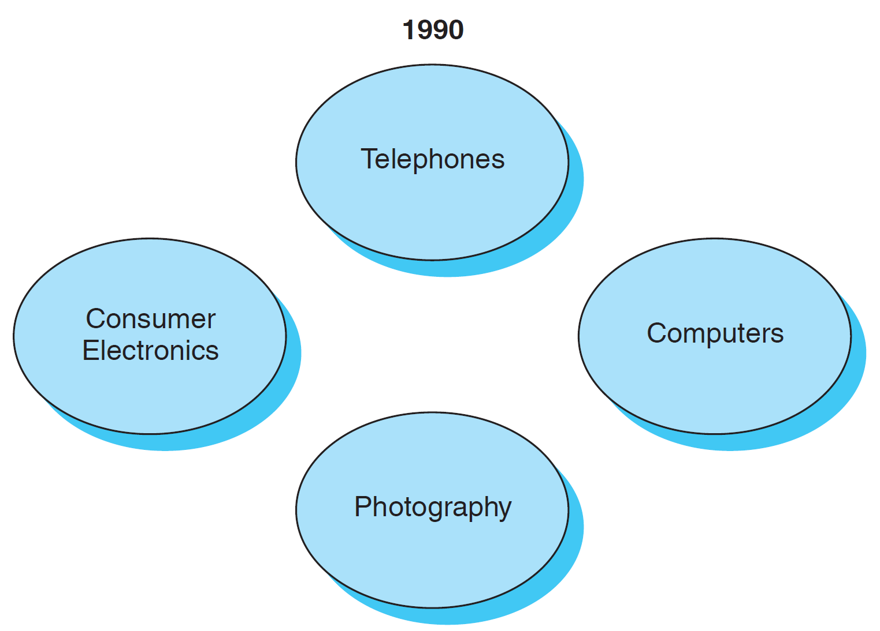
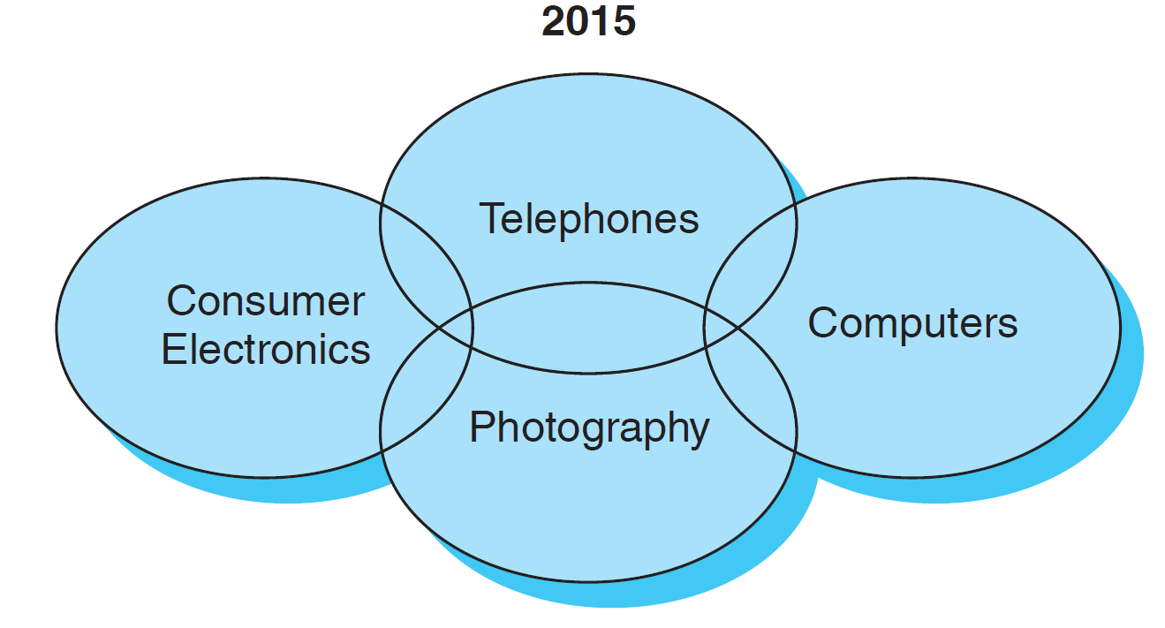
Industry Convergence
Convergence: The coming together of previously separate industries and product categories.
Notes:
The cell phone camera was invented in 1997; a key benefit was the ability to download digital photos from the camera and post them on the Web or e-mail them to friends. Ironically, Motorola, a key player in the cell phone business, could have been one of the first companies to market with a cell phone camera. However, management’s attention was distracted by the ill-fated launch of the Iridium satellite phone business. As a result, inventor Philippe Kahn took his idea to Japan where the first cell phone cameras were introduced in 1999. In 2010, annual sales of camera-equipped cell phones passed the 1-billion-unit mark.

Slide 10
Value Networks and Disruptive Technologies
Innovator’s Dilemma
Value network
Sustaining Technologies
Disruptive Technologies

Slide 11
Innovator’s Dilemma
Staying committed to a current, profitable technology
Failing to provide adequate levels of investment to new and possibly risky technologies
Company is responding to the needs of established customers
Notes:
In an era when environmental scanning, strategic planning, and other conceptual tools of the type discussed in Chapter 16 are widely known and used, how is it that managers at many companies have failed to respond to change in a timely manner? According to Harvard professor Clayton Christensen, the problem is that executives become so committed to a current, profitable technology that they fail to provide adequate levels of investment in new, apparently riskier technologies. Ironically, companies fall into this trap by adhering to prevailing marketing orthodoxy, namely, listening to and responding to the needs of established customers. Christensen calls this situation the innovator’s dilemma.

Slide 12
Value Network
Found in every industry
Cost structure that dictates the margins needed to achieve profitability
Boundaries are defined by the unique rank ordering of the importance of various product attributes
Each network has its own metrics of value
Notes:
Each network has its own “metrics of value,” e.g., for laptop computers, the metrics are small size, low weight and power consumption, and rugged design. For example, during the 1980s, customers who bought portable computers were willing to pay a premium for smaller size; buyers of mainframe computers did not value this attribute. Conversely, mainframe buyers valued (i.e., were willing to pay more for) memory capacity as measured by megabytes; portable computer buyers placed less value on this attribute. In short, the value networks for mainframe computers and portable computers are different.

Slide 13
Sustaining Technologies
Incremental or radical innovations that improve product performance
Most new technologies developed by established companies are sustaining in nature
The vast majority of innovations are sustaining in nature
Notes:
As firms gain experience within a given network, they are likely to develop capabilities, organizational structures, and cultures tailored to the distinctive requirements of their respective value networks. The industry’s dominant firms—typically with reputations as “well managed” firms—lead in developing and/or adopting sustaining technologies, that is, incremental or radical innovations that improve product performance. According to Christensen, most new technologies developed by established companies are sustaining in nature; indeed, the vast majority of innovations are of this type.

Slide 14
Disruptive Technologies
Redefine performance
New entrants to an industry
Enable something to be done that was previously deemed impossible
Enable new markets to emerge
Notes:
New entrants to an industry lead in developing disruptive technologies that redefine performance. The benefits associated with disruptive technologies go beyond enhancing product performance; disruptive technologies enable something to be done that was previously deemed impossible. Disruptive technologies typically enable new markets to emerge. As Christensen explains, “An innovation that is disrupting to one firm can be sustaining to another firm.” The Internet was sustaining technology to Dell Computer, which already sold PCs direct by telephone. But it was disruptive technology to Compaq, whose major distribution channel was retailers.

Slide 15
Five Principles of Disruptive Innovations
Companies are dependent on customers and many innovations are customer-driven. By listening to those long-established customers, opportunities may be missed.
Small markets don’t solve the growth needs of large companies.
Markets that don’t exist can’t be analyzed.
An organization’s capabilities define its disabilities.
Technology supply may not equal market demand.
Notes:
1. Companies depend on customers and investors for resources. As management guru Rosabeth Moss Kanter points out, the best innovations are user-driven; paradoxically, however, if management listens to established customers, opportunities for disruptive innovation may be missed.
2. Small markets don’t solve the growth needs of large companies. Small organizations can most easily respond to the opportunities for growth in a small market. This fact may require large organizations to create independent units to pursue new technologies, as IBM did in developing its PC.
3. Markets that don’t exist can’t be analyzed. Christensen recommends that companies embrace agnostic marketing. This is the explicit assumption that no one—not company personnel, not the company’s customers—can know whether, how, or in what quantities a disruptive product can or will be used before they have experienced using it.
4. An organization’s capabilities define its disabilities.
5. Technology supply may not equal market demand. Some products offer a greater degree of sophistication than the market requires. For example, developers of accounting software for small businesses overshot the functionality required by the market, thus creating an opportunity for a disruptive software technology that provided adequate, not superior, functionality and was simple and more convenient to use. This was the opportunity seized by Scott Cook, developer of Quicken and Quickbooks.

Slide 16
Global E-Commerce
Every 48 hours, Yahoo records more than 24 terabytes of data about its users’ online habits— equal to all the information contained in all the books in the Library of Congress
Between 2003 and 2014, the number of Internet users in China increased from 68 million to 640 million; 460 million + Chinese shop online; Chinese Alibaba rivals Yahoo, Google, eBay
Online retail & travel sales in Western Europe grew at a CAGR of 8% between 2008-2014; By 2018, 75% of Europeans will shop online, up from 65% in 2013

Slide 17
Global E-Commerce
Divided into three broad categories
Business to Business (B2B) largest share of the Internet economy
Business to Consumer (B2C) iTunes
Consumer to Consumer (Peer to peer) eBay
Notes:
E-commerce refers to the general exchange of goods and services using the Internet or a similar online network as a marketing channel. Global e-commerce sales surpassed $1.3 trillion in 2014. That figure includes hundreds of millions of Chinese consumers who are shopping online with greater frequency as smartphone penetration ramps up. According to Forrester Research, U.S. online retail sales revenues totaled $304 billion in 2014, a figure that represents about 7 percent of total U.S. retail sales. Internet penetration in some world regions is in the low single digits; this is especially true in Africa. For example, penetration is less than 10 percent in Eritrea, Burundi, Sierra Leone, Somalia, and other low-income countries. By contrast, in several countries, including South Korea, the Netherlands, Greenland, the UAE, Bahrain, and Qatar, more than 90 percent of the population is online. .
Industry forecasts call for global B2B revenues to reach $6.7 trillion by 2020, at which point B2C is expected to be $3.2 trillion .

Slide 18
Web Sites
Promotion sites: marketing communications
Content sites: news and entertainment; support PR
Transaction sites: online retail operations
Web sites can function as all three

Slide 19
Internet as a Communications Tool
“Content for broadband costs significantly less than TV…and distributes to a much larger audience.”
Ad Agency Executive
Unilever digitized TV commercials stored as product videos, and created Web series for Yahoo! Food built around Hellman’s Mayonnaise.

Slide 20
Internet Retail Sales
U.S online retails sales $300 billion in 2014; $370 billion by 2017
Companies like A&F, Saks, Timberland, Coach trying to attract foreign buyers
Strong U.S. dollar has Americans ordering from abroad
Delivery companies like FedEx, UPS, & DHL are acquiring & partnering with other firms from seamless delivery

Slide 21
Luxury Retailers and the Internet
Many do not sell online but use the Internet to inform and promote
Concern that the brand essence cannot be communicated online but changing
Smartphone and iPad apps and Facebook communities aim to “create a dialog and get consumers connecting with our brand”.

Slide 22
The Long Tail
Use of efficient economics of online retail to aggregate slow-selling products
eBay, Amazon.com., Netflix, iTunes
“…The Long Tail is really about the economics of abundance…what happens when the bottlenecks that stand between supply and demand in our culture start to disappear and everything becomes available to everyone……These millions of fringe sales are an efficient, cost-effective business…hits and niches are on equal footing.”
Chris Anderson, Author and Editor of Wired

Slide 23
Web Site Design
Internet potential requires using interactive media
Key issues
Register a country-specific domain name—Cybersquatting
Arranging payment—credit card usage rate, fraud, postal money order or bank check
Localizing sites—reflect local culture, language, aesthetics
Addressing privacy issues—EU laws more stringent
Setting up distribution—local sales tax issues
Notes:
A critical first step is registering a country-specific domain name. Thus, Amazon.com has a family of different domain names, one for each country in which it operates (see Table 15-3). Although it is certainly possible for European consumers to browse Amazon.com’s U.S. site, they may prefer a direct link to a site with a local domain name.
Payment can be another problem; in some countries, including China, credit card use is low. In such situations, e-commerce operators must arrange payment by bank check or postal money order; cash on delivery is also an option. Another issue is credit card fraud; Indonesia, Russia, Croatia, and Bosnia are among the countries where fraud is rampant. Extra identity measures may have to be taken, such as requiring buyers to fax the actual credit card they are using as well as photo IDs.
Ideally, each country-specific site should reflect local culture, language usage, customs, and aesthetic preferences. Logos and other elements of brand identity should be included on the site, with adjustments for color preferences and meaning differences when necessary. For example, the shopping cart icon is familiar to online shoppers in the United States and many European countries. However, online companies must determine whether that icon is appropriate in all country markets. Subtle but important language differences can also occur even in English-speaking countries. For example, www.figleaves.com and www.figleaves.com/uk are, respectively, the American and British Web addresses for a UK-based lingerie marketer. However, the U.S. site refers to “panties,” whereas the UK site has a listing for “briefs.” When two or more different languages are involved, translators should be used to ensure that copy reflects current language usage.
Another critical global e-commerce issue is privacy. The EU’s regulations are among the world’s strictest; companies are limited in terms of how much personal information—a customer’s age, marital status, and buying patterns, for example—can be gathered and how long the information can be retained. In 2012, EU Justice Commissioner Viviane Reding announced an overhaul of the EU’s data collection rules (see Exhibit 15-5). The rules will apply to companies based outside the EU—Apple, Google, and Facebook, for example—if they offer services to EU citizens. Customers living in the EU have the “right to be forgotten”—that is, they can request to have their personal data deleted.
A number of issues are related to physical distribution decisions. As online sales increase in a particular country or region, it may be necessary to establish local warehouse facilities to speed delivery and reduce shipping costs. In the United States, such a step has tax implications, meaning that the marketer may have to collect sales tax. To allay consumer concerns about ordering merchandise online, companies may opt to waive shipping fees and offer free returns and money-back guarantees.

Slide 24
Broadband
Has sufficient capacity to carry multiple voice, data, or video channels simultaneously
Bandwidth determines the range of frequencies that can pass over a transmission channel
Streaming audio and video; 48 million players on Xbox live worldwide
Notes:
A broadband communication system is one that has sufficient capacity to carry multiple voice, data, or video channels simultaneously. Bandwidth determines the range of frequencies that can pass over a given transmission channel. For example, traditional telephone networks offered quite limited bandwidth compared with state-of-the-art digital telephone networks. As a result, a traditional telephone call sounds “lo-fi.” Bandwidth is measured in bits-per-second (Bps); a full page of English text is about 16,000 bits. For example, a 56Kbs modem connected to a conventional telephone line can move 16,000 bits per second; by comparison, a broadband Internet connection that utilizes coaxial cable can move up to 10 gigabits per second.
South Korea currently boasts the world’s fastest average Internet speeds. However, technology upgrades currently underway will mean even higher speeds: The government has declared that, by the end of 2012, every Korean household will have a one gigabit Internet connection. As Choi Gwang-gi, the engineer overseeing the project, explains, “A lot of Koreans are early adopters, and we thought we needed to be prepared for things like 3D TV, Internet protocol TV, high-definition multimedia, gaming and videoconferencing, ultra-high definition TV, and cloud computing.” Consumers won’t be the only beneficiaries of the upgrade; corporations will also harness gigabit Internet connections for high-definition global video conferencing and other applications.

Slide 25
New Products and Services
Cloud Software will not be installed on a computer hard drive but through a web browser
Smartphone sales in 2014 of 1.3 billion
SMS texting to move to other channels like TV, the Internet, e-mail.
Apple and Android systems
Apps—iTunes store has over 50 billion downloads

Slide 26
Mobile Advertising and Mobile Commerce
Term for conducting commercial transactions using cell phones
Wi-Fi
Cellular data plans via 3G, 4G networks
Tablets like iPad, Galaxy
Mobile ad spending: $1 billion in 2007; $43 billion in 2014
GPS on phones led to location-based advertising
Notes:
A smartphone that is equipped with a positioning system (GPS) can determine the user’s exact geographic position. This capability has created new opportunities for location-based mobile platforms, such as Foursquare and Uber. The popularity of GPS-equipped mobile devices is driving interest in location-based advertising.
Cell phone usage is exploding in India. As Manoj Dawane, CEO of Mumbai software company People Infocom, explains, “In India, mobile phone penetration is high compared to other forms of media like television or the Internet. You can’t have a better place than India for mobile advertising.” One factor driving mobile ads in India is the low rates that subscribers pay—as little as 2 cents per minute. Demographics play an important role, too. About two-thirds of the Indian population lives in rural areas where television ownership and newspaper readership are low. Cellular operators such as BPL Mobile have built networks that reach tens of thousands of Indian villages. Arif Ali, head of brand communications at BPL, has ideas that will keep subscriber costs low. “We are thinking of providing 30- to 60-second commercials over the phone where we will pass on some kind of benefit,” he said.

Slide 27
Mobile Commerce
Bluetooth–uses less power than Wi-Fi, works well with cell phones and covers shorter distances than Wi-Fi
Handles data, not voice
Telematics: Cars can exchange info about location or mechanical performance
Notes:
Bluetooth mobile communication technology has the advantage of consuming less power than Wi-Fi. This makes Bluetooth well suited for use with cell phones. However, Bluetooth works over shorter distances than Wi-Fi. Both Bluetooth and Wi-Fi technology are being incorporated into automobiles and home appliances such as refrigerators, lighting systems, and microwave ovens. In short, the “Internet of things” is rapidly coming into being.
Likewise, the Internet-connected car is becoming a reality as automakers rush to incorporate technology into their vehicles. Indeed, many drivers view their cars as an extension of their digital selves, and a variety of apps permit various kinds of interactions. Nameplates such as Porsche and BMW have developed Apple Watch apps that enable drivers to remotely check, say, whether the doors are locked and the windows are up. Electric car owners can also check to see whether their cars’ batteries are fully charged. Mainstream manufacturers such as Ford and Hyundai are also launching their own apps. Most global automakers and suppliers have established research laboratories in California’s Silicon Valley tech hub Bluetooth is the Anglicized version of a Scandinavian epithet for Harald Blatand, a Danish Viking and king who lived in the tenth century.

Slide 28
Mobile Music, Gaming & Payments
iTunes downloads in 2006 reached 1 billion; cumulative total of 25 billion downloads
Cloud-based music systems offer a locker for storing music that is accessed by a variety of mobile devices
Mobile Gaming revenues of $17.6 billion in 2015
E-sport: video game competitions where pro gamers compete for cash prizes
Mobile payments exploded with Apple Pay with iPhone 6 in 2014; more important role of security after credit card cyber-theft at Home Depot, Target
Notes:
games.
In the past few years, online gaming has also morphed into a spectator sport. In fact, the term e-sport has been coined to describe video game competitions in which professional gamers compete for cash prizes that can reach $1 million. Examples include the StarCraft II 2014 World Championship Global Finals and the League of Legends World Championship that was held in South Korea. Fans in the United States can watch the matches from locations such as the Ignite lounge in Chicago or the Staples Center in Los Angeles.

Slide 29
Streaming Video
Global penetration of broadband Internet service has fueled the growing popularity of global digital video services such as YouTube,
Facebook, Instagram, Twitter, Netflix, Meerkat

Slide 30
Internet Phone Service
The “next big thing” for the telecommunications industry
VoIP—Voice over Internet Protocol
Has the potential to render the current telecommunications infrastructure obsolete
Currently only accounts for a small percentage of total global calling
Skype acquired by Microsoft for $8.6 billion in 2011
Notes:
Thanks to a technology known as voice over Internet protocol (VoIP), the human voice can be digitized and broken into data packets that can be transmitted over the Internet and converted back into normal speech. If a call is placed to a conventional phone, it must be switched from the Internet to a traditional phone network; local telephone companies generally own the lines into residences and businesses. However, if the call is made between two subscribers to the same VoIP provider, it bypasses the traditional network altogether.

Slide 31
Digital Books & Electronic Reading Devices and Wearables
Amazon’s Kindle, Barnes & Nobles’ Nook, Apple’s iPad may help newspapers & magazines
Textbooks are a huge market opportunity for publishers
Piracy is a concern for many authors
Wearables like Google Glass & Apple Watch are reaching a tipping point.
6 million units in 2013
113 million units in 2018

