Slide 1
Leadership, Organization, and
Corporate Social Responsibility
Chapter 17

Slide 2
Learning Objectives
Identify the names and nationalities of the chief executives at five global companies discussed in the text.
Describe the different organizational structures that companies can adopt as they grow and expand globally.
Discuss the attributes of lean production and identify some of the companies that have been pioneers in this organizational form
List some of the lessons on corporate social responsibility that global marketers can take away from Starbuck’s experience with Global Exchange.

Slide 3
Leadership
“Leadership is not about hierarchy or title or status: It is about having influence and mastering change. Leadership is not about bragging rights or battles or even the accumulation of wealth; it’s about connecting and engaging at multiple levels … Leaders can no longer view strategy and execution as abstract concepts, but must realize that both elements are ultimately about people.”
-Carly Fiorina, former CEO, HP
Notes:
Global marketing demands exceptional leadership. The hallmark of a global company is the capacity to formulate and implement global strategies that leverage worldwide learning, respond fully to local needs and wants, and draw on the talent and energy of every member of the organization. This heroic task requires global vision and sensitivity to local needs. Overall, the leader’s challenge is to direct the efforts and creativity of everyone in the company toward a global effort that best utilizes organizational resources to exploit global opportunities.

Slide 4
Leadership
The leader’s task is to articulate:
Intended geographical scope of activities
Beliefs
Values
Policies
Notes:
It is one thing to spell out the vision and another thing entirely to secure commitment to it throughout the organization. As noted in Chapter 1, global marketing entails engaging in significant business activities outside the home country. This means exposure to different languages and cultures. In addition, global marketing involves skillful application of specific concepts, considerations, and strategies. Such endeavors may represent substantial change, especially in U.S. companies with a long tradition of domestic focus. When the “go global” initiative is greeted with skepticism, the CEO must be a change agent who prepares and motivates employees.

Slide 5
Top Management Nationality
“Companies are realizing that they have a portfolio of human resources worldwide, that their brightest technical person might come from Germany, or their best financial manager from England. They are starting to tap their worldwide human resources. And as they do, it will not be surprising to see non-Americans rise to the top.”
- Christopher Bartlett, Harvard Business School
Notes:
The ability to speak foreign languages is one difference between managers born and raised in the United States and those born and raised elsewhere. For example, the U.S. Department of Education recently reported that 200 million Chinese children are studying English; by contrast, only 24,000 American children are studying Chinese! Roberto Goizueta, the Cuban-born CEO of Coca-Cola who died in 1997, spoke English, Spanish, and Portuguese; Ford’s former chief executive, Alexander Trotman, was born in England and speaks English, French, and German.

Slide 6
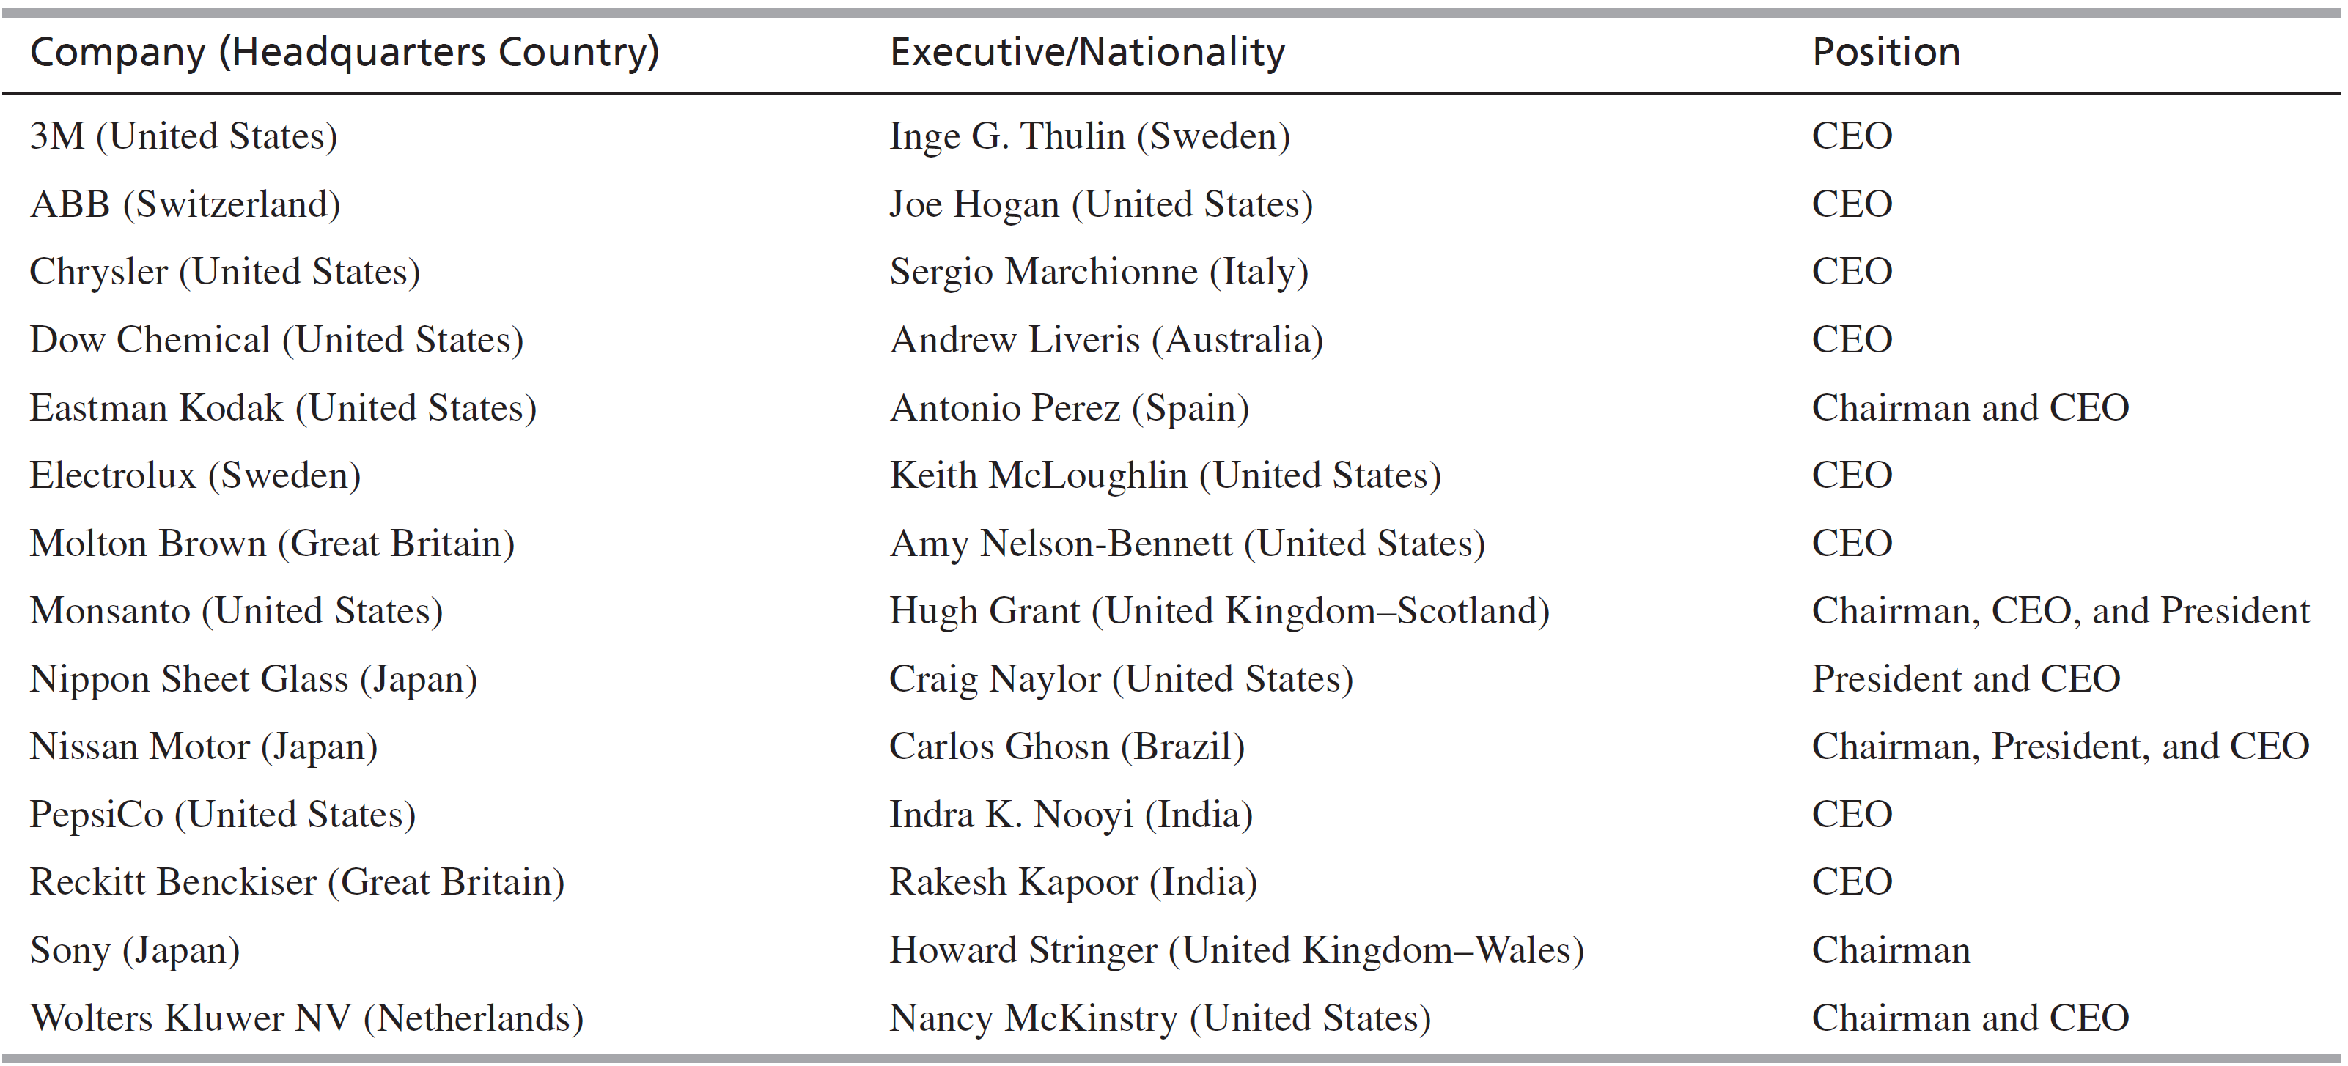
Who’s in Charge? Executives of 2015
Notes:
Corporate leaders and their national backgrounds.

Slide 7
Leadership and Core Competence
Executives were judged on their ability to identify, nurture, and exploit the organization’s core competencies in the 1990s as opposed to the focus on reorganization in the 1980s
Core competencies must:
Provide potential access to a wide variety of markets
Make a significant contribution to the perceived customer benefits
Be difficult to imitate
Notes:
Few companies are likely to build world leadership in more than five or six fundamental competencies. In the long run, an organization will derive its global competitiveness from its ability to bring high-quality, low-cost products to market faster than its competitors. To do this, an organization must be viewed as a portfolio of competencies rather than a portfolio of businesses.

Slide 8
Organizing for Global Marketing
The goal is to find a structure that:
Enables the company to respond to relevant market environment differences
Ensures the diffusion of corporate knowledge and experience throughout the entire system
Organizations must balance:
How to balance between autonomy & integration
The need for individualized response to local markets
Notes:
A key issue in global organization is how to achieve balance between autonomy and integration. Subsidiaries need autonomy to adapt to their local environment, but the business as a whole needs integration to implement global strategy. No single correct organizational structure exists for global marketing. Even within a particular industry, worldwide companies have developed different strategic and organizational responses to changes in their environments. Still, it is possible to make some generalizations. Leading-edge global competitors share one key organizational design characteristic: Their corporate structure is flat and simple, rather than tall and complex. The message is clear: The world is complicated enough, so there is no need to add to the confusion with a complex internal structuring. Simple structures increase the speed and clarity of communication and allow the concentration of organizational energy and valuable resources on learning, rather than on controlling, monitoring, and reporting. According to David Whitwam, CEO of Whirlpool, “You must create an organization whose people are adept at exchanging ideas, processes, and systems across borders, people who are absolutely free of the ‘not-invented-here’ syndrome, people who are constantly working together to identify the best global opportunities and the biggest global problems facing the organization.”

Slide 9
Organizing for Global Marketing
In global marketing there is not a single best structure
Leading-edge global competitors share one key organizational design characteristic:
Structure is flat and simple
In the 21st century corporations will have to find new, more creative ways to organize
Must be flexible, efficient, and responsive to meet the demands of globalizing markets
Notes:
Recently, several authors have described new organization designs that represent responses to today’s competitive environment. These designs acknowledge the need to find more responsive and flexible structures, to flatten the organization, and to employ teams. There is the recognition of the need to develop networks, to develop stronger relationships among participants, and to exploit technology. These designs also reflect an evolution in approaches to organizational effectiveness. At the turn of the century, Frederick Taylor claimed that all managers had to see the world the same way. Then came the contingency theorists who said that effective organizations design themselves to match their conditions. These two basic theories are reflected in today’s popular management writings. As Henry Mintzberg has observed, “To Michael Porter, effectiveness resides in strategy, while to Tom Peters it is the operations that count—executing any strategy with excellence.”

Slide 10
Patterns of International Organizational Development
Organizations vary in:
Size
Potential of targeted global markets
Local management competence
Conflicting pressures may arise
For product and technical knowledge
Functional area expertise
Area and country knowledge
Notes:
Because the constellation of pressures that shape organizations is never exactly the same, no two organizations pass through organizational stages in exactly the same way, nor do they arrive at precisely the same organizational pattern. Nevertheless, some general patterns hold. These will be discussed in the next few slides.

Slide 11
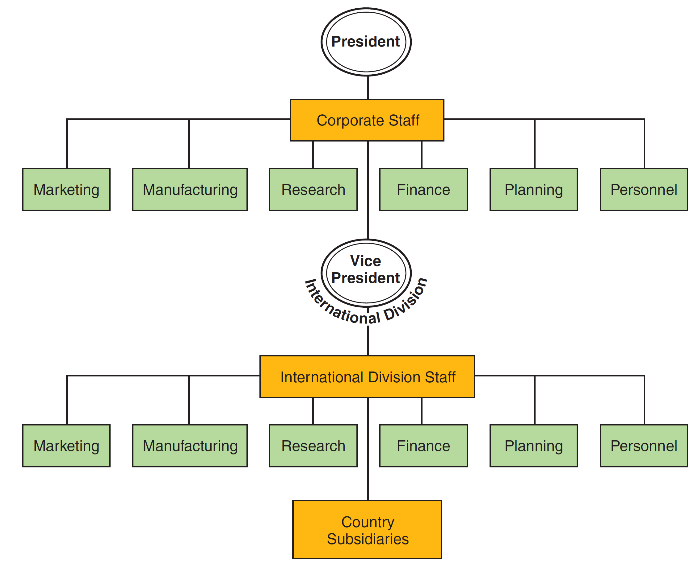
International Division Structure
Notes:
As a company’s international business grows, the complexity of coordinating and directing this activity extends beyond the scope of a single person. Pressure is created to assemble a staff that will take responsibility for coordination and direction of the growing international activities of the organization. Eventually, this pressure leads to the creation of the international division. The executive in charge of the international division typically has a direct reporting relationship to corporate staff and thus ranks at the same level as the executives in charge of finance, marketing, operations, and other functional areas. Best Buy, Hershey, Levi Strauss, Under Armour, Walmart, and Walt Disney are some examples of companies whose structures include international divisions.
Several factors contribute to the establishment of an international division. First, top management’s commitment to global operations has increased enough to justify an organizational unit headed by a senior manager. Second, the complexity of international operations requires a single organizational unit whose management has sufficient authority to make its own determinations on important issues such as which market-entry strategy to employ. Third, an international division is frequently formed when the firm has recognized the need for internal specialists to deal with the special demands of global operations. A fourth contributing factor is management’s recognition of the importance of strategically scanning the global horizon for opportunities and aligning them with company resources rather than simply responding on an ad hoc basis to opportunities as they arise.

Slide 12
International Division Structure
Four factors that lead to this structure
Top management’s commitment to global operations has increased enough to justify the position
Complexity of international operations requires a single organizational unity
The firm has recognized the need for internal specialists to deal with the demands of global operations
Management recognizes the importance of proactively scanning the global horizon for opportunities and threats
Notes:
Wal-Mart, Levi Strauss, Anheuser-Busch, Best Buy, Walt Disney Company, and Hershey are some examples of companies whose structures include international divisions. When Hershey announced the creation of its international division in 2005, J.P. Bilbrey, the division’s senior vice president, noted that Hershey will no longer utilize the extension strategy of exporting its chocolate products from the United States. Instead, the company will tailor products to local markets and also manufacture locally. As Bilbrey explained, “We’re changing our business model in Asia. The product was not locally relevant and it also got there at an unattractive cost.
Four factors contribute to the establishment of an international division. First, top management’s commitment to global operations has increased enough to justify an organizational unit headed by a senior manager. Second, the complexity of international operations requires a single organizational unit whose management has sufficient authority to make its own determination on important issues such as which market entry strategy to employ. Third, an international division is frequently formed when the firm has recognized the need for internal specialists to deal with the special demands of global operations. A fourth contributing factor is management’s recognition of the importance of strategically scanning the global horizon for opportunities and aligning them with company resources rather than simply responding on an ad hoc basis to situations as they arise.

Slide 13
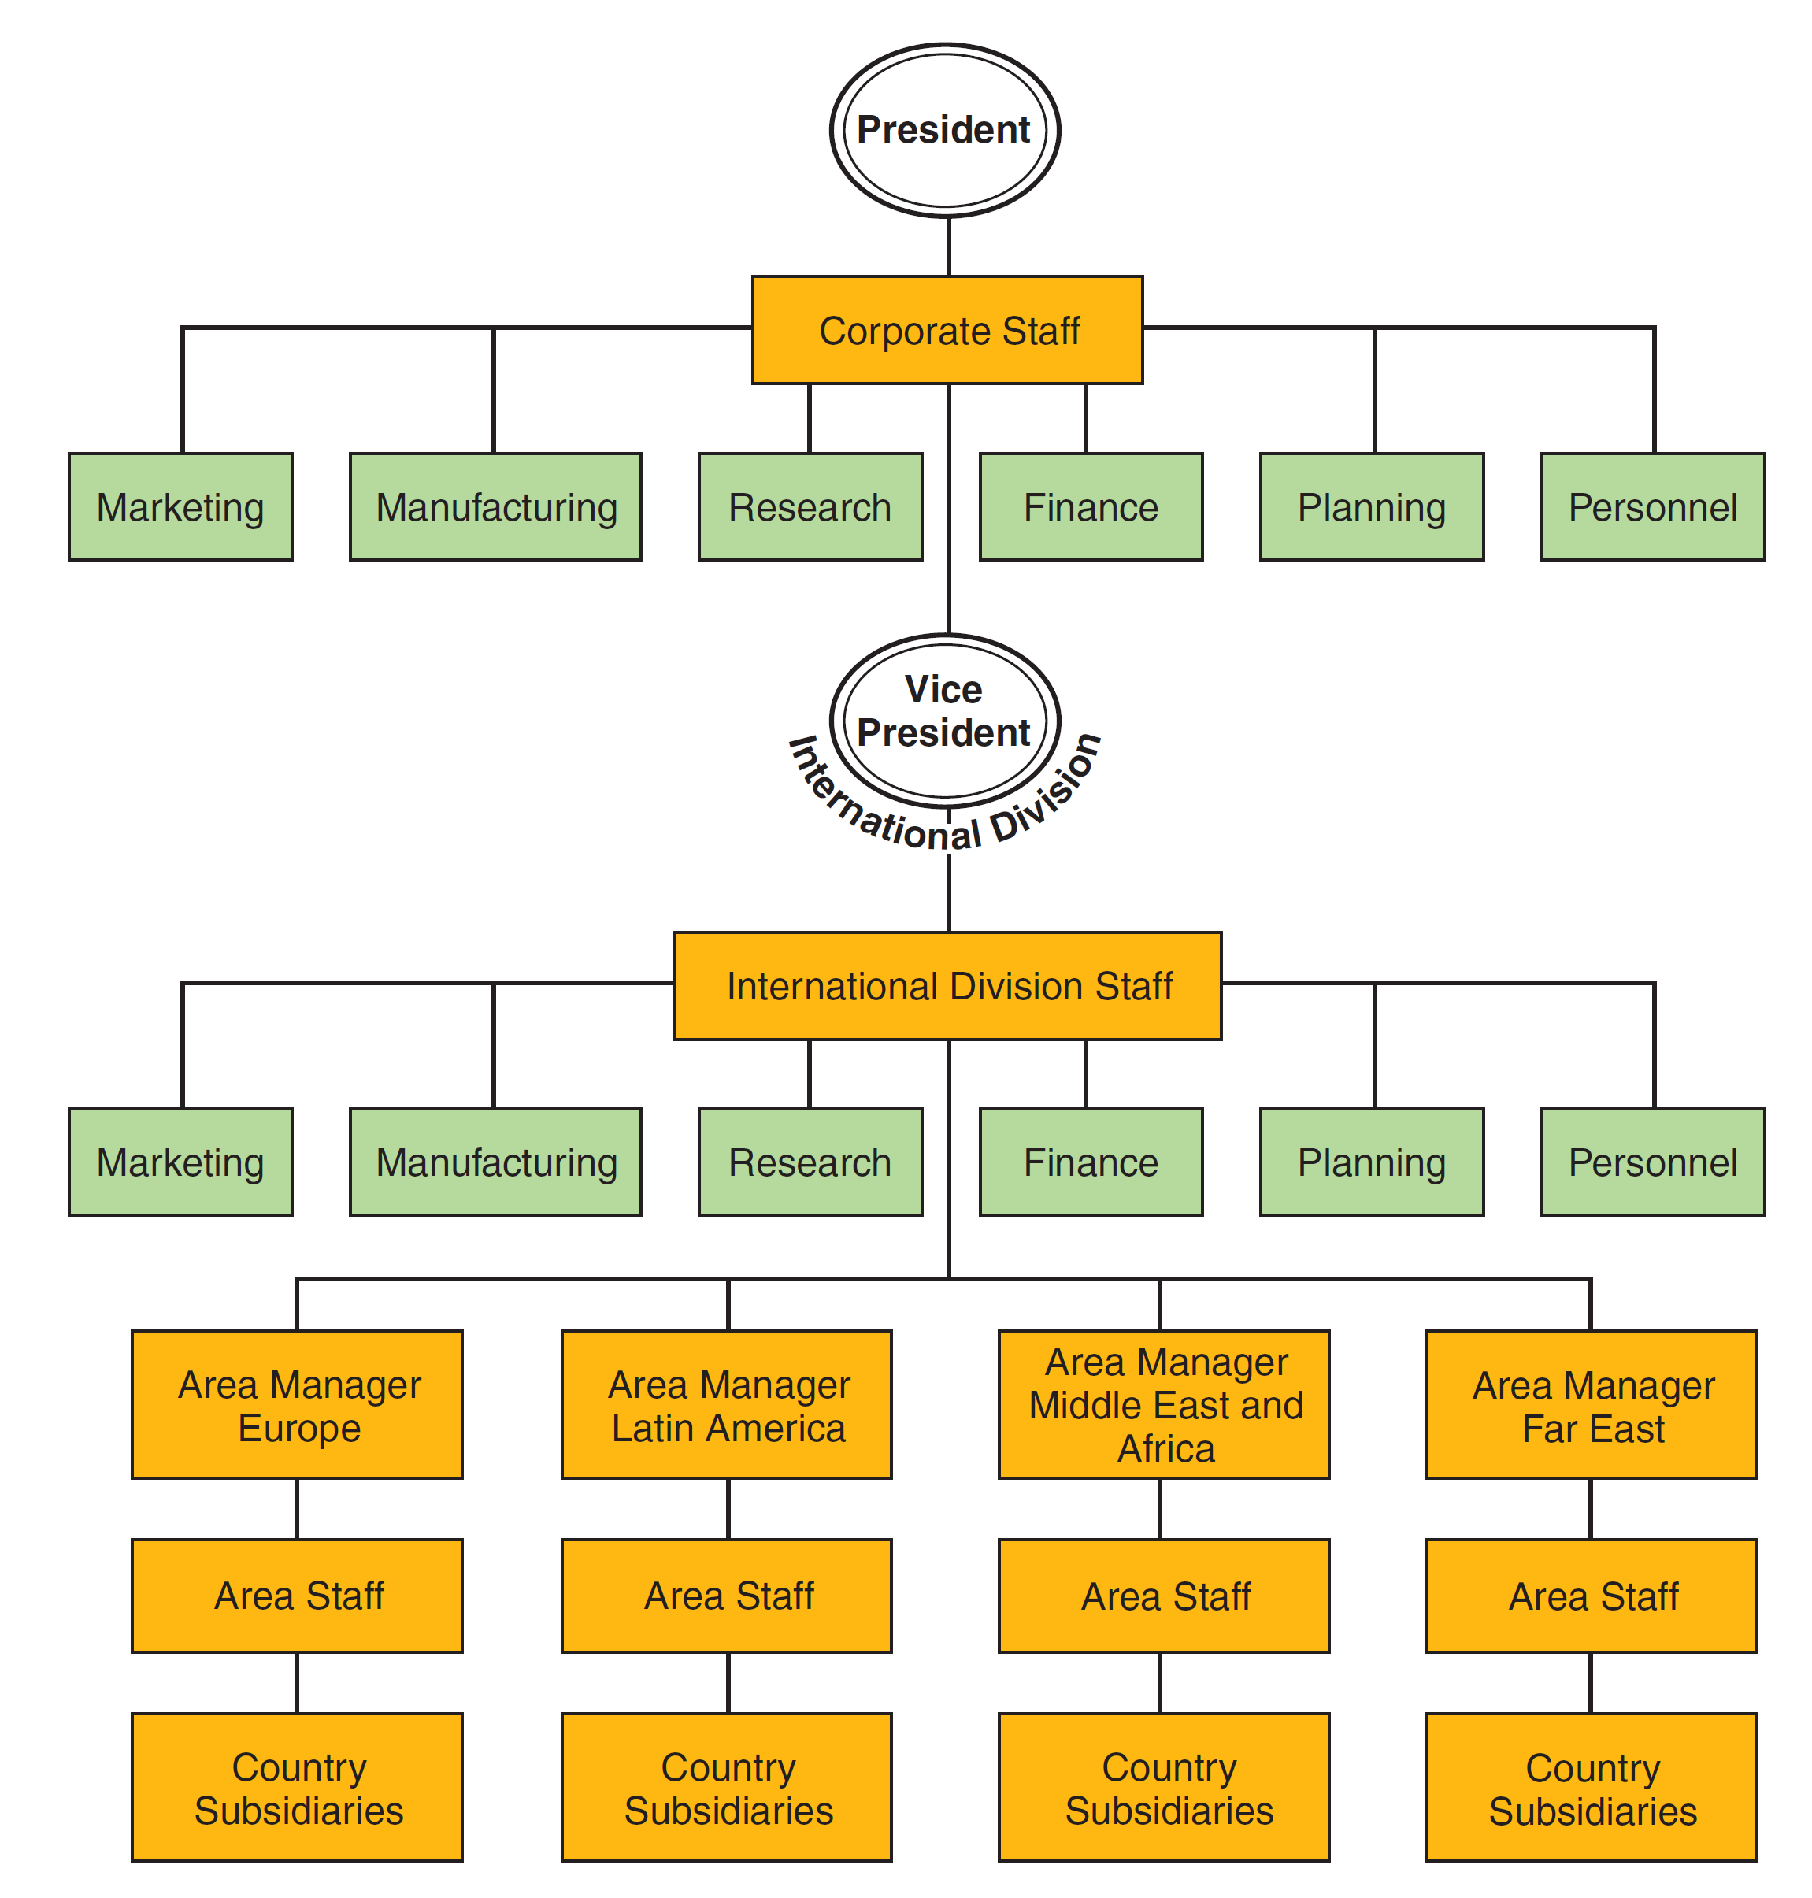
Geographical and Product Division Structures
Notes:
As a company becomes more global, management frequently faces the dilemma of whether to organize by geography or by product lines. The geographical structure involves the assignment of operational responsibility for geographic areas of the world to line managers. The corporate headquarters retains responsibility for worldwide planning and control, and each area of the world—including the “home” or base market—is organizationally equal. When an organization assigns regional or worldwide product responsibility to its product divisions, manufacturing standardization can result in significant economies.
This structure is most common in companies with closely related product lines that are sold in similar end-use markets around the world. For example, the major international oil companies utilize the geographical structure, which is illustrated in Figure 16-3. McDonald’s organizational design integrates the international division and geographical structures. McDonald’s U.S. is organized into five geographical operating divisions and McDonald’s International has four.

Slide 14
The Matrix Design
Product or business, function, area, and customer know-how are simultaneously focused on the organization’s worldwide marketing objectives
Management must achieve organizational balance that brings together different perspectives and skills to accomplish organizational objectives
Notes:
Professor John Hunt of the London Business School suggests four considerations regarding the matrix organizational design. First, the matrix is appropriate when the market is demanding and dynamic. Second, employees must accept higher levels of ambiguity and understand that policy manuals cannot cover every eventuality. Third, in country markets where the command-and-control model persists, it is best to overlay matrices on only small portions of the workforce. Finally, management must be able to clearly state what each axis of the matrix can and cannot do. However, this must be accomplished without creating a bureaucracy.

Slide 15
The Matrix Design
Geographic knowledge–understanding of economic, social, political, and governmental market and competitive dimensions
Product knowledge and know-how–product managers that have a worldwide responsibility can achieve new levels of product competency
Functional competence in areas like finance, production, and marketing
Customer, industry and needs
Notes:
Having established that the matrix is appropriate, management can expect the matrix to integrate four basic competencies on a worldwide basis.
Geographic Knowledge. An understanding of the basic economic, social, cultural, political, and governmental market and competitive dimensions of a country is essential. The country subsidiary is the major structural device employed today to enable the corporation to acquire geographical knowledge.
Product knowledge and know-how. Product managers with a worldwide responsibility can achieve this level of competence on a global basis. Another way of achieving global product competence is simply to duplicate product management organizations in domestic and international divisions, achieving high competence in both organizational units.
Competence in such fields as finance, production, and, especially, marketing. Corporate functional staff with worldwide responsibility contributes toward the development of functional competence on a global basis. In some companies, the corporate functional manager, who is responsible for the development of his or her functional activity on a global basis, reviews the appointment of country subsidiary functional managers
Knowledge of the customer or industry and its needs. Certain large and extremely sophisticated global companies have staff with a responsibility for serving industries on a global basis to assist the line managers in the country organizations in their efforts to penetrate specific customer markets.

Slide 16
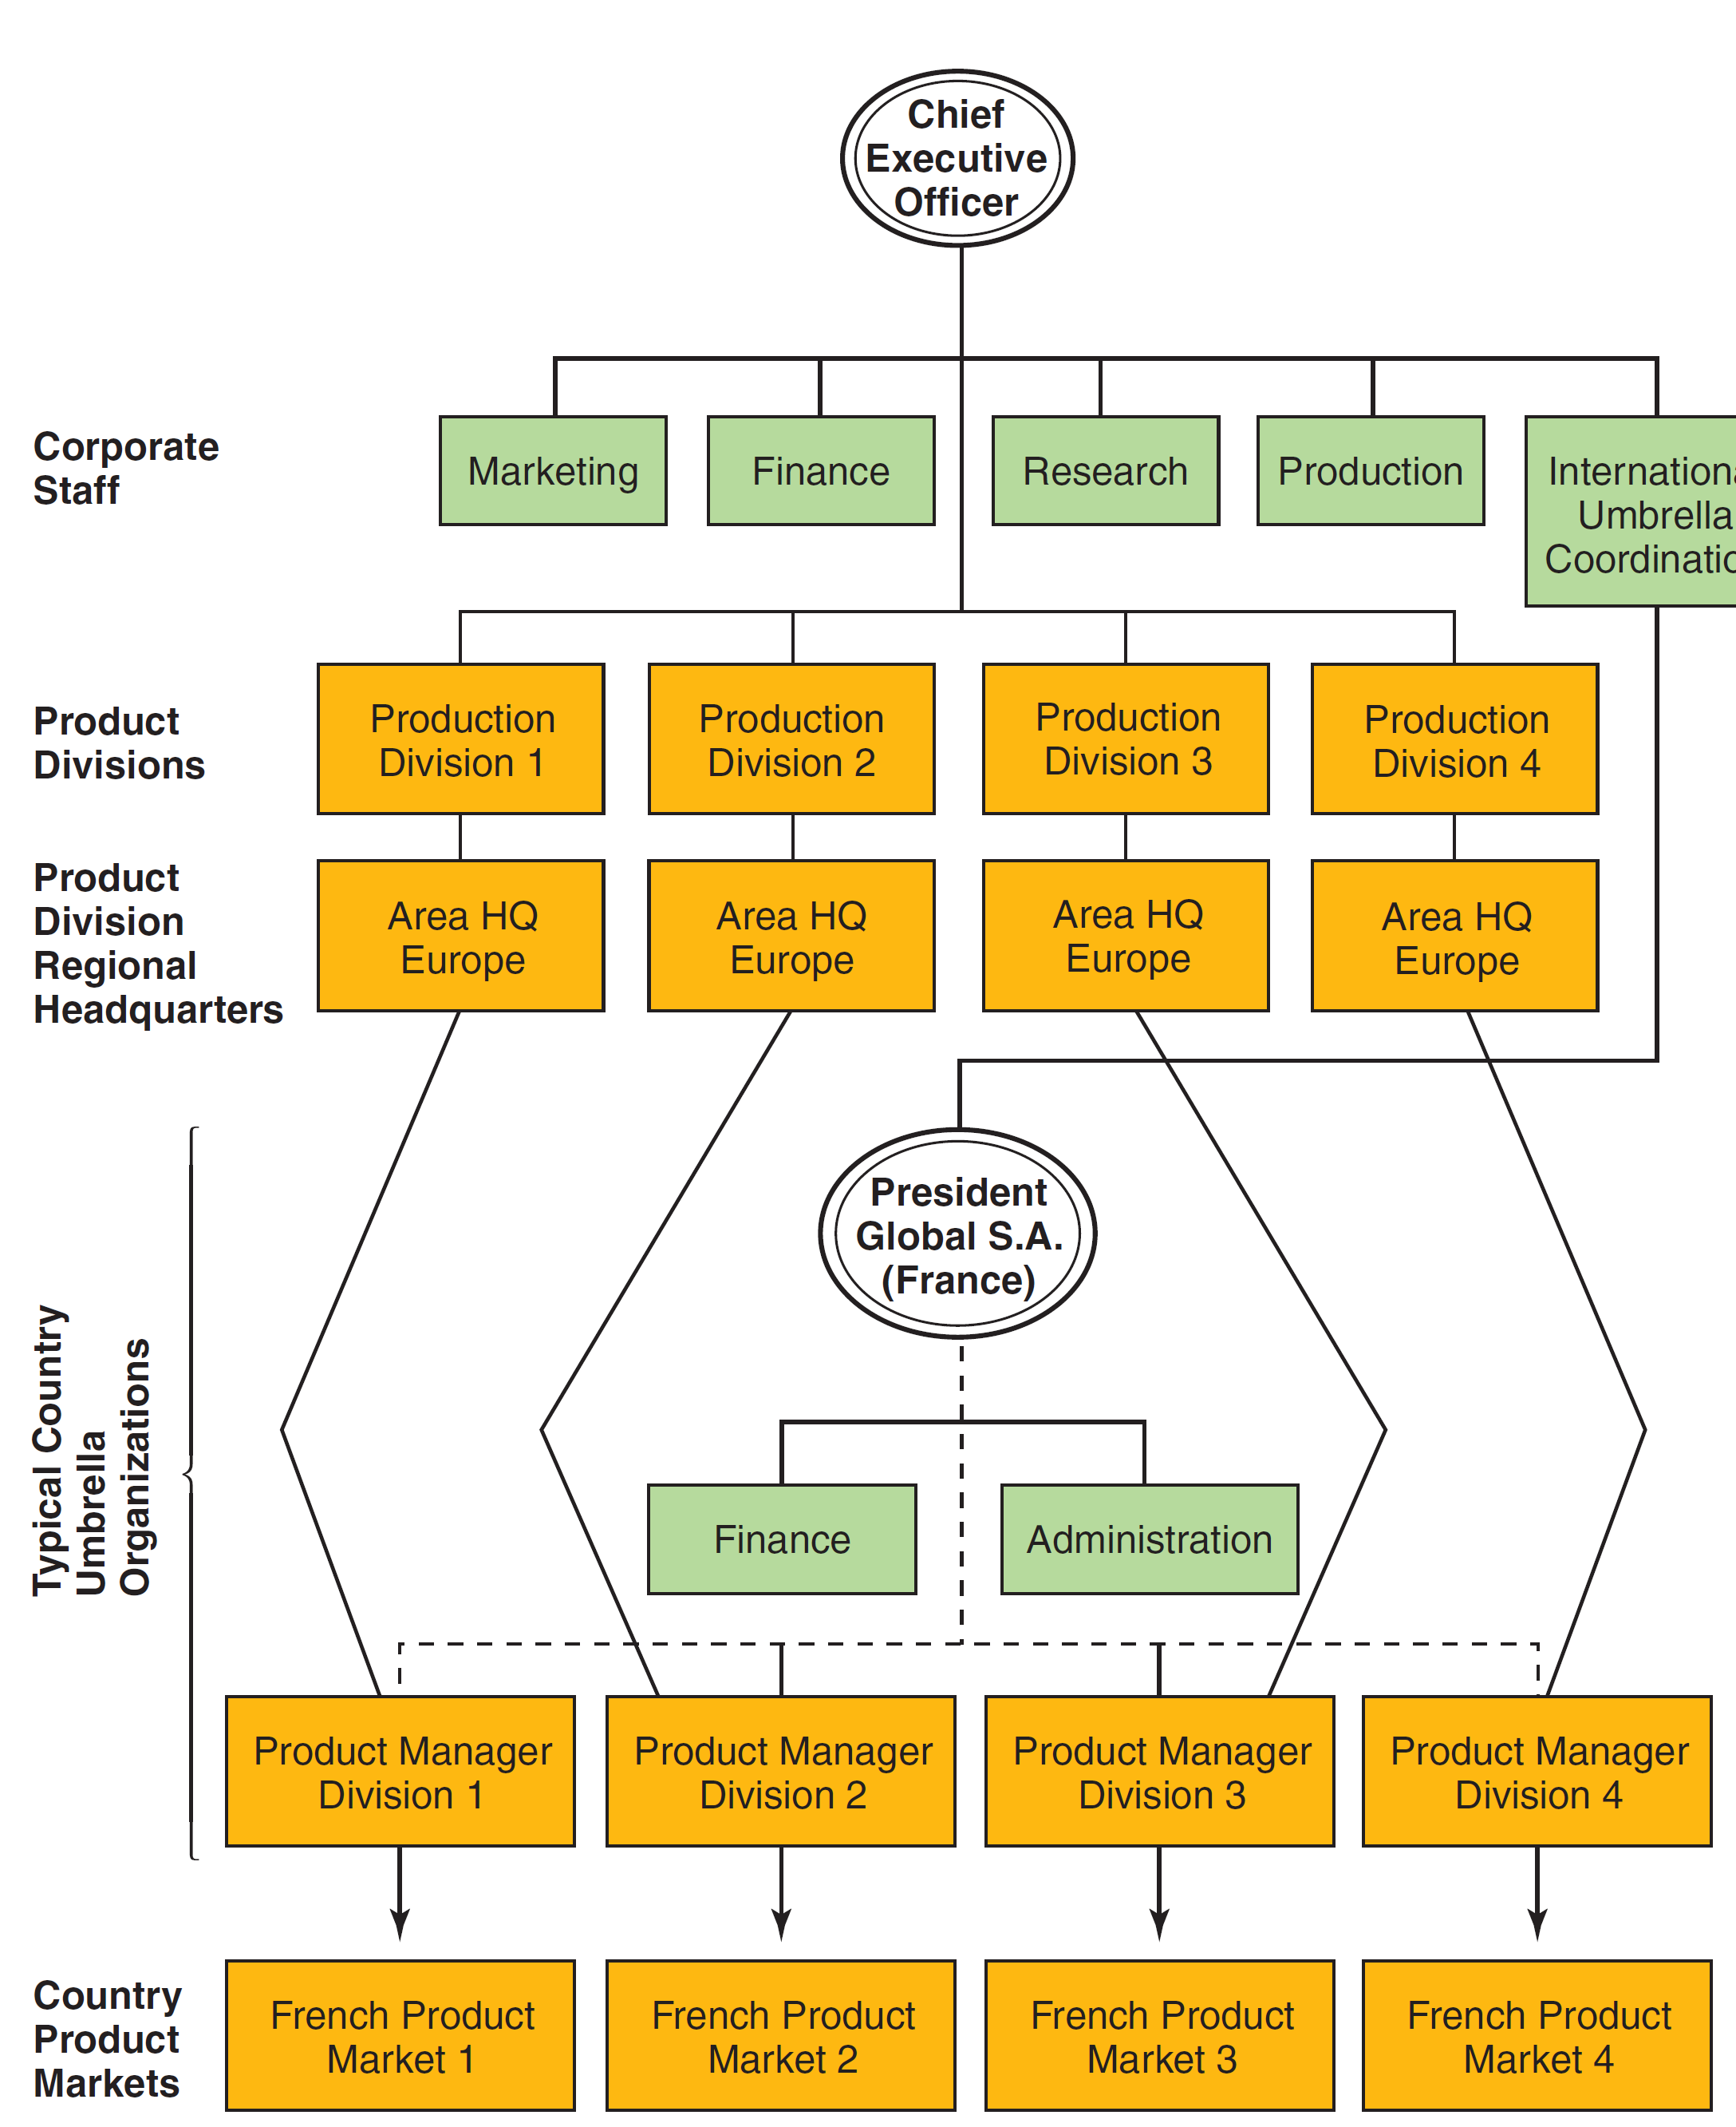
The Matrix Design
Notes:
This organization chart starts with a bottom section that represents a single-country responsibility level, moves to representing the area or international level, and finally moves to representing global responsibility from the product divisions to the corporate staff, to the chief executive at the top of the structure.

Slide 17
The Matrix Design
Functional competence – corporate staff with worldwide responsibility contributes toward the development of functional competence on a global basis
Knowledge of customer or industry and its needs – staff with responsibility for serving industries on a global basis assist organizations in their efforts to penetrate specific customer markets

Slide 18
Lean Production: Organizing the Japanese Way
Compares craft production, mass production, and lean production
Craft production meant one worker created one product
Mass production gained advantages because one worker could do far more specialized work due to the moving assembly line
Lean production uses less factory space, smaller inventories, and quality control methods; increased efficiency by 50% over typical mass production
Notes:
The mass producers—most notably Ford Motor Company—gained their substantial advantage by changing their value chains so that each worker was able to do far more work each day than the craft producers. The innovation that made this possible was the moving assembly line, which required the originators to conceptualize the production process in a totally new way. The assembly line also required a new approach to organizing people, production machinery, and supplies. By rearranging their value chain activities, the mass producers were able to achieve reductions in effort ranging from 62 percent to 88 percent over the craft producers. These productivity improvements provided an obvious competitive advantage.
The Toyota Production System (TPS), as the Japanese company’s manufacturing methods are known, achieves efficiencies of about 50 percent over typical mass production systems. Even with the reduced assembly time, the lean producer’s vehicles have significantly fewer defects than the mass-produced vehicles. The lean producer is also using about 40 percent less factory space and maintaining only a fraction of the inventory stored by the mass producer.

Slide 19
Lean Production
Assembler Value Chains
Skilled employees, Kaizen—continuous improvement enables quality control
Flexible mechanization is the hallmark of lean production
Downstream Value Chains
Eliminates conflict between producer and intermediaries, spirit of cooperation
Notes:
Employee ability is emphasized in a lean production environment. Before being hired, people seeking jobs with Toyota participate in the Day of Work, a 12-hour assessment test to determine who has the right mix of physical dexterity, team attitude, and problem-solving ability. Once hired, workers receive considerable training to enable them to perform any job in their section of the assembly line or area of the plant, and they are assigned to teams in which all members must be able to perform the functions of all other team members. Workers are also empowered to make suggestions and to take actions aimed at improving quality and productivity. Quality control is achieved through kaizen, a devotion to continuous improvement that ensures that every flaw is isolated, examined in detail to determine the ultimate cause, and then corrected.
Mechanization, and particularly flexible mechanization, is a hallmark of lean production. For example, a single assembly line in Georgetown, Kentucky, that produces Toyota’s Camry sedan also produces the Sienna minivan. The Sienna and Camry share the same basic chassis and 50 percent of their parts. Of the 300 different stations on the line, only 26 stations require different parts to assemble minivans.
The differences between lean producers and U.S. mass producers in the way they deal with their respective dealers, distributors, and customers are as dramatic as the differences in the way they deal with their suppliers. U.S. mass producers follow the basic industry model and maintain an “arm’s-length” relationship with dealers that is often characterized by a lack of cooperation and even open hostility. There is often no sharing of information because there is no incentive to do so. The manufacturer is often trying to force on the dealer models the dealer knows will not sell. The dealer, in turn, is often trying to pressure the customer into buying models he or she does not want.
In Japan, the dealer’s employees are true product specialists. They know their products and deal with all aspects of the products, including financing, service, maintenance, insurance, registration and inspection, and delivery. Further, dealer representatives are included on the manufacturer’s product development teams and provide continuous input regarding customer desires. The linkages between dealers, marketing divisions, and product development teams are totally optimized.

Slide 20
Ethics, CSR & Social Responsiveness
Today’s CEO must be a proactive steward of the firm
He or she must respond to:
Stakeholders—managers, employees, customers, stockholders, suppliers
Secondary stakeholders—general business community, local community groups, and nongovernmental organizations (NGOs)
Notes:
Nongovernmental organizations (NGOs) include Oxfam, Greenpeace, and Amnesty International. Stakeholder analysis is the process of formulating a “win-win” outcome for all stakeholders

Slide 21
Corporate Social Responsibility
An obligation to pursue goals and practices that are in the best interest of society
Many companies create a formal Code of Ethics that summarize core ideologies, corporate values, and expectations
Notes:
For many years, Jack Welch, the legendary former CEO of GE, challenged his employees to take an informal “mirror test.” The challenge: “Can you look in the mirror every day and feel proud of what you’re doing?” Today, GE uses more formal approaches to ethics and compliance; it has produced training videos, instituted an online training program, and provides employees with a guide to ethical conduct titled Spirit and Letter.

Slide 22
Corporate Responsibility
“Consumers are demanding more than ‘product’ from their favorite brands. Employees are choosing to work for companies with strong values. Shareholders are more inclined to invest in businesses with outstanding corporate reputations. Quite simply, being socially responsible is not only the right thing to do; it can distinguish a company from its industry peers.”
-Starbucks Web site

Slide 23
Corporate Social Responsibility
“Perhaps we have the opportunity to be a different type of global company, a global brand that can build a different model, a company that is a global business, that makes a profit, but at the same time demonstrates a social conscience and gives back to the local market.”
-Howard Schultz, CEO, Starbucks, responding to a question about the likelihood of anti-globalization activists

Slide 24
Issues in CSR
How do CEOs decide what is in the best interest of society?
Bangladeshi children lost garment industry jobs after the U.S. threatened trade sanctions and the children were worse off
Nike has been criticized for alleged poor working conditions in its factories
Wal-Mart has been under fire for a number of reasons including labor practices, resulting in social repercussions in communities it serves
Notes:
As retail gasoline prices soared in the United States following the devastation of Hurricane Katrina, BP, Royal Dutch Shell, and other companies were accused of gouging. The American Petroleum Institute, the industry’s trade group, launched a national TV advertising campaign aimed at explaining its business and urging conservation.
CEO pay in the United States is rising faster than average salaries and much faster than inflation. One study found that in 2004, CEOs were paid 431 times more than the average worker.

