Slide 1
Beyond the Hospital Door: Strengthening Health Systems Through Nurses
Osama A Samarkandi, PhD, NIAC
BSc, GMD, BSN, MSN-RN

Slide 2
Objectives;
Discuss the essential pillars of a health system in the world community
1
Explain emerging innovations in nursing and health care
2
Articulate the relationship between an educated workforce and walking beyond the hospital door
3

Slide 3
Introduction;
1
Health systems are being developed to address the needs of families and community throughout the world community,
Health systems are organizations, individuals, and actions whose primary purpose is to promote, restore or maintain health, *
2
Innovations in nursing and health care unite through the six pillars of health systems
3
* WHO, 2008

Slide 4
Six Pillars of Health Systems;

Slide 5
Six Pillars of Health Systems
✓
1
Service Delivery: Management and Quality of Service
✓
2
Health Workforce: Nurses and other Key Health Professionals
3
Health Information and Knowledge Systems: Innovation and Scientific and Practical Knowledge
✓
4
Medical Products, Vaccines, and Technologies: Access to drugs and equipment
5
Health Financing: Stable and adequate funds
Leadership and Governance: Stewardship, Vision and Oversight of Health System
6

Slide 6
Three of the Six Pillars for Health Systems; 1/3
Service Delivery Systems
Questions to be asked
1
Service Delivery Systems, should deliver high quality, safe, and effective health interventions with well trained professionals and lay people to individuals who need them, when needed, where needed, with minimum waste of resources.
Q
How are inputs and services organized and managed?
Is attention given to demand for Service, cultural and socioeconomic needs?
Are services based on a profile of nation’s or community’s health needs?
Is the provider network organized and of high quality?
Is duplication of services and tests monitored and costs controlled?
Is there continuity of care across the life span and the various settings (home, hospital, community)?

Slide 7
Three of the Six Pillars for Health Systems; 2/3
Health Workforce Systems
Questions to be asked
2
Health Workforce Systems, should deliver high quality, safe, and effective health interventions with well trained professionals and lay people to individuals who need them, when needed, where needed, with minimum waste of resources.
Q
How are inputs and services organized and managed?
Is attention given to demand for Service, cultural and socioeconomic needs?
Are services based on a profile of nation’s or community’s health needs?
Is the provider network organized and of high quality?
Is duplication of services and tests monitored and costs controlled?
Is there continuity of care across the life span and the various settings (home, hospital, community)?

Slide 8
Three of the Six Pillars for Health Systems; 3/3
Health Information System
Questions to be asked
3
Health Information System, Designed to ensure the accurate and reliable use of information on health determinants, health status, and health Systems performance.
Q
Population based data: censuses and household surveys and medical records; and health system resources (e.g. health infrastructure and financing),
Detect and communicate events that threaten public health security—where and when they occur,
Synthesize information and promote new science and knowledge)?

Slide 9
Significance of the Three Pillars for Nurses in the Global Community;
Service Delivery Systems
Health Workforce Systems
Health Information System
1
Provide Quality Health Care Disease Prevention and Management,
Support Patients in Behavioral Change Across the Life Span,
Practice Culturally Competent Care,
Participate in Health Policy Decisions; Generate New Knowledge,
Utilize Technology and Data Analysis for Health.
*
2
Nurse Work Force
Introduce new technologies to increase efficiency, effectiveness, and safety for patients and nurses,
Retain existing workers, including those who could retire,
Educate a new generation of nurses with advanced knowledge and skills to work in Communities, Schools, Hospitals, & Clinics in all Geographical Settings
*.
3
Develop health sector policies
Create national policies that reflect basic human rights, and gender equality.
Regulatory framework
Design and monitor health related laws, standards– regulate medical products, vaccines and
Technologies, and assure workplace safety for nurses and others.
Accountability
Require monitoring of health outcomes, health information, and costs.
Generate and Implement Culturally Competent Policies and Health Systems
Use knowledge and science for prevention through community based health programs in schools, villages, and mosques.
Build coalitions
Government ministries, religious organizations, schools, and community leaders should act to eliminate the determinants of poor health---nurses work beyond the hospital doors.
*
Notes:
Develop health sector policies
Create national policies that reflect basic human rights, and gender equality.
Regulatory framework
Design and monitor health related laws, standards– regulate medical products, vaccines and
Technologies, and assure workplace safety for nurses and others.
Accountability
Require monitoring of health outcomes, health information, and costs.
Generate and Implement Culturally Competent Policies and Health Systems
Use knowledge and science for prevention through community based health programs in schools, villages, and mosques.
Build coalitions
Government ministries, religious organizations, schools, and community leaders should act to eliminate the determinants of poor health---nurses work beyond the hospital doors.

Slide 10
*

Slide 11
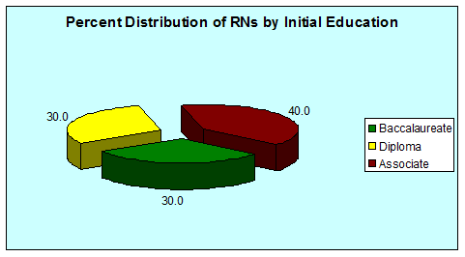
Source: Spratley, E., Johnson, A., Sochalski, J., Fritz, M., and Spencer, W. (2000). The Registered Nurse Population. USHHS, Health Resources and Service Administration, Bureau of Health Professions, Division of Nursing, p. 9.

Slide 12
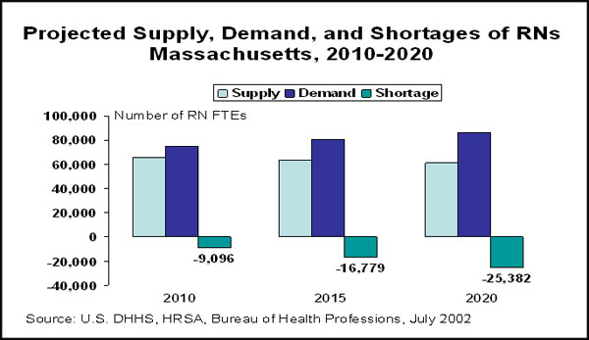
A chartbook, Workforce Facts & Trends at a Glance: The Hospital Leader's Guide was developed as a companion resource to the report.
http://www.patientcarelink.org/Workforce/Our-Workforce-Needs.aspx

Slide 13
Significance of the Three Pillars for Nurses in the Global Community;
The rate of nurses is 28 nurses /10,000 people (one nurse for 357 people).
Ireland; 1:101 Japan ; 1:206
New Zealand; 1:102 Spain ; 1:208
Australia; 1:105 UK ; 1:222
USA; 1:123 Taiwan ; 1:292
Canada; 1:134 Denmark ; 1:730
The total number of nurses is 75,978. The number of Saudi nurses is 37,009 (48.71% of total).
MOH, 1431
The International Labour Market 2010

Slide 14
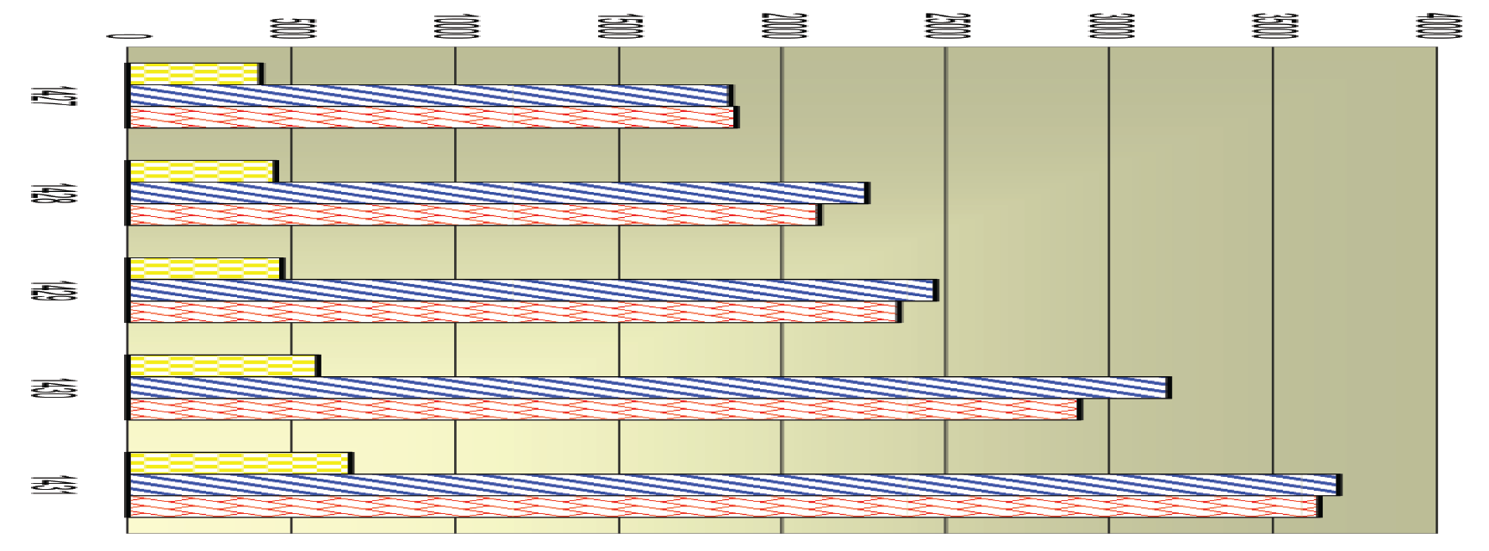
Trends in Saudi Manpower (Medical Categories) MOH 1427 - 1431 H;
MOH, 1431 H; Physicians, Nurses, Allied Health Professionals

Slide 15
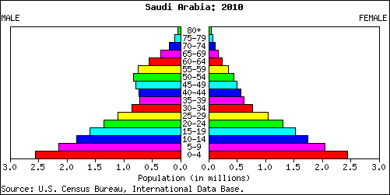
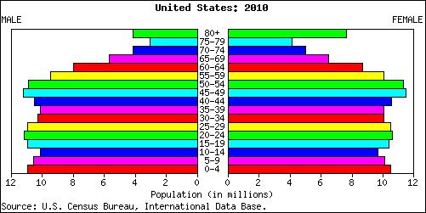
Saudi’s Population Profile Comparing to USA
*

Slide 16
Significance of the Three Pillars for Nurses in the Global Community;
Deliver Primary Health Care in all Geographical Setting, through Integrated Systems, with A Focus on Individual and Population Needs
Manage Chronic Diseases through Local and Regional Networks
Assist with Redesigning Health systems that have Cores in Prevention, Wellness, Self-Care, Early Detection, and Access to Quality Care
Improve Quality and Safety Across all Levels of Health Care
Assume Leadership Roles in Health Organizations at the Local, Regional, and National Levels

Slide 17
World Health Organization’s Primary Care Recommendation;
Essential Snippets
Integration of Health Care Across Regions, Systems, and Disciplines
Usage of Information and technology
Knowledgeable and Skillful Nurse workforce
Infrastructure Expansion Including Expanded Roles of Nurses
Clear Financial and System Performance Monitoring and Transparency

Slide 18
Conclusion; 1/2
Throughout the World Community, Nurses Provide Care in Different Geographical Settings, Across the Life Span, and to all Groups of People
The Future Suggests that Primary Care Will Become More Dominant in Health Systems as They Address Prevention, Early Detection, Access to Care, Disease Management, and Health Education

Slide 19
Conclusion;
Nurses will Also Focus on Individuals and Communities, and Become Engaged in Integrating Health Systems, Health Literacy, and Wellness Program
Knowledge and Skill Sets for Nurses will Expand in Scope and Complexity and Must be Accompanied by Advanced Practice and Research Expertise

Slide 20
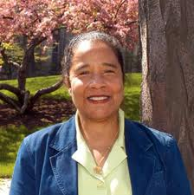
Recognition …!
Faye Gary, EdD, RN, FAAN
The Medical Mutual of Ohio Kent W. Clapp Chair & Professor of Nursing
Associate Dean for Minority Affairs and Health Disparities
Frances Payne Bolton School of Nursing
Case Western Reserve University
Cleveland, Ohio - USA

