Slide 1
Global Edition Chapter Three
Analyzing the Marketing Environment
Copyright ©2014 by Pearson Education

Slide 2
Analyzing the Marketing Environment
Microenvironment
Macroenvironemnt
Demographic Environment
Economic Environment
Natural Environment
Technological Environment
Political and Social Environment
Cultural Environment
Responding to the Marketing Environment
Copyright ©2014 by Pearson Education

Slide 3
The Marketing Environment
The marketing environment includes the actors and forces outside marketing that affect marketing management’s ability to build and maintain successful relationships with customers
Copyright ©2014 by Pearson Education

Slide 4
The Marketing Environment
Microenvironment consists of the actors close to the company that affect its ability to serve its customers, the company, suppliers, marketing intermediaries, customer markets, competitors, and publics
Copyright ©2014 by Pearson Education

Slide 5
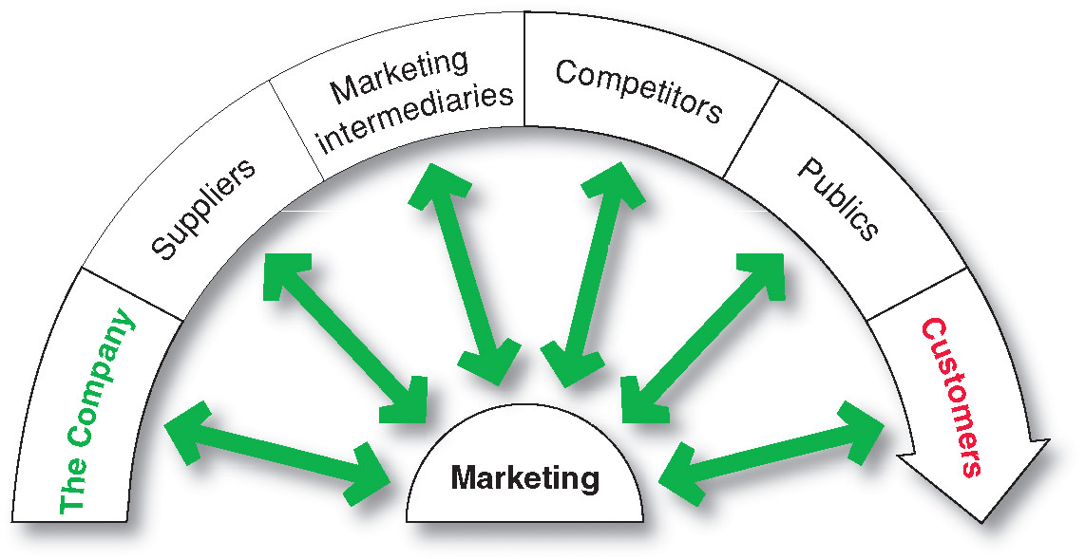
The Company’s Microenvironment
Actors in the Microenvironment
Copyright ©2014 by Pearson Education

Slide 6
The Company’s Microenvironment
The Company
Top management
Finance
R&D
Purchasing
Operations
Accounting
Copyright ©2014 by Pearson Education

Slide 7
The Company’s Microenvironment
Suppliers
Provide the resources to produce goods and services
Treat as partners to provide customer value
Copyright ©2014 by Pearson Education

Slide 8
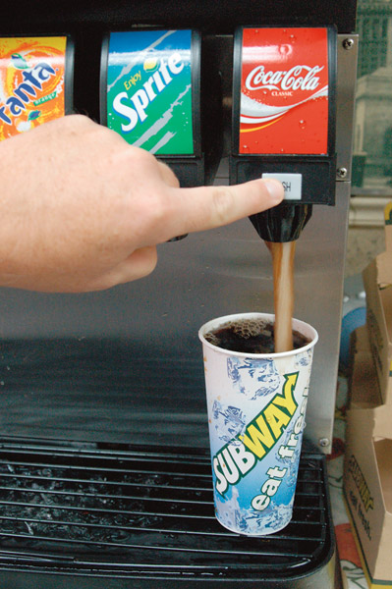
The Company’s Microenvironment
Marketing Intermediaries
Help the company to promote, sell and distribute its products to final buyers
Copyright ©2014 by Pearson Education

Slide 9
The Company’s Microenvironment
Types of Marketing Intermediaries
Resellers
Physical distribution firms
Marketing services agencies
Financial intermediaries
Copyright ©2014 by Pearson Education

Slide 10
The Company’s Microenvironment
Competitors
Firms must gain strategic advantage by positioning their offerings against competitors’ offerings
Copyright ©2014 by Pearson Education

Slide 11
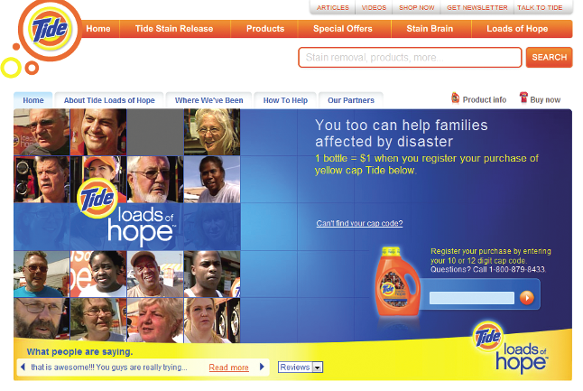
The Company’s Microenvironment
Publics
Any group that has an actual or potential interest in or impact on an organization’s ability to achieve its objectives
Financial publics
Media publics
Government publics
Citizen-action publics
Local publics
General public
Internal publics
Copyright ©2014 by Pearson Education

Slide 12
The Company’s Microenvironment
Customers
Consumer markets
Business markets
Government markets
International markets
Copyright ©2014 by Pearson Education

Slide 13
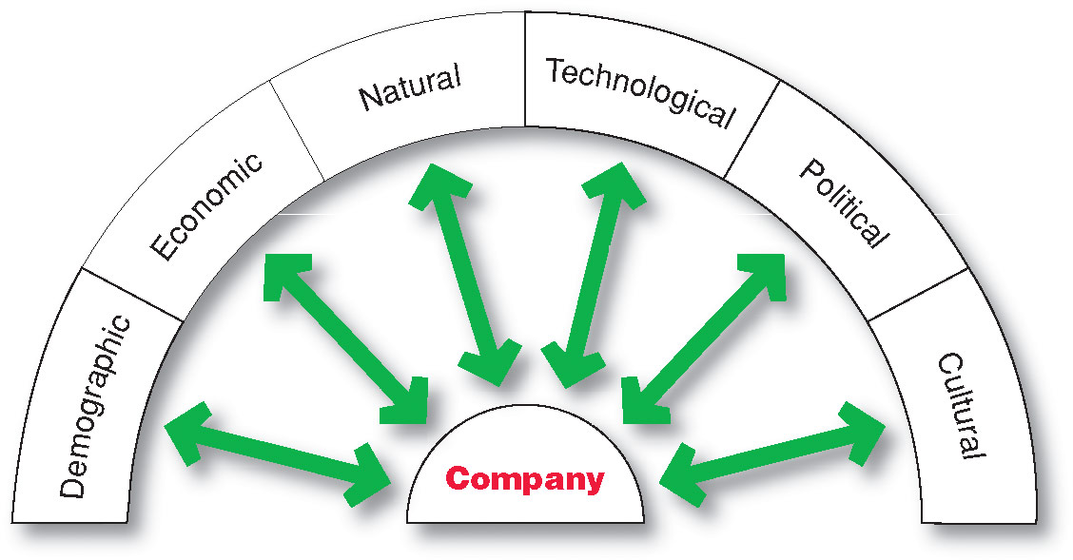
The Company’s Macroenvironment
Copyright ©2014 by Pearson Education

Slide 14
The Company’s Macroenvironment
Demographic Environment
Demography: the study of human populations-- size, density, location, age, gender, race, occupation, and other statistics
Demographic environment: involves people, and people make up markets
Demographic trends: shifts in age, family structure, geographic population, educational characteristics, and population diversity
Copyright ©2014 by Pearson Education

Slide 15
The Company’s Macroenvironment
Demographic Environment
Baby Boomers
Born 1946 to 1964
rethinking the purpose and value of their work, responsibilities, and relationships.
spending more carefully and planning to work longer
the wealthiest generation in U.S. history
Copyright ©2014 by Pearson Education

Slide 16
The Company’s Macroenvironment
Demographic Environment
Generation X includes people born between 1965 and 1976
High parental divorce rates
Cautious economic outlook
Less materialistic
Family comes first
Copyright ©2014 by Pearson Education

Slide 17
The Company’s Macroenvironment
Demographic Environment
Millennials (gen Y or echo boomers) include those born between 1977 and 2000
Most financially strapped generation
Higher unemployment and saddled with more debt
Comfortable with technology
Copyright ©2014 by Pearson Education

Slide 18
The Company’s Macroenvironment
Demographic Environment
Generational marketing is important in segmenting people by lifestyle of life state instead of age
Copyright ©2014 by Pearson Education

Slide 19
The Company’s Macroenvironment
Demographic Environment
Changing American Family
More people are:
Divorcing or separating
Choosing not to marry
Choosing to marry later
Marrying without intending to have children
Increasing number of working women
Increasing number of stay-at-home dads
Copyright ©2014 by Pearson Education

Slide 20
The Company’s Macroenvironment
Demographic Environment
Geographic Shifts in Population
Growth in U.S. West and South and decline in Midwest and Northeast
Change in where people work
Telecommuting
Home office
Copyright ©2014 by Pearson Education

Slide 21
The Company’s Macroenvironment
Demographic Environment
Changes in the Workforce
More educated
More white collar
Copyright ©2014 by Pearson Education

Slide 22
The Company’s Macroenvironment
Demographic Environment
Increasing Diversity
Markets are becoming more diverse
International
National
Includes:
Ethnicity
Gay and lesbian
Disabled
Copyright ©2014 by Pearson Education

Slide 23
The Company’s Macroenvironment
Economic Environment
Economic environment consists of factors that affect consumer purchasing power and spending patterns
Industrial economies are richer markets
Subsistence economies consume most of their own agriculture and industrial output
Copyright ©2014 by Pearson Education

Slide 24
The Company’s Macroenvironment
Economic Environment
Changes in Consumer Spending
Value marketing
offering financially cautious buyers greater value—
the right combination of quality and service at a fair price
Copyright ©2014 by Pearson Education

Slide 25
The Company’s Macroenvironment
Natural Environment
Natural environment: natural resources that are needed as inputs by marketers or that are affected by marketing activities
Trends
Increased shortages of raw materials
Increased pollution
Increased government intervention
Increased environmentally sustainable strategies
Copyright ©2014 by Pearson Education

Slide 26
The Company’s Macroenvironment
Technological Environment
Most dramatic force in changing the marketplace
New products, opportunities
Concern for the safety of new products
Copyright ©2014 by Pearson Education

Slide 27
The Company’s Macroenvironment
Political and Social Environment
Legislation regulating business
Increased legislation
Changing government agency enforcement
Copyright ©2014 by Pearson Education

Slide 28
The Company’s Macroenvironment
Political and Social Environment
Increased emphasis on ethics
Socially responsible behavior
Cause-related marketing
Copyright ©2014 by Pearson Education

Slide 29
The Company’s Macroenvironment
Cultural Environment
Cultural environment consists of institutions and other forces that affect a society’s basic values, perceptions, and behaviors
Copyright ©2014 by Pearson Education

Slide 30
The Company’s Macroenvironment
Cultural Environment
Persistence of Cultural Values
Core beliefs and values are persistent and are passed on from parents to children and are reinforced by schools, churches, businesses, and government
Secondary beliefs and values are more open to change and include people’s views of themselves, others, organization, society, nature, and the universe
Copyright ©2014 by Pearson Education

Slide 31
The Company’s Macroenvironment
Cultural Environment
Shifts in Secondary Cultural Values
People’s view of themselves
People vary in their emphasis on
serving themselves versus serving others.
People’s view of others
More “cocooning” – staying home, home cooked meals
Copyright ©2014 by Pearson Education

Slide 32
The Company’s Macroenvironment
Cultural Environment
Shifts in Secondary Cultural Values
People’s view of organizations
Decline of loyalty toward companies
People’s view of society
Patriots defend it
Reformers want to change it
Malcontents want to leave it
Copyright ©2014 by Pearson Education

Slide 33
The Company’s Macroenvironment
Cultural Environment
Shifts in Secondary Cultural Values
People’s view of nature
Some feel ruled by it
Some feel in harmony with it
Some seek to master it
People’s view of the universe
Renewed interest in spirituality
Developed more permanent values
family, community, earth,
spirituality, ethics
Copyright ©2014 by Pearson Education

Slide 34
Responding to the Marketing Environment
Views on Responding
Uncontrollable
React and adapt to forces in the environment
Proactive
Aggressive actions to affect forces in the environment
Reactive
Watching and reacting to forces in the environment
Copyright ©2014 by Pearson Education

