Slide 1
Chapter Nine
New-Product Development and Product Life-Cycle Strategies
Copyright ©2014 by Pearson Education, Inc. All rights reserved

Slide 2
New-Product Development and Product Life-Cycle Strategies
Topic Outline
New-Product Development Strategy
New-Product Development Process
Managing New-Product Development
Product Life-Cycle Strategies
Additional Product and Service Considerations
Copyright ©2014 by Pearson Education, Inc. All rights reserved

Slide 3
New-Product Development Strategy
Two ways to obtain new products
Acquisition refers to the buying of a whole company, a patent, or a license to produce someone else’s product
New product development refers to original products, product improvements, product modifications, and new brands developed from the firm’s own research and development
Copyright ©2014 by Pearson Education, Inc. All rights reserved

Slide 4
New-Product Development Process
Major Stages in New-Product Development
Copyright ©2014 by Pearson Education, Inc. All rights reserved

Slide 5
New-Product Development Process
Idea Generation
Idea generation is the systematic search for new-product ideas
Sources of new-product ideas
Internal
External
Copyright ©2014 by Pearson Education, Inc. All rights reserved
Notes:
.

Slide 6
New-Product Development Process
Idea Generation
Internal sources refer to the company’s own formal research and development, management and staff, and intrapreneurial programs
External sources refer to sources outside the company such as customers, competitors, distributors, suppliers, and outside design firms
Copyright ©2014 by Pearson Education, Inc. All rights reserved
Notes:
.

Slide 7
New-Product Development Process
Crowdsourcing
Inviting broad communities of people—
customers, employees, independent
scientists and researchers, and even the
public at large—into the new-product
innovation process.
Copyright ©2014 by Pearson Education, Inc. All rights reserved

Slide 8
New-Product Development Process
Idea Screening
Identify good ideas and drop poor ideas
R-W-W Screening Framework:
Is it real?
Can we win?
Is it worth doing?
Copyright ©2014 by Pearson Education, Inc. All rights reserved

Slide 9
New-Product Development Process
Concept Development and Testing
Product idea is an idea for a possible product that the company can see itself offering to the market
Product concept is a detailed version of the idea stated in meaningful consumer terms
Product image is the way consumers perceive an actual or potential product
Copyright ©2014 by Pearson Education, Inc. All rights reserved

Slide 10
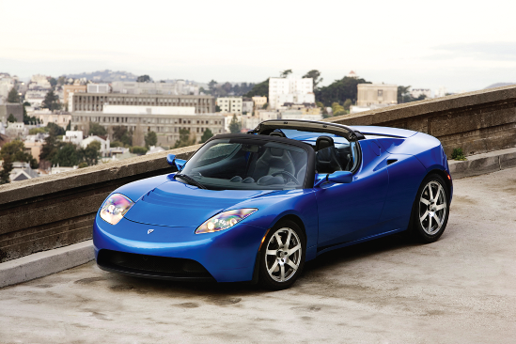
New-Product Development Process
Concept Development and Testing
Concept testing refers to testing new-product concepts with groups of target consumers
Copyright ©2014 by Pearson Education, Inc. All rights reserved

Slide 11
New-Product Development Process
Marketing Strategy Development
Marketing strategy development refers to the initial marketing strategy for introducing the product to the market
Marketing strategy statement includes:
Description of the target market
Value proposition
Sales and profit goals
Copyright ©2014 by Pearson Education, Inc. All rights reserved

Slide 12
New-Product Development Process
Marketing Strategy Development
Business analysis involves a review of the sales, costs, and profit projections to find out whether they satisfy the company’s objectives
Copyright ©2014 by Pearson Education, Inc. All rights reserved

Slide 13
New-Product Development Process
Marketing Strategy Development
Product development
Involves the creation and testing of one or more physical versions by the R&D or engineering departments
Requires an increase in investment
Shows whether the product idea can be turned into a workable product.
Copyright ©2014 by Pearson Education, Inc. All rights reserved

Slide 14
New-Product Development Process
Marketing Strategy Development
Test marketing is the stage at which the product and marketing program are introduced into more realistic marketing settings
Provides the marketer with experience in testing the product and entire marketing program before full introduction
Copyright ©2014 by Pearson Education, Inc. All rights reserved

Slide 15
New-Product Development Process
Marketing Strategy Development
When firms test market
New product with large investment
Uncertainty about product or marketing program
When firms may not test market
Simple line extension
Copy of competitor product
Low costs
Management confidence
Copyright ©2014 by Pearson Education, Inc. All rights reserved

Slide 16
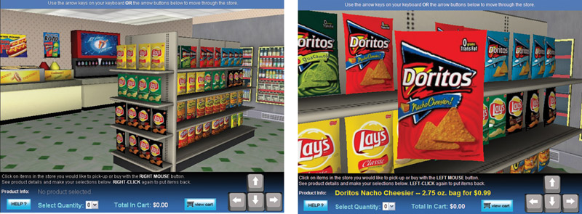
New-Product Development Process
Types of Test Markets
Simulated test markets
Standard test markets
Controlled test markets
Copyright ©2014 by Pearson Education, Inc. All rights reserved

Slide 17
New-Product Development Process
Marketing Strategy Development
Advantages of simulated test markets
Less expensive than other test methods
Faster
Restricts access by competitors
Disadvantages
Not considered as reliable and accurate due to the controlled setting
Copyright ©2014 by Pearson Education, Inc. All rights reserved

Slide 18
New-Product Development Process
Marketing Strategy Development
Commercialization is the introduction
of the new product
When to launch
Where to launch
Planned market
rollout
Copyright ©2014 by Pearson Education, Inc. All rights reserved

Slide 19
Managing New-Product Development
Successful new-product development should be:
Customer centered
Team-based
Systematic
Copyright ©2014 by Pearson Education, Inc. All rights reserved

Slide 20
Managing New-Product Development
New-Product Development Strategies
Customer-centered new product development new ways to solve customer problems and create more customer satisfying experiences
Copyright ©2014 by Pearson Education, Inc. All rights reserved

Slide 21
Managing New-Product Development
New-Product Development Strategies
Team-based new-product development Company departments work closely together in cross-functional teams, overlapping in the product-development process to save time and increase effectiveness
Copyright ©2014 by Pearson Education, Inc. All rights reserved

Slide 22
Managing New-Product Development
New-Product Development Strategies
Systematic new-product development
innovative development approach that collects, reviews, evaluates, and manages new-product ideas
Creates an innovation-oriented culture
Yields a large number of new-product ideas
Copyright ©2014 by Pearson Education, Inc. All rights reserved

Slide 23
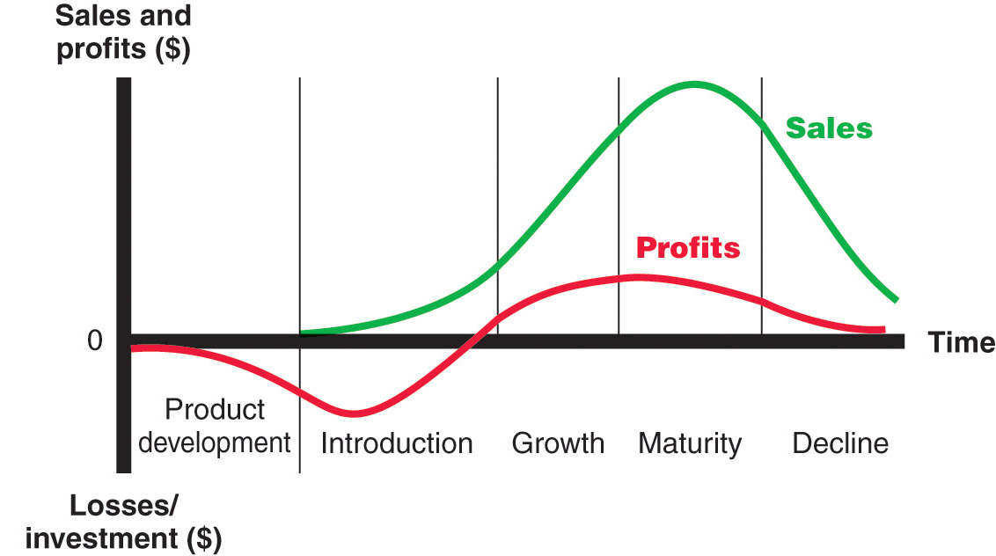
Product Life-Cycle Strategies
Product Life Cycle
Copyright ©2014 by Pearson Education, Inc. All rights reserved

Slide 24
Product Life-Cycle Strategies
Product development
Sales are zero and investment costs mount
Introduction
Slow sales growth and profits are nonexistent
Growth
Rapid market acceptance and increasing profits
Maturity
Slowdown in sales growth and profits level off or decline
Decline
Sales fall off and profits drop
Copyright ©2014 by Pearson Education, Inc. All rights reserved

Slide 25
Product Life-Cycle Strategies
Copyright ©2014 by Pearson Education, Inc. All rights reserved

Slide 26
Product Life-Cycle Strategies
Introduction Stage
Slow sales growth
Little or no profit
High distribution and promotion expense
Copyright ©2014 by Pearson Education, Inc. All rights reserved

Slide 27
Product Life-Cycle Strategies
Growth Stage
Sales increase
New competitors enter the market
Price stability or decline to increase volume
Consumer education
Profits increase
Promotion and manufacturing costs gain economies of scale
Copyright ©2014 by Pearson Education, Inc. All rights reserved

Slide 28
Product Life-Cycle Strategies
Maturity Stage
Slowdown in sales
Many suppliers
Substitute products
Overcapacity leads to competition
Increased promotion and R&D to support sales and profits
Copyright ©2014 by Pearson Education, Inc. All rights reserved

Slide 29
Product Life-Cycle Strategies
Maturity Stage Modifying Strategies
Market modifying
Product modifying
Marketing mix modifying
Copyright ©2014 by Pearson Education, Inc. All rights reserved
Notes:
.

Slide 30
Product Life-Cycle Strategies
Decline Stage
Maintain the product
Harvest the product
Drop the product
Copyright ©2014 by Pearson Education, Inc. All rights reserved

Slide 31
Additional Product and Service Considerations
Product Decisions and Social Responsibility
Public policy and regulations regarding developing and dropping products, patents, quality, and safety
Copyright ©2014 by Pearson Education, Inc. All rights reserved

Slide 32
Additional Product and Service Considerations
International Product and
Service Marketing—Challenges
Determining what products and services to introduce in which countries
Standardization versus customization
Packaging and labeling
Customs, values, laws
Copyright ©2014 by Pearson Education, Inc. All rights reserved

