Slide 1
Chapter Twelve
Marketing Channels: Delivering Customer Value
Copyright ©2014 by Pearson Education, Inc. All rights reserved

Slide 2
Marketing Channels: Delivering Customer Value
Topic Outline
Supply Chains and the Value Delivery Network
The Nature and Importance of Marketing Channels
Channel Behavior and Organization
Channel Design Decisions
Channel Management Decisions
Public Policy and Distribution Decisions
Marketing Logistics and Supply Chain Management
Copyright ©2014 by Pearson Education, Inc. All rights reserved
Notes:
.

Slide 3
Supply Chains and the Value Delivery Network
Supply Chain Partners
Upstream partners include raw material suppliers, components, parts, information, finances, and expertise to create a product or service
Downstream partners include the marketing channels or distribution channels that look toward the customer, including retailers and wholesalers
Copyright ©2014 by Pearson Education, Inc. All rights reserved

Slide 4
Supply Chains and the Value Delivery Network
Supply Chain Views
Supply chain “make and sell” view includes the firm’s raw materials, productive inputs, and factory capacity
Demand chain “sense and respond” view suggests that planning starts with the needs of the target customer, and the firm responds to these needs by organizing a chain of resources and activities with the goal of creating customer value
Copyright ©2014 by Pearson Education, Inc. All rights reserved

Slide 5
Supply Chains and the Value Delivery Network
Value Delivery Network
Value delivery network is the firm’s suppliers, distributors, and ultimately customers who partner with each other to improve the performance of the entire system
Copyright ©2014 by Pearson Education, Inc. All rights reserved

Slide 6
The Nature and Importance of Marketing Channels
How Channel Members Add Value
Intermediaries offer producers greater efficiency in making goods available to target markets. Through their contacts, experience, specialization, and scale of operations, intermediaries usually offer the firm more than it can achieve on its own.
Copyright ©2014 by Pearson Education, Inc. All rights reserved

Slide 7
The Nature and Importance of Marketing Channels
How Channel Members Add Value
From an economic view, intermediaries transform the assortment of products into assortments wanted by consumers
Channel members add value by bridging the major time, place, and possession gaps that separate goods and services from users
Intermediaries offer the firm more than it can achieve on its own
Copyright ©2014 by Pearson Education, Inc. All rights reserved

Slide 8
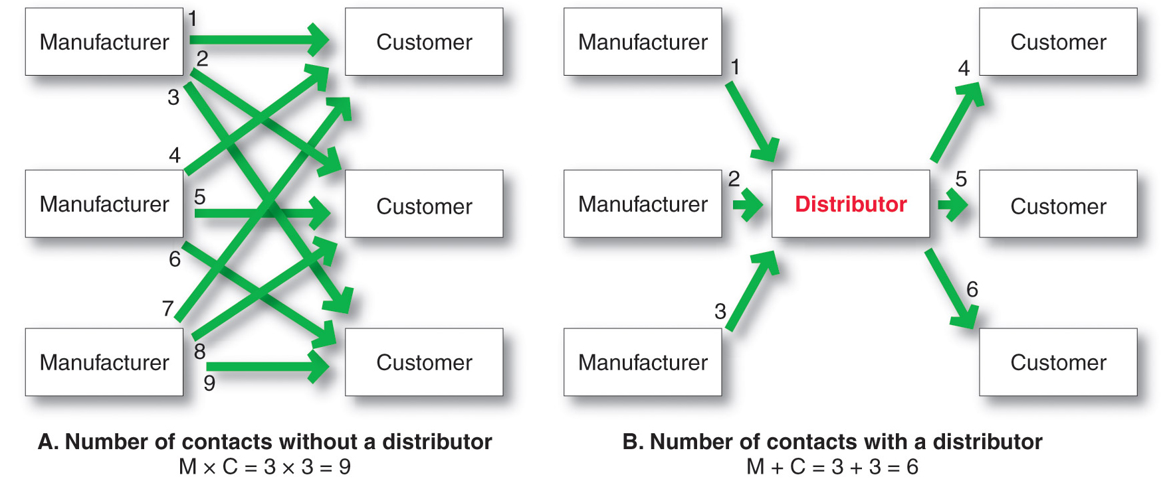
The Nature and Importance of Marketing Channels
How Channel Members Add Value
Copyright ©2014 by Pearson Education, Inc. All rights reserved

Slide 9
The Nature and Importance of Marketing Channels
How Channel Members Add Value
Information
Promotion
Contact
Matching
Negotiation
Physical distribution
Financing
Risk taking
Copyright ©2014 by Pearson Education, Inc. All rights reserved

Slide 10
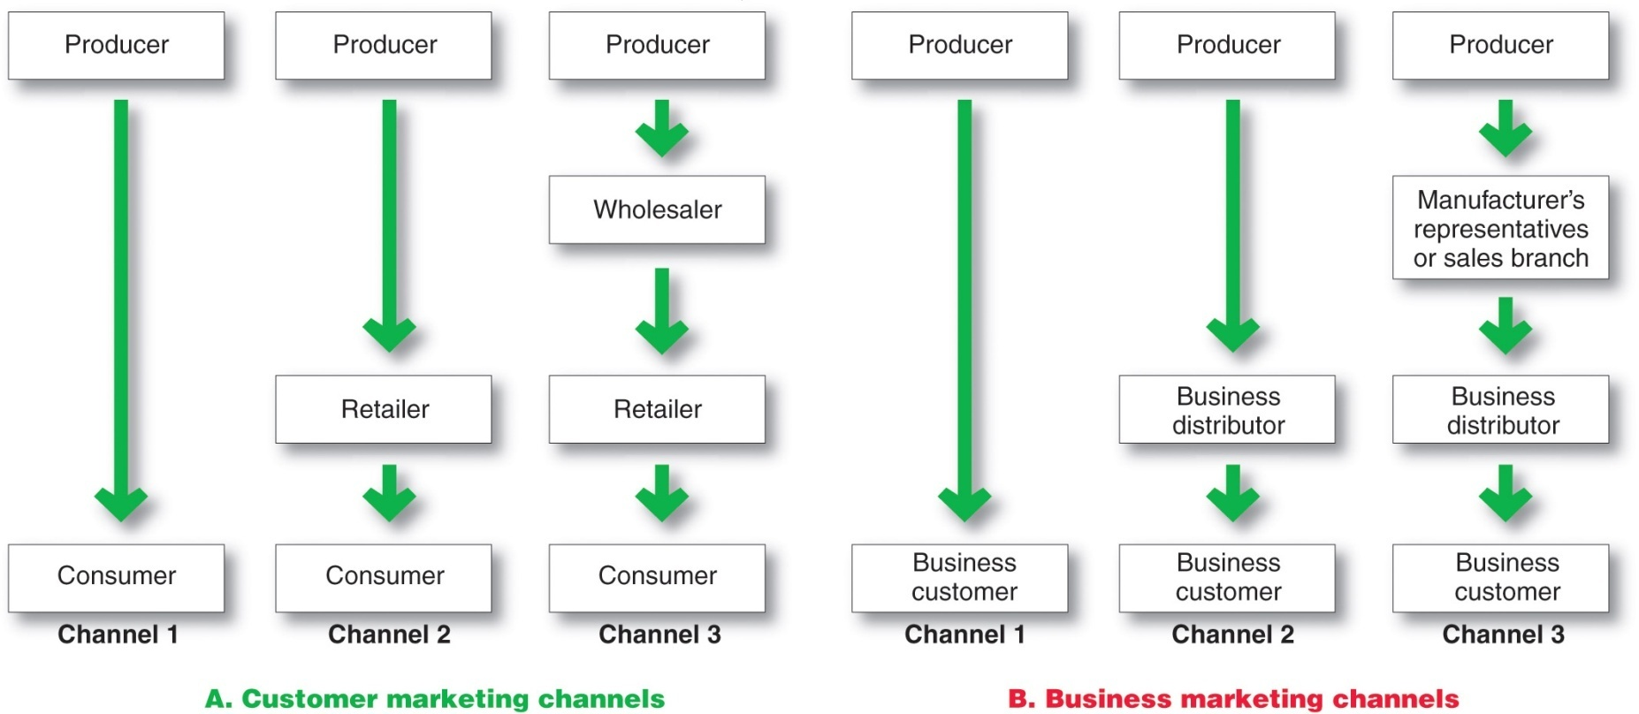
The Nature and Importance of Marketing Channels
Number of Channel Levels
Copyright ©2014 by Pearson Education, Inc. All rights reserved
Notes:
.

Slide 11
The Nature and Importance of Marketing Channels
Number of Channel Levels
Connected by types of flows:
Physical flow of products
Flow of ownership
Payment flow
Information flow
Promotion flow
Copyright ©2014 by Pearson Education, Inc. All rights reserved

Slide 12
Channel Behavior and Organization
Channel Behavior
Marketing channel consists of firms that have partnered for their common good with each member playing a specialized role
Channel conflict refers to disagreement over goals, roles, and rewards by channel members
Horizontal conflict
Vertical conflict
Copyright ©2014 by Pearson Education, Inc. All rights reserved

Slide 13
Channel Behavior and Organization
Conventional Distributions Systems
Conventional distribution systems consist of one or more independent producers, wholesalers, and retailers. Each seeks to maximize its own profits, and there is little control over the other members and no formal means for assigning roles and resolving conflict.
Copyright ©2014 by Pearson Education, Inc. All rights reserved

Slide 14
Channel Behavior and Organization
Vertical Marketing Systems
Vertical marketing systems (VMSs) provide channel leadership and consist of producers, wholesalers, and retailers acting as a unified system and consist of:
Corporate marketing systems
Contractual marketing systems
Administered marketing systems
Copyright ©2014 by Pearson Education, Inc. All rights reserved

Slide 15
Channel Behavior and Organization
Vertical Marketing Systems
Corporate vertical marketing system integrates successive stages of production and distribution under single ownership
Copyright ©2014 by Pearson Education, Inc. All rights reserved

Slide 16
Channel Behavior and Organization
Vertical Marketing Systems
Contractual vertical marketing system consists of independent firms at different levels of production and distribution who join together through contracts to obtain more economies or sales impact than each could achieve alone. The most common form is the franchise organization.
Copyright ©2014 by Pearson Education, Inc. All rights reserved

Slide 17
Channel Behavior and Organization
Vertical Marketing Systems
Franchise organization links several stages in the production distribution process
Manufacturer-sponsored retailer franchise system
Manufacturer-sponsored wholesaler franchise system
Service firm-sponsored retailer franchise system
Copyright ©2014 by Pearson Education, Inc. All rights reserved

Slide 18
Channel Behavior and Organization
Vertical Marketing Systems
Administered vertical marketing system has a few dominant channel members without common ownership. Leadership comes from size and power.
Copyright ©2014 by Pearson Education, Inc. All rights reserved

Slide 19
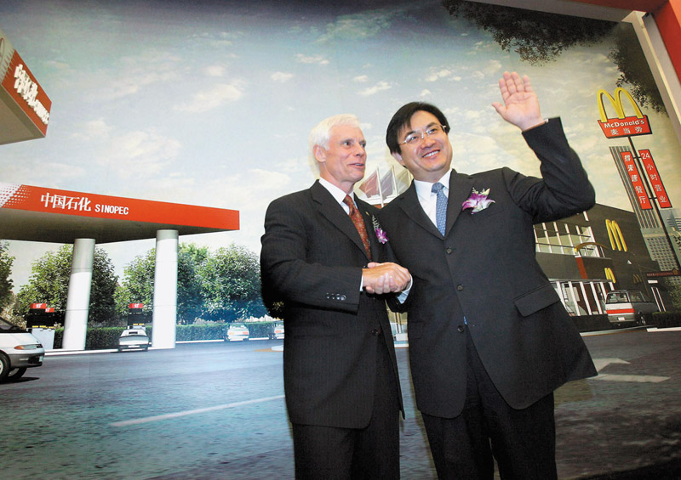
Channel Behavior and Organization
Horizontal Marketing System
Horizontal marketing systems are when two or more companies at one level join together to follow a new marketing opportunity. Companies combine financial, production, or marketing resources to accomplish more than any one company could alone.
Copyright ©2014 by Pearson Education, Inc. All rights reserved

Slide 20
Channel Behavior and Organization
Multichannel Distribution Systems
Hybrid Marketing Channels
Multichannel Distribution systems (Hybrid marketing channels) are when a single firm sets up two or more marketing channels to reach one or more customer segments
Copyright ©2014 by Pearson Education, Inc. All rights reserved

Slide 21
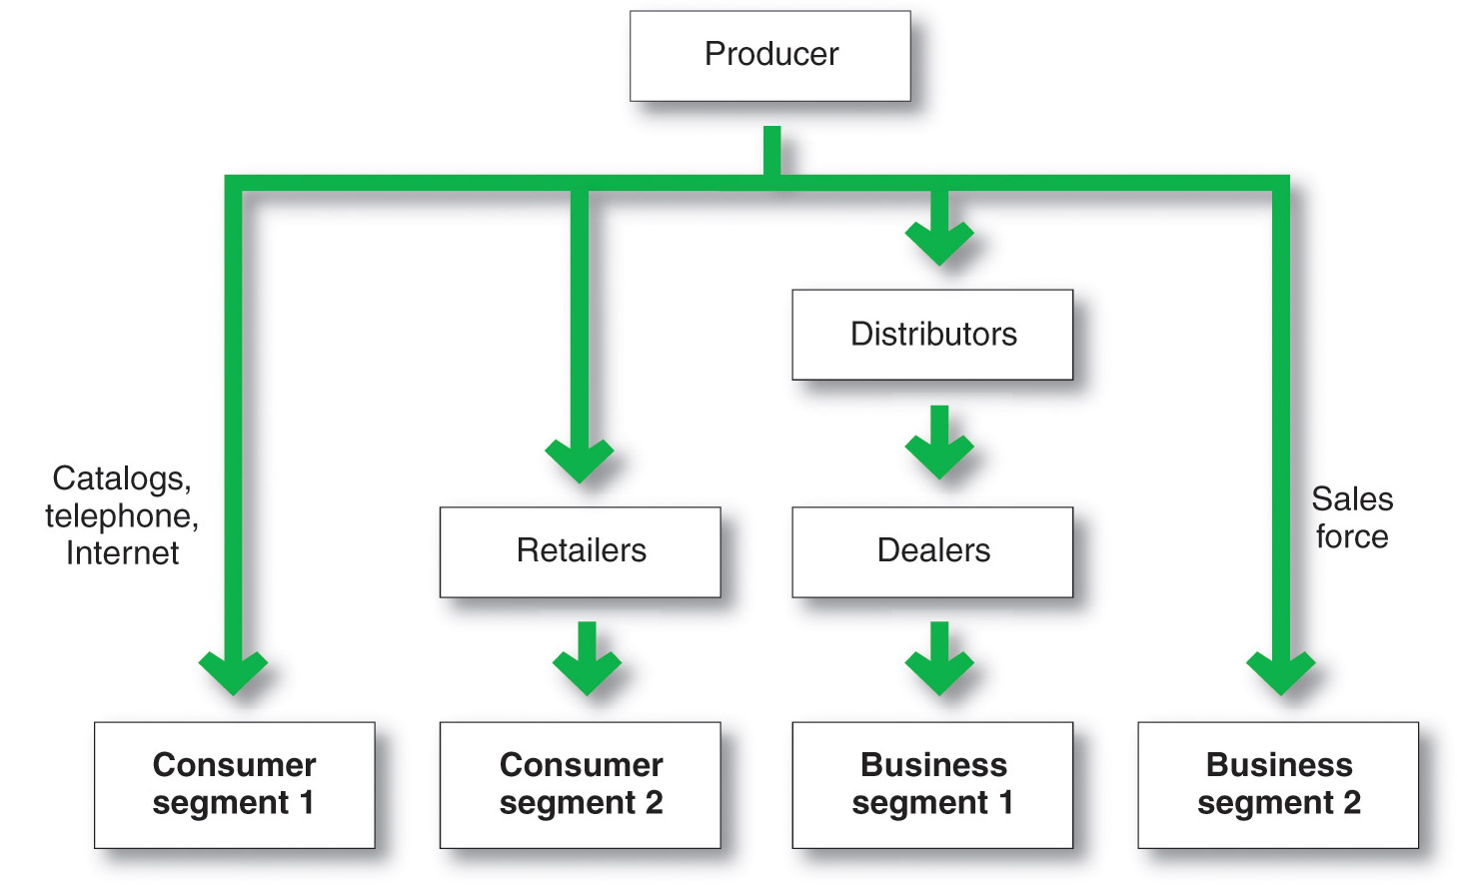
Channel Behavior and Organization
Multichannel Distribution System
Copyright ©2014 by Pearson Education, Inc. All rights reserved

Slide 22
Channel Behavior and Organization
Changing Channel Organization
Disintermediation occurs when product or service producers cut out intermediaries and go directly to final buyers, or when radically new types of channel intermediaries displace traditional ones
Copyright ©2014 by Pearson Education, Inc. All rights reserved

Slide 23
Channel Design Decisions
Analyzing consumer needs
Setting channel objectives
Identifying major channel alternatives
Evaluation
Copyright ©2014 by Pearson Education, Inc. All rights reserved

Slide 24
Channel Design Decisions
Analyzing Consumer Needs
Find out what target consumers want from the channel
What segments to serve
Best channels to use
Minimize the cost of meeting customer service requirements
Copyright ©2014 by Pearson Education, Inc. All rights reserved

Slide 25
Channel Design Decisions
Setting Channel Objectives
Determine targeted levels of customer service
Balance consumer needs not only against the feasibility and costs of meeting these needs but also against customer price preferences
Copyright ©2014 by Pearson Education, Inc. All rights reserved

Slide 26
Channel Design Decisions
Identifying Major Alternatives
Types of intermediaries
Number of marketing intermediaries
Responsibilities of channel members
Copyright ©2014 by Pearson Education, Inc. All rights reserved

Slide 27
Channel Design Decisions
Identifying Major Alternatives
Intensive distribution
Candy and toothpaste
Exclusive distribution
Luxury automobiles and prestige clothing
Selective distribution
Television and home appliance
Copyright ©2014 by Pearson Education, Inc. All rights reserved

Slide 28
Channel Design Decisions
Evaluating the Major Alternatives
Each alternative should be evaluated against:
Economic criteria
Control
Adaptability criteria
Copyright ©2014 by Pearson Education, Inc. All rights reserved

Slide 29
Channel Design Decisions
Designing International Distribution Channels
Channel systems can vary from country to country
Must be able to adapt channel strategies to the existing structures within each country
Copyright ©2014 by Pearson Education, Inc. All rights reserved

Slide 30
Channel Management Decisions
Selecting channel members
Managing channel members
Motivating channel members
Evaluating channel members
Copyright ©2014 by Pearson Education, Inc. All rights reserved

Slide 31
Public Policy and Distribution Decisions
Exclusive distribution is when the seller allows only certain outlets to carry its products
Exclusive dealing is when the seller requires that the sellers not handle competitor’s products
Exclusive territorial agreements are where producer or seller limit territory
Tying agreements are agreements where the dealer must take most or all of the line
Copyright ©2014 by Pearson Education, Inc. All rights reserved

Slide 32
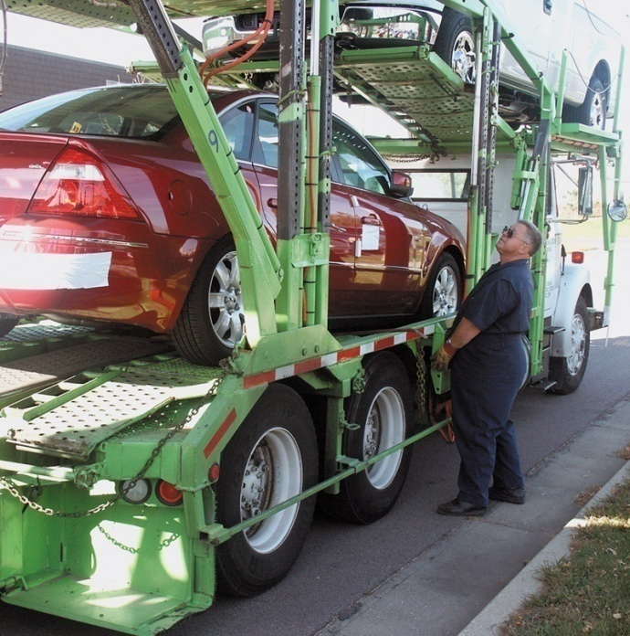
Marketing Logistics and Supply Chain Management
Nature and Importance of Marketing Logistics
Marketing logistics (physical distribution) involves planning, implementing, and controlling the physical flow of goods, services, and related information from points of origin to points of consumption to meet consumer requirements at a profit
Copyright ©2014 by Pearson Education, Inc. All rights reserved

Slide 33
Marketing Logistics and Supply Chain Management
Nature and Importance of Marketing Logistics
Copyright ©2014 by Pearson Education, Inc. All rights reserved

Slide 34
Marketing Logistics and Supply Chain Management
Nature and Importance of Marketing Logistics
Supply chain management is the process of managing upstream and downstream value-added flows of materials, final goods, and related information among suppliers, the company, resellers, and final consumers
Copyright ©2014 by Pearson Education, Inc. All rights reserved

Slide 35
Marketing Logistics and Supply Chain Management
Major Logistics Functions
Warehousing
Inventory management
Transportation
Logistics information management
Copyright ©2014 by Pearson Education, Inc. All rights reserved

Slide 36
Marketing Logistics and Supply Chain Management
Warehousing Decisions
How many
What types
Where to locate
Warehouses
Distribution centers
Copyright ©2014 by Pearson Education, Inc. All rights reserved

Slide 37
Marketing Logistics and Supply Chain Management
Inventory Management
Just-in-time systems
RFID
Knowing exact product location
Smart shelves
Placing orders automatically
Copyright ©2014 by Pearson Education, Inc. All rights reserved

Slide 38
Marketing Logistics and Supply Chain Management
Major Logistics Functions
Transportation affects the pricing of products, delivery performance, and condition of the goods when they arrive
Truck
Rail
Water
Pipeline
Air
Internet
Copyright ©2014 by Pearson Education, Inc. All rights reserved
Notes:
.

Slide 39
Marketing Logistics and Supply Chain Management
Logistics Information Management
Logistics information management is the management of the flow of information, including customer orders, billing, inventory levels, and customer data
EDI (electronic data interchange)
VMI (vendor-managed inventory)
Copyright ©2014 by Pearson Education, Inc. All rights reserved

Slide 40
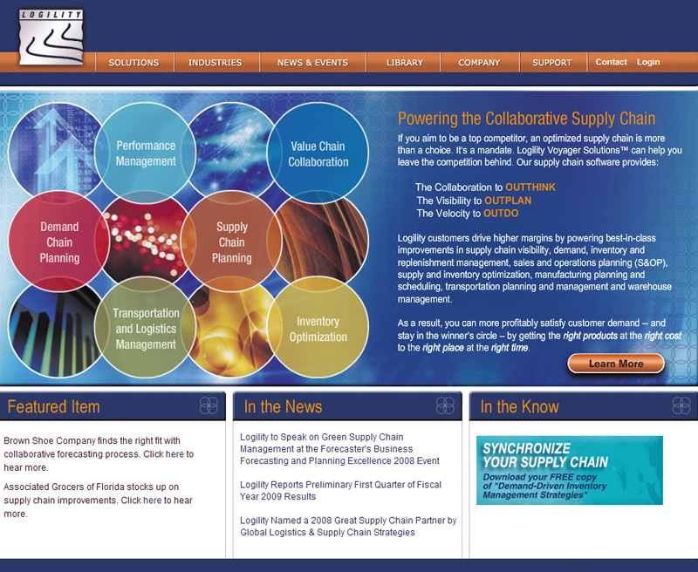
Marketing Logistics and Supply Chain Management
Integrated Logistics Management
Integrated logistics management is the recognition that providing customer service and trimming distribution costs requires teamwork internally and externally
Copyright ©2014 by Pearson Education, Inc. All rights reserved

Slide 41
Marketing Logistics and Supply Chain Management
Integrated Logistics Management
Third-party logistics is the outsourcing of logistics functions to third-party logistics providers (3PLs)
Copyright ©2014 by Pearson Education, Inc. All rights reserved

