Slide 1
Graphics and Multimedia

Slide 2
Introduction
The language contains many sophisticated drawing capabilities as part of namespace System.Drawing and the other namespaces that make up the .NET resource GDI+.
GDI+ is an application programming interface (API) that provides classes for creating two-dimensional graphics, and manipulating fonts and images.
The most commonly used components of GDI+ reside in the System.Drawing and System.Drawing.Drawing2D namespaces.

Slide 3
System.Drawing
System.Drawing
Key
Key
class
Bitmap
Class
Bitmap
Structure
Font
Structure
Font
FontFamily
FontFamily
Graphics
Graphics
Color
Color
Icon
Icon
Point
Point
Pen
Pen
Rectangle
Rectangle
Region
Region
Size
Size
SolidBrush
SolidBrush
TextureBrush
TextureBrush
Image
Image
SolidBrush
SolidBrush
HatchBrush
HatchBrush
LinearGradient
LinearGradient
PathGradient
PathGradient
SolidBrush
SolidBrush
TextureBrush
TextureBrush
System.Drawing namespace’s Classes and Structures.

Slide 4
Introduction
Class Graphics contains methods used for drawing Strings, lines, rectangles and other shapes on a Control.
The drawing methods of class Graphics usually require a Pen or Brush object to render a specified shape.
The Pen draws shape outlines;
the Brush draws solid objects

Slide 5
Introduction
Structure Color has:
  properties to set color of various graphical components.
  Methods to create new colors.
Class Font has:
  Properties to define unique fonts
Class FontFamily has
  Methods for obtaining font information.

Slide 6
Introduction
GDI+’s coordinate system is a scheme for identifying every point on the screen.
To begin drawing in Visual Basic, we first must understand GDI+’s coordinate system:
  Upper-left corner of component has coordinates (0, 0)
  Coordinate pairs:
    Allow positioning of text and shapes
    Horizontal coordinate (x-coordinate)
      Distance to the right from upper-left corner
    Vertical coordinate (y-coordinate)
      Distance down from upper-left corner
  Coordinate units measured in pixels
  Used with structures Rectangle and Point that are provided by System.Drawing namespace

Slide 7
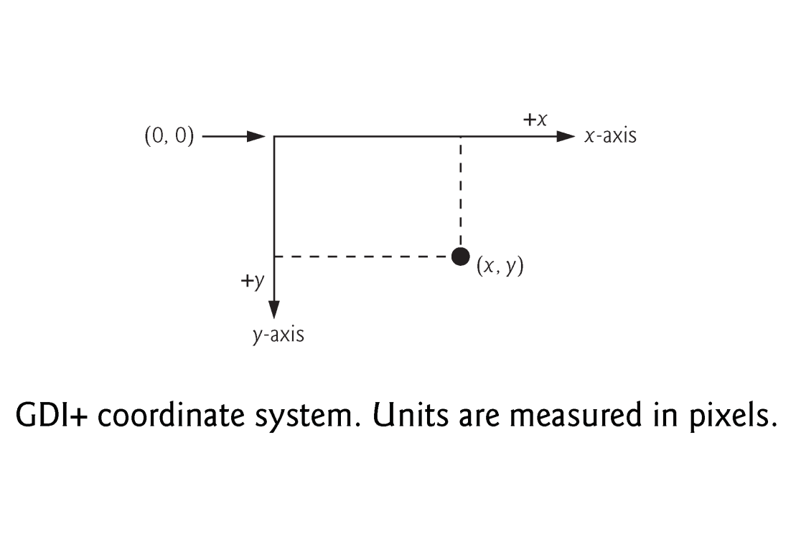

Slide 8
Introduction
Rectangle structure defines rectangular shapes with ( width & height ) dimension.
Point structure represents the x-y coordinates of a point on a two-dimensional plane.

Slide 9
Graphics Contexts and Graphics Objects
Graphics objects contain methods for drawing, font manipulation, color manipulation and other graphics-related actions.
Every Windows application that derives from class System.Windows.Forms.Form inherits an Overridable OnPaint method where most graphics operations are performed.
The arguments to the OnPaint method include a PaintEventArgs object from which we can obtain a Graphics object for the control.
The OnPaint method triggers the Control’s Paint event.

Slide 10
Graphics Contexts and Graphics Objects
When displaying graphical information on a control, we need to:
    Access Graphics object of the control.
    Then, use Graphics object to draw shapes and strings on the control.
Graphics object Can be accessed in 2 ways:
    By overriding OnPaint() method to retrieve a Graphics object from argument PaintEventArgs
    Create a new Graphics object associated with the appropriate surface.

Slide 11
Graphics Contexts and Graphics Objects
1-Overriding OnPaint() :
  Protected Overrides Sub OnPaint(ByVal e As PaintEventArgs)
  ‘ extract the Graphics object from the PaintEventArgs argument:
  Dim graphicsObject As Graphics = e.Graphics
Calling the OnPaint method raises the Paint event.
Instead of overriding the OnPaint method, programmers can add an event handler for the Paint event because OnPaint method is rarely called directly.
  Public Sub MyEventHandler_Paint( _
  ByVal sender As Object, ByVal e As PaintEventArgs) _
  Handles Me.Paint

Slide 12
OnPaint is called automatically by system when events occur such as moving or resizing of windows. Similarly, when controls( such as Label or Button) are displayed the program calls that controls paint method.
Programmers can invoke OnPaint explicitly by calling Invalidate method.
This method refreshes a control’s client area and repaints all graphical components.

Slide 13
Graphics Context and Graphics Objects
2-Creating a new Graphics:
  By invoking CreateGraphics method.
    Dim graphicsObject As Graphics = label1.CreateGraphics()
Then, you can use the methods provided in class Graphics to draw on the control for example we can draw a circle on label1
    graphicsObjects.DrawCircle(……)

Slide 14
Color Control
Structure Color
  ARGB values
    Alpha, red, green and blue values, respectively
    Each value represented as a Byte
    Alpha value determines intensity
      0 = transparent, 255 = opaque color.
    The first number in the RGB value defines the
    amount of red in the color, the second defines the amount of green and the third defines the amount of blue.
    The larger the value, the greater the amount of that particular color.

Slide 15
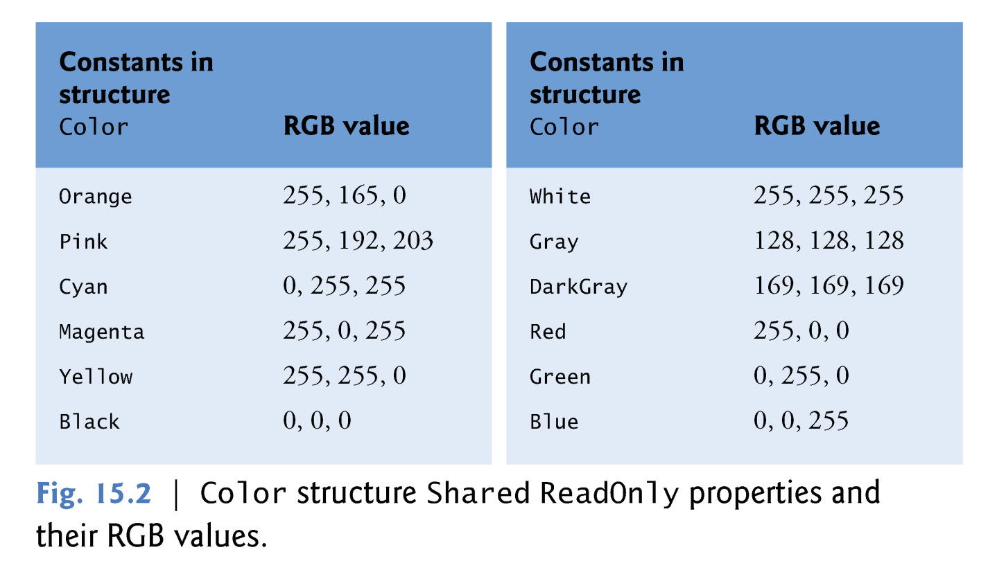
Color Control

Slide 16
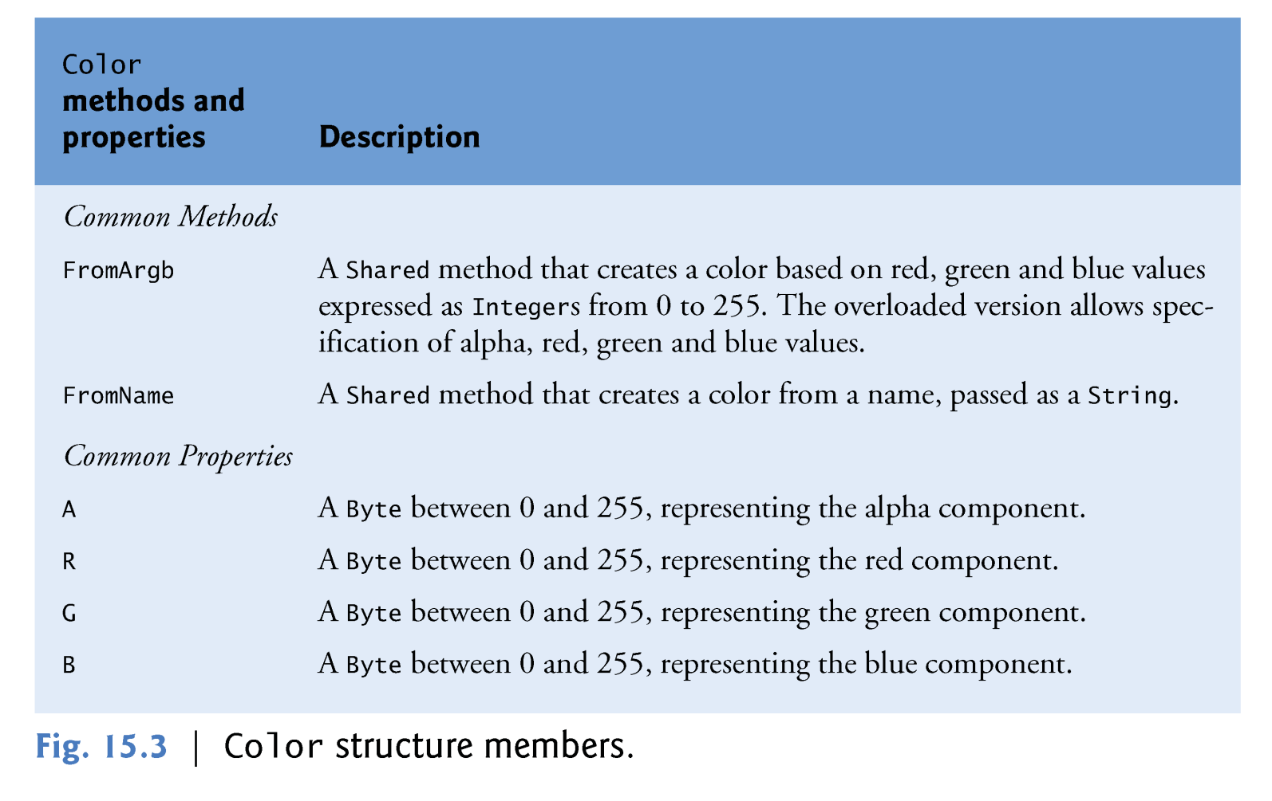
Color Control

Slide 17
Color Control
Programmers draw shapes and Strings using Brushes and Pens.
Pen objects
  functions similarly to an ordinary pen, is used to draw lines.
  constructors allow programmers to specify the colors and widths of the lines that they wish to draw.
  Pens collection (System.Drawing) contains predefined Pens.
Brush objects
  Used to color interiors of shapes
  In most Fill methods, Brushes fill a space with a color, pattern or image.
  Upcoming example: Color value and alpha demonstration

Slide 18
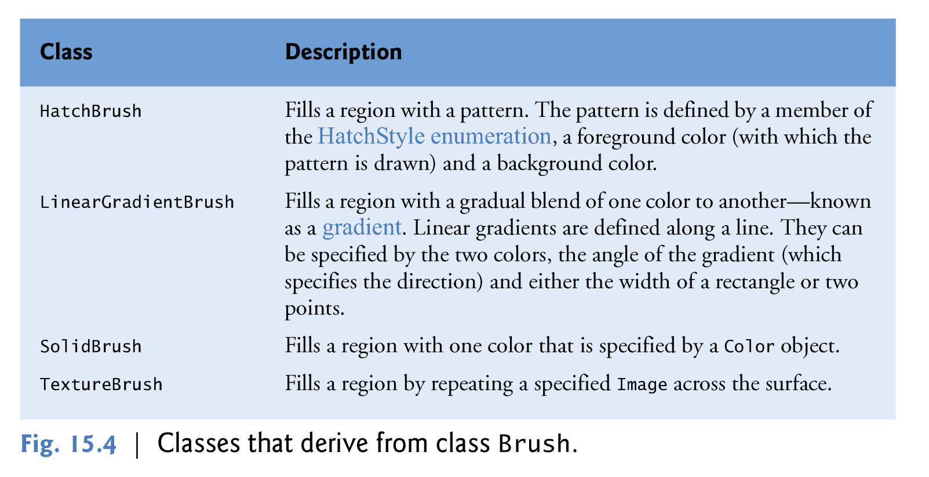
Color Control

Slide 19
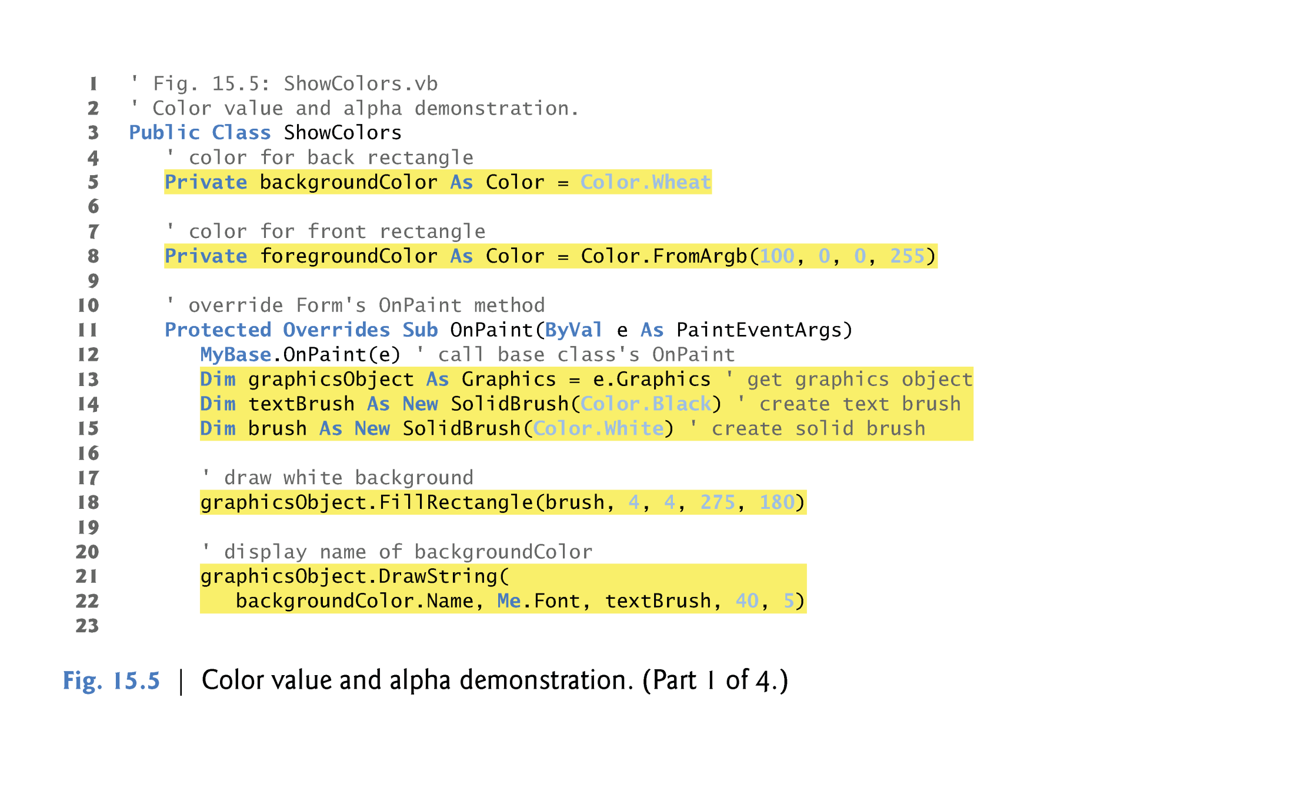

Slide 20
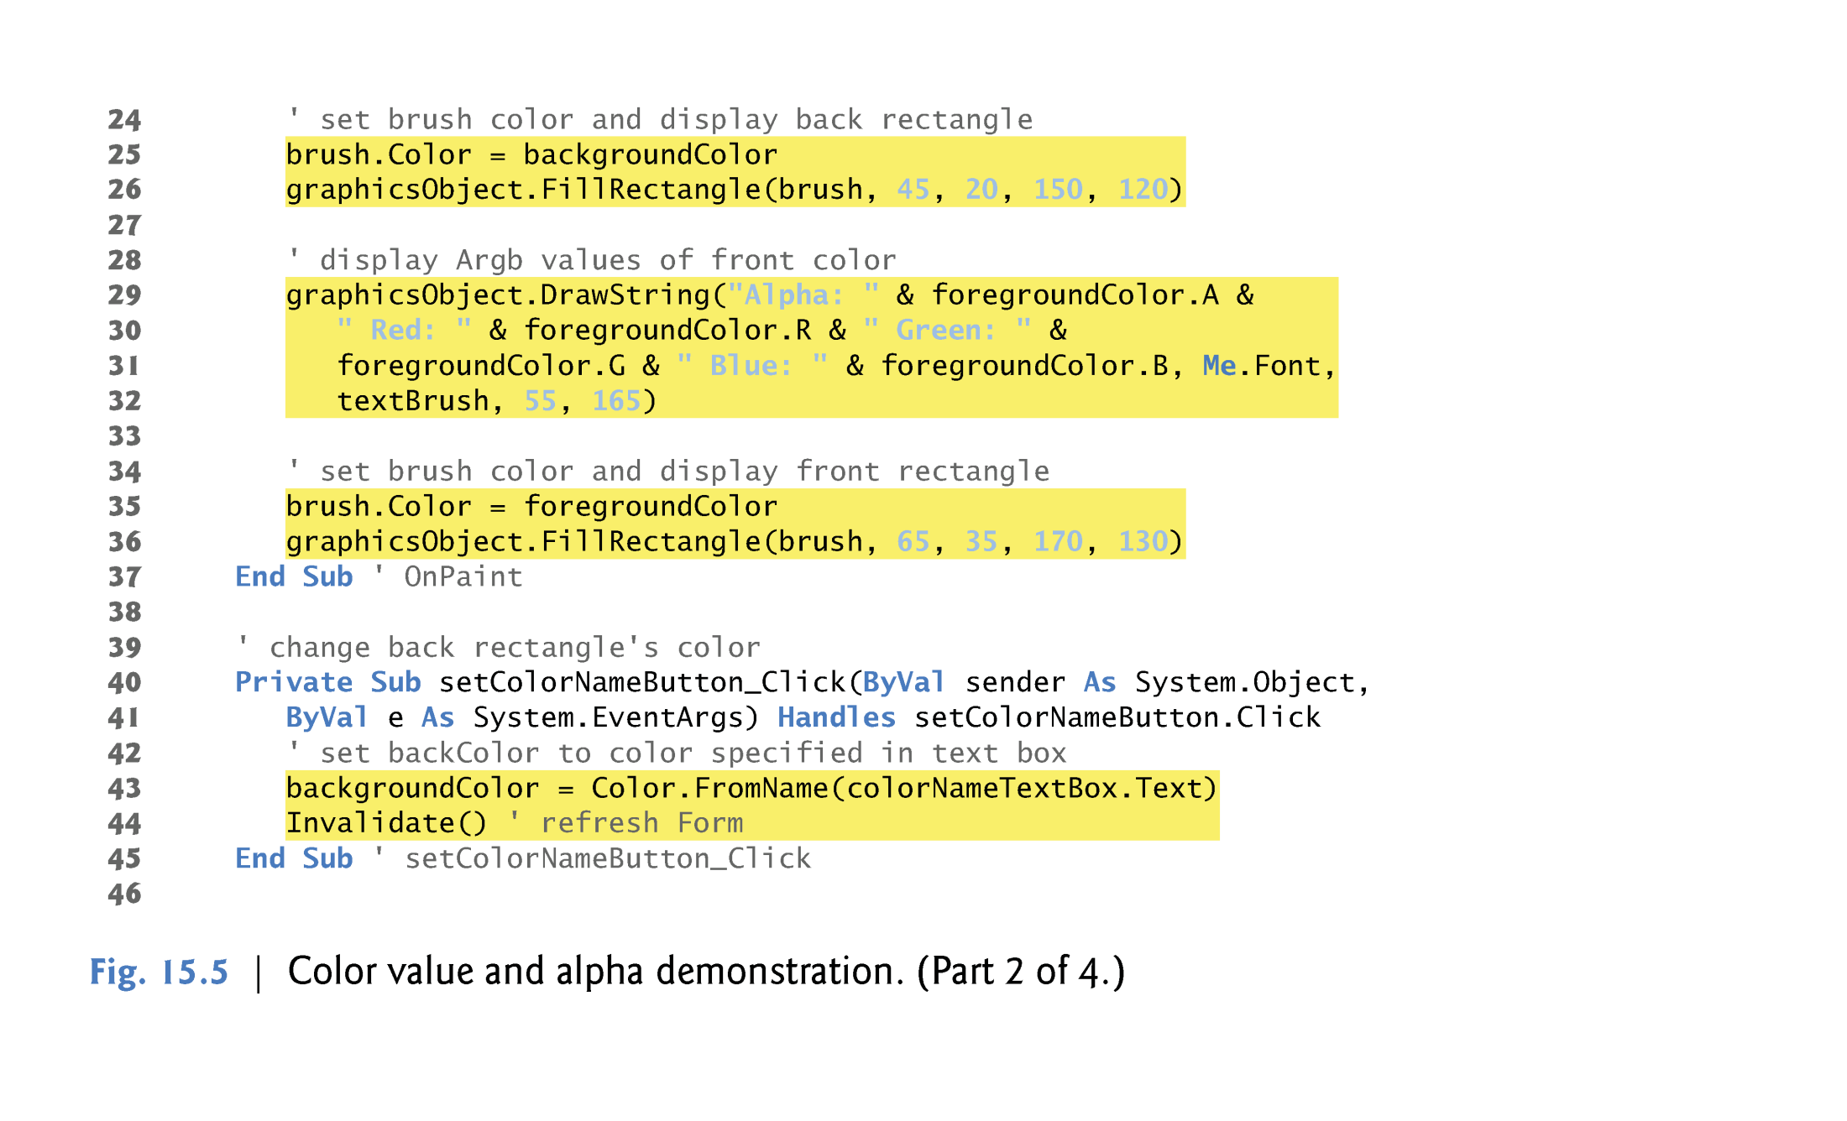

Slide 21
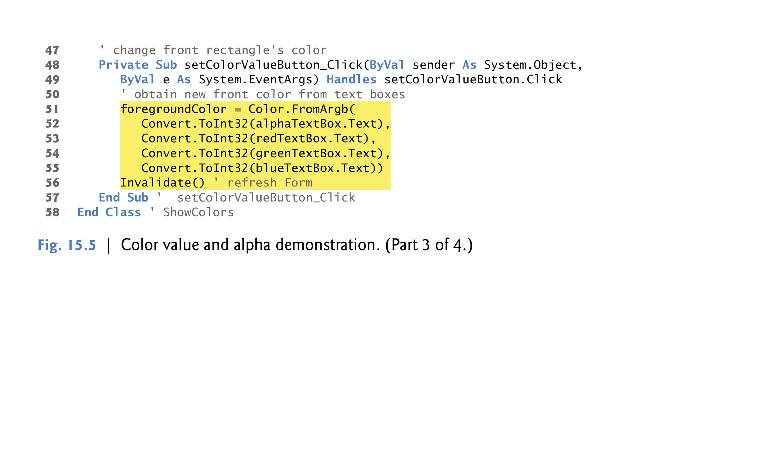

Slide 22
