Slide 1
Graphics and Multimedia
(Part II)

Slide 2
Font Control
Fonts
After a Font is created, its properties cannot be modified
Programmers must create a new Font object to be different
Font constructors
Must require a font name as an argument
They usually require the font size as an argument
And usually require the font style which is a member of
the FontStyle enumeration: Bold, Italic, Regular, Strikeout, Underline.
Graphics method DrawString sets the current drawing font—the font in which the text displays—to its Font argument.

Slide 3
Font Control
DrawString constructors:
String to display
Font,
Brush
and the x- and y-coordinates of the location for the String’s first character.
Example
Dim textbrush As New SolidBrush(Color.Red)
g.DrawString("Hello World", Me.Font, textbrush, 10, 10)

Slide 5
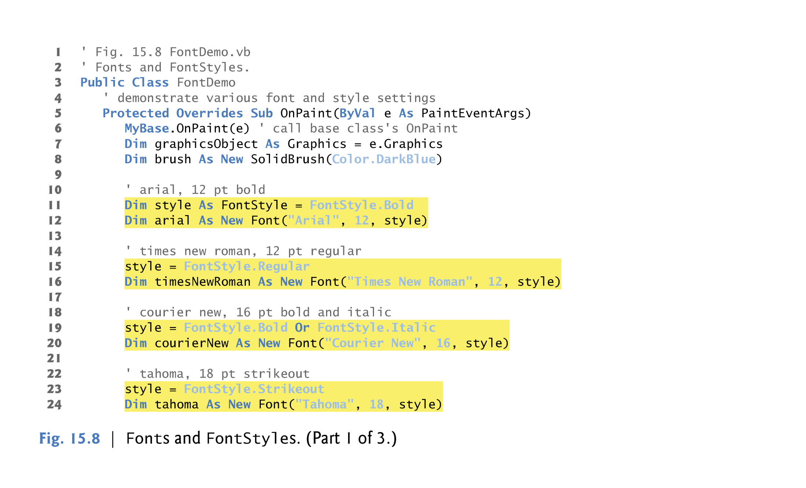
Example

Slide 6
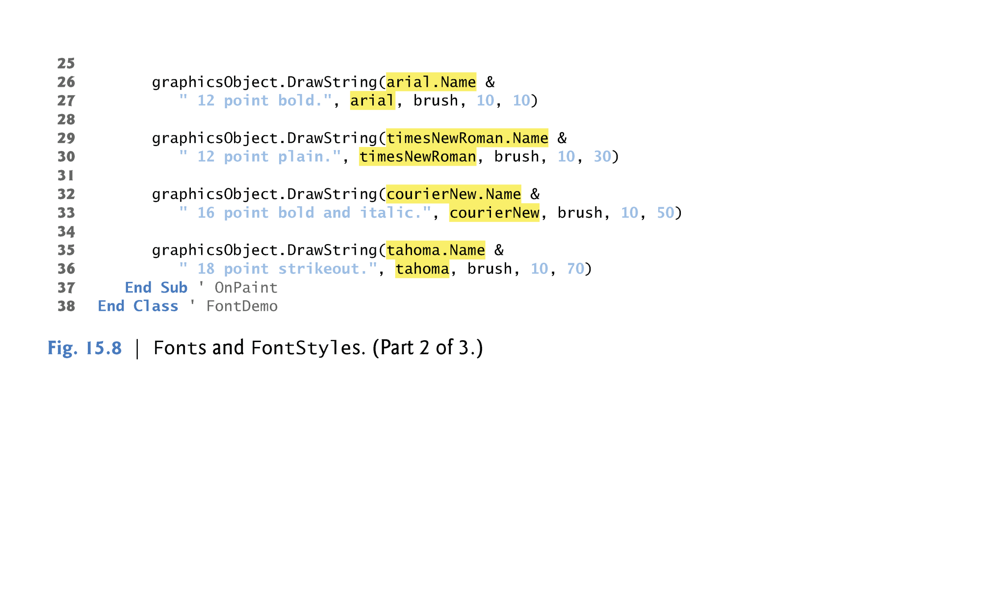

Slide 8
Drawing Lines, Rectangles and Ovals
Draw Shape
Shape Outline
Pen
Solid Shape
Brush
Example:
DrawRectangle(ByVal p As Pen, ByVal x As Integer, ByVal y As Integer, ByVal width As Integer, ByVal height As Integer)
FillRectangle(ByVal b As Brush, ByVal x As Integer, ByVal y As Integer, ByVal width As Integer, ByVal height As Integer)

Slide 10
Drawing Lines, Rectangles and Ovals
(x, y)
height
width
Ellipse bounded by a rectangle.

Slide 11
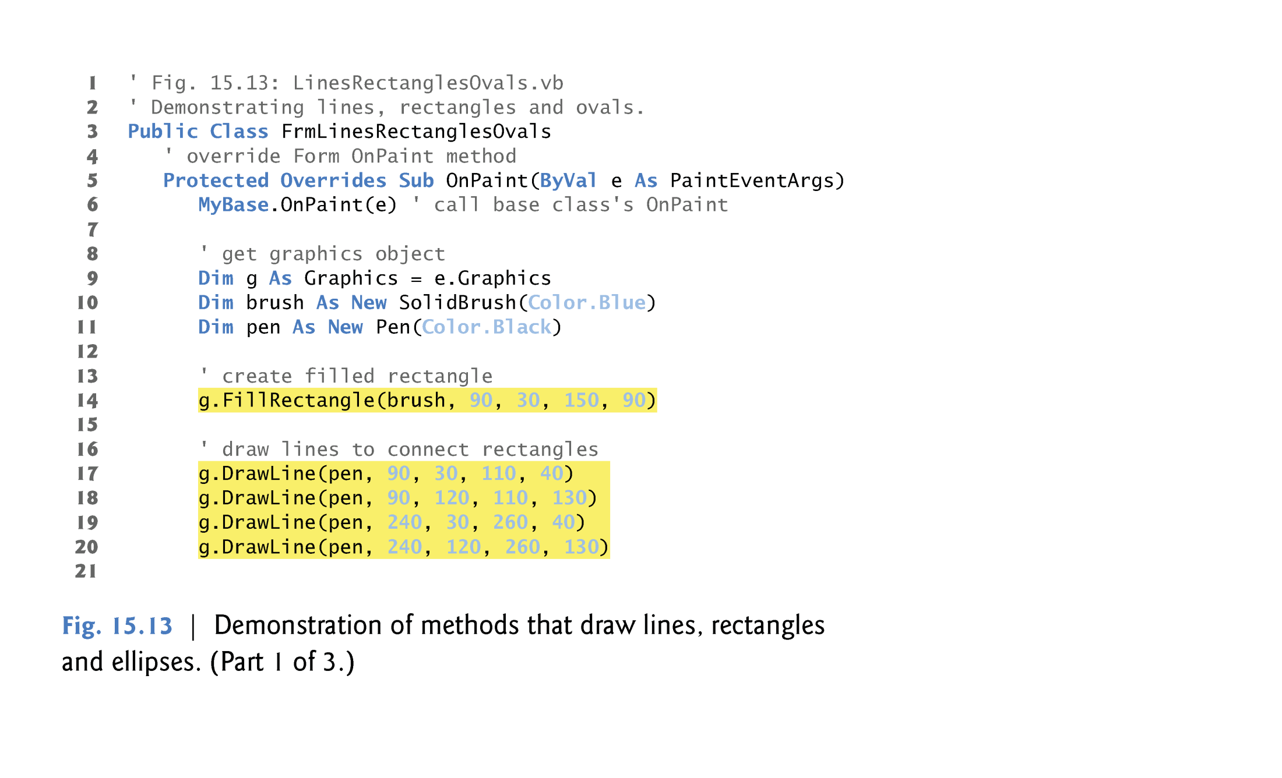
Example

