Slide 1
Stacks

Slide 2
Stack: Last In First Out (LIFO).–Used in procedure calls, to compute arithmetic expressions etc.•

Slide 3
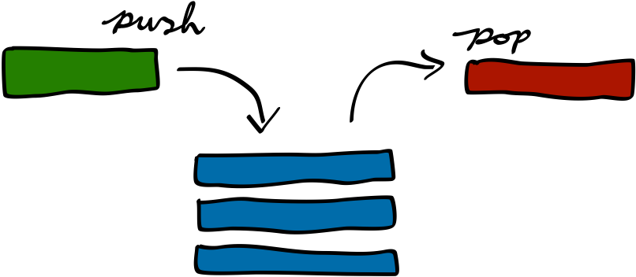
Applications of Stacks
Direct applications
◦Page-visited history in a Web browser
◦Undo sequence in a text editor
◦Chain of method calls in the Java Virtual Machine
Indirect applications
Auxiliary data structure for algorithms
Component of other data structures

Slide 4
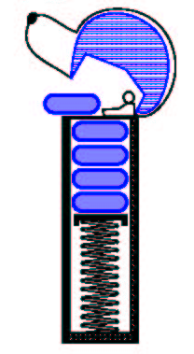
The Stack ADT (§4.2)
The Stack ADT stores arbitrary objects
Insertions and deletions follow the last-in first-out scheme
Main stack operations:
push(object): inserts an element
object pop(): removes and returns the last inserted element
Auxiliary stack operations:
object top(): returns the last inserted element without removing it
integer size(): returns the number of elements stored
boolean isEmpty(): indicates whether no elements are stored

Slide 5
Stack Interface in Java
public interface Stack {
public int size();
public boolean isEmpty();
public Object top() throws EmptyStackException;
public void push(Object o);
public Object pop() throws EmptyStackException; }
Java interface corresponding to our Stack ADT
Requires the definition of class EmptyStackException
Different from the built-in Java class java.util.Stack

Slide 6
Array-based Stack
A simple way of implementing the Stack ADT uses an array
We add elements from left to right
A variable keeps track of the index of the top element
Algorithm size()
return t + 1
Algorithm pop()
if isEmpty() then
throw EmptyStackException
else
t ← t − 1
return S[t + 1]
…
S
0
1
2
t

Slide 7
Array-based Stack (cont.)
The array storing the stack elements may become full
A push operation will then throw a FullStackException
Limitation of the array-based implementation
Not intrinsic to the Stack ADT
Algorithm push(o)
if t = S.length − 1 then
throw FullStackException
else
t ← t + 1
S[t] ← o
…
S
0
1
2
t

Slide 8
Performance and Limitations
Performance
Let n be the number of elements in the stack
The space used is O(n)
Each operation runs in time O(1)
Limitations
The maximum size of the stack must be defined a priori and cannot be changed
Trying to push a new element into a full stack causes an implementation-specific exception

Slide 9
Array-based Stack in Java
public class ArrayStack implements Stack {
// holds the stack elements private Object S[ ];
// index to top element private int top = -1;
// constructor public ArrayStack(int capacity) { S = new Object[capacity]); }
public Object pop() throws EmptyStackException { if isEmpty() throw new EmptyStackException (“Empty stack: cannot pop”); Object temp = S[top]; // facilitates garbage collection S[top] = null; top = top – 1; return temp; }

Slide 10
Stack
Array-based Stack
http://www.cs.usfca.edu/~galles/visualization/StackArray.html
Link stack
http://www.cs.usfca.edu/~galles/visualization/StackLL.html

